Slide 1
Introducing the Media Studies Framework
L7: COM 1 SEC A
LO: To explore CAMERA METHODS and their contribution to representation in the Paralympics advert
Super. Human. advert

Slide 2
Starter: How does the next slide make you feel?
Write down a word or words on a post-it.

Slide 4
What are camera methods?
Camera methods include camera shot types, camera angles and camera movements.
They are included in the TECHNICAL CODES category of media codes and conventions. Other technical codes include anything that uses equipment to create meaning. Lighting is an excellent example of this.

Slide 5
Why the focus on camera methods?
The camera shots and angles that are selected by a photographer or cinematographer can make a real difference to how we ‘read’, or make sense of, a media text.

Slide 6
Study the camera shots and angles handout. You have 5 minutes to learn as many as possible. You can work in pairs.

Slide 7
Can you identify the following angles and shot types?
Title: Shot Types Quiz
What’s the effect of them?

Slide 8
Notes:
Extreme close-up (XCU)

Slide 9
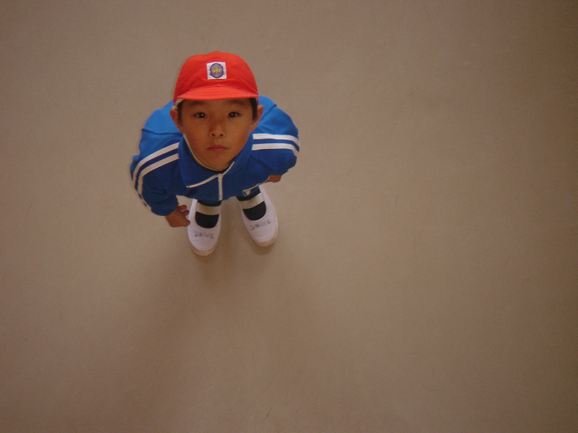
Notes:
Birds eye view

Slide 10
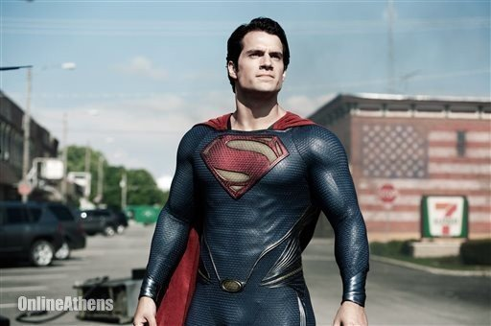
Notes:
Low angle, mid-long shot (MLS)

Slide 11

Notes:
Close up (CU), eye-level

Slide 12
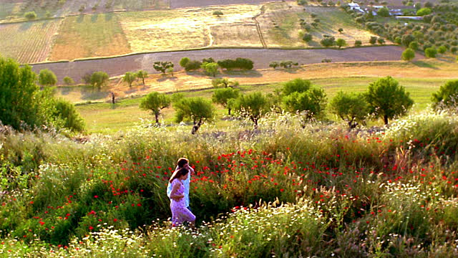
Notes:
High angle, long shot

Slide 13
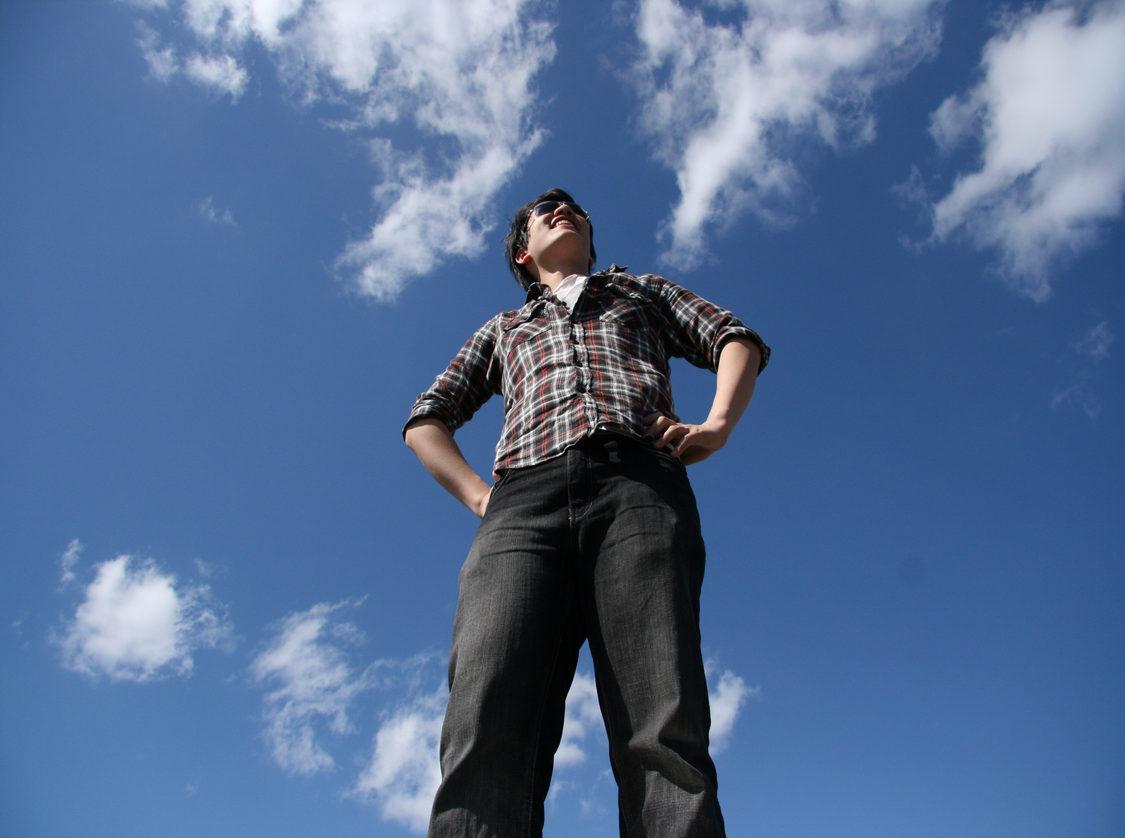
Notes:
Worms eye view, Mid-long shot (MLS)

Slide 14

Notes:
Mid shot, eye-level angle (creates a feeling of being close but comfortable – normal personal space for an acquaintance. Is there a slight low angle to create dignity?, particularly when coupled with codes of expression and posture.)

Slide 15
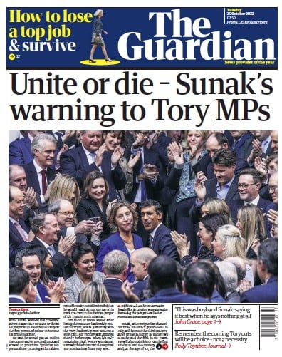
Newspapers select their photos carefully. They know that camera methods are important.
Notes:
High angle wide shot – feels chaotic, like a rugby scrum and emphasises the homogeneity of the tories at a time when Rishi’s ethnicity is being hailed as a sign of progress for equality.

Slide 16
How do camera methods link to representation?
On the handout, which camera method represents the subject as:
Lonely, powerless, vulnerable
Terrified, terrifying
Sad
A stranger
Powerful, dominant
Explain your choices
Notes:
Students can simply match the descriptors to the pictures on the camera angles examples handout or add their own if the suggestions don’t fit, or see lesson plan for other ideas.

Slide 17
How do camera methods link to representation?
Task: choose the best camera angles and shot types for the following representations
Isolated
Incredibly happy
Loving
Friendly
Explain your choices
Notes:
This could be done as a practical exercise (using phones to take pics) or as a storyboard – draw stick people if not good at drawing. Students don’t have to do all – you could assign one representation to a group. They could be differentiated, eg. ‘sad’ might be an easier one.

Slide 18
Writing it down
This image uses an XCU shot and an eye-level angle.
The effect of this is to make every detail of the eyes clear and to conceal the rest of the face. It makes the viewer feel very close to the subject and allows them to see the small signs of emotion that might not be visible if a long shot were used.
The camera methods help to represent this person as terrifying, because the emotional effect is exaggerated by the XCU. He is also represented as mysterious, as we have no other clues about him such as clothing, surroundings or age. He is also represented as threatening as it feels as if he is uncomfortably close to us. We don’t normally get this close to people unless we know them very well or they are about to hurt us in some way. The closeness, combined with the expression represents him as aggressive and frightening.
The audience would respond by feeling vulnerable and tense. It would be a perfect shot choice for a horror film.
Notes:
Point out how the writing connects with the B/S/G descriptors. Point out what makes it work – focus on use of terminology. Point out how the ‘challenge’ student starts to look at audience response and genre features. You might point out how the development of this paragraph is rather similar to a PEA paragraph!

Slide 19
Task
Work in groups or individually.
Decide on an emotion to represent
Using phones, take pics to represent this emotion. The camera angle should be your primary technique for conveying this.

Slide 20
Part 2: What about moving images?
Admin
Homework:
Produce a ‘five frames from’ for the Paralympics advert. The template is on Satchel

Slide 21
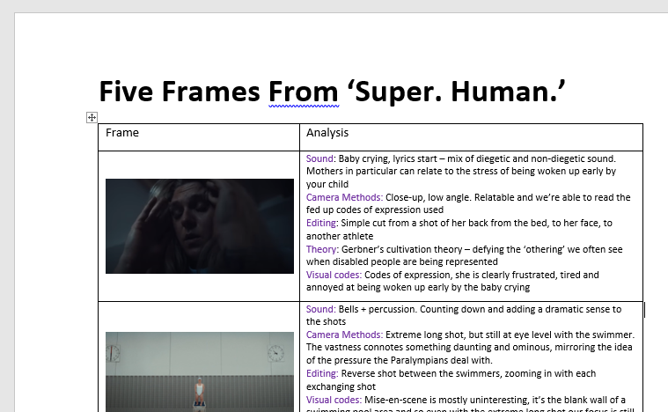

Slide 22
Watch the following up to 1.20 to see other examples of film shot types, then do one of the following activities
8
Try to remember at least three new shot names
Explain the effect of three shots, giving examples
Analyse why a director might use those shots to create those effects
https://www.youtube.com/watch?v=4316BUEVYkE
Notes:
Could be a group discussion, pair work or written activity.

Slide 23
Watch the following again up to 1.20 to see examples of high angle, low angle and Dutch tilt in a film, then do one of the following activities
8
Describe high angle, low angle and dutch tilt
Explain the effect of three angles, giving examples
Analyse why a director might use those angles to create those effects
https://www.youtube.com/watch?v=4316BUEVYkE
Notes:
This activity gives the students an opportunity to try again at the success criteria. They can repeat the level they tried before, with the aim of being better at it, or they can try a harder level.

Slide 24
Before you watch the rest of the video:
8
POV shot stands for POINT OF VIEW shot. In the film Jaws for example, the viewer often sees the action from the POV of the shark.
Tilting and Panning can be done from a tripod. Only the top part of the camera moves.
Tracking and crabbing require the whole camera to move. Often a track is built (hence the name) for the camera to move on. A dolly is the name given to a trolley that you can rest a camera on and move it around. This type of filming can be expensive.
Steadicam, or hand held camera are when a camera is moved around by a human who is holding the camera and following the action. It’s a camera movement often used in news reporting, where the camera operator hasn’t got time to plan the camera movements or build tracks.

Slide 25
Extras
Mrs Fisher’s take:
https://www.youtube.com/watch?v=fVAFTluCBgI

