Slide 1
Guided Revision Lesson
COM 1 SEC A Media Language and Representation

Slide 2
Admin
The following fact sheets and resources have been attached to Satchel, along with this ppt:
Quick overview of changes to the way the exam papers look
Factsheets for COM 1 Section A
Practice questions for COM 1 Section A MEDIA LANGUAGE

Slide 3
Revision starter
From your head can you…
Describe three specific examples of a moment from across the Assassin’s Creed franchise that relate to gender representation (each one from a different game ideally)
Describe three specific examples from ‘Turntables’ where the text explores ideas about representations of ethnicity
Give three examples of media language that represent Boris Johnson in a particular way (describe) on the front pages of The Times and The Mirror
Explain what ‘distribution’ means

Slide 4
Question Paper Format
Following a review of the 2022 series, changes have been made to the format of the C1 and C2 exam question papers and answer booklets
From summer 2023, there will be a separate question paper and answer booklet
Candidates will write their answers in a 16 page answer booklet – they must write the correct question numbers in the boxes themselves
The numbering of the questions on the papers has changed – see examples
Centres should prepare candidates for the exams using the new formats and numbering so they are familiar with them and can follow the instructions in the answer booklet in the exam

Slide 5
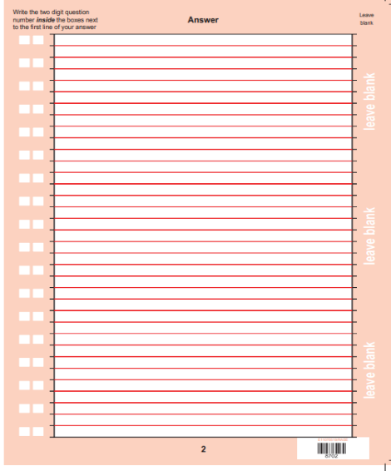
Answer Booklet format

Slide 6
COM 1 SEC A Media Language 15 marker Representation 30 marker
TODAY’S LESSON
Eduqas ‘walkthroughs’
Decoding the question
Using practice questions to work on decoding the question
Reflecting on revision gaps
Curveball questions
Independent revision homework ideas

Slide 7
Media Language: 15 marks

Slide 8
Timings: 15 marker – approx. 25 mins
Media Language 15 markers will always be on an unseen print or audiovisual resource. You will not be expected to compare to any of your set texts. That happens in the 30 mark representation question.
Tide
Superhuman
KOTV
Janelle Monae
Sam Fender
Daily Mirror front page
Daily Mirror DPS
The Times front page

Slide 9
Decoding the ‘trigger’ words
What do we mean by convey meaning/ construct meaning/ influence meaning?
If a question asks you how a product conveys or constructs meaning, you can usually substitute the phrase ‘conveys or sends a message to its audience which is understood in a particular way’. Examiners like the word ‘meaning’ because it is a trigger word for talking about semiotics: symbols, connotations, indexes, icons, etc. etc and so is very appropriate for a media language question.

Slide 10
Look at the practice questions
QUESTION FOCUS: highlight the ‘trigger’ words first
Explore how this product uses genre conventions to construct meaning. (15 marks)
Decoding the question using your highlights
How does any product use genre conventions? What are they for? (Supporting or challenging audience’s expectations, familiarity, typicality etc.)
What are the genre conventions of the product?
How typical is the product of its genre?
How does the typicality or atypicality of the product help to construct meaning?

Slide 11
Made up response to give you some sentence ideas
Explore how this product uses genre conventions to construct meaning. (15 marks)
Answer based on an imaginary film poster that is clearly meant to advertise a horror movie, but doesn’t conform to all the typical genre expectations.
Film posters use genre conventions to help audiences understand and categorise the film. Often the genre conventions help to prime the audience, giving them some idea of what to expect. Normally a horror film would include a central picture of the main protagonist and some mise-en-scene that typifies the setting of a horror film. In this case the genre expectations are challenged as the mise-en-scene indicates a calm, romantic setting as suggested by the light blue sky, clouds and golden sunshine. These signifiers of contentment, combined with the pastel pink codes of clothing and relaxed code of posture of the young female protagonist all lead the audience to expect a romantic teen comedy. Only one genre convention is in place: the young woman has glowing red eyes, an index for the supernatural and coded red for danger. This hybridity of convention makes it hard for the audience to accurately pinpoint the meaning of this poster: is it a horror film? Is it a romance? In this case, it seems the product is using genre conventions to challenge the audience’s expectations.
Other aspects of media language are more conventional for the horror genre. There is the typical billing block and endorsements and the title of the film is prominent with a tagline underneath. The font is…which, paired with the…suggests…

Slide 12
Look at the practice questions
QUESTION FOCUS: highlight the ‘trigger’ words first. https://www.youtube.com/watch?v=4YUbquK_OaI
How important is intertextuality in helping the audience to accept the message of the advert? (15 marks)
Decoding the question using your highlights
What is your ‘knee jerk’ answer to this question?
Who is the specific audience?
What is the purpose or ‘message’ of the advert?
What is the intertextuality here?
How might this help the target audience to accept the message?
So, how important is the intertextuality?

Slide 13
Look at the practice questions
QUESTION FOCUS: highlight the ‘trigger’ words first
How does the Daily Mirror use technical codes on their front page to convey meaning?
Decode the question using your highlights:

Slide 14
Look at the practice questions
REVISION FOCUS
Go through the practice questions. What revision gaps do they highlight?
Some thoughts from me:
Genre conventions
Specific categories of media language (visual codes, technical codes, genre, narrative etc) – see media language checklists in your handbook! It’s all there!

Slide 15
Look at the practice questions
CURVEBALL QUESTION: highlight the ‘trigger’ words first
How far does this text use narrative structure to convey meaning?
Decode the question using your highlights:
See pages 85, 86, 87 of media handbook for help with ‘narrative structure’

Slide 16
Eduqas’s walkthrough
Eduqas provides specific training for students called ‘Exam walkthroughs’.
Here is the walkthrough for Com 1 Section A media language (based on the 2019 exam paper)

Slide 17
What this exam paper is all about:
This paper is Component 1: Media Products, Industries and Audiences.
It is testing:
AO2 (Section A) - Apply knowledge and understanding of the theoretical framework of media to:
analyse media products, including in relation to their contexts and through the use of academic theories
make judgements and draw conclusions.
AO1 (Section B) - Demonstrate knowledge and understanding of:
the theoretical framework of media
contexts of media and their influence on media products and processes.
The paper is made up of 2 sections. Section A is worth 45 marks and Section B is worth 45 marks.
The exam lasts 2 hours 15 minutes, including time to study the audio-visual and print resources.
Notes:
This exam paper is Component 1: Media Products, Industries and Audiences. Section A is testing AO2: apply knowledge and understanding of the theoretical framework of media to analyse media products, including in relation to their contexts and through the use of academic theories, and to make judgements and draw conclusions.
Section B is testing AO1: demonstrate knowledge and understanding of the theoretical framework of media and contexts of media and their influence on media products and processes.
The paper is made up of 2 sections. Section A is worth 45 marks and Section B is worth 45 marks.
The exam lasts 2 hours 15 minutes, including time to study the audio-visual and print resources.

Slide 18
How do I tackle Q1?
Media Language
Question 1 is based on the audio-visual resource: an advertisement which is part of the This Girl Can campaign, produced by Sport England in 2017: https://www.youtube.com/watch?v=mwKmYibtFYw
Explore how the combination of elements of media language influences meaning in the This Girl Can advertisement.
Instructions from exam paper
(note: the amount of viewings for exams from 2020 onwards has now increased to three as below, instead of two as on the exam paper)
You will be allowed one minute to read Question 1. The advertisement will be shown three times.
First viewing: watch the advertisement.
Second viewing: watch the advertisement and make notes. You will then have five minutes to make further notes.
Final viewing: watch the advertisement and make final notes. Once the final viewing has finished, you should answer Question 1.
Notes:
Question 1 is on Media Language and is based on the audio-visual resource: an advertisement which is part of the This Girl Can campaign, produced by Sport England in 2017.
The question is: Explore how the combination of elements of media language influences meaning in the This Girl Can advertisement.
You will be allowed one minute to read Question 1. The advertisement will be shown three times. For the first viewing, you should watch the advertisement. For the second viewing, you should watch the advertisement and make notes. You will then have five minutes to make further notes. For the final viewing: watch the advertisement and make final notes. Once the final viewing has finished, you should answer Question 1.

Slide 19
How do I tackle Q1?
Question 1: skill being tested – analysis (AO2)
Time for answering: approximately 20 minutes, not including viewing time.
Approach:
Re-read Q1 and pay attention to the key words highlighted.
Explore how the combination of elements of media language influences meaning in the This Girl Can advertisement. [15]
TOP TIPS – track through the text to find the relevant information and don’t copy large chunks of text!
Command word for AO2 - analysis
Can include a wide range of aspects, e.g. camerawork, editing, sound, visual codes etc.
How different aspects work together
Semiotics
Connotations
Ideologies
Consider mark allocation, timing and length of response required
How might the purpose of the product affect its meanings?
Notes:
The skill being tested in Question 1 is analysis (AO2). You have approximately 20 minutes to answer, not including viewing time.
Re-read Question 1 and pay attention to the key words.
The key words to highlight in Question 1 are:
explore – this is the command word for AO2: analysis
combination – this suggests a focus on how different aspects work together
media language – this can include a wide range of aspects, e.g. camerawork, editing, sound, visual codes etc.
meaning – this is a cue to consider semiotics, connotations and ideologies
advertisement – consider how the purpose of the product may affect its meanings
Question 1 is worth 15 marks. Consider the timing and length of the response required for this mark allocation.

Slide 20
Top Tips for Q1
Be selective about the aspects of media language and parts of the advert you include – you can’t cover all of them for 15 marks so choose the most significant/ interesting/ important in influencing meaning
Focus on the keyword ‘combination’ – which elements of media language are combined to influence meaning? e.g. sound and visual codes, camerawork and editing etc. – and consider the specific effects of the combination/s, rather than simply analysing individual elements
Organise your response around the elements of media language you have chosen to focus on, not as a chronological walk through – this will allow you to explore what is most significant, provide a clear structure and develop a more sophisticated response
Remember this is a media language question, not a representation one – your focus should primarily be on textual analysis of meanings within the advert, not analysis of representations as such (as this is assessed in Q2 on this paper)
Analyse specific shots / uses of sound / editing techniques etc. and use subject specific terminology – you will be credited for accurate and appropriate use
Notes:
Here are some top tips for Question 1.
Be selective about the aspects of media language and parts of the advert you include – you can’t cover all of them for 15 marks so choose the most significant/ interesting/ important in influencing meaning
Focus on the keyword ‘combination’ – which elements of media language are combined to influence meaning? e.g. sound and visual codes, camerawork and editing etc. – and consider the specific effects of the combination/s, rather than simply analysing individual elements
Organise your response around the elements of media language you have chosen to focus on, not as a chronological walk through – this will allow you to explore what is most significant, provide a clear structure and develop a more sophisticated response
Remember this is a media language question, not a representation one – your focus should primarily be on textual analysis of meanings within the advert, not analysis of representations as such (as this is assessed in Q2 on this paper)
Analyse specific shots / uses of sound / editing techniques etc. and use subject specific terminology – you will be credited for accurate and appropriate use

Slide 21
How do I tackle Q1?
Practice
Write part of your response to Q1, using the guidance from the previous slide.
Use paragraphs to separate your main points based around elements of media language.
A paragraph may be of different lengths but should be at least 4 sentences.
It should be long enough to explore the element of media language being considered.
You have 5 minutes to complete this – press enter for the timer!
Notes:
Now you are going to practice tackling Question 1.
Write part of your response to Q1, using the guidance from the previous slide.
Use paragraphs to separate your main points based around elements of media language.
A paragraph may be of different lengths but should be at least 4 sentences.
It should be long enough to explore the element of media language being considered.
You have 5 minutes to complete this practice.

Slide 22
5
4

Slide 23
How do I tackle Q1?
Feedback – Selected Points From Mark Scheme
Purpose: advert has a clear purpose/message to make exercise seem less daunting and encourage women of all ages to become involved
Responses may be informed by reference to relevant theories, such as semiotics
Montage of images juxtaposing different, ordinary women in diverse situations e.g. applying lipstick/playing rugby, all involving exercise - suggests women of all ages and shapes can exercise in some way
Final bird's eye view shot shows group of women, logo and slogan of campaign, reinforcing it in audience’s mind
Use of poem in voiceover and matching of images to the words, e.g. 'I'm not cute or built to suit a fashion model size' juxtaposed alongside range of images of different women
Notes:
Here is some feedback on Question 1 from the mark scheme.
The advert has a clear purpose/message to make exercise seem less daunting and encourage women of all ages to become involved
Responses may be informed by reference to relevant theories, such as semiotics
The montage of images juxtaposing different, ordinary women in diverse situations e.g. applying lipstick/playing rugby, all involving exercise - suggests women of all ages and shapes can exercise in some way
The final bird's eye view shot shows a group of women, the logo and slogan of the campaign, reinforcing it in the audience’s mind
The use of the poem in the voiceover and matching of the images to the words, e.g, 'I'm not cute or built to suit a fashion model size’ is juxtaposed alongside a range of images of different women.

Slide 24
Representation: 30 marks

Slide 25
Timings: 30 marker – approx. 50 mins
Representation 30 markers will always be on two texts - an unseen (print or audiovisual) resource and one of your set texts. You are expected to compare and make judgements within a well-constructed essay.
If an audiovisual resource is used, it will be the same format as your set text audiovisual – a music video or a audiovisual advert.
If an audiovisual resource is used, it will be Q1
Tide
Superhuman
KOTV
Janelle Monae
Sam Fender
Daily Mirror DPS
Daily Mirror front page
The Times front page

Slide 26
Taken from Mrs. Fisher’s video on this part of the exam
https://www.youtube.com/watch?v=gdDHY_EyK-w

Slide 27
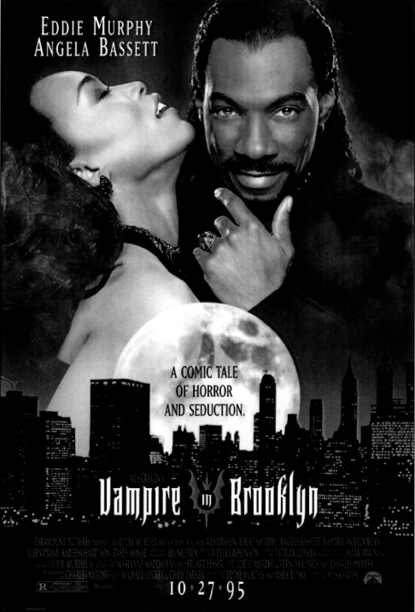
Using the practice questions

Slide 28
Decoding the ‘trigger’ words to create our intro
Compare how representations convey values, attitudes and beliefs. Refer to the film poster for Kiss of the Vampire and Resource A
Representations convey the values, attitudes and beliefs of the producer of the text through the choices that are made when representing people, places or events. Ideologies are revealed through these choices. Both Kiss of the Vampire and the unseen text reveal attitudes towards gender and ethnicity through the ways that the characters and settings are constructed in the film posters.

Slide 29
Using the bullet points to construct our paragraphs
Both texts represent male and female characters but there is a difference in the power balance between men and women. The poster for Vampire in Brooklyn was produced in 1995 but there seems to be a more traditional attitude when it comes to how the male and female characters are constructed. The man’s direct mode of address creates a strong connection to the audience, giving him the agency in this poster. The combination of the woman’s codes of posture and gesture suggest that she is the victim in this scenario etc…In KOTV, there is also a traditional approach to gender representation, with codes of clothing being employed in similar ways to suggest sexuality and submissiveness, however there is also a representation of a female vampire that … These differences are not explained by the historical contexts as it is the older poster that is less traditional in its representations…A context that might be more relevant is the industry context as Eddie Murphy’s star power could influence the representation seen on the poster…
Representation of ethnicity – reflects modern contexts in ViB poster, traditional pattern in KOTV
Representation of genre? Hybridity?

Slide 30
Look at the practice questions
REVISION FOCUS
Go through the practice questions. What revision gaps do they highlight?

Slide 31
Look at the practice questions
CURVEBALL QUESTION:
The curveball will come if you don’t ‘get’ the unseen resource
Practise making notes on unseen resources, both print and audiovisual. Do more on audiovisual
My suggestion for notetaking for the audiovisual resource:
In the first minute, highlight trigger words of the question and begin to decode it.
Divide notes paper into three columns. They will become your paragraphs potentially.
As you watch the first time through, decide what your focus will be for each column
As you watch a second time through, try to fit some specific examples into each column. Leave a space for ‘outliers’
During the five minutes after that, try to build some points together, and identify where you will need more examples.
On the third viewing, find those missing examples

Slide 32
More advice from Mrs. Fisher – do these tasks!
TASK 3
Watch her video: https://www.youtube.com/watch?v=gdDHY_EyK-w

Slide 33
Eduqas’s walkthrough: REPRESENTATION
Eduqas provides specific training for students called ‘Exam walkthroughs’.
Here is the walkthrough for Com 1 Section A representation (based on the 2019 exam paper)

Slide 34
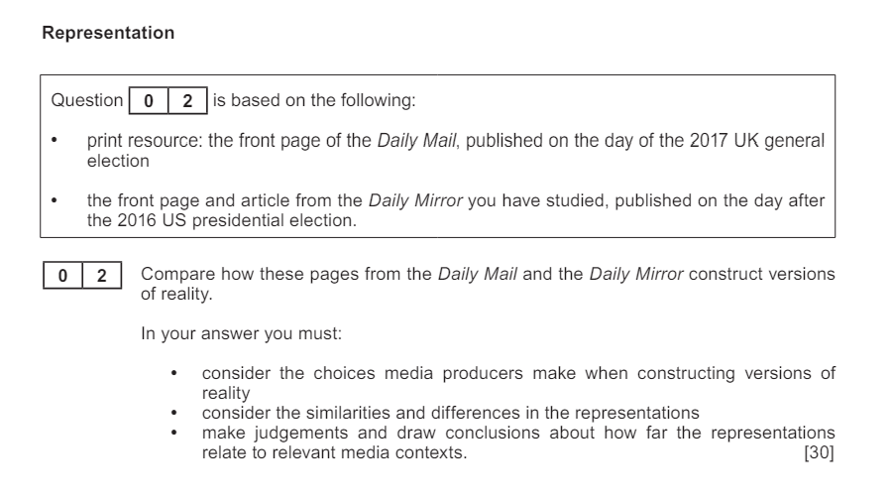
The question from 2019

Slide 35
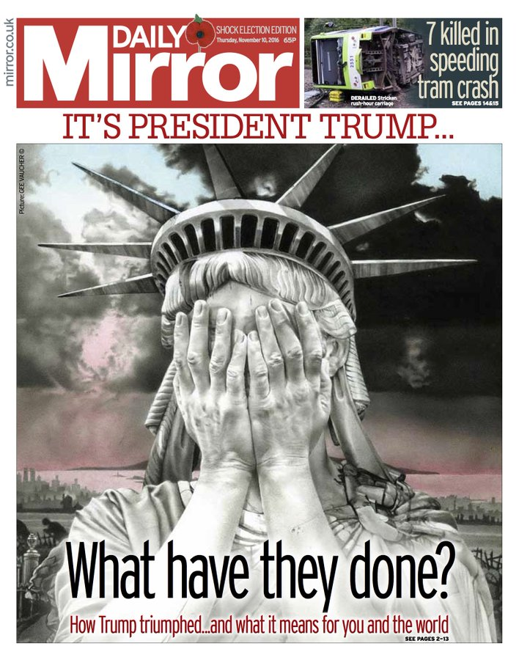
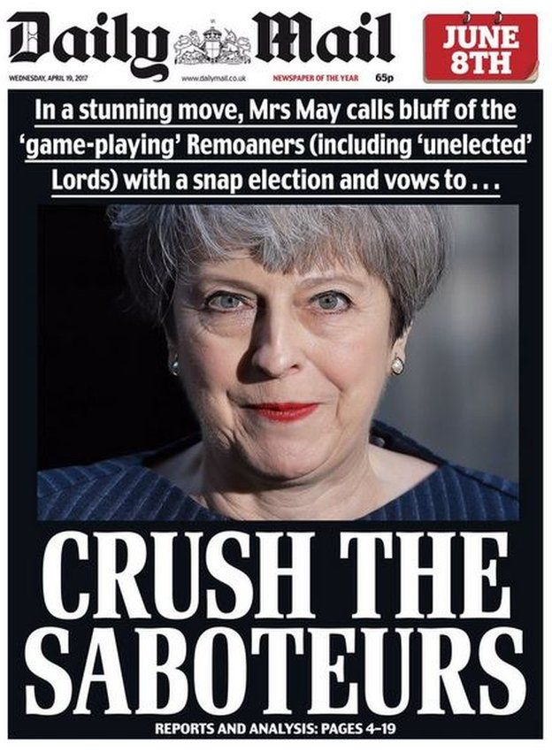
The resources from 2019

Slide 36
How do I tackle Q2?
Question 2: skills being tested – analysis, making judgements and drawing conclusions (AO2)
Time for answering: approximately 60 minutes, including studying print resource
Approach: Re-read Q2 and pay attention to the key words highlighted.
Compare how these pages from the Daily Mail and the Daily Mirror construct versions of reality. [30]
Command word for AO2 – analysis, but specific requirement here to compare
Consider what you know already about these 2 papers - how might this affect the ‘versions of reality’ they construct?
Consider mark allocation, timing and length of response required
Consider how representations are created through selection and construction – links to ‘choices media producers make’ in bullet point
Suggests idea of representations as mediated: not ‘window on the world’ but re-presentation
Notes:
Question 2 is testing analysis, making judgements and drawing conclusions (AO2).
You have approximately 60 minutes to answer, including studying the print resource.
Re-read Question 2 and pay attention to the key words.
The key words to highlight in Question 2 are:
compare – this is the command word for AO2 – analysis, but there is a specific requirement here to compare
Daily Mail and Daily Mirror - consider what you know already about these 2 papers. How might this affect the ‘versions of reality’ they construct?
construct - consider how representations are created through selection and construction – this links to the ‘choices media producers make’ in the bullet point
versions of reality – this suggests the idea of representations as mediated: not a ‘window on the world’ but a re-presentation
Question 2 is worth 30 marks. Consider the timing and length of the response required for this mark allocation.

Slide 37
Top Tips for Q2
This is an extended response question where you gain marks for the quality of your essay writing, including relevance of content, logical and fluent structure, use of examples to support points or arguments – this means you should spend some time planning your answer before writing
Your plan should include the following:
introduction (1 or 2 paragraphs) - outline the focus of the essay and engage with the key words or concepts within the question; as this is a question on representation, it would be valuable to introduce this
main body – a series of paragraphs covering the key points of the essay
conclusion – a final paragraph which sums up your response and forms a conclusion in response to the question set
Remember this is a representation question – you should aim to apply knowledge and understanding of relevant concepts, theories and theoretical perspectives to develop a point of view
Ensure you address all of the bullet points in the question (on the exam paper)
Ensure you address the specific question set, engaging directly with the key words in the question
Notes:
Here are some Top Tips for Question 2:
This is an extended response question where you gain marks for the quality of your essay writing, including relevance of content, logical and fluent structure, use of examples to support points or arguments – this means you should spend some time planning your answer before writing
Your plan should include the following:
an introduction (1 or 2 paragraphs) - outline the focus of the essay and engage with the key words or concepts within the question; as this is a question on representation, it would be valuable to introduce this
the main body – a series of paragraphs covering the key points of the essay
a conclusion – a final paragraph which sums up your response and forms a conclusion in response to the question set
Remember this is a representation question – you should aim to apply knowledge and understanding of relevant concepts, theories and theoretical perspectives to develop a point of view
Ensure you address all of the bullet points in the question (these are on the exam paper)
Ensure you address the specific question set, engaging directly with the key words in the question

Slide 38
Decoding the question using the highlighted words; use this to form introduction
Compare how these pages from the Daily Mail and the Daily Mirror construct versions of reality. [30]
How does any paper construct versions of reality? (Through the way they REPRESENT the news)
How might the way the Daily Mail differ in the way it represents the news compared to the Daily Mirror? (Political bias in both – explain)
What key representations will I cover? (Images? Linguistic codes? Layout?)
NOTE TO SELF…
What theories might work? (Binary opposition? Reception theory?)

Slide 39
Using the wording of the bullet points to structure paragraphs
Both front pages choose images to construct versions of reality. One choice that the Daily Mirror has made to construct a version of reality is to select particular images that represent Boris Johnson as…(analyse the representation, focusing on the combinations of media language elements in the pictures – codes of colour, composition, codes of clothing etc.). This is a complete contrast to the choice of image found on the front page of the Daily Mail, which represents him as …(analyse). These vastly different constructions of reality relate significantly to the political contexts of the papers. The Daily Mirror is a largely left-wing…whereas the Daily Mail is…
Another choice made by both papers to construct versions of reality is through the linguistic codes they employ to represent the events. The Daily Mirror represents reality as catastrophic through linguistic codes…example…analyse…However, the Daily Mail uses language in a very different way to represent reality as…example…analyse. These differences in how far the representations reflect reality can be explained again by the political biases of the papers…explain…
Layout?

Slide 40
How do I tackle Q2?
Practice
Write an essay plan for your response to Q2, using the guidance from the previous slide.
Include paragraphs for the introduction, main body and conclusion with headings to separate your content.
Include at least 4 bullet points of content under each paragraph heading.
You should be able to write your essay from the plan.
You have 5 minutes to complete this - press enter for the timer!
What will this look like?
Notes:
Now you are going to practice tackling Question 2.
Write an essay plan for your response to Question 2, using the guidance from the previous slide.
You should include paragraphs for the introduction, main body and conclusion with headings to separate your content
You should include at least 4 bullet points of content under each paragraph heading.
You should be able to write your essay from the plan.
You have 5 minutes to complete this.

Slide 41
5
4

Slide 42
4
3

Slide 43
3
2

Slide 44
2
1

Slide 45
1
0

Slide 46
How do I tackle Q2?
Feedback – Selected Points From Mark Scheme
Application of knowledge/understanding of representation, e.g. how representations invoke discourses/ideologies, how events/issues are represented through selection and combination
Mediation - paradigmatic choices, e.g. language and mode of address
How newspapers construct versions of reality through ways in which they re-present events:
Similarities - e.g. events represented in both newspapers reflect ideology/discourse of the newspaper: Daily Mirror - left-wing, liberal anti-Republican stance in relation to US election and Daily Mail - right-wing, anti-Labour position related to General Election
Differences - e.g. Daily Mirror - representation of statue weeping in despair accompanied by choice of headline reflects political ideology of newspaper, Daily Mail – constructs positive image of Theresa May: emotive language and photo selected to make her appear strong and in control
Both papers clearly relate to political contexts, e.g. Daily Mail uses emotive language offering biased view of election with aim of persuading voters; Daily Mirror attempts to place event in global context whilst making links to the UK ('America's Brexit’) to make it culturally relatable to readers -'what it means for you and the world’, giving an idea of the momentous and implicitly negative repercussions of the event
Notes:
Here is some feedback on Question 2 from the mark scheme:
You will be credited for the application of knowledge/understanding of representation, e.g. how representations invoke discourses/ideologies, how events/issues are represented through selection and combination
Answers are likely to include some of the following points:
mediation - paradigmatic choices, e.g. language and mode of address
how newspapers construct versions of reality through way in which they re-present events, including:
similarities - e.g. events represented in both newspapers reflect the ideology/discourse of the newspaper: Daily Mirror - left-wing, liberal anti-Republican stance in relation to US election and Daily Mail - right-wing, anti-Labour position related to General Election
differences - e.g. Daily Mirror - representation of the statue weeping in despair accompanied by the choice of headline reflects the political ideology of the newspaper, Daily Mail – constructs a positive image of Theresa May: emotive language and the photo selected make her appear strong and in control
both papers clearly relate to political contexts, e.g. Daily Mail uses emotive language, offering a biased view of the election with the aim of persuading voters; Daily Mirror attempts to place the event in a global context whilst making links to the UK ('America's Brexit’) to make it culturally relatable to readers -'what it means for you and the world’, giving an idea of the momentous and implicitly negative repercussions of the event

Slide 47
Independent revision tasks
CHOOSE WHAT WORKS FOR YOU.
Complete a practice question
Use the practice questions to identify gaps and revise those. See the ‘revision pyramid’ for a range of revision ideas (see next slide)
Use factsheets to revise the set texts
Re-do a previous question you have had marked, aiming to get a few more marks
Set your own revision task
Do a combination of the above

Slide 48
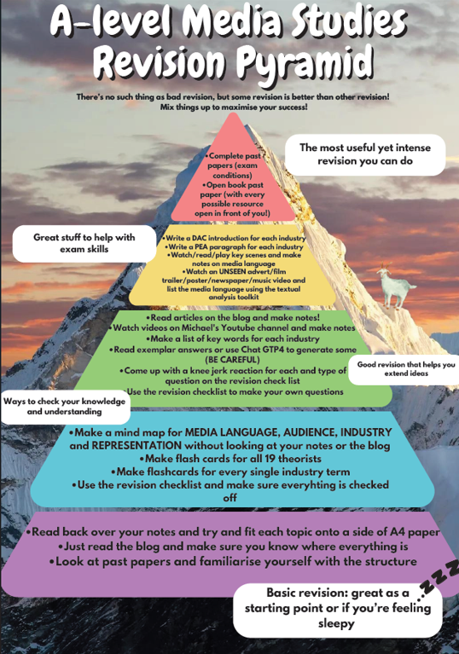
The Revision Pyramid
See p108 of the online media studies handbook
This comes from ‘Media Blogger’ and resources referred to can be found on there.

