Slide 1
Revision
Camera methods and meaning

Slide 2
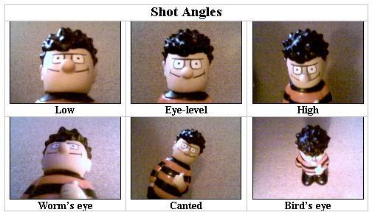
Some reminders…

Slide 3
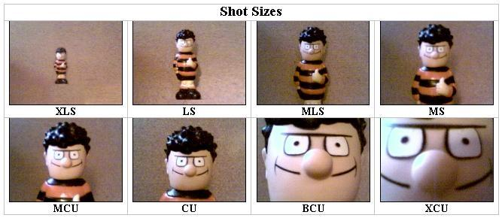

Slide 4
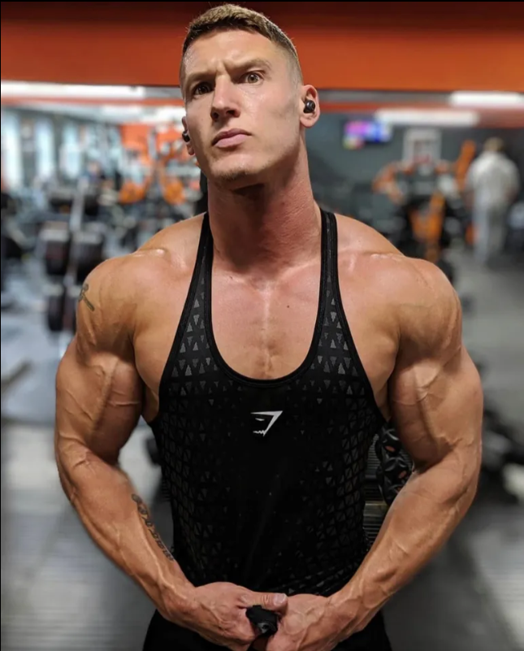
Starter: ‘Legend’ from Gladiators
Questions:
What is the SHOT TYPE?
What is the CAMERA ANGLE?
Why has the photographer chosen these camera methods?

Slide 5
Starter: 2023 ‘Bake Off’ contestants
Questions:
What is the SHOT TYPE?
What is the CAMERA ANGLE?
Why has the photographer chosen these camera methods?

Slide 6
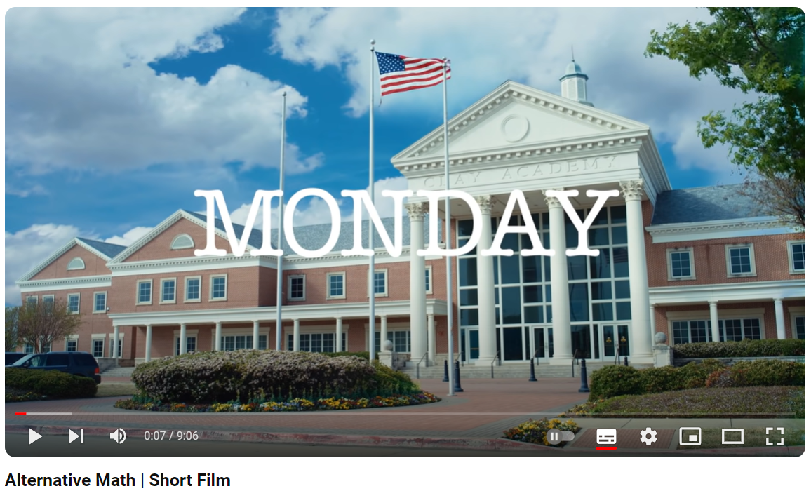
A short film: ‘Alternative Math’
Alternative Math - A Short Film

Slide 7
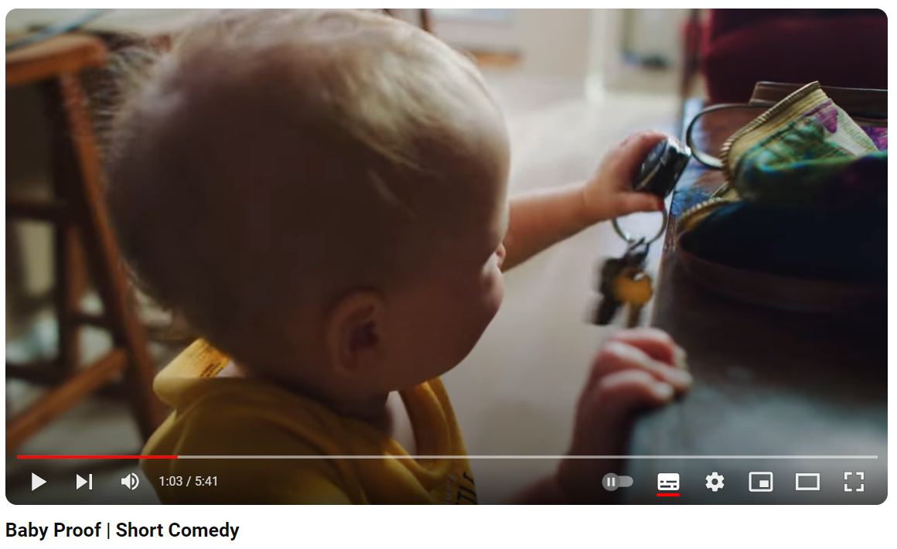
Your turn – watch this and then commentate on it like I did.
Baby Proof - A Short Comedy

Slide 8
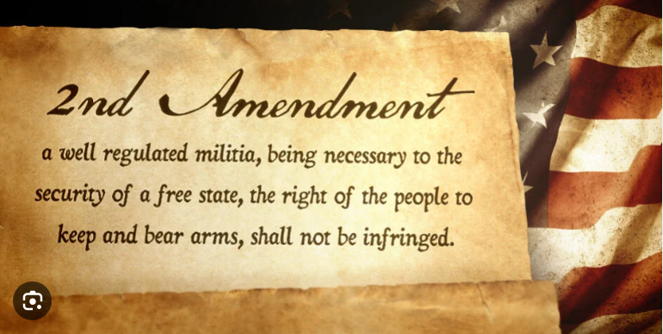
So…what is the ‘Second Amendment’?

Slide 9
Finally…
Opening sequence of Jaws

