Slide 1
COM 1 SEC B
Assassin’s Creed: The Franchise
L2: To understand the significance of the video games industry and to develop knowledge of gaming terminology

Slide 2
Industry Context
The computer games industry is relatively new when you compare it with other media industries…
This industry is experiencing rapid growth
Its profits rival major films
Multi-player activity broadens the gaming experience
Three big industry markets – Japan, USA, Europe (why these places?)

Slide 3
When we picture a ‘gamer’, what do you think of? Name? Age? Gender? Other interests?
The profile of gaming has changed in that a gamer is no longer the lone teenage boy playing in his bedroom, gamers are now all ages, genders and demographics. Games actively court new audiences through their content.
The playing of games is now taken more seriously and computer games are accepted as media texts that are valid for study in the same way as films.
Games can be complex in their construction and the demands made on the gamer compared with other texts… Why do you think this is the case?

Slide 4
‘I consider video games a form of design that is amazingly important today and that is going to become even more important in the future, because it is a way we interact with machines and screens.’ Paola Antonelli, Senior curator of the Museum of Modern Art’s Department of Architecture and Design.
Do you agree?

Slide 5
Gaming Industry Statistics
In 2012, two physical games sold over 1 million units: Call of Duty Black Ops II and FIFA 13.
Overall 2015 games market in the UK worth £4.19bn – up £210m from 2014
Mobile market achieves best ever year in 2017 and is worth £664m
2016 was the biggest ever year for games software, exceeding £3bn in sales for the first time.
70.6m PS4 and 617m PS4 games have been sold to date.
There are over 7.5m PS4 and Xbox One consoles active in homes across the UK.
Digital sales of games exceeded the combined sales of digital video and music in 2016/17.

Slide 6
Terminology
I anticipate that you will know all of these…Correct me if I am making a middle-aged mistake.

Slide 7
Platform
What you use to play a game on: e.g. Playstation, Xbox, Gameboy - this also includes mobile phones and Steam, an online platform.

Slide 8
VR (Virtual Reality)
Current VR technology uses virtual reality headsets to generate realistic images, sounds and other sensations that simulate a user's physical presence in a virtual or imaginary environment.
A person using virtual reality equipment is able to "look around" the artificial world, move around in it, and interact with virtual features or items. The effect is commonly created by VR headsets consisting of a head-mounted display with a small screen in front of the eyes, but can also be created through specially designed rooms with multiple large screens.

Slide 9

Sidescroller
Could be a platformer game.
A character moves to the right, overcoming obstacles to succeed, e.g. Sega’s Sonic the Hedgehog.

Slide 10
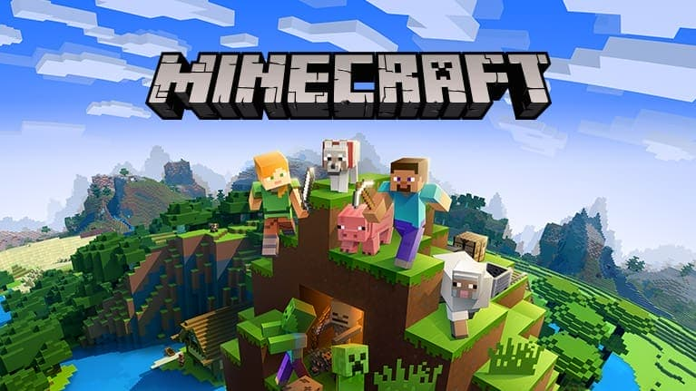
Sandbox
A sandbox is a style of game in which minimal character limitations are placed on the gamer, allowing the gamer to roam and change a virtual world at will.
In contrast to a progression-style game, a sandbox game emphasizes roaming and allows a gamer to select tasks.

Slide 11
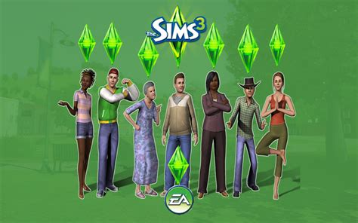
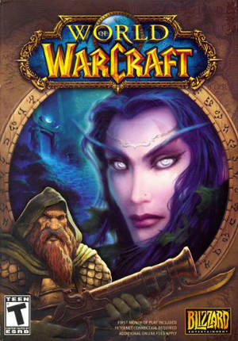
Role Play
A game where you design your own avatar to represent you which you then play as through the game.
E.g. Blizzard’s World of Warcraft and EA’s SIMS

Slide 12
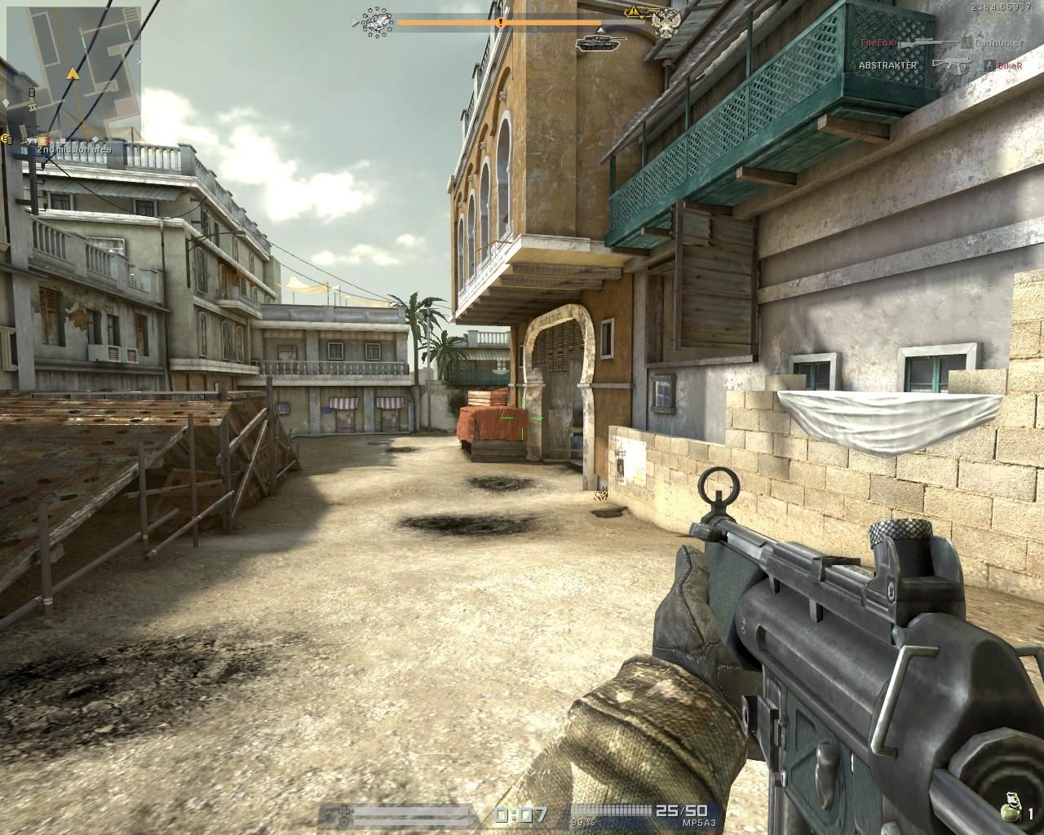
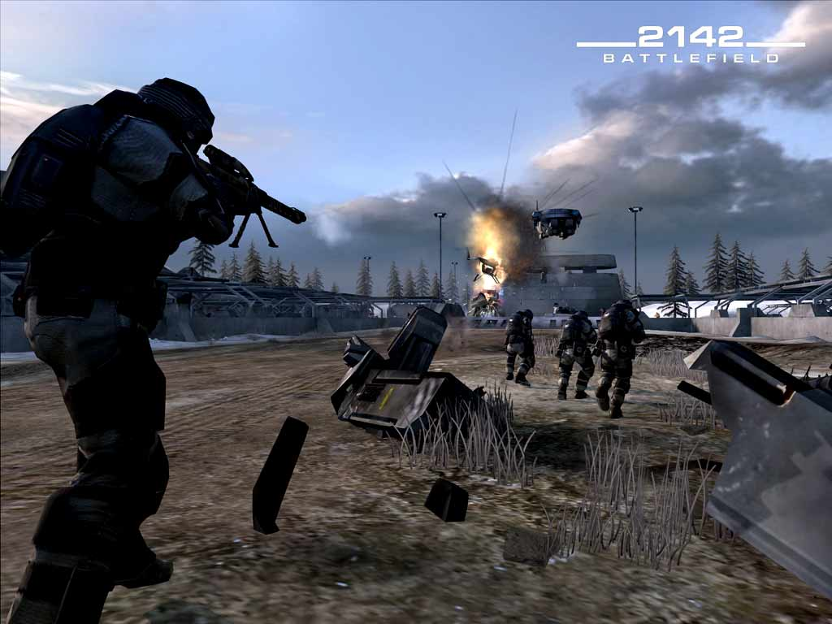
Shooter
A game based around shooting, played in either first person (from the perspective of the character) or third person (you can see the character that you are playing).
E.g. Activision’s Call of Duty or EA’s Battlefield

Slide 13

Narrative
A game with a story which underpins gameplay. Often associated with the ‘openworld’ style of game
E.g. The Last of Us

Slide 14
AAA
An AAA game, or pronounced “Triple-A game", is generally a title developed by a large studio, funded by a massive budget.
These games will have a marketing budget in the multiple-millions of dollars, and are planned to earn out in excess of one million titles sold. Investors/publishers expect a multiple-of-cost return on their investment In order to recoup general development costs.
Publishers will generally produce the title for the major platforms (currently Xbox 360, PS4, and PC) to maximize profits, unless it is a console exclusive, in which case the console maker will pay for exclusivity to offset the loss of potential profit to the developer.

Slide 15
High Visibility Marketing / Promotion

Slide 16
DLC
Downloadable content
Extras that can be downloaded in online games

Slide 17
Formats of Computer Games
MMORPG = Massively Multi-player Online Role-playing Game.
A large number of players can be involved in the virtual world of the game at one time. Offer persistent worlds – the game world continues even when the gamer is not part of it.
CRPG = Computer Role-Playing Game
Fewer players than MMORPG and non-persistent worlds.

Slide 18
Players Positioning
Players can be positioned in different ways in a game.
Single player
Multi player
Specific Character role play
First person
Third person

Slide 19
Tasks
On Satchel, find this ppt and go to slide 5
Research all of these statistics and verify them. If they need updating, put in the latest statistics. Make sure your statistics are correct (how will you verify?) before you write them down (see 3).
Create a revision sheet for this lesson that you can file away and use later. Include your research from number 2 in this document. Use the AC factsheet if necessary.
Read the factsheet.

