Slide 1
COM 1 SEC B
Assassin’s Creed: The Franchise
L3: To apply INDUSTRY THEORIES to this text

Slide 2
INDUSTRY THEORIES FOR THIS TEXT:
Power and Media (Curran and Seaton)
Regulation (Livingstone and Lunt)
Cultural Industries (Hesmondhalgh)

Slide 3
CURRAN AND SEATON (POWER AND INDUSTRY) – A DEEP DIVE

Slide 4
Curran and Seaton: gap fill
media is controlled by a small number of companies driven by _________ and power
media concentration generally _________variety, creativity and quality
more socially ________ patterns of ownership help create _________ for more varied media productions

Slide 5
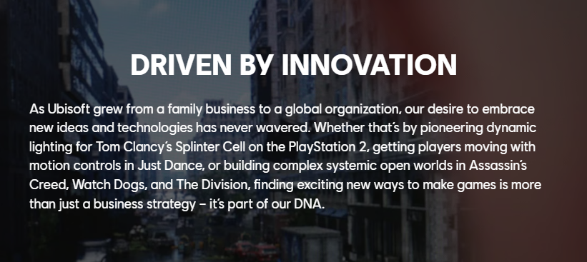
Does the ‘Assassin’s Creed’ franchise support C & S’s theory?
‘The media is controlled by a small number of companies driven by profits and power’
Ubisoft would dispute this claim saying that they are:

Slide 6
However, Ubisoft does make very large profits and is in the top ten list of biggest game producers.
Profits this year: 2.5 billion U.S dollars (Jan 2023)
In conclusion – yes, it’s a big, profit making company that owns a number of lucrative brands but the company itself does not want to project the idea that they are interested primarily in making money. There is also the competition provided by indie developers and the challenge presented by their highly engaged audience. It could be argued that they are not a completely unassailable monolith – they have power, but are accountable to outside influences.
‘The media is controlled by a small number of companies driven by profits and power’

Slide 7
Does the ‘Assassin’s Creed’ franchise support C & S’s theory?
‘media concentration generally limits variety, creativity and quality’
The franchise itself helps to create predictability and perhaps places limits on some aspects of the game as certain expectations have to be met.
However, the franchise also allows for development and change as that is also part of the expectation. Lack of quality is swiftly ‘punished’ by an active audience.
Again, Ubisoft would argue that creativity drives what they do.

Slide 8
Here’s what they say…
In conclusion – yes, Ubisoft is one of the major players in this industry, but it could be argued that it has to stay creative and varied to maintain this position. On the other hand, the activities of its audience in terms of ‘policing’ quality means that they potentially can’t take too many risks, so that could be viewed as a limitation. One of the selling points of ‘Mirage’ is that it is designed to appeal to its ‘core’ audience
‘media concentration generally limits variety, creativity and quality’

Slide 9
Does the ‘Assassin’s Creed’ franchise support C & S’s theory?
‘more socially diverse patterns of ownership help create conditions for more varied media productions’
Ubisoft dedicates a lot of time on its website to promoting the diversity and inclusivity of the company, but the diversity lies with the workforce rather than the owners:

Slide 10
And…
https://research.monm.edu/mjur/files/2019/02/MJUR-i09-2018-2-Fishbune.pdf

Slide 11
Comparison of Kassandra and Alexios – AC Odyssey
Assassin's Creed Odyssey Kassandra and Alexios character comparison - YouTube
In conclusion – yes, it appears that the active drive towards inclusivity and diversity is challenging the stereotypical representations often associated with gaming. Kassandra and Alexios are good examples of how characters are not driven by gender stereotypes, at least in the later iterations of the franchise. However, the ownership of the company is distinct from the workforce in this instance – see next slide for the key players in this company.
‘more socially diverse patterns of ownership help create conditions for more varied media productions’

Slide 13
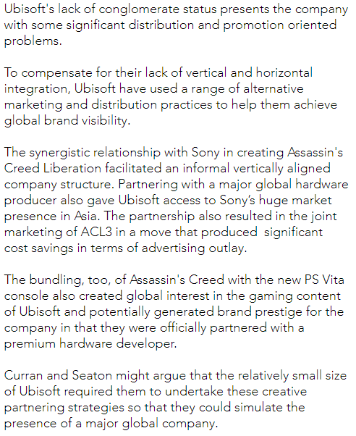
Final thoughts about company structure

Slide 14
LIVINGSTONE AND LUNT (REGULATION) – A DEEP DIVE

Slide 15
Regulation - Sonia Livingstone and Peter Lunt
the idea that there is an underlying struggle in recent UK regulation policy between the need to further the interests of citizens (by offering protection from harmful or offensive material), and the need to further the interests of consumers (by ensuring choice, value for money, and market competition)
the idea that the increasing power of global media corporations, together with the rise of convergent media technologies and transformations in the production, distribution and marketing of digital media, have placed traditional approaches to media regulation at risk
Consumer choice vs consumer protection
Powerful and ubiquitous companies vs traditional regulators

Slide 16
How are games regulated in the UK?
‘This rating has been given due to depictions of gross violence towards human characters, motiveless killing of multiple innocent human characters, violence towards vulnerable and defenceless human characters, and use of sexual expletives. Not suitable for persons under…’
‘This video game is primarily intended for a desensitized audience. The goal of this game is to stage subversive content: raw violence, very suggestive content, raw humor, gambling, drugs. Not recommended for minors.’

Slide 17
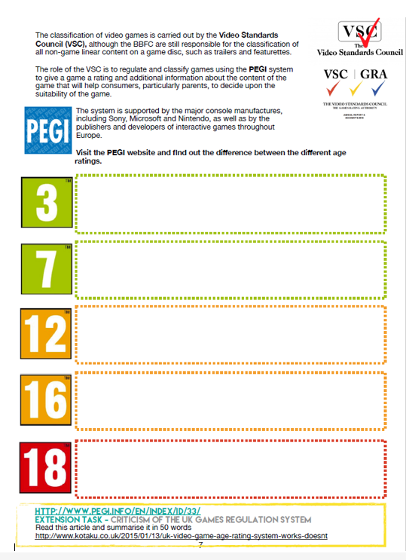
Starter task:
Complete the PEGI worksheet to gain a greater understanding of the system.
15 mins! 3 mins per box.

Slide 18
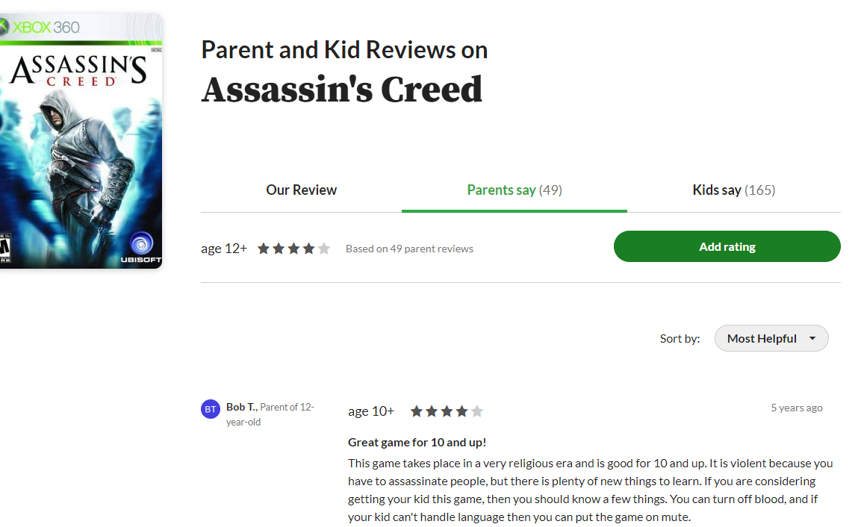
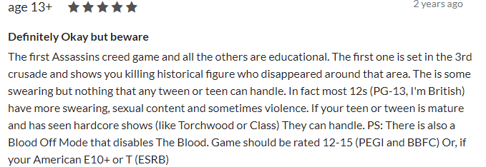
In the real world…
'Assassin's Creed Valhalla is 50 shades of violence' gameplay vid
https://www.outcyders.net/article/the-problems-with-pegi
Read this through – have a look at the ‘Mass Effect’ video about two thirds of the way through and decide if the BBFC 12 or the PEGI 18 rating is more appropriate.

Slide 19
HESMONDHALGH (CULTURAL INDUSTRIES) – A DEEP DIVE

Slide 20
The theory:
companies try to minimise risk and maximise audiences through vertical and horizontal integration, and formatting products (e.g. stars, genres, and serials)
largest conglomerates now operate across a number of different cultural industries
the radical potential of the internet has been contained by partial incorporation into a large, profit-orientated set of cultural industries

Slide 21
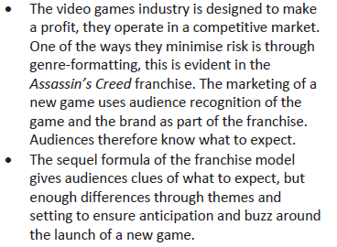
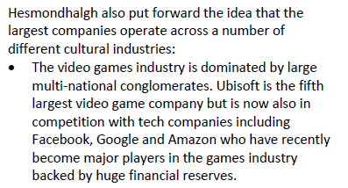
Minimising risk, maximising audiences, growing ever bigger…
Mrs Fisher - Hesmondhalgh's Cultural Industries theory - Simple guide for students & teachers - YouTube

Slide 22
Your task – have a look at the massive sheets. If you can learn the stuff on them for this text, you will be well prepared. Your job is to absorb as much of this as possible.
SOME TECHNIQUES FOR REMEMBERING
Start with one section. Transform the text – this will begin the process of cementing it in your long-term memory. There are many ways of doing this
Create quiz cards – question on one side, answer on the other

Slide 23
Further research
A-Level Media Studies: Videogames - component one section b - Explore how ownership has shaped Assassin's Creed III: Liberation (lr-media.blogspot.com)
Assassin's Creed Franchise and Genre – YouTube
https://research.monm.edu/mjur/files/2019/02/MJUR-i09-2018-2-Fishbune.pdf

