Slide 1
COM 1 SEC B
Assassin’s Creed: The Franchise
L5: Creating Case Study notes

Slide 2
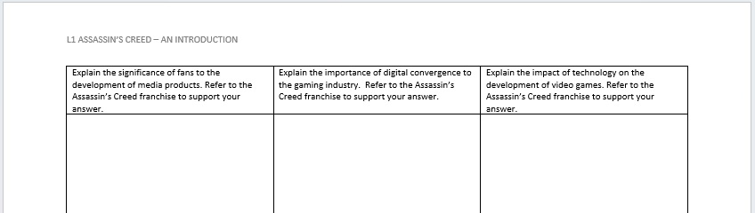
Remember this?
Update it as we go through this lesson.

Slide 3
Close study: AC3: Liberation – an introduction
https://www.youtube.com/watch?v=GXv1dCxVvuk
Mrs Fisher’s guide to AC III: Liberation (8 mins)

Slide 4
Creating useful case study notes…
Today you will familiarise yourself with the ‘case study chart’.

Slide 5
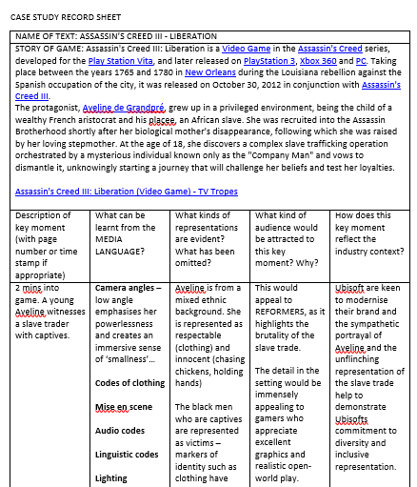
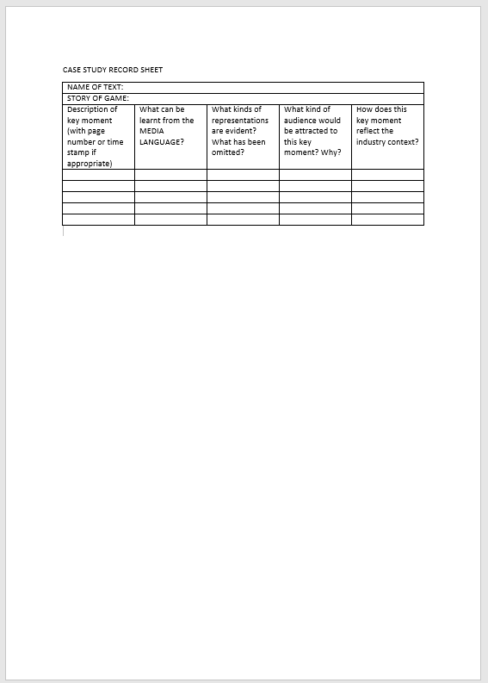
How to complete the case study chart
This is the blank version, available on Satchel.

Slide 6
‘Liberation’ play through
For your exam, you are expected to know one iteration of the franchise well. Below is the link to a complete playthrough of Assassin’s Creed: Liberation.
https://www.youtube.com/watch?v=iTO8a-iEhtg
Fill out the ‘case study’ chart to record at least 4 key moments from across the game.

Slide 7
Thursday’s lesson
Use the following link to get to a playthrough of Assassin’s Creed 2. This is one of the most popular games of the franchise, released in 2009
Assassin's Creed 2 - Full Game Walkthrough (youtube.com)
If you expand the ‘more’ section under the video, there is a breakdown of each chapter. You can also get this as a sidebar. Use this to pick interesting moments of the game. Don’t just get your examples from the start of the game.
Record your findings on the ‘Case Study Record sheet’ (available on Satchel). When done, print the chart off and file it in your folder for revision next year.

