Slide 1
COM 1 SEC B
Assassin’s Creed: The Franchise
L6: Two more theories: End of Audience and Fandom

Slide 2
Remember these?

Slide 3
Fandom – Henry Jenkins

Slide 4
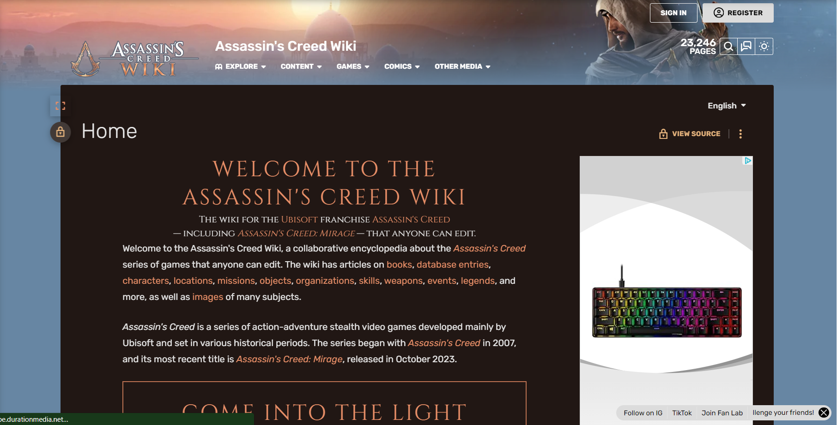
‘Fans are active participants’
This is a work of utter dedication – there are even style notes.
https://assassinscreed.fandom.com/wiki/Assassin%27s_Creed_Wiki

Slide 5
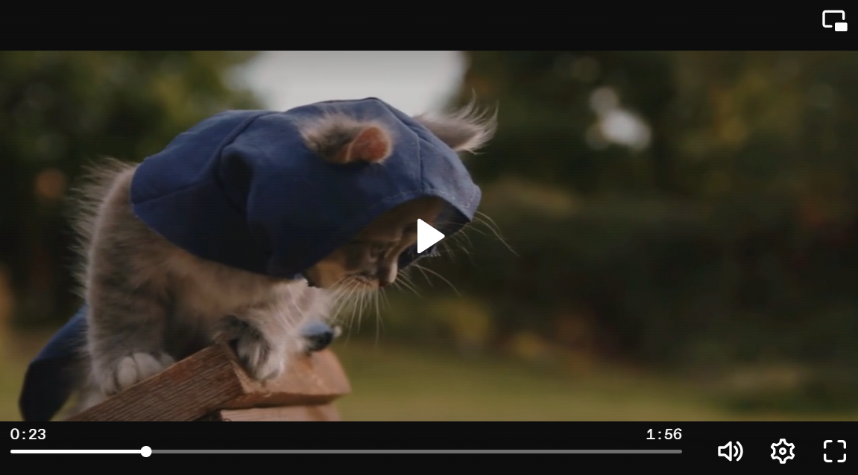
Textual poaching
https://www.dailymotion.com/video/x26px57

Slide 6
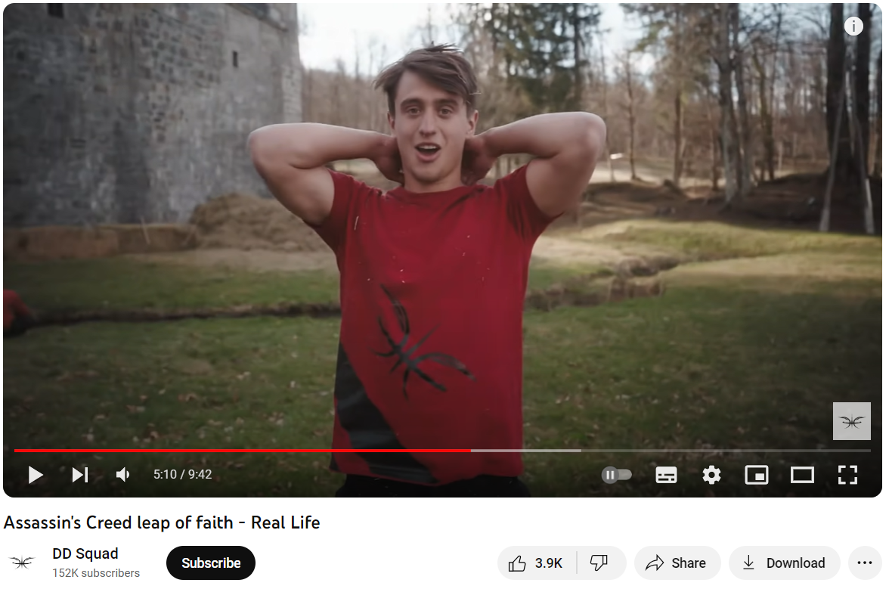
‘Part of a participatory culture that has a vital social dimension’
https://www.youtube.com/watch?v=kKLMHsDQzYA
Super dangerous recreations of the iconic ‘Leap of Faith’. Do not do this at home. Not even off your bed onto a pile of cats. No. I know from recent personal experience that this ends badly
https://www.youtube.com/watch?v=kKrtbUinWOU
‘Literal Assassin’s Creed Trailer’ – have a look at the comments for the impact that this satirical series had on a generation

Slide 7
‘End of Audience’ – Clay Shirky
See all the above examples and go and find your own!

Slide 8
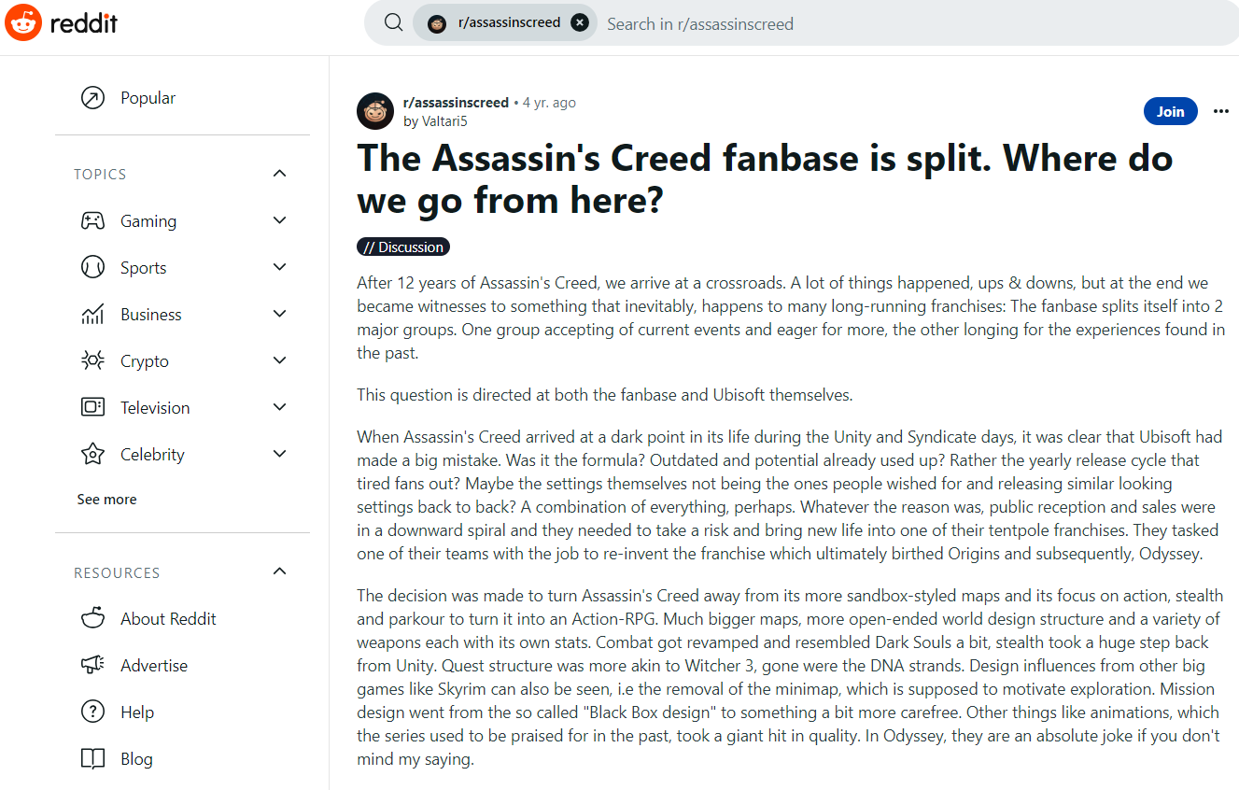
Ubisoft acknowledge the input of their fans.
In the following mini-documentary (11 mins) celebrating 15 years of AC, you can see part of the ‘feedback’ system in operation. Ubisoft have a community of ‘mentors’, well-known gamers with a special interest in AC.
There are also countless unofficial forums for players to voice their opinions. Reddit is a common place for bemused or disgruntled fans to gather and communicate their views. Click on the image to go to this thread
Assassin's Creed 15th Anniversary documentary (11.30 mins)

