Slide 1
COM 1 SEC B
Assassin’s Creed: The Franchise
L7: Production, distribution, divergence

Slide 2
Production Distribution and Circulation
Ubisoft is a French video game publisher that is well known for publishing the following games…

Slide 3
Ubisoft is a truly global company:
Ubisoft Montreal
Ubisoft Annecy
Ubisoft Sofia
Ubisoft Milan
Ubisoft Quebec
Ubisoft Toronto
Gameloft
Griptonite Games
Blue Byte

Slide 4
Ubisoft Montreal
Ubisoft Annecy
Ubisoft Sofia
Ubisoft Milan
Ubisoft Quebec
Ubisoft Toronto
Gameloft
Griponite Games
Blue Byte
Many of these subsidiaries are responsible for the design, development and testing of a selection of the Assassins Creed games. In many cases these organisations are employed on a rota basis to ensure games in the franchise are constantly being developed
Example: Ubisoft Quebec were completing Assassins Creed: Odyssey in 2018, Ubisoft Montreal were already underway developing Assassins Creed: Valhalla for 2020

Slide 5
MEDIA STUDIES DICTIONARY
AAA GAMES - The term "AAA Games" is a classification used within the video gaming industry to signify high-budget, high-profile games
SIMULTANEOUS RELEASE – in gaming, this means that one game is released for all different consoles in order to broaden the target audience.
Assassins Creed is considered a AAA video Game release; an anticipated video game release, backed by heavy funding for advertising and promotion. Many of the games in the franchise tend to be released simultaneously across all major platforms (including the latest generation consoles) to capitalise/profit across all video game markets.

Slide 6
Technological Change
The Franchise has always strived to be on the ‘cutting edge’ of gaming technology as they aim to integrate the latest developments in console gaming into their narratives. Most recently these have included a ‘better than ever’ digital display through 4K resolution. It is rumoured that Ubisoft are developing Assassin’s Creed games to accommodate virtual reality platforms (including Oculus Rift) for future release too.

Slide 7
A high-quality product
Assassins Creed = is produced by Ubisoft who is well know for high production values
Ubisoft continually attempt to improve their high production values by transitioning onto the next generation of consoles.

Slide 8
Gameplay is designed to appeal to and maintain a range of audiences
MEDIA STUDIES DICTIONARY
There are many aspects of the games within the franchise that are significant to audience targeting & construction:
sub-plots and side-quests - More complex story-lines, puzzle solving and an appreciation for historical contexts may link to the fact that the average age of the UK gamer is 34 and more educated than originally first assumed.
Cut scenes are used to add cinematic scope and real audience engagement - adds depth to narrative and therefore long term character / story investment.
SUB-PLOT – A secondary plot alongside the main plot. this may help to enrich and further add character to the main protagonist.
SIDE QUEST – A mission for gamers to complete in addition to the main mission, Additional rewards my be won during side quests.
CUT SCENES - cutscene or event (an in-game movie) is a sequence in a video game that is not interactive, interrupting the gameplay.
Click on the link below to see a wide range of Assassins Creed cut scenes
https://www.youtube.com/watch?v=-1G4igJxH8I
Notes:
Audiences are engaged by sub-plots and side-quests which they can complete (but which may not be vital to the overall main plot or completion of the game) to enrich and further add character. More complex story-lines, puzzle solving and an appreciation for historical contexts may link to the fact that the average age of the UK gamer is 34 and more educated than originally first assumed.
Cut scenes are used to add cinematic scope and real audience engagement - although they may not be playable they do add depth to narrative and therefore long term character / story investment.

Slide 9
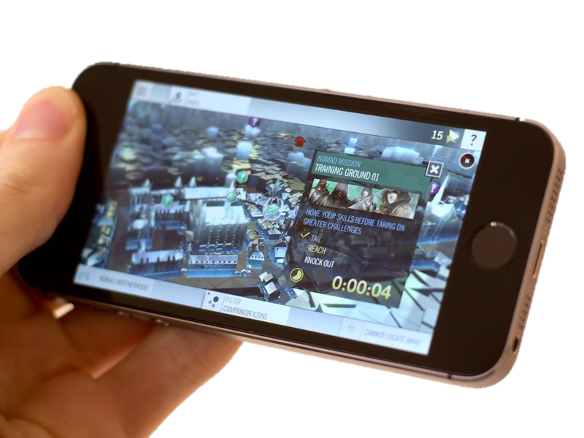
Divergence
Ubisoft have experimented with a variety of alternative/divergent platforms, aside from the mainstream console variation. This has included more accessible variants such as the handheld PS Vita, PSP, Nintendo DS etc. and the mobile phone app (Windows, IOS, Android) market.
Notes:
Limited by the technology of that device – tended to be side scrolling gameplay rather than the third person graphically superior imagery.

Slide 10
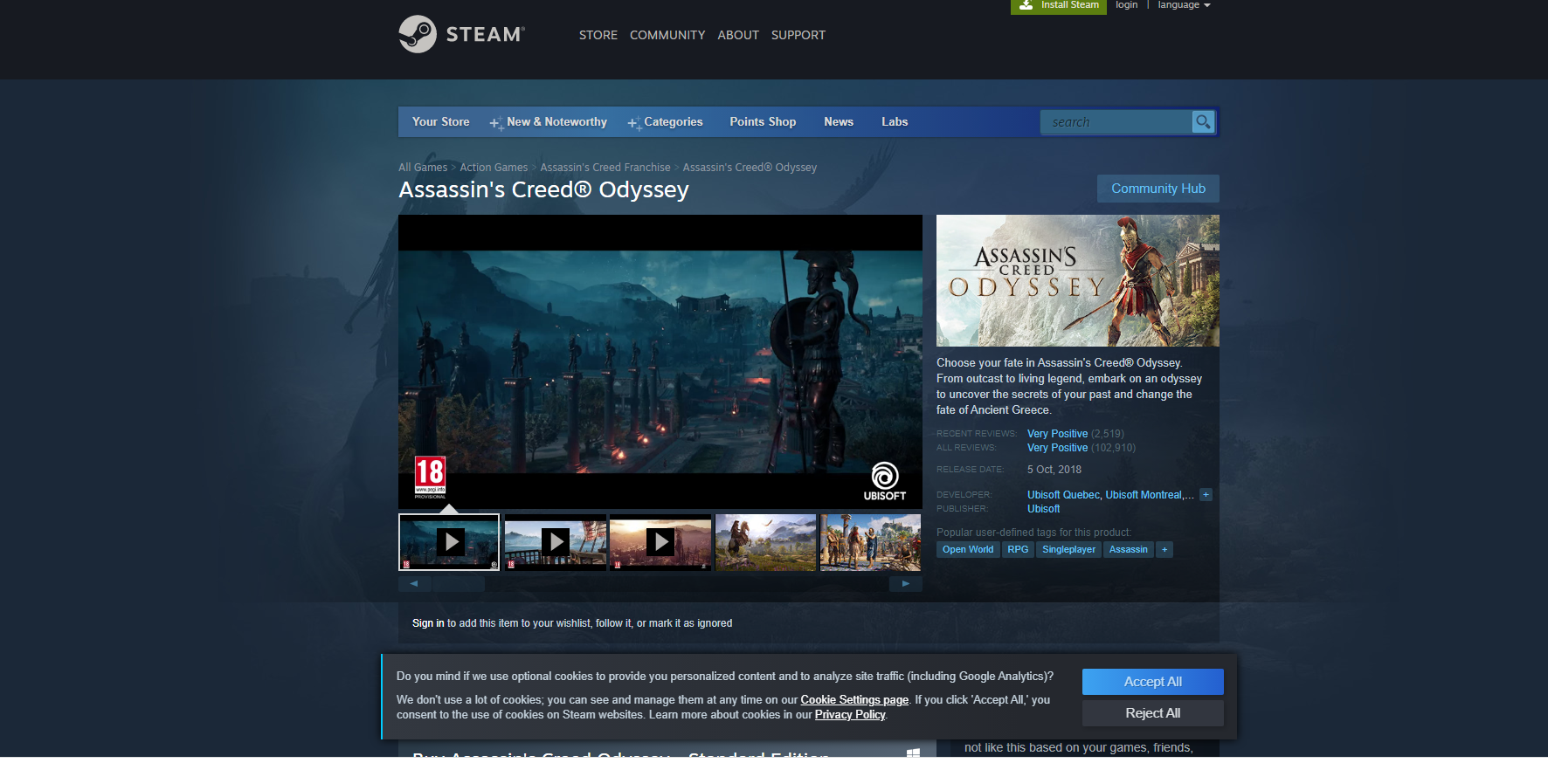
Distribution
Technology has had an impact on game distribution. The majority of gamers will purchase their games online.
Steam
The PlayStation Network
Xbox Live (now Xbox Network)
Stadia (Google Owned)
Amazon Luna
See next slide for the pros and cons of buying online
Notes:
In many cases some of these online purchases offer exclusive deals or variations over the usual retail version. They also show gameplay clips.

Slide 11
Pros and cons of online purchasing
Pros | Cons
Able to search all games on one website – all in one place. Community page – audiences/fans of games can write reviews which potential buyers can read before making a decision to purchase Demo’s/trailers – helps to make a decision Won’t go out of stock Can get game passes online Can be cheaper online – online sales and can compare prices on different sites Can browse multiple games at once | Cant trade it in once you’ve finished playing it Hard to regulate – young children are able to purchase games that are of an 18 certificate without question High chance of spending too much on credit cards or having account hacked if you buy from a dodgy site – young children may spend too much on parents’ card without realising If you lose your account you can lose any purchases you have made reliant on internet connection No safeguarding – easy to be exposed to unsuitable content

Slide 12
Tasks: take excellent notes for all of these things – they will form the basis for your revision. You will have tomorrow’s lesson as well if needed. All articles are attached to Satchel along with this ppt
Find your past questions sheet (also attached on Satchel). Use the learning from this lesson to continue to fill up the boxes.
Then, read the ‘Eat Sleep Raid Repeat’ (on satchel) article from ‘Media Magazine’. When you have read it, use relevant information from it to continue to fill up the boxes.
Read the ‘Inside Pegi: Rating Violence’ article (on Satchel). Read it and fill out relevant boxes with relevant information from the article.
Then, on the next slide is a link to an article about new technology for ‘Mirage’. Read it and fill out relevant boxes with relevant information from the article.
Finally, use the rest of the time to familiarise yourself with one or two iterations of the franchise if you are not someone who regularly plays Assassin’s Creed. You could skim through it and pick out examples of gameplay that might be of use to you in an exam. Think about representation and how it links to audiences for example. Have a look at the level of violence and how it might affect regulation.

Slide 13
New technology for ‘Mirage’
https://www.playstationlifestyle.net/2023/07/14/assassins-creed-mirage-haptic-feedback-system-owo/?fbclid=IwAR1iKwkOrN_Dvf7pzyQ1koqaekDnv1dwU3EyllWLllJsFECX2oOYGJ-kTlQ

