Slide 1
COM 1 SEC B
Assassin’s Creed: The Franchise
L8: Audience – Bartle’s Taxonomy of Gamers

Slide 2
Admin
You are in K16 tomorrow! Ms. Cheng will see you there.
Homework for over the holidays: revise Assassin’s Creed – this is what you will be assessed on during assessment week (from Tues 30th April)

Slide 3
Starter
Someone asked if there was an Assassin’s Creed Film – the answer is yes!
Assassin’s Creed | Official Trailer 2 [HD] | 20th Century FOX - YouTube

Slide 4
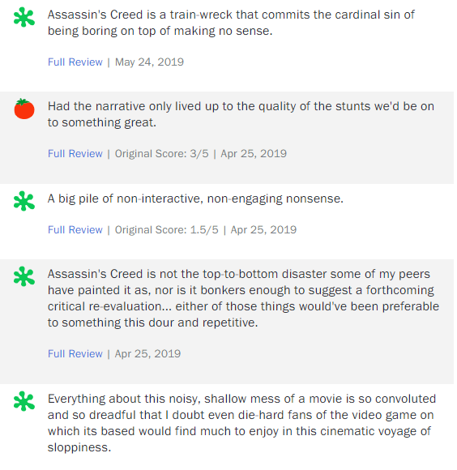
The reviews…
It’s an action movie, with dollops of thriller and splodges of Dan Brown conspiracy; and hardly five minutes go by without someone in a monk’s outfit doing a bit of sub-parkour jumping from the roof of one building to another. And yet it is at all times mysteriously, transcendentally boring.
I bet playing the game is much more exciting. But then getting Fassbender to slap a coat of Dulux on the wall of his hi-tech prison cell and monitoring the progressive moisture-loss would be more exciting.
Marion Cotillard says in her doom-laden accent: “Prepare the animus”; and it sounds worryingly like “Prepare the enemas”.
There is no animus in this film, however. It’s rare to see a film quite so lacking in animus. It exists only to gouge money out of gamers. They might well want to stick to the game.

Slide 5
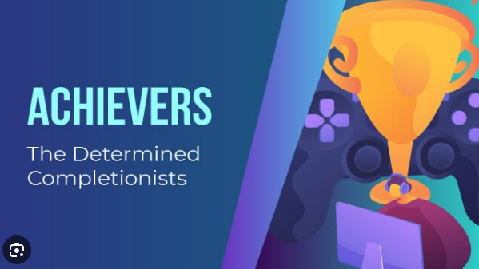
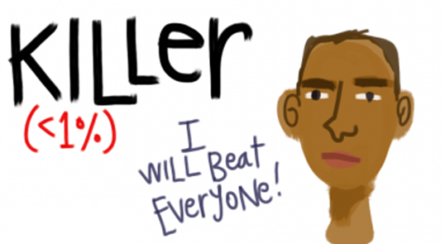
Bartle’s Player Types
Can you predict their behaviour? Even more impressively, can you guess what percentage of players fall into each category? What does this remind you of in media that we’ve already learnt about?
The Achiever
The Explorer
The Socialiser
The Killer
I am going to explain each type on the next four slides. Your task is to summarise each type using a graphic. Here are two examples:

Slide 6
The Achiever
Achievers are all about points and status. They want to be able to show their friends how they are progressing. They like to collect badges and put them on display. This is the type of person who responds particularly well to incentive schemes such as Air Miles, where every additional mile collected is an achievement in its own right. Bartle estimates that roughly 10% of people are players of the Achiever type. Chances are you will know several people of this sort; someone who boasts he used a quicker route to get to a destination than his friend did is an Achiever type.
[Kumar, J., Herger, M. and Dam, R. F. (2023, March 23). Bartle’s Player Types for Gamification. Interaction Design Foundation - IxDF. https://www.interaction-design.org/literature/article/bartle-s-player-types-for-gamification#:~:text=Achievers%20are%20all,an%20Achiever%20type] .

Slide 7
The Explorer
Explorers want to see new things and discover new secrets. They’re not as bothered about points or prizes. For them, discovery is the prize. Explorers are fine with repetitive tasks as long as they eventually “unlock” a new area of the game, or they deliver some kind of “Easter Egg” (an Easter Egg is a small bonus within a game – sometimes it’s as simple as a little joke, whereas in other cases it might be a full extra video sequence regarding what has been accomplished). Explorers really enjoy the surprise that’s possible in a game, and around 10% of players fit into this category. These are the players who will feel at walls in a game in order to access a secret passage; their satisfaction on doing so is what makes them tick, not bragging to their friends about their discovery. Build this sort of feature into your gamification design—and you’ll be speaking their language.

Slide 8
The Socialiser
‘The vast majority of players are Socializers. That’s almost 80% of people who play games. Socializers experience fun in their games through their interaction with other players. Socializers are happy to collaborate in order to achieve bigger and better things than they could on their own. Games, such as Farmville (Facebook’s largest game), appeal to the Socializer. For instance, Socializers are happy to water someone else’s farm in exchange for new crops for their own farm. For example, office workers who leave at the end of the day and remind each other to water each others’ crops may be friends… or they may just be acquaintances. Whatever the deal is, the point with Socializers is that joining forces makes sense to them. Note—this is the last place you’ll find fierce competition, but it doesn’t mean Socializers are passive milksops who lack ambition.’

Slide 9
The Killer
The Killer denotes an ominous-sounding type, but one that is nonetheless valid. Killers are similar to Achievers in the way that they get a thrill from gaining points and winning status too. What sets them apart from Achievers is that the Killers want to see other people lose. They’re highly competitive, and winning is what motivates them. They want to be the best at the game—and it should come as little surprise that the only way for that to be true is if they beat everyone else. You may expect this personality type to be common, but Bartle’s research suggests that only a small number of players are Killers – less than 1% to be precise.

Slide 10
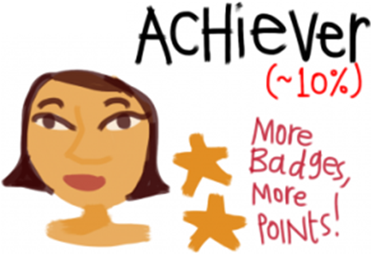
How has Ubisoft developed Assassin’s Creed: Valhalla to appeal to the different gamer types in Bartle’s Taxonomy of Gamers?
Trailer

Slide 11
Video Games = Violent Behaviour?
https://www.youtube.com/watch?v=-ixUGwk6IC8
Watch the video, and answer:
What does “priming” mean?
What did the Car/Mouse experiment reveal about priming by video games?
What are “rag doll” physics in a video game? Why do people believe it might lead to violent behaviour?
In experiments and studies that did find a connection between video games and violent behaviours, what was the true reason for these findings? Did they reflect the truth?

Slide 12
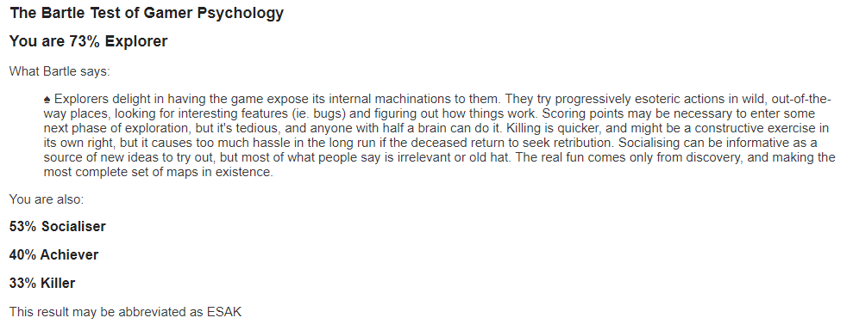
Final tasks
What is your Bartle Type? Find out: Take the Bartle Test (matthewbarr.co.uk)
If time, look at the trailer for another version of Assassin’s Creed and see how they might cater for the different Bartle types. Create another chart like you did before. The more examples you have from across the franchise, the better!
This is me

