Slide 1
COM 1 SEC B
Industry and Audience
L14: Audience – how do audiences use and interpret texts?

Slide 2
Admin
Please hand in Black Panther ‘ownership and control’ homework due today if you haven’t already
New homework for next week: see slide 28

Slide 3
Key words
Lexical fields
Opinion leader
Demographic
Hegemony / hegemonic
Ideology
USP (unique selling point)

Slide 4
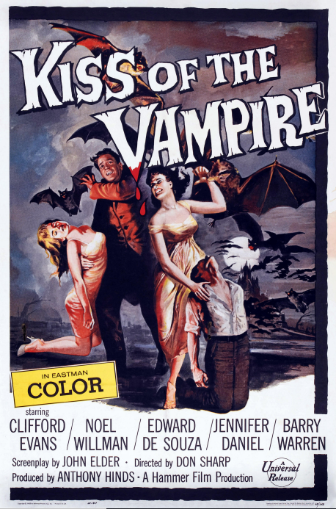
Revision starter
Name 3 VISUAL CODES
Identify 1 visual code on this poster and explain at least 2 ways that the audience might decode it
Which organisation is responsible for regulating the film industry in the UK?

Slide 5
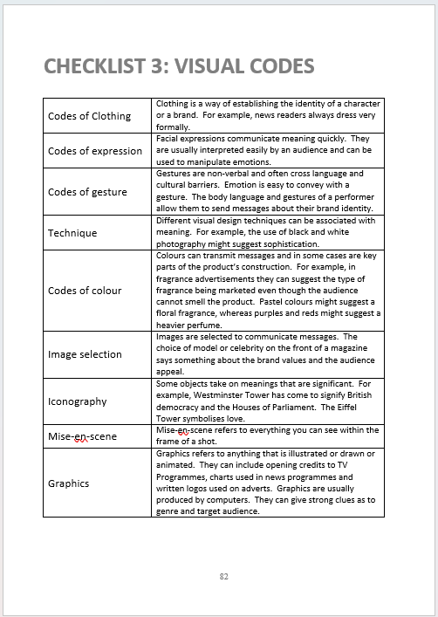
Revision starter: ANSWERS
Name 3 VISUAL CODES
Identify 1 visual code on this poster and explain at least 2 ways that the audience might decode it
Which organisation is responsible for regulating the film industry in the UK?
Name 3 VISUAL CODES
Identify 1 visual code on this poster and explain at least 2 ways that the audience might decode it
Which organisation is responsible for regulating the film industry in the UK?

Slide 6
Today we will use TIDE and SUPERHUMAN texts to study audience
Don’t forget, Tide and Superhuman are also on the syllabus for Com 1 Sec A (media language and representation).
In Sec B, you will only be asked about the AUDIENCE aspect of these texts.

Slide 7
Typical questions
How might audiences interpret and use the media? Refer to the Tide advert to support your points.
How do media producers target audiences? Refer to the Superhuman advert to support your points.

Slide 8
How might audiences interpret and use the media? Refer to the Tide advert to support your points.
The starting point for a question like this is to understand and explain to the examiner who the target audience is for the Tide advert. Then you can give very specific examples of targeting, using the Tide advert.
Context helps you identify the target audience.

Slide 9
Tide advert: Product context
Designed specifically for heavy-duty, machine cleaning, Procter & Gamble launched Tide in 1946 and it quickly became the brand leader in America, a position it maintains today.
The D’Arcy Masius Benton & Bowles (DMB&B) advertising agency handled P&G’s accounts throughout the 1950s. Its campaigns for Tide referred explicitly to P&G because their market research showed that consumers had high levels of confidence in the company.
Uniquely, DMB&B used print and radio advertising campaigns concurrently in order to quickly build audience familiarity with the brand. Both media forms used the “housewife” character and the ideology that its customers “loved” and “adored” Tide.

Slide 10
Tide advert: Historical context
The post-WWII consumer boom of the 1950s included the rapid development of new technologies for the home, designed to make domestic chores easier. Vacuum cleaners, fridge-freezers, microwave ovens and washing machines all become desirable products for the 1950s consumer. Products linked to these new technologies also developed during this time, for example, washing powder.

Slide 11
Tide advert: Social context
Despite women having seen their roles in society change during the War (where they were needed in medical, military support and other roles outside of the home) domestic products of the 1950s continued to be aimed at female audiences.
The likely target audience of increasingly affluent lower-middle class women were, at this point in the 1950s, being appealed to because of their supposed need for innovative domestic technologies and products. The increasing popularity during the 1950s of supermarkets stocking a wider range of products led to an increased focus by corporations on brands and their unique selling points, so that the product would stand out amongst its competitors.

Slide 13
So…the target audience is…
Lower-middle class women
Younger – mothers with children
Increasingly affluent as the result of an economic boom
Materialistic – aspire to own the latest ‘labour-saving’ devices such as washing machines
Proud housewives
How might audiences interpret and use the media? Refer to the Tide advert to support your points.

Slide 14
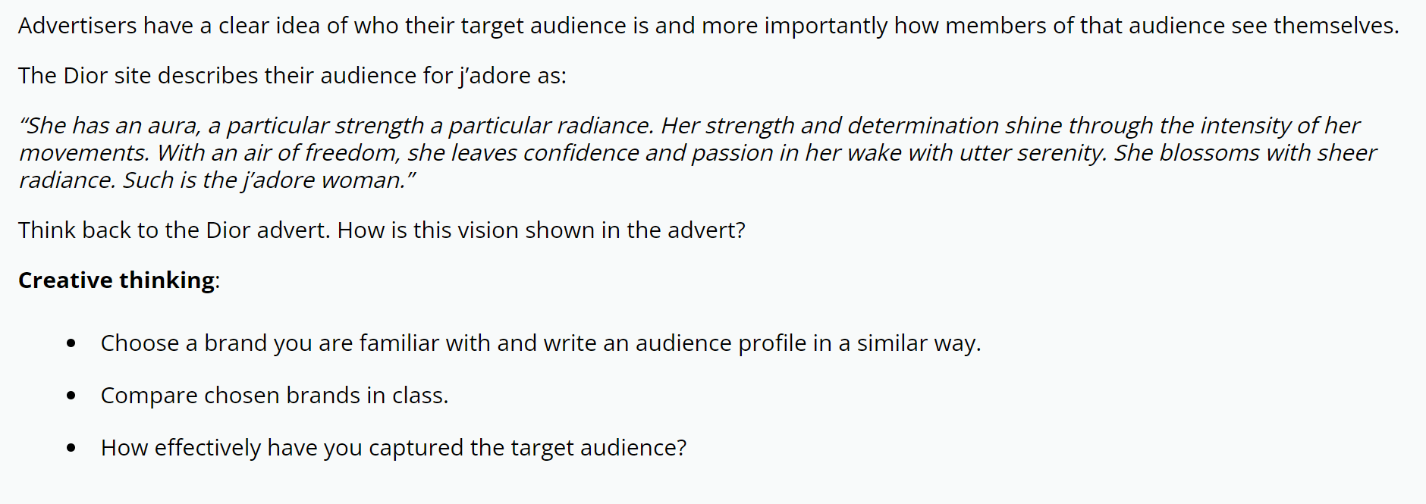
Think like an advertiser: describing the target audience in a more creative way - Dior ‘J’Adore’ advert
J'adore advert 2021
How is it helpful to think like an advertiser when considering audience?

Slide 15
Pause for theory…

Slide 16
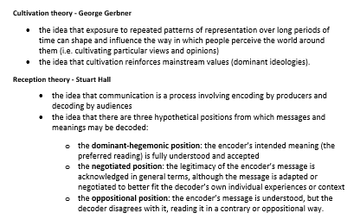
Theories linked to this text:
But, there are other theories you can use to explain how audiences use and interpret media

Slide 17
Uses and Gratifications theory
One way of theoretically explaining how specific audiences are using the text is through Blumler and Katz’s Uses and Gratifications theory.
Media Insider: Uses and Gratifications (3.50 mins)

Slide 18
So which need is the Tide advert fulfilling?
Surveillance
Identity
Relationships
Diversion

Slide 19
Does the fact sheet agree?
‘The likely audience demographic is constructed through the advert’s use of women with whom they might personally identify (Uses and Gratifications Theory). These young women are likely to be newly married and with young families (clothing belonging to men and children on the washing line creates these connotations).’

Slide 20
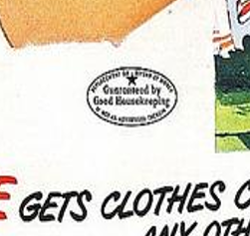
What about how the audience might interpret the text?
What is this tiny detail? How might it affect how the audience interpret this advert?
Opinion Leader – how is this terminology relevant here?

Slide 21
How might these words from the advert affect the audience’s interpretation?
Lexical field – what is the cumulative effect of this lexical field?
What word would you use to describe this lexical field?
Excitable
Romantic
Reliable
Reassuring
Worrying
Emotive
Truly safe
Trust
Miracle
Nothing like

Slide 22
How does the factsheet word it?
‘The endorsement from Good Housekeeping Magazine makes them an Opinion Leader for the target audience, reinforcing the repeated assertion that Tide is the market-leading product.
The preferred reading (Stuart Hall) of the advert’s reassuring lexical fields (“trust”, “truly safe”, “miracle”, “nothing like”) is that, despite being a “new” product, Tide provides solutions to the audience’s domestic chores needs.’

Slide 23
How can Cultivation Theory help us answer this question?

Slide 24
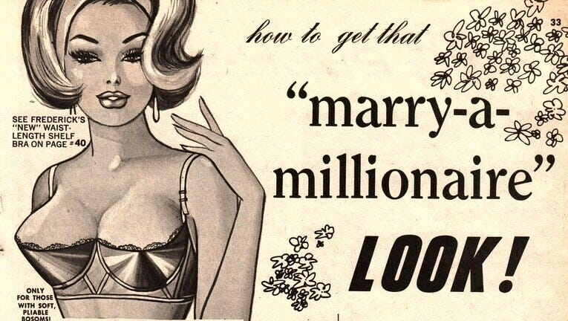
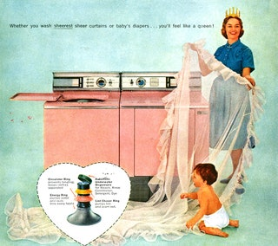
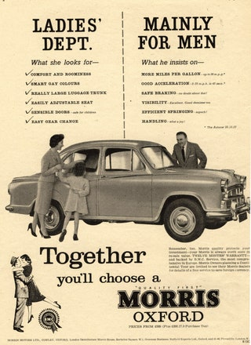
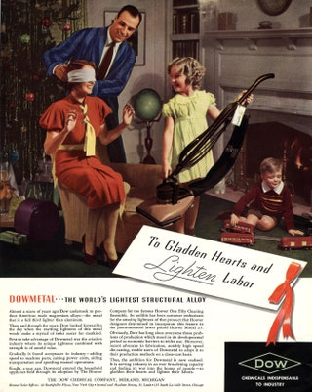
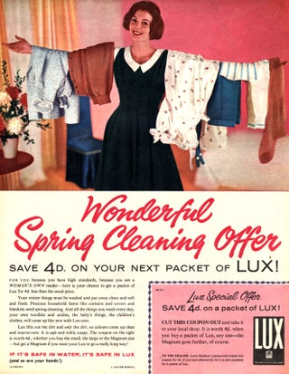
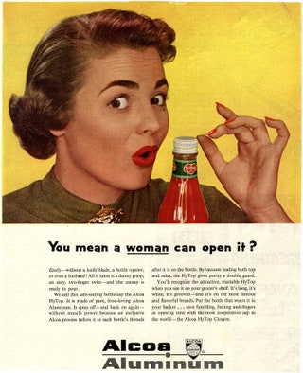
How might the following images of adverts from the 1950s prove or refute Cultivation theory?
Mrs Fisher - Cultivation Theory (1.50 mins)

Slide 25
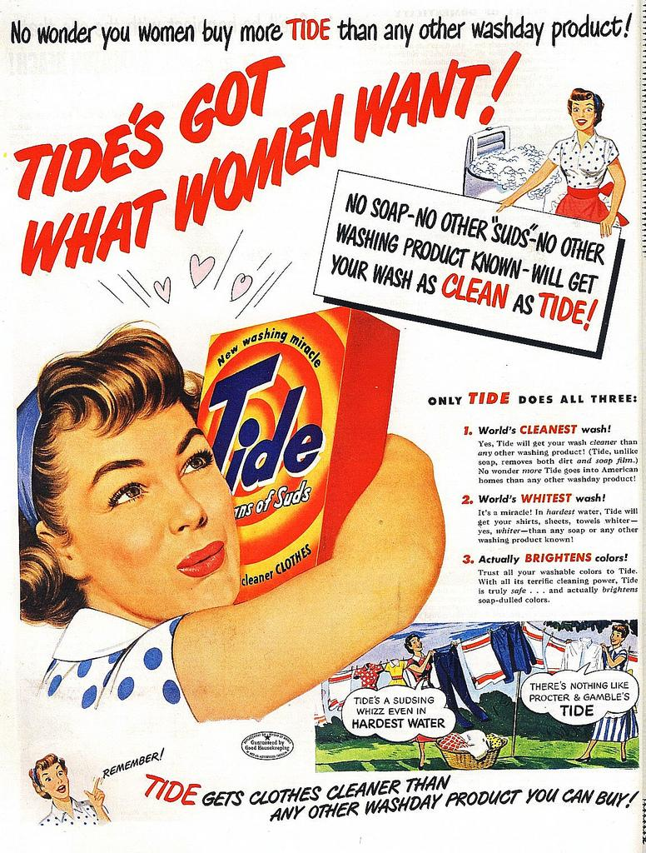
Question: in how many different ways is the message encoded that this is a desirable product for women repeated in this text?

Slide 26
How can Reception Theory help us answer this question?
Media Insider: Reception theory (6.30 mins)
What would a dominant, or preferred, reading look like for the Tide advert? Who would have this reading?
What would a negotiated reading look like? Who would have this reading?
What would an oppositional reading look like? Who would have this reading?
Task: answer the above questions (5 mins silent work)

Slide 27
How might audiences interpret and use the media? Refer to the Tide advert to support your points.
Structuring an answer
General comment about how audiences might interpret media (refer to Reception Theory and Cultivation theory)
Specific examples from Tide for Reception theory: briefly introduce the text and describe the target audience. Then show how a dominant reading is constructed. You could then go on to explain how a modern audience might have a different interpretation.
Specific examples from our lesson today for Cultivation theory. Critique the theory – what are the problems?
General comment about how audiences might use the media (refer to Uses and Gratifications theory)
Specific examples from Tide about how target audience would use this advert (personal identity etc.)
Sentence starters that might help
Audiences interpret media in many different ways, depending on…Reception theory states that…Cultivation theory explores another perspective on audience interpretation, stating that…
The interpretation of the Tide advert is very dependent on who the target audience is. The producers of Tide wanted to target…The target audience would be likely to have a preferred, or dominant reading of the text, and this preferred reading would be…This preferred reading is constructed through the use of …
Interpretation is also affected by the larger media context. In the 1950s there were a lot of adverts that repeated similar messages (give examples). This proves / challenges Gerbner’s Cultivation theory because…This suggests that the interpretation of Tide would have been influenced by…
Audiences use the media in many different ways as well. The Uses and Gratifications model suggests that…
The target audience for Tide would probably be using the advert for… This need would be fulfilled in the advert by…

Slide 28
Task: write the answer to the following question, using all the help provided on the previous slide.
Finish for homework – hand in next Tuesday. No time limits on this one.
How might audiences interpret and use the media? Refer to the Tide advert to support your points.

Slide 33
Can you answer these context questions about Tide?
What is the name of the company that launched Tide?
When was it launched?
What was the name of the advertising company that took charge of the advertising campaign?
What was unique about the types of adverts produced?
Why is it possibly a bit odd that advertising for domestic products after the war still continued to be aimed at women?
What was there a rapid development of after WW2?
How did products attempt to stand out amongst their competitors in an increasingly crowded market?
List three desirable products for the 1950s consumer.

Slide 34
Demonstrate your understanding

