Slide 1
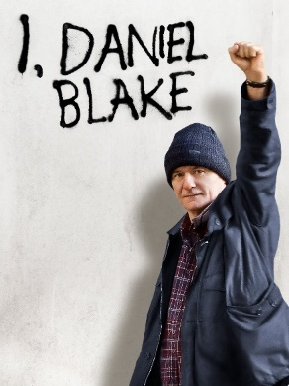
COM 1 SEC B
Industry and Audience
L13: Digital convergence, theory, regulation

Slide 2
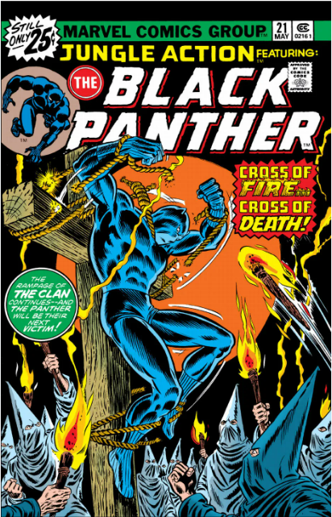
Starter
This is a cover of the Black Panther comic from around 1976
Comments?

Slide 3
Examples of Digital Convergence
The teaser trailer was released in June 2017 by Disney’s sister channel ABC, during NBA Finals.
Within 24 hours it had been viewed 89 million times on Youtube.
Just before release, Black Panther was the most-tweeted about film of 2018 with more than 5 million tweets globally. In mid- March 2018, it became the most-tweeted about film ever with 35 million tweets.
This is an example of how Disney’s TV platform (ABC) worked in synergy with its film studio (Marvel studios) to better promote its product

Slide 4
Not all of the social media convergence would have been welcome to the marketing team…
Inaccurate reporting on Twitter

Slide 5
Questions on digital convergence and marketing
Where and how is film/film marketing most likely to be consumed by audiences?
How has this consumption changed/ been impacted by the internet, including YouTube and smartphones?
Are audiences now more likely to seek out, for example, new trailers online as active consumers? (Think about ‘reaction’ videos of people watching trailers!)
Consider the way people share trailers or movie gossip (casting decisions, plot elements etc.) especially those with a strong fan community. How is this is an example of ‘word-of- mouth’ marketing?
How does this impact the relationship between audience and product?
How did Black Panther harness other, more political social media campaigns to create a ‘cultural event’ rather than just another summer blockbuster? (We covered this yesterday)

Slide 6
BLACK PANTHER: APPLYING THEORY
CURRAN AND SEATON ‐ MEDIA AND POWER
What are Curran and Seaton’s big ideas?
The media is controlled by a small number of companies primarily driven by the logic of profit and power
Media concentration generally limits or inhibits variety, creativity and quality
More socially diverse patterns of ownership help to create the conditions for more varied and adventurous media productions.
SUMMARY: If we had more of a variety of media companies we’d have more of a variety of better quality texts.
How might this theory apply to Black Panther? Does it challenge or reinforce these ideas? Does it do both?

Slide 7
Thoughts about Curran and Seaton
How does the film’s much celebrated diversity challenge Curran and Seaton’s idea that domination by a small number of media institutions limits creativity and variety?
How could the conglomerate model (Marvel as a separate brand to Disney) offer a more complex pattern of ownership than Curran and Seaton describe?
To what extent does the dominance of Marvel in the sci-fi/superhero genre limit theopportunities for alternative, riskier independent films in these genres?

Slide 8
BLACK PANTHER: APPLYING THEORY
HESMONDHALGH – CULTURAL INDUSTRIES
Mrs Fisher Hesmondhalgh
In what ways might the film Black Panther be seen as a commercial risk? (i.e. a risk of losing money and not returning profit)
In what ways might it be seen as commercially safe? (i.e. likely to make a lot of money and return a healthy profit)

Slide 9
Ideas about profit v risk and Black Panther
Further explore the concept of profit in relation to the film industry and in this case specifically to the film franchises.
Often films within a series can become formulaic and lack risk. Is this the case with Marvel Studios? Or Disney?
Explore Hesmondhalgh’s idea that media conglomerates operate across a range of cultural industries by considering the way the film was released as part of a synergy - with fashion, music, videogames, sports tie-ins, even a car!
You might also usefully introduce the idea that this film has a very low risk for the producers. The character of T’Challa and Wakanda were introduced in Captain America: Civil War, the comic is over 50 years old, and all previous Marvel films have been hugely successful.
On the other hand, having such an Afrocentric film could have been seen as a commercial risk, especially outside the USA and Africa.

Slide 10
Finally…regulation
The BBFC (an independent, non-governmental body) classifies film and video releases in the UK. However, local councils have the power to overrule BBFC decisions and rate films differently (e.g. This is England was rated 18 by the BBFC but several councils rated it 15).
The theatrical release of Black Panther gained a 12a certificate. Look at the BBFC website for what constitutes a 12a - why do you think they awarded this to Black Panther?
The film, like many recent Marvel films, features very little romantic drama and no sex or nudity. It is fairly violent, but the combat is fantastical (hard to imitate) and there is a strong moral code to most of the conflict. The film was classified as PG-13 in USA, and similarly in other territories. Why do you think the film was regulated this way, even in countries with stricter rules and censorship like China or India?

Slide 11
And finally – a fun article
https://www.digitalspy.com/movies/a860327/black-panther-2-cast-release-date-trailer-plot-villain-spoilers/
As you look through this, do you have any thoughts about how the second film develops any ideas we have had about the first film?

Slide 18
Admin
Homework: see next slide

Slide 19
Homework: hand in Tuesday 20th Feb
Use this powerpoint to answer the question:
Discussion – how many marks do you think this should be worth?
How did Disney target, grow and maintain audiences for Black Panther both nationally and globally?

Slide 20
Starter: I, Daniel Blake revision Kahoot
https://create.kahoot.it/share/l12-i-daniel-blake-revision/7c082690-db19-4f5a-96be-572874248ec4

Slide 21
Flash forward
At the end of the lesson there will be a vocabulary test. Please make a note of all the words in bold green. These are the terminology words that you need to know for this test.
Do also ask me about other words. I often deliberately use longer words to enrich your vocabulary, so check I know what they mean!

Slide 22
So, what marketing strategies did Disney use to target, grow and maintain audiences?
The ‘360-degree’ – in other words, wherever you looked, you saw Black Panther marketing!
Disney were keen to make the release of the film a ‘cultural’ event, something beyond just another ‘action’ movie. They wanted to lean into the political resonance of the film. Some of the brand association deals helped with this.

Slide 23
Brand Association / Synergy
When one brand ties in with another, aiming to grow the profits and profile of both.
See also…
SYNERGY: The combination of elements to maximise profits within a media organisation or product. For example, where a film soundtrack sells the film and the film sells the soundtrack.
Either term might be used in an exam

Slide 24
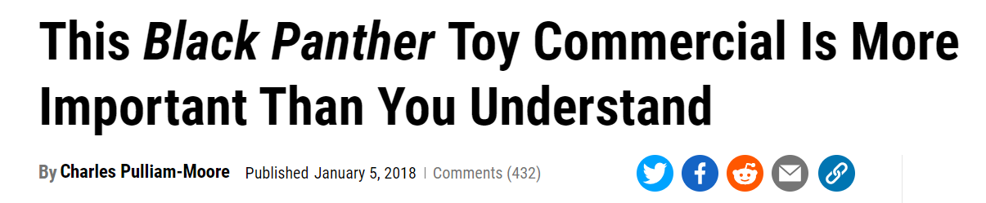
CASE STUDY: Hasbro Toys
Black Panther Vibranium suit advert
Compare it to this, released by Hasbro in the same year: NERF gun advert
This toy advert led to commentary like this (see next slide), which definitely helped to cement Black Panther as a cultural influence…

Slide 25
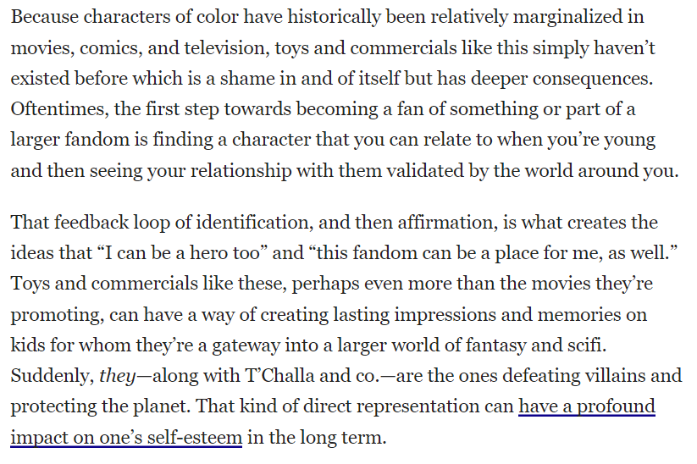
From ‘Gizmodo’

Slide 26
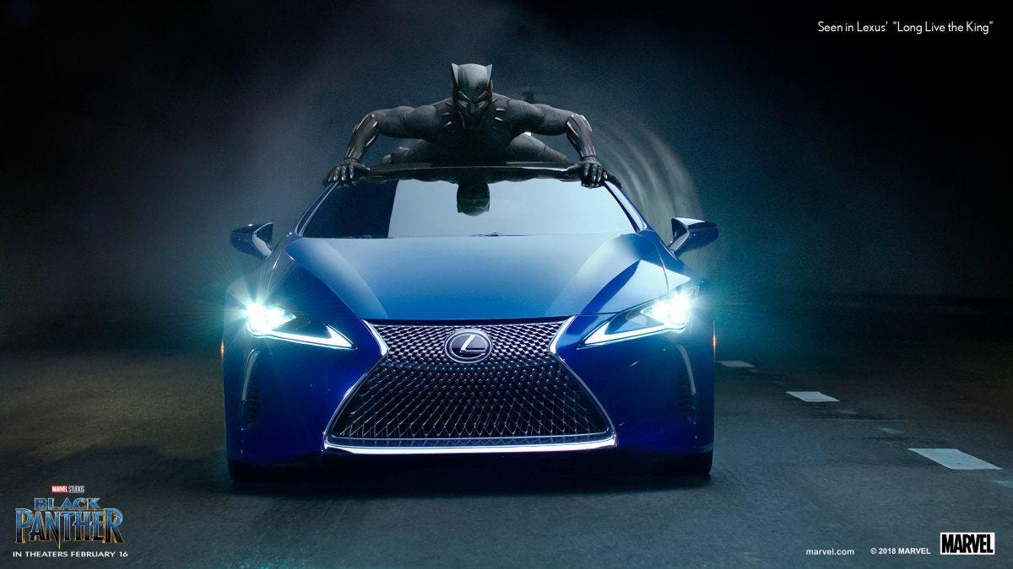
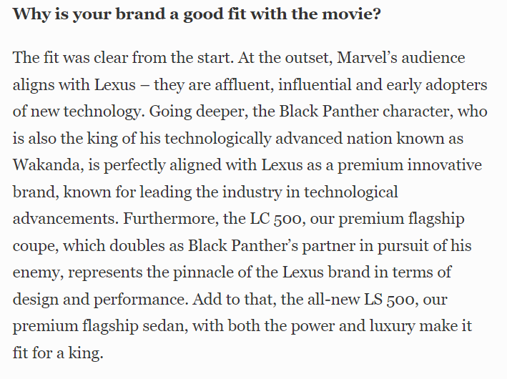
CASE STUDY: Lexus Cars
Extract from an interview in Forbes:
Question: how does the media language in this scene help to endorse the Lexus brand?
Black Panther car chase scene
You’ll notice that this is also sneaky practice for the unseen! We will watch it three times. What might your three notes columns be?

Slide 27
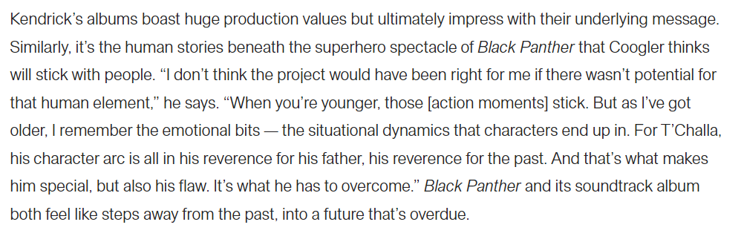
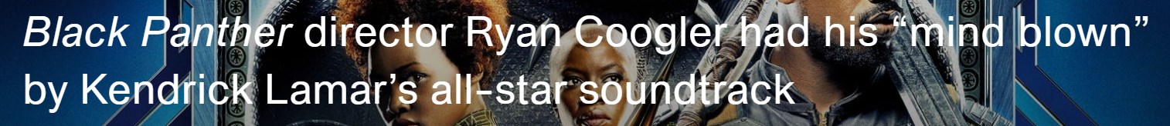
CASE STUDY: Kendrick Lamar
Kendrick Lamar, SZA - All the Stars

Slide 28
More collaborations…
What kind of audiences normally watch these programmes? How are they different to the usual Marvel fanbase?
Black Panther’s teaser trailers were shown between NBA games and a special collaboration with Lexus called ‘Long Live The King’ was shown during the Superbowl.
The film’s release also harnessed a political element to add gravitas. Crowd-funding projects to buy under-privileged children a ticket won support from celebrities; the film was released during Black History Month; plus Coogler, the stars and the costume , hair/make-up , production designers all gave detailed interviews about how the film celebrates African culture.
https://www.theatlantic.com/entertainment/archive/2018/02/why-fashion-is-key-to-understanding-the-world-of-black-panther/553157/
Read this article as an example of one of these interviews.

Slide 29
And more…
Black Panther comes to Fashion Week (3.30 mins)
There was also a ‘Welcome to Wakanda’ catwalk show at New York Fashion Week and features in numerous fashion magazines. (On opening weekend 44% of ticket buyers were female – why would the Black Panther marketing team have been delighted with this?)
Disney are adept at identifying nuanced demographic groups and strategies for targeting them. Many of their products are ‘intercultural’ i.e. they strongly represent one cultural tradition but in a way that resonates with audiences from other cultural / national / ethnic backgrounds. Question: can you see any evidence of that from this clip?

Slide 30
Disney has also done their research…
Disney has used recent Nielsen research to challenge conventional ideas about the ethnic diversity in mainstream America. 53% of Americans live in a multicultural or ‘blended’ household. 67% indicated they were enthusiastic about encountering and experimenting with ‘diverse cultures’.
Question: what are the ‘conventional ideas’ about ethnic diversity that this research challenges?
Question: can you think of any other Disney releases that also challenge conventional ideas about ethnic diversity?

Slide 31
Homework: hand in Tues 20th Feb
In summary:
They used 360 degree marketing
They used synergy and brand association
They thought carefully about where and when to show teaser trailers, for example at the Superbowl
They released it during Black History Month
They use crowdfunding to raise money for charitable donations
They gave lots of interviews about the cultural aspect of the film
They ran a fashion show
Disney commissioned research.
WHICH IS NATIONAL AND WHICH IS GLOBAL?
Use this powerpoint to answer the question:
Discussion – how many marks do you think this should be worth now that you’ve seen how much material there is?
Question: how would this question be worded if it were set for I, Daniel Blake instead?
How did Disney target, grow and maintain audiences for Black Panther both nationally and globally?

Slide 32
Vocabulary – do you know what the following mean?
‘360-degree’ marketing
brand association deals
synergy
teaser trailers
nuanced demographic groups
What other words have we learned today?

Slide 33
Finally…
If we have time, spend it going back through this ppt and following the many links. Have a read of the articles and note down any interesting material that might help you in your exam.

