Slide 1
COM 1 SEC B
Industry and Audience
L2: What is the context of ‘I, Daniel Blake’?

Slide 2
First set text: ‘I, Daniel Blake’
Questions
What are your impressions of the film from the title and the film poster?
What do you think it will be about?
Do you think it’s high budget or low budget?
Notes:
Discussion/spider diagram

Slide 3
Product Context – Learn this!
I, Daniel Blake is an independent social realist film directed by renowned filmmaker Ken Loach (Kes, Raining Stones, Sweet Sixteen etc.).
A UK/French co-production, it received funding from the BFI and BBC Films.
It became Ken Loach’s largest grossing film at the box office (taking over $8 million), was highly critically acclaimed and generated much debate due to the contemporary social and political issues addressed in the film.
I, Daniel Blake was exhibited at many film festivals, won the Palme d’Or at Cannes, and was nominated for many awards including several BAFTAs.
Key words
Independent film
Social realist
Co-production
Acclaimed
Contemporary
Notes:
Discussion/spider diagram

Slide 4
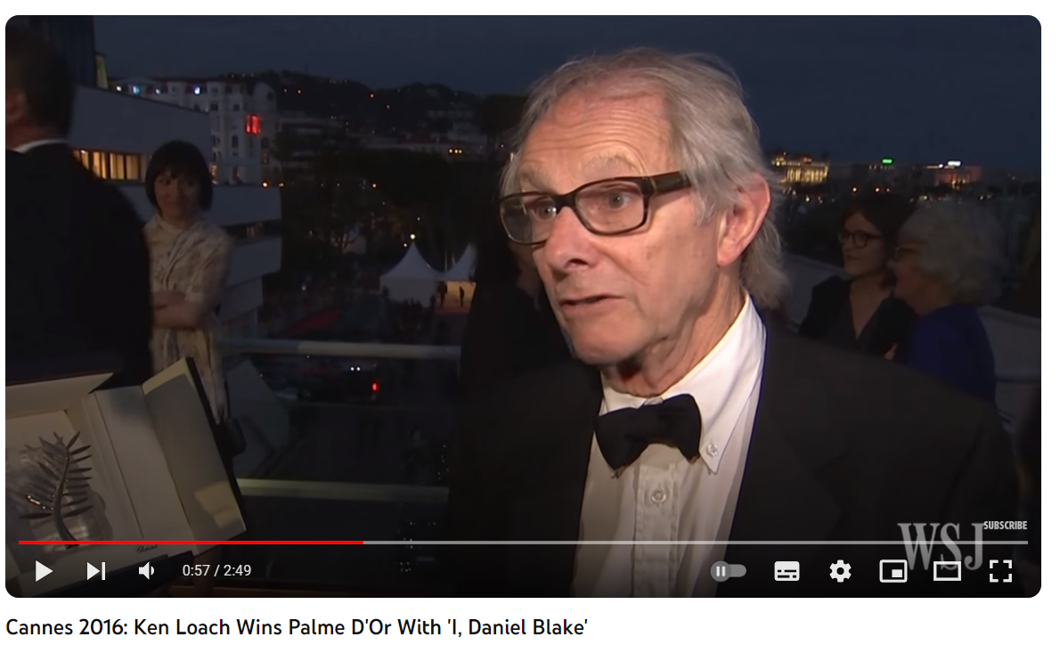
Social and Political Contexts – learn this!
Social and Political Contexts:
I, Daniel Blake addresses contemporary British social issues such as poverty, the welfare system and the Work Capability Assessment. The film portrays a group of traditionally underrepresented characters in Newcastle struggling in poverty to gain benefits and support. I, Daniel Blake conveys a clear left-wing political message and criticises specific government policies. Consideration of the wider economic context and concept of “austerity” might be useful in exploring how changes to benefit policy had been justified.
Much of Ken Loach’s work has addressed similar issues (Cathy Come Home, Raining Stones) and he is a social campaigner, known for his socialist political views. This is important to consider in terms of film production and maintaining audiences (arguably the intended audience for this film is educated, media literate and socially aware).
Ken Loach accepts his Palme D'Or
Notes:
Discussion/spider diagram

Slide 5
Mrs Fisher…watch up to 8.51
Mrs Fisher on I, Daniel Blake and Industry
Notes:
Discussion/spider diagram

Slide 6
We will watch the film. You are not required to watch the films we study, as the focus is industry, but I think it’s important for this one that you understand an unfamiliar genre.
https://www.amazon.co.uk/gp/video/detail/B01M6ZFMCC/ref=atv_hm_wat_7_c_7de9kC_1_1
Notes:
Discussion/spider diagram

Slide 7
Notes:
Discussion/spider diagram

Slide 8
Notes:
Discussion/spider diagram

Slide 9
Notes:
Discussion/spider diagram

Slide 10
Notes:
Discussion/spider diagram

Slide 11
Notes:
Discussion/spider diagram

Slide 12
Notes:
Discussion/spider diagram

