Slide 1
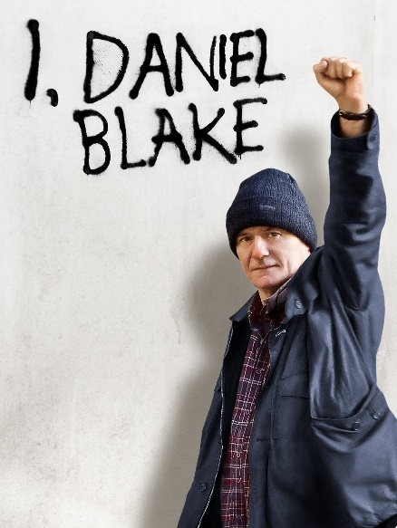
COM 1 SEC B
Industry and Audience
L3: What is the significance of the funding model for ‘I, Daniel Blake’?

Slide 2
Mrs Fisher…watch from 8.51
Mrs Fisher on I, Daniel Blake and Industry
Notes:
Discussion/spider diagram

Slide 3
Before we start on the funding, let’s listen to the motivation…
Ken Loach: 'Life in austerity Britain is consciously cruel,' interview with C4 news

Slide 4
Key words
Remit – an official description of duties and obligations

Slide 5
Where did the money come from for ‘I, Daniel Blake’?
Two places:
The BFI
The BBC
Notes:
Discussion/spider diagram

Slide 6
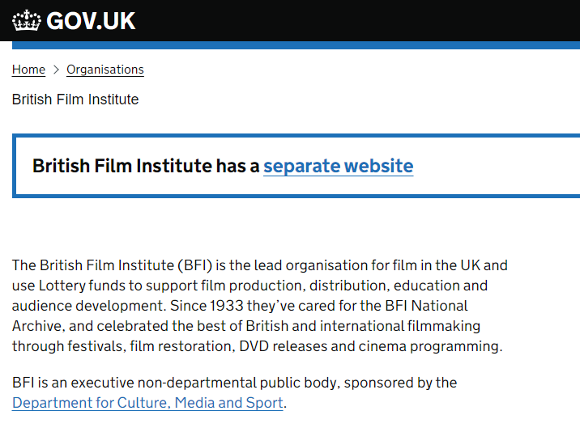
Funding context: the BFI
The BFI is a charity. It is partly publicly funded, through the national lottery and partially funded by commercial activities such as showing films at their famous IMAX cinema in London. This screenshot shows you how closely it is linked to the government department in charge of media. Have a look at the website for yourself.
Notes:
Discussion/spider diagram

Slide 7
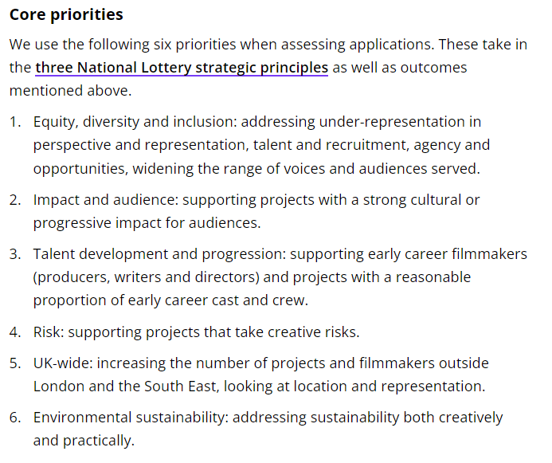
You can only apply for BFI funding if you are a British producer, registered in the UK
How does I, Daniel Blake fulfil these criteria?

Slide 8
Funding context: the BBC
The BBC is a Public Service Broadcaster
Notes:
Discussion/spider diagram

Slide 9
What is a PSB?
PSB stands for Public Service Broadcasting
Public service broadcasters create television and radio programmes that are broadcast to provide information, advice, or entertainment to the public without trying to make a profit
This means that for ‘I, Daniel Blake’ there was no pressure from a private funding partner to create a profit.
Other PSBs include ITV, Channel 4 and Channel 5 and S4C

Slide 10
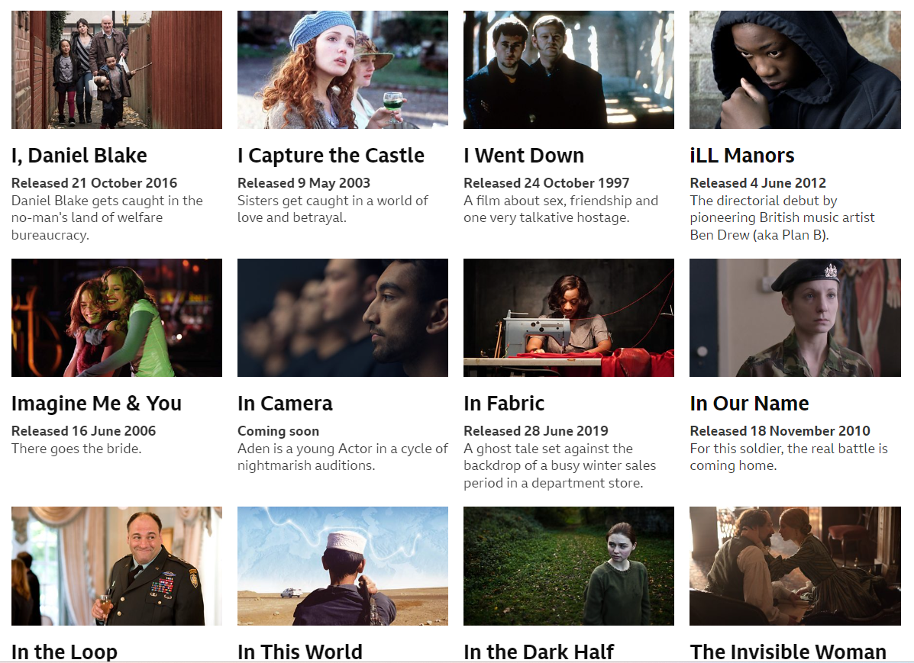
Funding context: the BBC
Go onto the BBC Film website. Do you think the films they produce help to fulfil their ‘public purposes remit’ as shown above? Look at the bullet points for details.
Notes:
Discussion/spider diagram

Slide 11
Tasks for the rest of the lesson
Go back through this powerpoint and do all the tasks listed – check each slide carefully. Make great notes as you do so – make sure this is a useful addition to your notes on IDB. These tasks are marked with a big red arrow
Once these have been done, properly, you may have the rest of the time to work on your media videos
Alternatively, read up on the controversy that ‘I, Daniel Blake’ caused. Understandably, it upset some people. Put I Daniel Blake controversy into a search engine and have a read. Take notes where appropriate.
Notes:
Discussion/spider diagram

Slide 12
Notes:
Discussion/spider diagram

Slide 13
Notes:
Discussion/spider diagram

