Slide 1
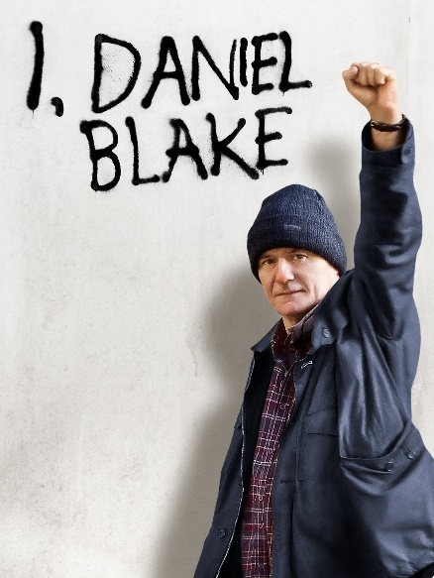
COM 1 SEC B
Industry and Audience
L5: How do media industries create, target and maintain audiences?

Slide 2
Admin
Assessment week information
Reminder: ‘audience’ is not an area of study for IDB
However, industry and audience can overlap and you may well get a question on how industry and audience interact for IDB
You can see this interaction in the learning question for today: how do media industries create, target and maintain audiences?

Slide 3
Starter
On the next two slides, are examples of a COM 1 Sec B question. It is a question based on the last lesson we did last term. You would be expected to refer to the texts you have studied to answer this (film marketing: IDB and Black Panther)
What do you remember?
Where might you find out what you need to know to answer these questions?

Slide 4
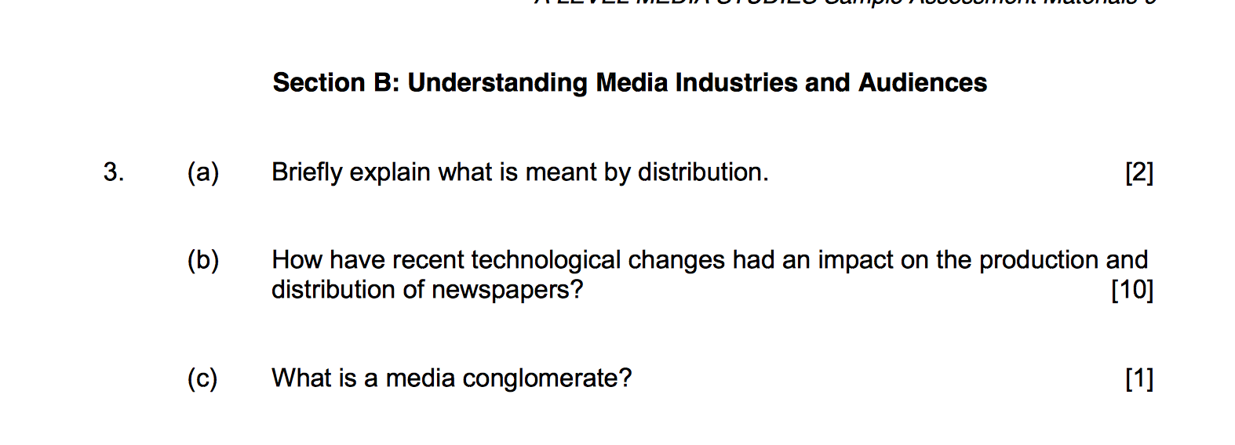
Com 1 Sec B style exam questions
EXAM Question
Marketing?
promotion
of films?
(d) Explain how Independent films can be promoted despite a lesser budget. [12]
NOTE
There is also a question 4 in this part of the paper. It is usually divided into two parts.

Slide 5
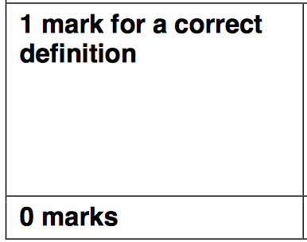
The mark scheme
3a: 2 marks
3b: 10 marks
3c: 1 marks
5 | 9-10 marks Excellent, detailed and accurate knowledge A thorough understanding
4 | 7-8 Good, accurate knowledge A secure understanding
3 | 5-6 Satisfactory, knowledge A reasonable understanding
2 | 3-4 Basic, knowledge A basic understanding
1 | 1-2 Minimal knowledge Minima1, if any understanding
3d: 12 marks
4 | 10-12 marks Excellent, detailed and accurate knowledge A thorough understanding
3 | 7-9 Good, accurate knowledge A secure understanding
2 | 4-6 Satisfactory, knowledge A reasonable understanding
1 | 1-3 Basic, knowledge A basic understanding
0 | Minimal knowledge Minima1, if any understanding

Slide 6
This lesson
We will look at how an audience was created, targeted and maintained.
We will consider the impact of Ken Loach on helping to build an audience
We will consider how the form of marketing materials we have previously studied helped to target diverse audiences
We will consider how the choice of genre helps to build an audience
We will consider how the awards help to build an audience
We will consider how the political angle helped to target and maintain an audience

Slide 7
Exam-style question
How do media industries create, target and maintain audiences? Refer to I, Daniel Blake and Black Panther in your answer. [12]
On the following slides are the sorts of things that you would need to include. They are brief bullet points – your job would be to expand where necessary

Slide 8
How to create/target an audience (IDB style)
Decide on a genre (social realism)
Bring in a well-known director with an established reputation (Ken Loach)
Use marketing that establishes the reputation of the film (reviews on posters, mentions of awards such as the Palme D’or)
Use trailers to highlight the political nature of the film, thereby potentially attracting politically interested, left-wing audiences
Reference the BBC and BFI in marketing materials, thereby targeting audiences who respect, and are knowledgeable about, these institutions
Ensure that marketing is ATL as well as BTL to target an older audience
Show previews for free, with snacks, in accessible places outside of London

Slide 9
How to maintain/grow an audience IDB style
Use social media – prosumers and content creators #wearealldanielblake
Infiltrate other potentially sympathetic audiences (e.g. via the Daily Mirror DPS)
Do interviews – actors, director
Do rousing speeches (Ken Loach at the Palme D’or awards)
Get politicians to refer to the film in the Houses of Parliament
Light up the side of the Houses of Parliament with promotional material – causing controversy

Slide 10
In an COM 1 exam you would have about 12 mins to expand all of this into an answer.
Task: using the bullet points already discussed, answer the following:
How do media industries create, target and maintain audiences? Refer to I, Daniel Blake in your answer. [12]
You will have 12 mins (15 for extra time)
For those of you who do not have extra time, here is your three minute task:
Briefly explain what is meant by ‘marketing’ [2]
What is a conglomerate? [1]
Let’s SWOT it first

Slide 16
SOME REMINDERS Component 1 : Section B Understanding Media Industries and Audiences
In this part of the exam, you are demonstrating knowledge and understanding of key aspects of media industries, including
The significance of ownership and funding.
Regulation
Production and distribution
The impact of digitally convergent platforms
The effect of individual producers on media industries
Audience
The film component (which we are currently studying) is only studied in relation to media industries.

Slide 17
Film – Cross Media Study I, Daniel Blake & Black Panther
Film is to be studied in relation to industry only.
What you will learn:
The films’ marketing across across various media
Explore convergence of media platforms and technologies
How the two films reflect contrasting aspects of the film industry (mainstream and independent)
Develop an awareness of the films as contemporary examples of the film industry and the marketing strategies used.
Understanding of digital and non-digital marketing strategies.
Question: what have we already covered?

Slide 18
Marketing Strategies
Marketing is Film promotion, which is the practice of promotion specifically in the film industry, and usually occurs in coordination with the process of film distribution.

Slide 19
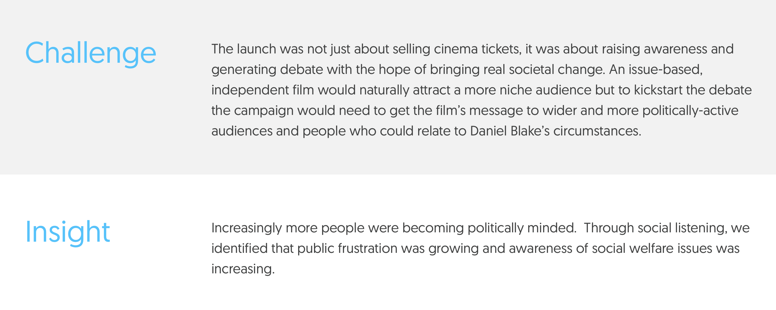
What were the challenges for marketing this particular film?

Slide 20
Above The Line Marketing
Below The Line Marketing
Above The Line (ATL) advertising is where mass media is used to promote brands and reach out to the target consumers. These include conventional media as we know it, television and radio advertising, print as well as internet. This is communication that is targeted to a wider spread of audience and is not specific to individual consumers. ATL advertising tries to reach out to the mass as consumer audience.
Below the line (BTL) advertising is more one to one, and involves the distribution of pamphlets, stickers, promotions, brochures placed at point of sale, on the roads through banners and placards. It could also involve product demos and samplings at busy places like Shopping centres and market places.

Slide 21
Marketing Strategy: Traditional method
https://www.youtube.com/watch?v=ahWgxw9E_h4
How is a trailer an example of above the line marketing?
Where can trailers be watched?
Why is traditional marketing (such as a trailers) still important for such a film? (consider target demographic)

Slide 22
Marketing Strategy: Traditional method
Film posters
Why are posters still a highly successful marketing method?

Slide 23
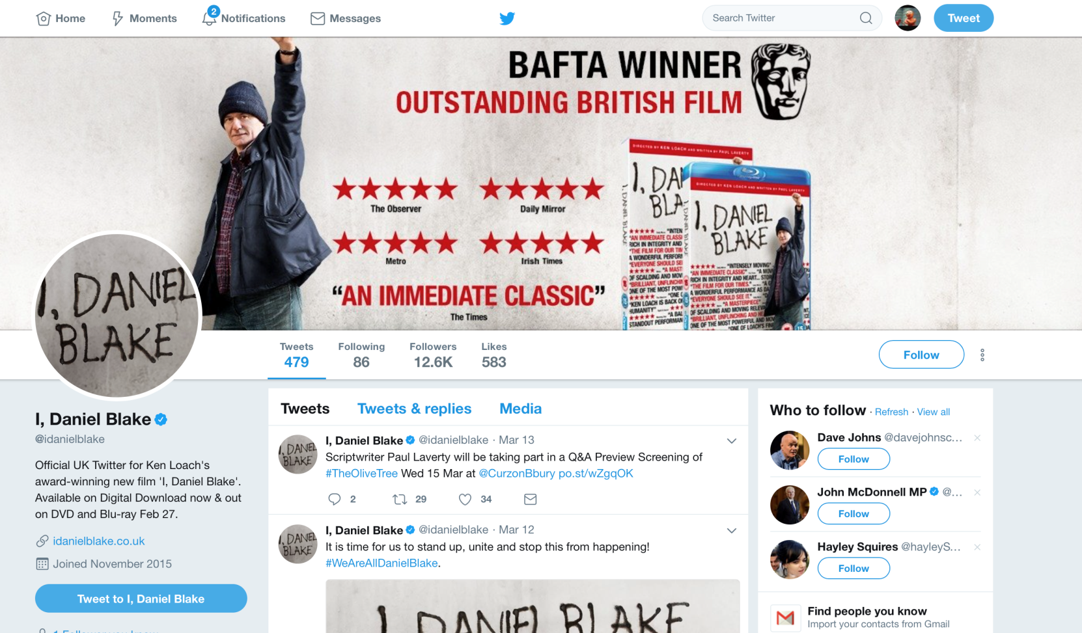
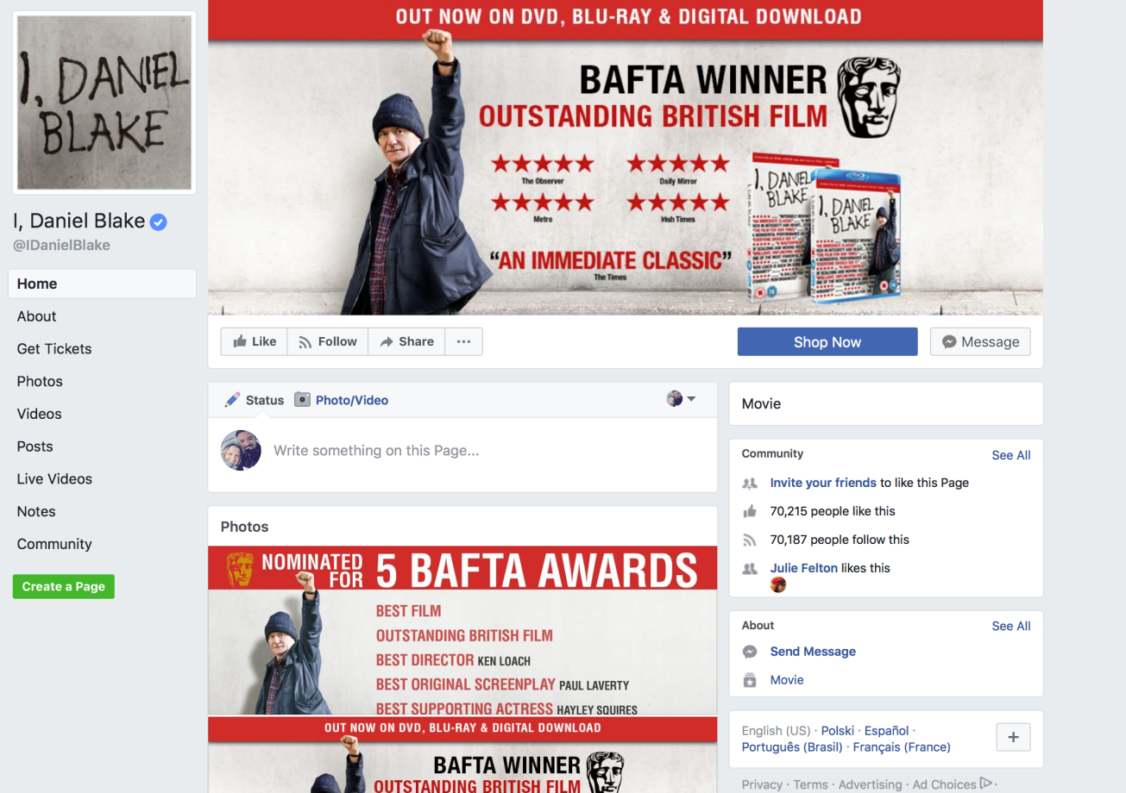
Whereas social media would have previously been considered below the line, X & FB have become over the line.
Why do you think this is?

Slide 24
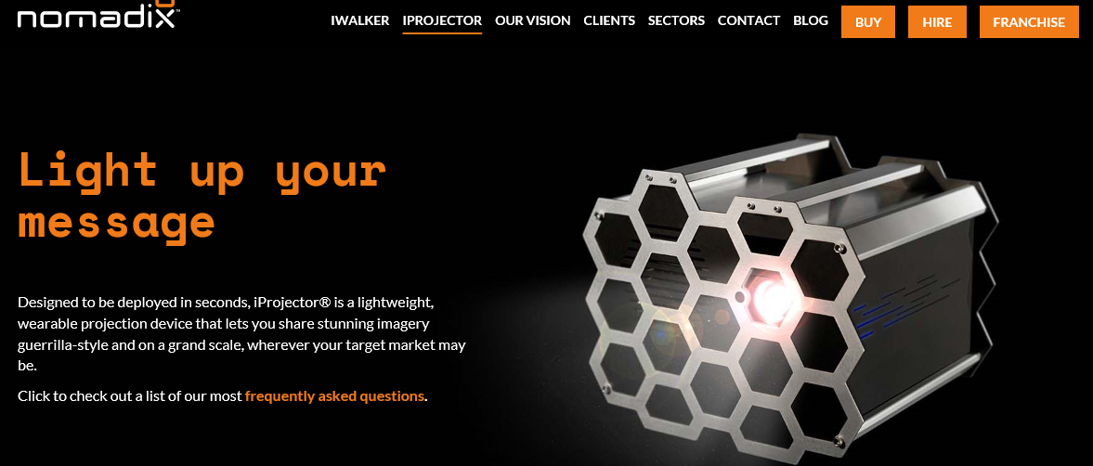
Marketing Strategy. Guerilla Marketing
Guerrilla marketing is an advertisement strategy concept designed for businesses to promote their products or services in an unconventional way with little budget to spend. This involves high energy and imagination focusing on grasping the attention of the public in more personal and memorable level.
Under the cover of darkness, using stealth and speed NomadiX Medias' iProjector®, we brought the streets across the U.K to a standstill.
This latest guerrilla marketing incursion by NomadiX used the power of outdoor projections to capture attention and get people talking about the launch of this year’s Palme d’Or winner; "I, Daniel Blake"
Nomadix promo video

Slide 25
I, Daniel Blake
| Our Latest Guerrilla Marketing Campaign
Under the cover of darkness, using stealth and NomadiX Medias' iProjector, we brought the streets across the U.K to a standstill.
This latest guerrilla marketing incursion by Kommando used the power of outdoor projections to capture attention and get people talking about the launch of this year’s Palme d’Or winner; The powerful movie "I, Daniel Blake" by Ken Loach.
‘About Us
Born in 2000 in a brave new world of non-traditional marketing we've evolved into a pioneering experiential agency with global experience across 17 countries.
Our core value: Always resist the ordinary guides our passion to create powerful experiences that amaze and get people sharing in connected digital ways. Our values and innovation-led culture shape us today into a fearless yet highly professional bunch with a few awards, who believe creativity only flourishes when ideas are made into reality.’

Slide 26
Below The Line Marketing-why use it?
BTL advertising uses less conventional methods of advertising that the specific channels of advertising that may or may not be used by ATL advertising to promote products and services.
BTL is a preferred tool when test marketing a product and when the target audience is very niche.
BTL is sometimes preferred over ATL due to budget issues, the need to physically display the product and for new launches and teasers campaigns- adopting BTL to reach out to target consumers when their product is something they need to engage the audience with.
When you are communicating with a niche audience BTL is better. However, digital media has more or less broken these boundaries of ATL versus BTL as digital communication can address both at the same time.
Through the Line integrates both ATL and BTL activities.
Other BTL activities could include roadshows and vehicles with promotional staff interacting with people demonstrating the product and distributing literature on the product.

Slide 27
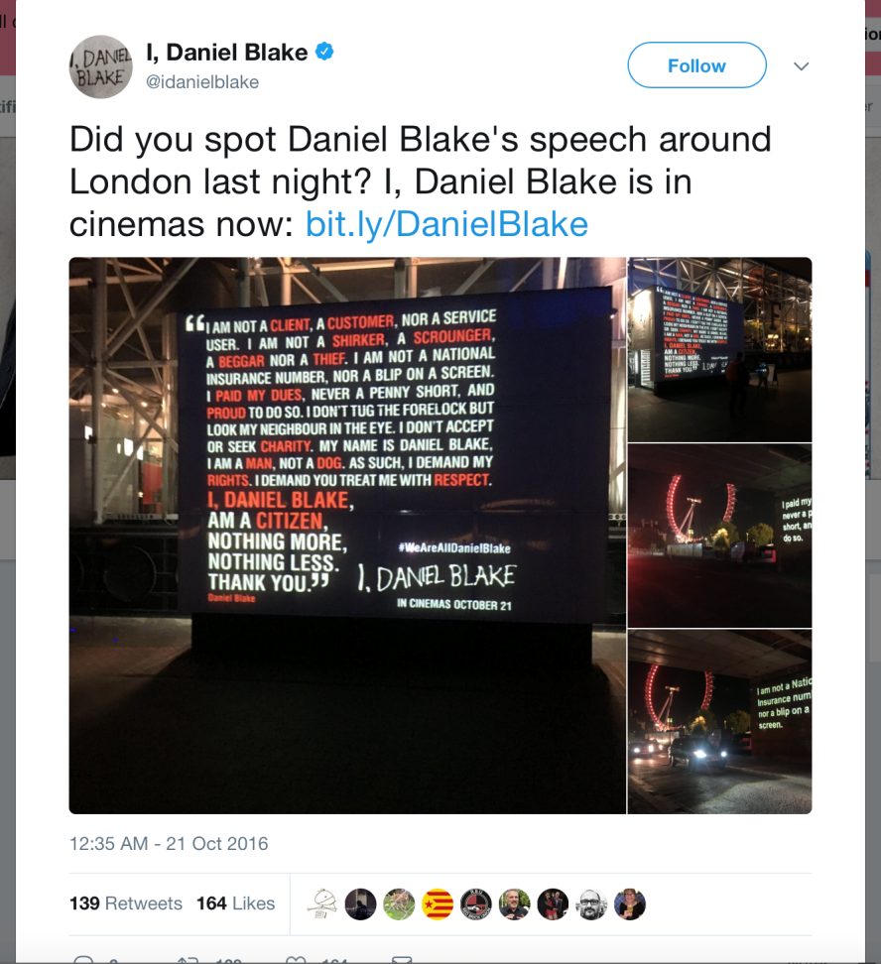
GRASSROOTS CAMPAIGN MANAGER (Jo Taylor)
‘In autumn 2016 I worked as the Grassroots Campaign Manager for the theatrical release of Ken Loach’s Palme D’Or winning feature I, Daniel Blake. The film was released in UK cinemas on 21 October 2016.
Managing five Regional Marketing Officers around the UK (in Scotland, the North East of England, the North West of England the North of England and the Midlands), I coordinated the delivery of their grassroots campaigns through specialised below the line activity in order to achieve a strong community engagement for local audiences.
Bespoke activity included taste maker screenings, street marketing, 'takeovers' of regional cinemas plus innovative activity including the I, Daniel Blake speech video which was seeded with local stakeholders and organisations and outdoor projections in key cities.’

Slide 28
Marketing Strategy:
I Daniel Blake speech.
This is a speech that was shared via social media, shown in cinemas at the time of the film. It also featured prominent figures like Jeremy Corbyn (leader of the Labour Party).
Why is this method an effective form of advertising for this particular film?
https://www.youtube.com/watch?v=NjxRIax5AIs

Slide 29
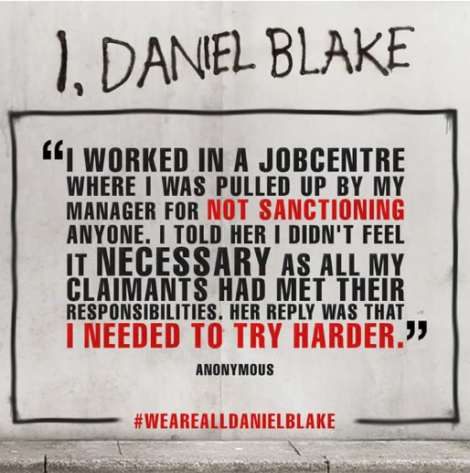
The internet has impacted heavily on the marketing of smaller, independent films like I, Daniel Blake., allowing active audiences to form debates and create forums to address equal rights within the UK.
The internet and online marketing also allowed interactive audiences to join in with the #WeAreAllDanielBlake campaign, creating blogs, vlogs, Youtube videos and artwork (all User Generated Content – UGC) describing their similar experiences or opinions on the matter.
The prosumers became real agents of social change in the way the media reported the impact of this film – the audience were marketing the film FOR the film distributer, through viral marketing, as audiences were actively seeking out this material.

Slide 30
Marketing part 2
Admin
I will set holiday work next week, which will also count for this week’s homework.

Slide 31
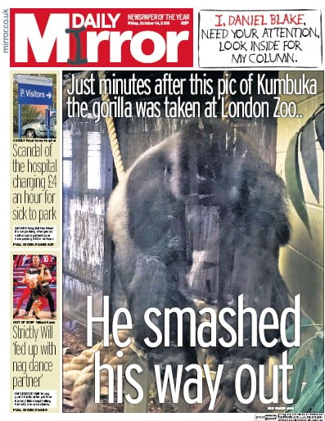
The Mirror Campaign

Slide 32
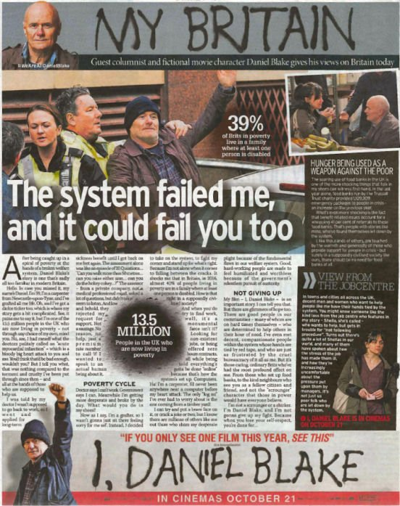

Slide 33
The company behind the Mirror Campaign
http://www.trinitymirrorsolutions.co.uk/invention
We’re Trinity Mirror Solutions - the national sales arm for Trinity Mirror and our independent publishing partners. Part of one of the largest multimedia publishers in the UK, we reach 27m people every week.
Our audience is the gatekeeper to Modal Britain. They are the modern mass market. The middle 50% of the population. Our tailored advertising solutions, which utilise our unique National and Regional, print and digital media products, are developed specifically for them.
We listen to our audience and we stand up for the things that they care about. Our audience allows us to help shape and reflect their views and we feel privileged for that.
Under the new set-up TMS will provide well integrated and creative solutions for clients across Trinity Mirror’s portfolio.
James Wildman, Chief Revenue Officer, TMS, said: “Solutions is our commitment to our customers - we will solve not sell - and represents our ability to produce valuable marketing answers to all briefs by leveraging our influential and iconic brands and audiences across print and digital.
“The Mirror is a national power brand, one of the fastest growing in the UK, with global reach and a campaigning voice and editorial differentiation as the intelligent tabloid.
“Trinity Mirror is a cornerstone of the regional and local press and our compelling proposition offers advertisers valuable engagement with local communities in a highly trusted context.

Slide 34
eOne – the company that distributed I, Daniel Blake
eOne – I, Daniel Blake
AWARDS
Drum Content Awards 2017
Winner: Best Use of Print in a Content Marketing Campaign
Highly Commended: Best Branded Content Campaign
Highly Commended: Best News/Media/Publishing Content Marketing Strategy/Campaign Background
eOne approached Trinity Mirror to promote Ken Loach’s Bafta award-winning film, I, Daniel Blake. The award-winning film follows the story of Daniel, a sick joiner in the North East, & Katie, a single mother of two, as they navigate the red tape of the benefits system, highlighting the social injustices they face everyday.
Our brief was to raise awareness of the film & generate conversation around the main themes, positioning it as a must-see release with a potent social message.
CHALLENGE
We know that Modal Britain is a cinema loving audience – our challenge with I, Daniel Blake would be to get them to see & pay for a film that isn’t an action packed blockbuster. However, we also know that our audience are socially & culturally conscious & want to change things for the better. 60% believe we should actively strive for equality for all; behind this is the belief that it’s everyone’s responsibility to be well informed & to do the right thing. Therefore, the story of I, Daniel Blake would resonate strongly with our audience’s strong & passionate beliefs.

Slide 35
What eOne did
SOLUTION
The themes & content of I, Daniel Blake aligned perfectly with Trinity Mirror’s editorial news agenda. We’ve got a history of standing up for what is right & supporting good causes that affect us all. After seeing I, Daniel Blake for the first time, we were sure that this was a film that would really resonate with Trinity Mirror’s socially conscious audience. This gave us an opportunity to offer and promote preview screenings around the UK (giving away 10,000 tickets), with our iconic regional titles perfectly placed to start stimulating early interest in I, Daniel Blake’s wider story.
Our full creative approach was to then communicate the film’s powerful messages by giving the title character a voice on our many platforms. We wanted to echo the frustrations shared by the character and the many millions of real-life “Daniel Blakes” who find themselves let down by the failings of Britain’s welfare state. Masthead and front-cover takeovers saw Daniel literally making his mark across some of the UK’s biggest and most iconic news titles, instructing readers to take note of his plight. We gave Daniel his own one-off column inside – based on the Mirror’s brilliant weekly series Real Britain. In “My Britain”, Daniel was given a platform to talk frankly about the important issues raised within the film that also affect millions of real life Brits.
Digital content continued the theme and utilised disruptive display advertising to give Daniel Blake a voice across Trinity Mirror’s digital portfolio. Supporting content also celebrated the positive impact films like I, Daniel Blake can have on society, paying particular attention to the achievements of its director Ken Loach.

Slide 36
How successful was this campaign?
RESULTS
Using our in-house, bespoke campaign measurement tool ARQIVE (Audience Reach, Quality, Impact and Value evaluation) we could measure the effectiveness & success of our campaign against press industry benchmarks:
The campaign saw an overall editorial approval rating of 75% (24% loved it & 51% liked it). 76% found the content interesting, beating the industry benchmark by 22ppts.
53% of Trinity Mirror readers said the “My Britain” column made them reflect on their own experiences:
“It was very interesting and something I understand, being in the same situation myself.” Viki, 51
“It’s a true reflection of what is happening in this day and age.” Michelle, 44
The digital native article saw over 18k page views, with audiences spending around 4 minutes reading the content. It was shared over 5,000 times online, including by Ken Loach himself on his personal Twitter feed!
The bespoke overlay format online saw over 400k impressions with a 10.65% CTR – absolutely thrashing the industry average of 0.29%. (Click-through rate (CTR) is the ratio of users who click on a specific link to the number of total users who view a page, email, or advertisement. It is commonly used to measure the success of an online advertising campaign)
Overall, 57% of our audience said they wanted to watch the film as a result of the campaign

Slide 37
Video ad overlays
Both Internet and mobile advertising are growing outlets for marketers who seek to capture the attention of people who are obtaining greater amounts of information through use of the Internet and using mobile-phone devices. Video ad overlays are a relatively new online advertising format developed to monetize web-based video content.
How does it work?
Video ad displays are advertised across online videos monitors as a small semi-transparent banner, typically across the bottom of the screen. The ad banners appear during the course of a video's broadcast, displaying streaming ad units to the viewer of the video content. The viewer has the option to click on the ad space to open up a larger advertising display content or for redirect to the advertiser's website. There is also the option to click a box that makes the ad display from the video display.

Slide 38
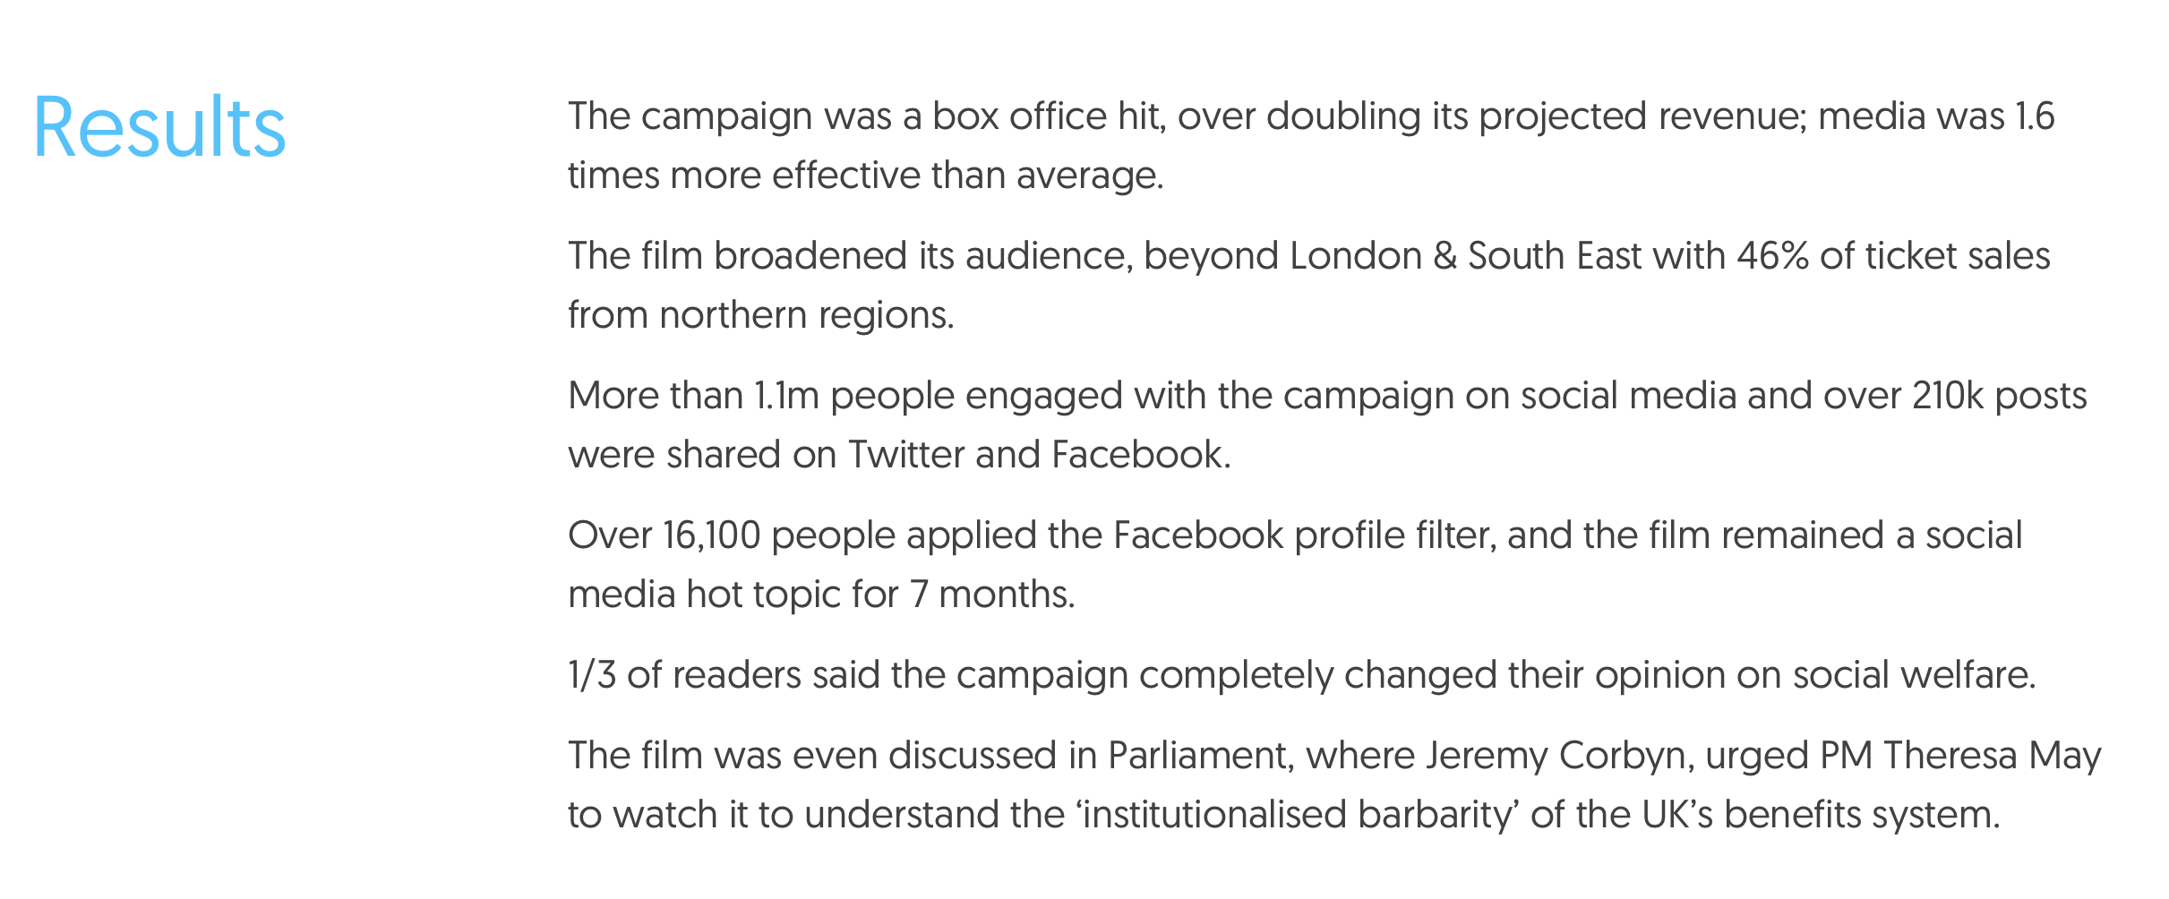
So how did the whole campaign go?

Slide 39
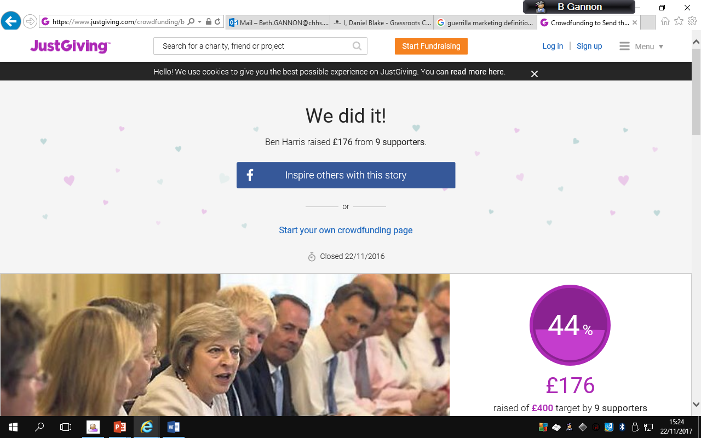
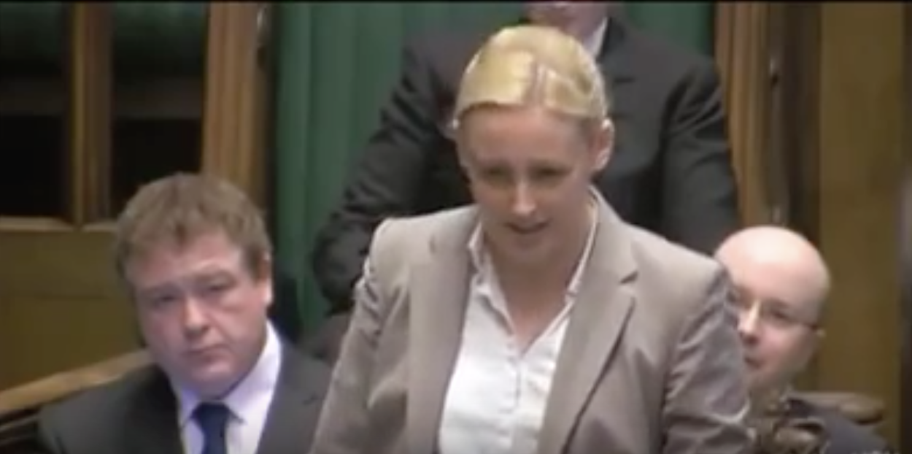
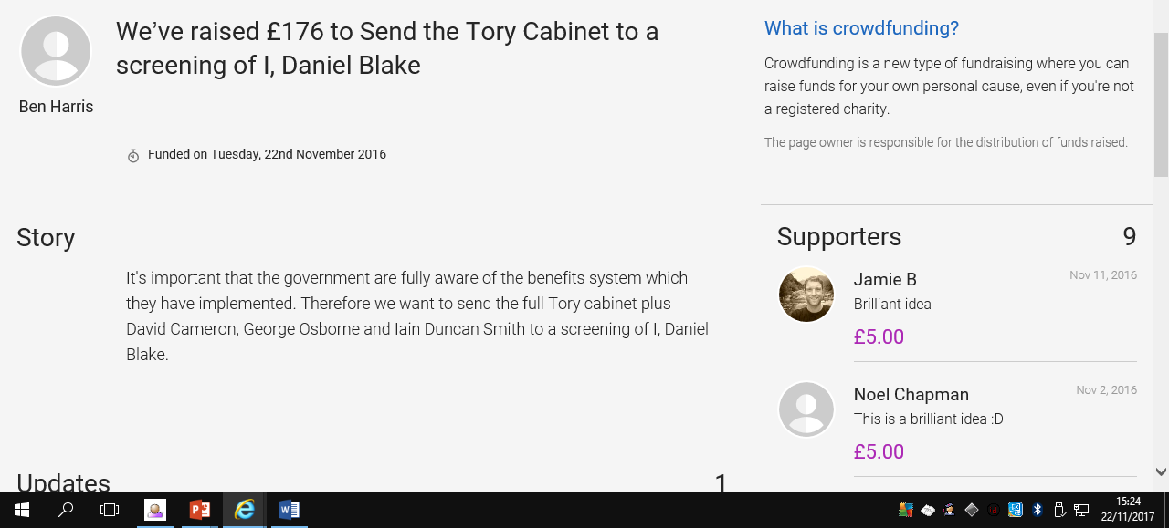
Other Campaigns
https://www.youtube.com/watch?v=Nv0WY2TJnvM
Speeches in parliament
Crowdfunding campaigns

Slide 40
Task: summarise the film promotion methods used. Divide them into ABL and BTL.
Give your summary a sensible title and file it along with the rest of your notes.

