Slide 1
COM 1 SEC B
Industry and Audience
L12: Newspapers – Introduction to the set texts

Slide 2
In this part of the syllabus, you will study both INDUSTRY and AUDIENCE
Theories for The Daily Mirror and The Times(newspapers)
Industry:
Power and Media Audiences (Curran and Seaton)
Regulation (Livingstone and Lunt)
Cultural Industries (Hesmondhalgh)
Audience:
Cultivation Theory (Gerbner)
Reception Theory (Hall)
End of Audience (Shirky)

Slide 3
We will be looking at print copies of the papers in question as well as the online versions.

Slide 4
Key concepts
News values, or Newsworthiness (see handbook, page 92)

Slide 5
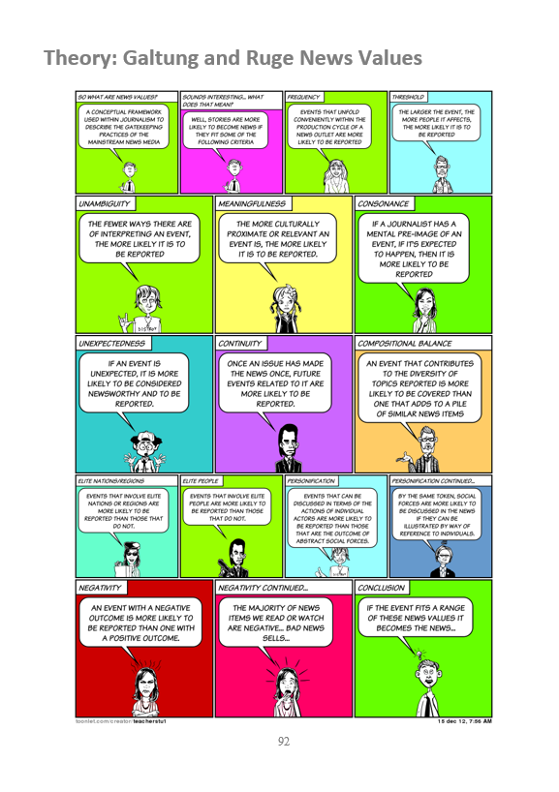
A summary of NEWS VALUES is on P92 of the latest media handbook

Slide 6
So, you want to work in news? Today’s lesson might put you off…

Slide 7
Newsworthiness & News Values

Slide 8
News Media
Newsworthiness
Not all news is created equal.
To make it onto the screen or into a newspaper, somebody must decide that the news is worthy. In media theory this is called news values.
The person who makes the decision is referred to as the gatekeeper.

Slide 9
News Media
Newsworthiness - Gatekeeping
Gate
Source of News
Audience

Slide 10
News Media
Newsworthiness
The gatekeeper of each media business is not impartial – they all have personal interests and commercial pressures that will affect their decisions. This is called their agenda.
It is impossible to present a completely impartial, factual version of the news.

Slide 11
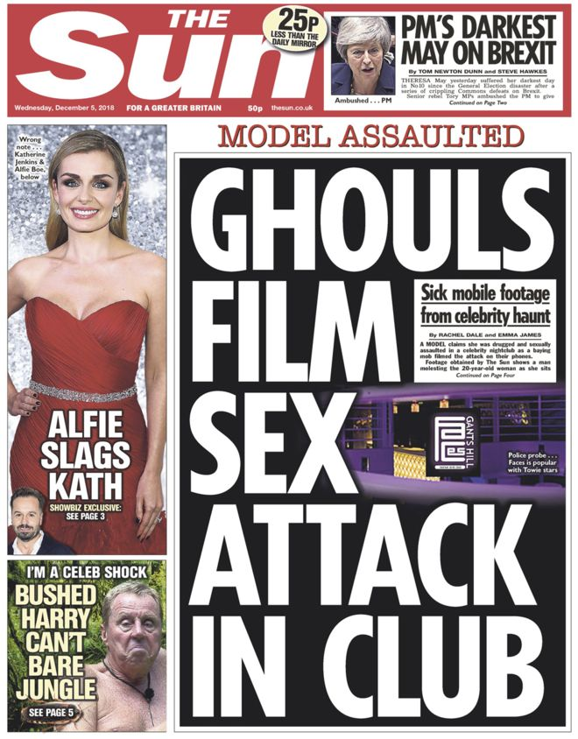
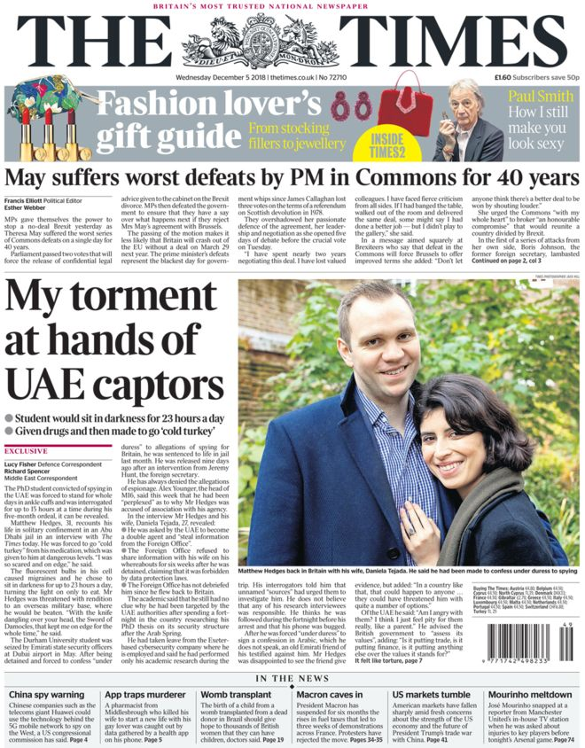
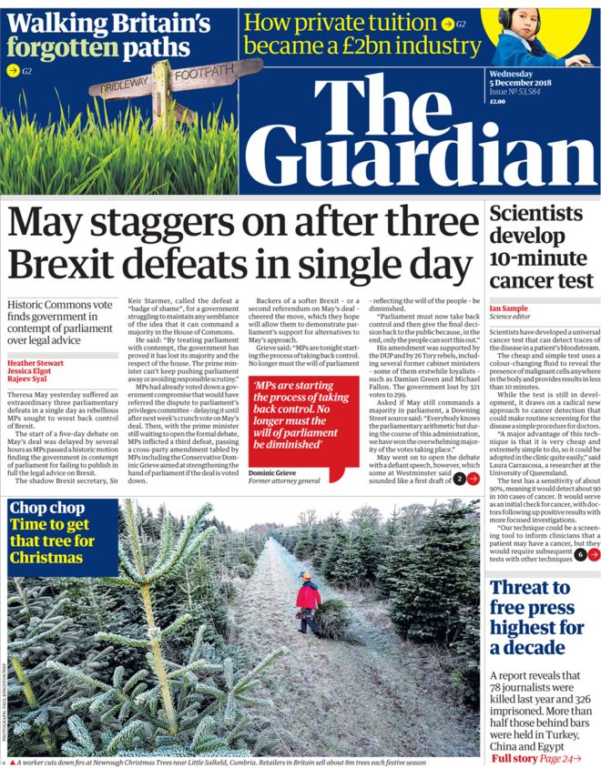
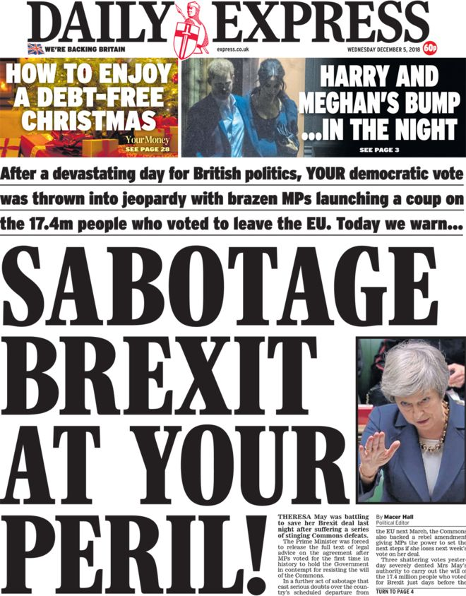
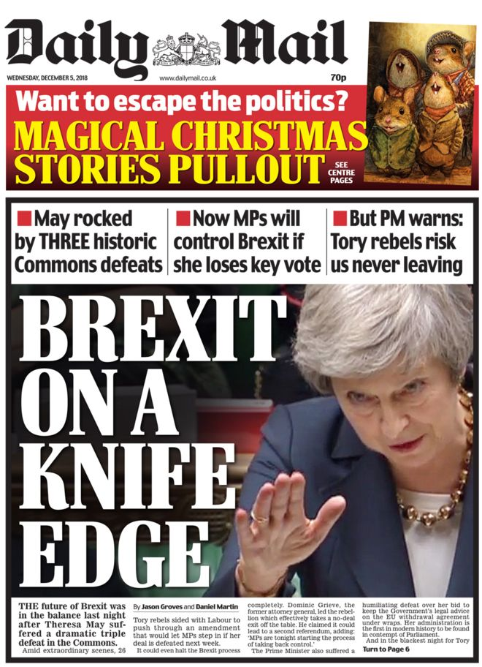

Slide 12
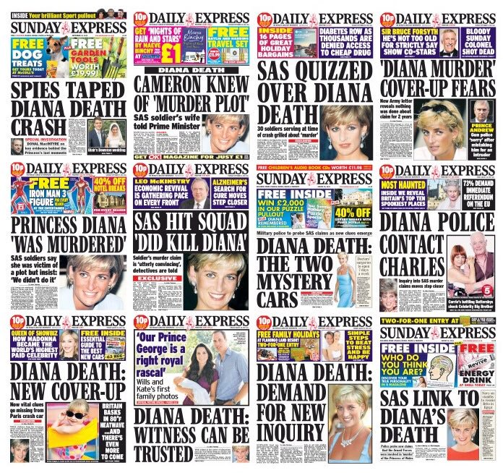

Slide 13
News Media
Newsworthiness
You will find dozens of different definitions of what makes a story newsworthy depending on where you look, but we are going to use the following categories:

Slide 14
News Media
Newsworthiness
Unexpectedness
Elite nations/people
Threshold
Continuity
Negativity
Unambiguity
Personalisation
Proximity

Slide 15
News Media
Newsworthiness
Unexpectedness
How unlikely is the event?

Slide 16
News Media
Newsworthiness
Threshold
What is the scale of the event?

Slide 17
News Media
Newsworthiness
Negativity
How bad is it? Bad news is better than good news.

Slide 18
News Media
Newsworthiness
Personalisation
‘Human interest’. Does the story touch the audience on an emotional level?

Slide 19
News Media
Newsworthiness
Elite nations/elite people
How close are we (politically) to the country/people in the story?

Slide 20
News Media
Newsworthiness
Continuity
Is this a continuation of another story?

Slide 21
News Media
Newsworthiness
Unambiguity
How clear is the impact of the story?

Slide 22
News Media
Newsworthiness
Proximity
How close (geographically) are we to the location of the story?

Slide 23
News Media
Newsworthiness
Unexpectedness
A bomb explodes in Paris, 2 people are killed
The grave of a Viking is found in Egypt
The Arabian oil fields run dry
Michael Jackson is discovered alive in Hollywood
Queen Elizabeth II gives birth

Slide 24
News Media
Newsworthiness
Threshold
A bomb explodes in Paris, 2 people are killed
A firework is thrown at a group of people in Paris, 1 person is slightly burnt
A protest in Cairo becomes violent, 9000 people attended, 11 people are shot
A peaceful protest occurs in Cairo, 500 people attended
President Trump resigns
The President of Burundi resigns
Foot and Mouth Disease is discovered in Germany. A mass cull of animals is initiated
A small pocket of cat flu is discovered in Southampton. A few cats have caught a sniffle

Slide 25
News Media
Newsworthiness
Negativity
A bomb explodes in Paris, 2 people are killed
French figures show a 1.2% rise in employment compared to 2017
A chemical leak in Nigeria kills 12 and leaves 250 people homeless
A new university opens in Nigeria with state-of-the-art facilities and creates 1200 new jobs
Danny Dyer punches Stephen Fry in the face at an awards show
Downton Abbey wins 3 awards at the International Emmys
3 people are infected with a serious stomach infection at a Nottingham hospital
Funding for cancer care in England and Wales increases by a higher rate than inflation for the 30th straight year

Slide 26
News Media
Newsworthiness
Personalisation
One of the men killed in the bomb blast in Paris had previously survived the Bataclan massacre in 2015
Prince William and the Duchess of Cambridge are expecting their 4th child
The world’s oldest man dies in Tokyo
A pile of postcards from 1941 are discovered in a postal sorting office in Ealing

Slide 27
News Media
Newsworthiness
Elite nations/elite people
A bomb explodes in Paris, 2 people are killed
A bomb explodes in Mogadishu, 8 people are killed
Unemployment in the USA is up by 0.6% in a year
Unemployment in Zimbabwe is up by 7% in a year
40 Post Office branches are to close in England with the loss of 200 jobs
The government-owned steel industry in Cambodia collapses. 16,000 state employees are made redundant
Strong winds in Cornwall cause the roof of a pub to collapse injuring 8 people
A typhoon in Kiribati destroys countless homes and leaves 18 dead, 200 injured and 1000 people homeless

Slide 28
News Media
Newsworthiness
Continuity
Continued coverage of the bomb blast in Paris
The average temperature of earth increases by 0.2 of a degree since 2010
London fails to meet its CO2 emission target for the fifth year
A controversial fifth day of cricket occurs at Edgbaston in the match between England and Sri Lanka

Slide 29
News Media
Newsworthiness
Unambiguity
A bomb explodes in Paris, 2 people are killed
A wall collapses in Blackpool and injures 8 teenagers. The owner of the wall had previously been told by the council to repair it
14 people are arrested on drugs charges at the Notting Hill Carnival

Slide 30
News Media
Newsworthiness
Proximity
A bomb explodes in Paris, 2 people are killed
A bomb explodes in Marseilles, 2 people are killed
A record number of shoppers are recorded at Christmas time on Oxford Street
A record number of shoppers are recorded at Christmas time at the Trafford Centre in Manchester
The mayor of Chester is sacked for embezzling £40,000 of public funds
The mayor of Dumfries is sacked for embezzling £40,000 of public funds
A two bedroom flat in Chelsea sells for a record £52 million
A five bedroom house in Bangor sells for a record £2 million

Slide 31
News Media
Newsworthiness
Threshold
Proximity
Negativity
!

Slide 32
Task 1
I will show you three more Venn diagrams of newsworthy categories. Think of a suitable story that might fit all three categories.

Slide 33
Task 1
Continuity
Proximity
Unambiguity
!

Slide 34
Task 1
Personalisation
Elite nations
Unexpectedness
!

Slide 35
Task 1
Proximity
Threshold
Negativity
!

Slide 36
Task 2
Using the categories of newsworthiness, discuss how the following stories might be considered newsworthy:
King Charles dies
The world’s longest bridge opens in China
Knife crime in London reaches a 30-year high

Slide 37
Task 3
Get into 2 groups – see below. You will need pen and paper
One group should take the side of a tabloid newspaper gatekeeper – The Mirror
One group should take the side of a broadsheet newspaper gatekeeper – The Times
The Mirror: Bella, Evie, Tapiwa, Hollie, Eve
The Times: Fifi, Archie, Zara, Neive

Slide 38
Task 3
You will be shown 8 developing stories.
Rank the stories from 1-8 with 1 being the story that would be tomorrow’s headline and 8 being a story that you might not even feature.

Slide 39
Task 3
You only have space for 6 stories in your newspaper.
You will then be given 2 clarifications of each story. See how this affects your ranking.

Slide 40
A woman is stabbed on Oxford Street in London
A teenage boy is stabbed in central Manchester
The killer escaped capture and is now on the run near Regents Street
He had just attended the launch of a violent new computer game
A group of teenagers are suspected of the killing
The killer is identified as an Asian man was last seen entering the Apple store
414 people are injured during a typhoon in The Philippines
18 people die in a bus crash in Kampala, Uganda
Most of the people affected lived in small, rural communities
10 of the people on-board had Ebola virus and the rescue workers may have caught it
There are no reports of any deaths
3 of the rescue workers are British
Hurricane Caroline is 12 hours from making landfall in Miami
World’s oldest man dies in Tokyo at 119
He liked cats and he smoked lots of cigars
It is currently just a category 1 storm but is predicted to become a category 2
He had been married 6 times and has 18 children, 48 grandchildren, 67 great-grandchildren and 12 great-great-grandchildren
Forecasters say that the storm will probably head north to Orlando
A kitten is born with 7 legs in rural Canada
A small earthquake is recorded in central Italy
There is a nuclear power station within a mile of the house
A priceless fresco on the ceiling of a church painted by Michelangelo has been destroyed
The kitten is in constant pain and some of the legs are deformed
There are no reports of any deaths

Slide 41
Task 4
You have chosen your six stories
One will be the main story on the front page
One will be the second story on the front page
One will be on page 3
One will be on page 5
Two will be on page 7
(why odd numbers?)
DECIDE: which goes where?

Slide 42
Task 5
Choose either task one or task two
Each of you mock up a front page in the style of your chosen newspaper. Get as close to the original style as you can.
Each of you mocks up a different story on a different page of your chosen newspaper. Get as close to the original style as you can.
Question: what research will you need to do?

Slide 43
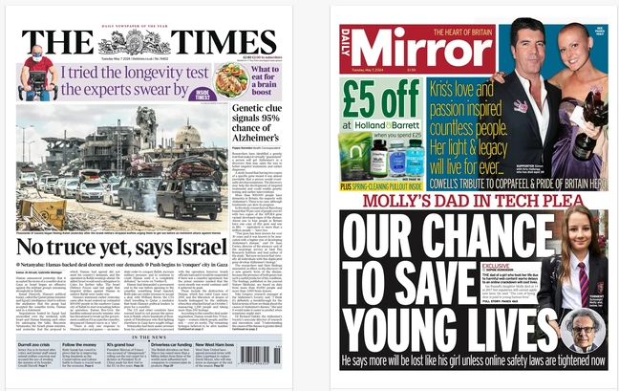

Slide 44
