Slide 1
COM 1 SEC B
Industry and Audience
L3: Newspapers – Industry and The Mirror

Slide 2
Starter: match the news value to the definition
News Value
Definition
Unambiguity
Proximity
Threshold
Elite nations/people
Question: what are the other 4 news values we learnt?
The news happened close by
The news happened in a wealthy, ‘western’ country
The news was easy to understand and explain
The news happened on a massive scale

Slide 3
News Media
Newsworthiness
Unexpectedness
Elite nations/people
Threshold
Continuity
Negativity
Unambiguity
Personalisation
Proximity

Slide 4
Today: we will be looking at INDUSTRY and The Mirror
Key concepts for today’s lesson:
Patterns of OWNERSHIP and CONTROL, and their significance for The Mirror
How new media technologies have changed patterns of CONSUMPTION and RESPONSE in The Mirror’s audience
How newspapers are REGULATED

Slide 5
Exam questions on these key concepts
Explain how far media regulation benefits the public. Refer to The Mirror newspaper in your answer to support your points [12]
Explain how developments in technology shape media products. Refer to The Mirror newspaper in your answer to support your points [12]
Explain how media organisations try to minimise risk. Refer to The Mirror newspaper in your answer to support your points [12]
Explain the importance digital convergence to the media industry. Refer to The Mirror newspaper in your answer to support your points [12]
Explain how patterns of ownership shape media products. Refer to The Mirror newspaper in your answer to support your points [12]

Slide 6
Industry context
The Mirror was first published in 1903

Slide 7
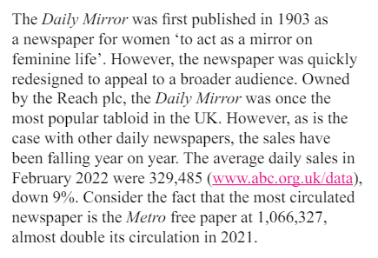
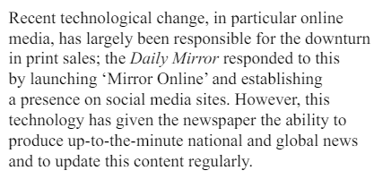
Industry context: from the factsheet

Slide 8
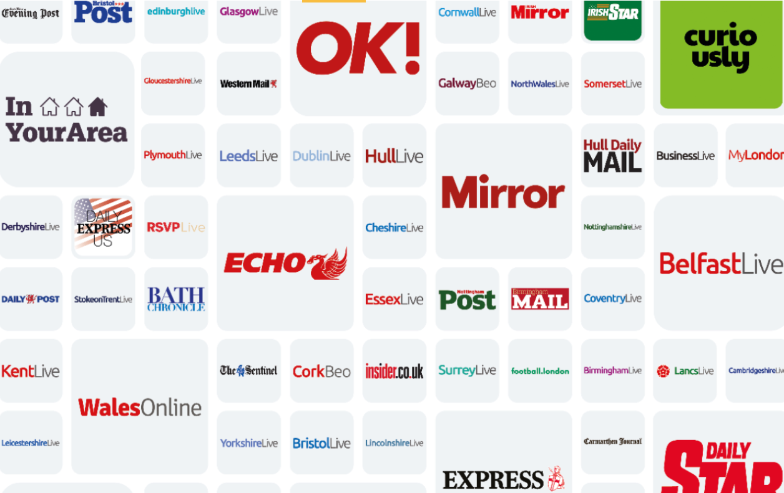
So, who owns The Mirror?
Reach PLC

Slide 9
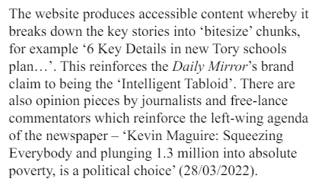
The Mirror views itself as ‘The Intelligent Tabloid’
This is reflected in its relatively in-depth and complex reporting, as well as the usual tabloid diet of celebrities and gossip.
It’s not scared to align itself with particular politicians and particular political viewpoints. These are always on the left side of politics. The Mirror would never support a conservative government, unlike most other newspapers.

Slide 10
What is the significance of this pattern of ownership?
The Mirror is part of a huge conglomerate with associations with many areas of the cultural and media industries. This allows it to have quick and easy access to many types of media. Its size has led to it being investigated by the Competition and Markets Authority to ensure it wasn’t creating a monopoly.
It also means it is well-protected economically.
According to Curran and Seaton, this type of ownership pattern, could lead to a monopoly, which is turn leads to lack of creativity and diversity of opinion.
However, the publications that sit within the Reach PLC publishing house are very diverse. The Express is a very different newspaper ideologically than the Daily Mirror. The Daily Mirror is one of the few daily newspapers that regularly champions the rights of the working class. This seems to suggest that Curran and Seaton’s ideas about the media don’t quite fit the Daily Mirror.
Reach PLC has had to diversify to keep up sales. It has done this by expanding into regional news over recent years.

Slide 11
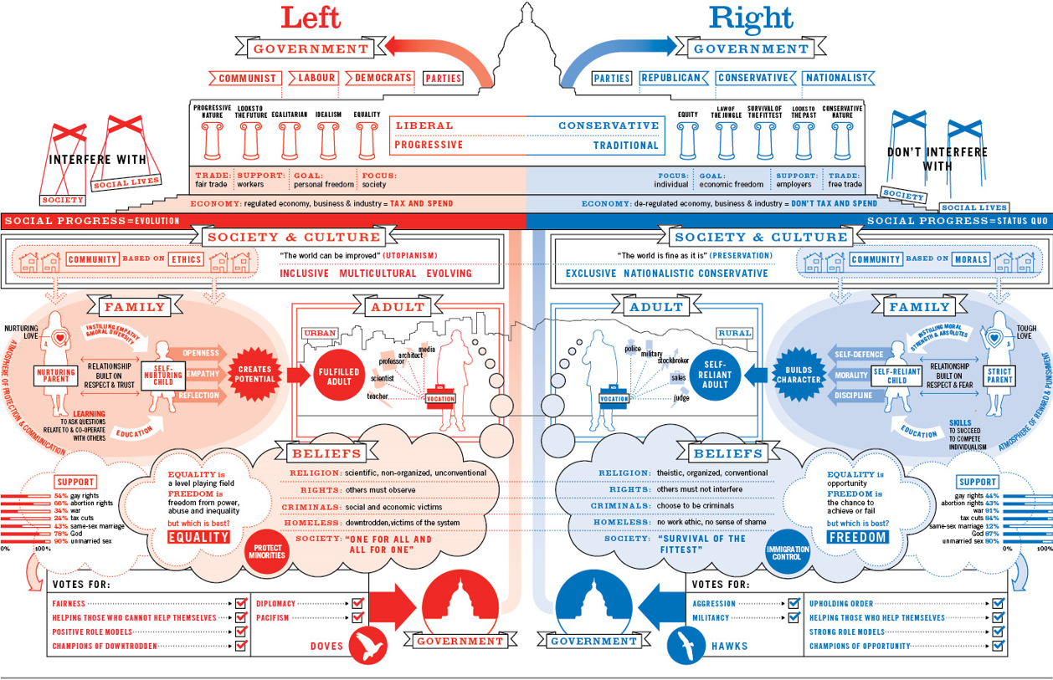

Slide 12
How has The Mirror embraced changing technologies?
The Mirror online was established in 2012.
The website is a free service, but the digital ‘replica’ of the paper was put behind a paywall from September 2016
The Mirror and Reach PLC in general has a high social media presence, often crashing onto news feeds with ‘clickbaity’ headlines

Slide 13
How has regulation impacted the newspaper industry?
According to Livingstone and Lunt, there is a tension between the need to regulate to protect consumers from harmful content and practices, and the need for free news reporting.
The Leveson Enquiry into the ‘phone-hacking’ scandal has increased the pressure for regulation in the press.
There is also increasing concern about fake news.
The newspaper industry is regulated by IPSO
However, the expansion into digital territory makes it harder to regulate effectively.

Slide 14
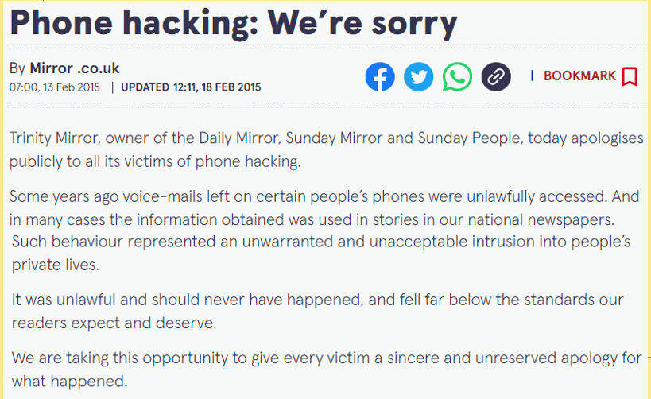
The Mirror also fell foul of the phone-hacking scandal. They weren’t part of the original News of the World scandal, but it became clear that phone-hacking was a systemic problem in the news industry. The Mirror also had to publish an apology in 2015 for its phone-hacking activities.
Want to learn more? Go to https://hackinginquiry.org/ to find out how the ‘Hacked Off’ campaign has been investigating these claims.

Slide 15
Exam questions on these key concepts
Explain how far media regulation benefits the public. Refer to The Mirror newspaper in your answer to support your points [12]
Explain how developments in technology shape media products. Refer to The Mirror newspaper in your answer to support your points [12]
Explain how media organisations try to minimise risk. Refer to The Mirror newspaper in your answer to support your points [12]
Explain the importance digital convergence to the media industry. Refer to The Mirror newspaper in your answer to support your points [12]
Explain how patterns of ownership shape media products. Refer to The Mirror newspaper in your answer to support your points [12]
WHAT YOU HAVE LEARNT TODAY FORMS AN OUTLINE FOR AN ANSWER. YOU NEED EXAMPLES FROM REGULATION CASE STUDIES, THE PRINT EDITIONS AND THE WEBSITE AS WELL. WE WILL COME BACK TO THIS…

Slide 16
Tasks
You are going to split into your news teams again.
This time, you will swap papers.
Visit the Reuters news agency website https://www.reuters.com/
This will give you constantly updating news from around the world
Choose the six main stories for tomorrow’s newspaper
Choose the six main stories for today’s online edition (these can be constantly updated)
Create a definitive list and then mock up what you think tomorrow’s front page will be for both papers. Try to get the text written as well as the pictures and layout
Tomorrow, we’ll look at the real front pages and see how close you get
Want to go deeper? Assign roles for each member of the team, for example, celebrity news correspondent, world news correspondent, royal correspondent, political correspondent, climate correspondent… Each of you has to fight for the prized front page spot! You could appoint an editor who makes the final decision (and maybe writes an editorial piece as well)

