Slide 1
COM 1 SEC B
Industry and Audience
L4: Newspapers – Audience and The Times

Slide 2
Starter: divide these into either stereotypically left-wing values or right-wing values (there are 5 of each)
I want the government to increase my taxes so that society can improve
War is never wanted but sometimes necessary
Children need clear boundaries
People who are poor should work harder to improve their finances
Freedom is more important than any other value
War is never necessary but sometimes wanted
Fairness is more important than any other value
I want the government to decrease my taxes so that I can improve my life
Children need gentle nurturing
People who are poor should be supported with benefits
Comments?

Slide 3
Today: we will be looking at AUDIENCE and The Times
Key concepts for today’s lesson:
GROUPING and CATEGORISING audiences
How media texts TARGET audiences
SPECIALISED versus NON-SPECIALISED audiences
How audiences USE media
Audience theories for this text: Gerbner (Cultivation), Hall (Reception theory), Shirky (End of Audience)

Slide 4
Exam questions on these key concepts
Explain how the newspaper industry targets audiences. Refer to The Times newspaper in your answer to support your points [10]
Explain how audiences use media products in different ways. Refer to The Times newspaper in your answer to support your points [10]
Explain how media producers attract audiences. Refer to The Times newspaper in your answer to support your points [12]
Explain how social and cultural circumstances affect audience interpretations of newspaper content. Refer to The Times newspaper in your answer to support your points [10]
Explain how patterns of consumption can be influenced by media technologies. Refer to The Times newspaper in your answer to support your points [8]

Slide 5
How is The Times’ audience categorised?
The Times’ target audience, according to ABC data is predominantly ABC1, over 35, with a liberal/right-wing political stance.
The audience are well-educated and middle-class and take an interest in global as well as national news. They are comfortable with a ‘long read’, and complexity in their news stories.
See the next slides for examples of how this type of audience is targeted by The Times

Slide 6
How does The Times target its audience?
The front page is a great starting point as it will be the thing people see straight away. Look at the media language choices being made (font style, colour, layout, linguistic codes, image choice) and decide why those choices are appropriate for the target audience.
The audience can be targeted through its content, often ‘teased’ on the front page. The inclusion of a supplement for example might attract the target audience (e.g ‘times2’).
Creating digital formats can help target audiences in specific ways. For example, the Times’ digital version closely resembles the print version, which caters to the more traditional values of the target audience. However, the fact that it can be updated might appeal to a younger audience, thus broadening the target audience. The Times is only updated 3 times a day, enabling it to more closely resemble the print edition in this way too.
Editorial opinion pieces and cartoons can be a way of targeting audiences by signalling the paper’s political allegiances more forcibly. The letters page of the Times is culturally iconic and helps to create a community of like-minded people, as do the comments on the digital versions.
Because of this targeting, the audience will have a preferred reading of the newspaper.

Slide 7
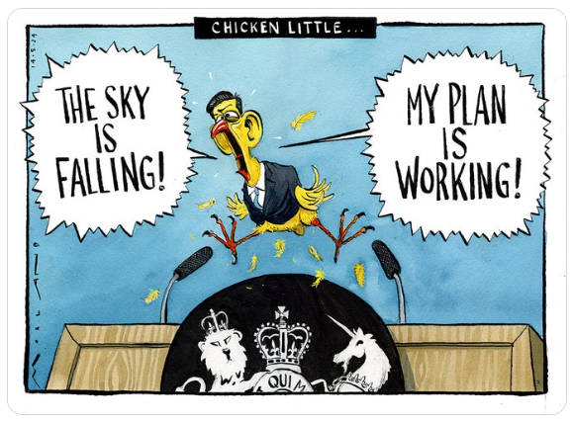
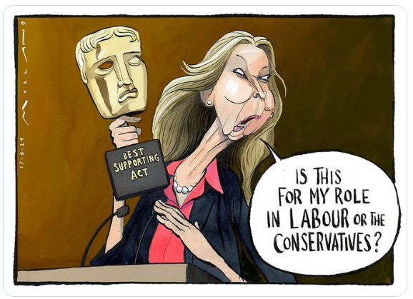
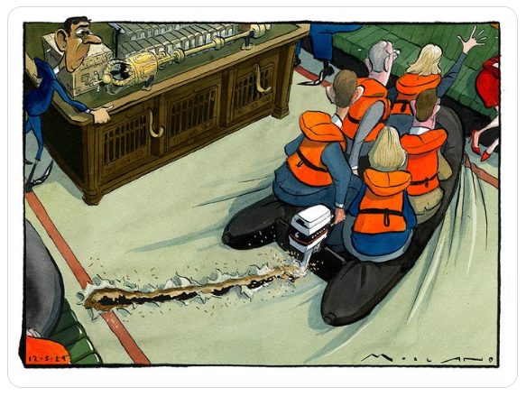
Tuesday 14th May
Monday 13th May
Recent Times cartoons
What political stories do they relate to?
How do these cartoons target the audience of The Times?
How are they unexpected given the audience?
Sunday 12th May

Slide 8
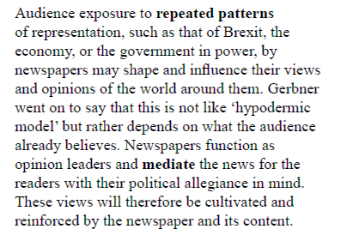
Theoretical approaches: Cultivation Theory
When we do our case studies, we will be looking for evidence of ‘cultivation’ in both papers

Slide 9
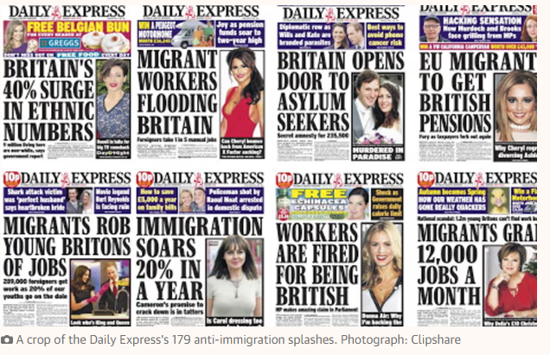
Here’s a very obvious example from The Express

Slide 10
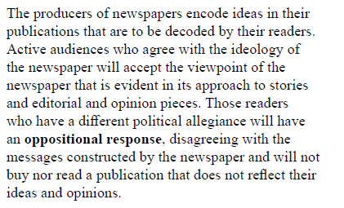
Theoretical approaches: Reception Theory
When we do our case studies, we will be looking for examples of news stories that could be interpreted in various ways in both papers

Slide 11
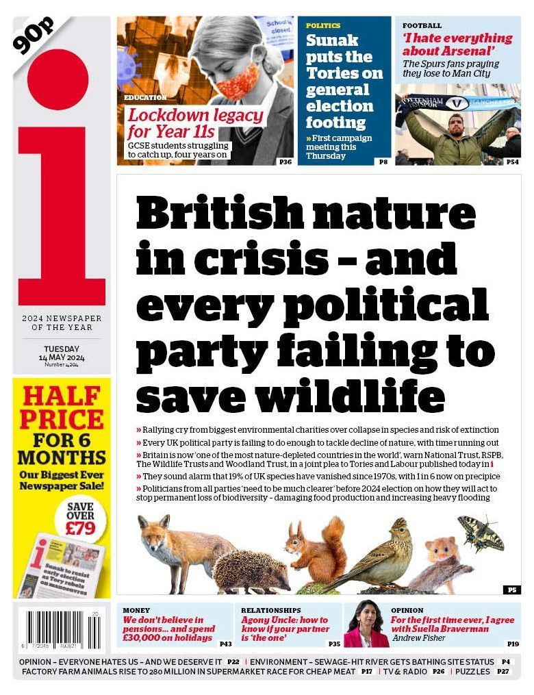
Here’s the front page I had the strongest ‘preferred’ reading for on Tuesday 14th May

Slide 12
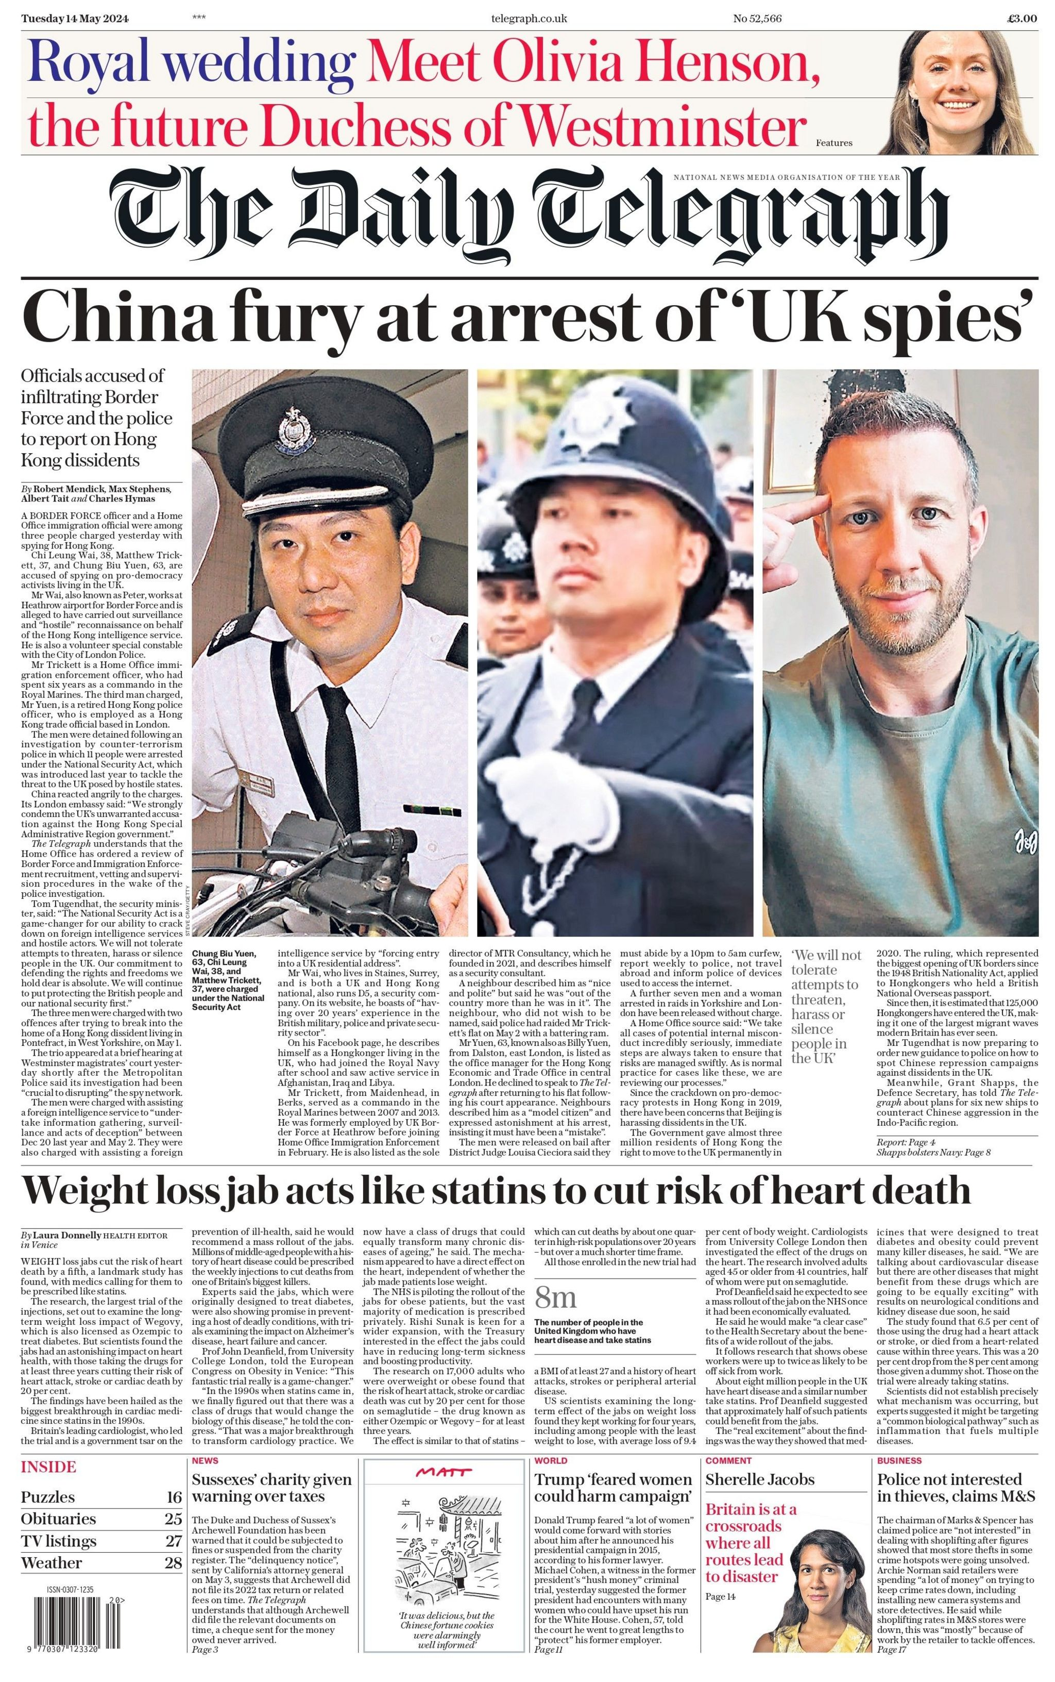
Here’s the front page I had the strongest ‘oppositional’ reading ‘ to on Tuesday 14th May What about you? Tomorrow's Papers Today - UK Front Pages - Latest Newspaper Headlines (tomorrowspapers.co.uk)

Slide 13
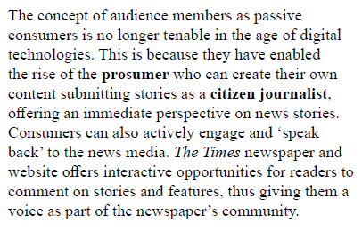
Theoretical approaches: End of Audience
When we do our case studies, we will be looking for examples of interactive opportunities on both websites

Slide 14
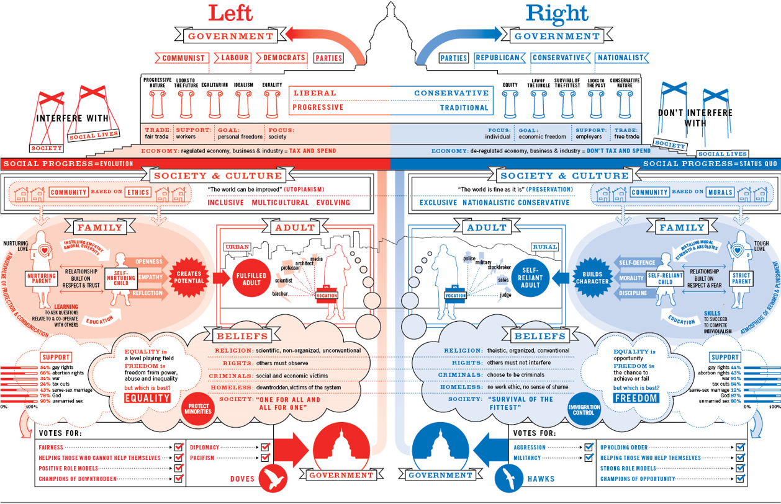

Slide 15
Tasks
You are going to split into your news teams again.
This time, you will swap papers.
Visit the Reuters news agency website https://www.reuters.com/
This will give you constantly updating news from around the world
Choose the six main stories for tomorrow’s newspaper
Choose the six main stories for today’s online edition (these can be constantly updated)
Create a definitive list and then mock up what you think tomorrow’s front page will be for both papers. Try to get the text written as well as the pictures and layout
Tomorrow, we’ll look at the real front pages and see how close you get
Want to go deeper? Assign roles for each member of the team, for example, celebrity news correspondent, world news correspondent, royal correspondent, political correspondent, climate correspondent… Each of you has to fight for the prized front page spot! You could appoint an editor who makes the final decision (and maybe writes an editorial piece as well)

