Slide 2
COM 1 SEC B
Industry and Audience
L5: Newspapers – Audience and The Mirror

Slide 3
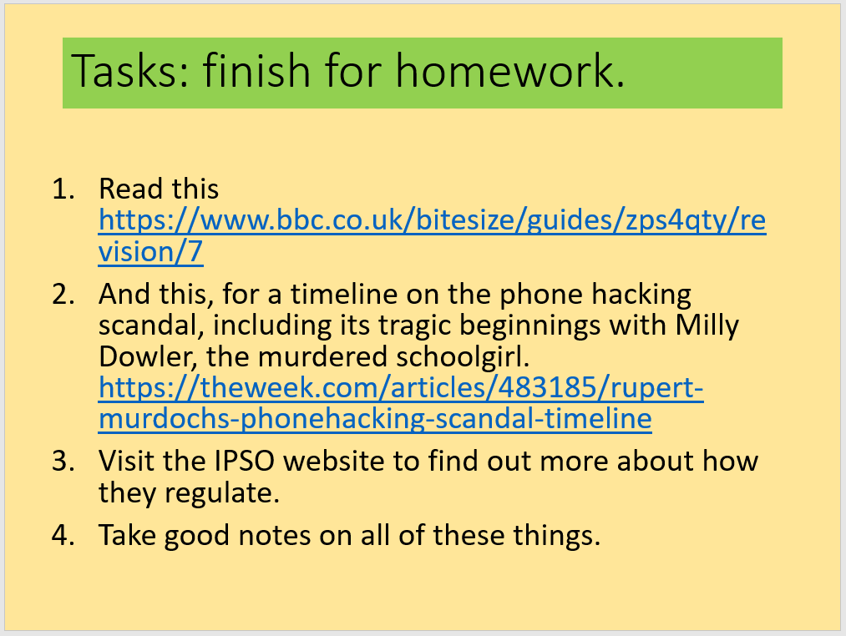
Admin
I’ll check your notes from last week’s homework, as promised.
I have attached all the factsheets for COM 1 SEC B to Satchel. If we have time at the end of the lesson, your job will be to print off any that you don’t have for section B. It’s very important that you have an up-to-date collection!
Next week: Analysis of print and online editions of newspapers. Introduction to NEA on Friday. Booklets are on their way!

Slide 4
Today: we will be looking at AUDIENCE and The Mirror
Key concepts for today’s lesson:
GROUPING and CATEGORISING audiences
How media texts TARGET audiences
SPECIALISED versus NON-SPECIALISED audiences
How audiences USE media
Audience theories for this text: Gerbner (Cultivation), Hall (Reception theory), Shirky (End of Audience)

Slide 5
Exam questions on these key concepts
Explain how the newspaper industry targets audiences. Refer to The Mirror newspaper in your answer to support your points [10]
Explain how audiences use media products in different ways. Refer to The Mirror newspaper in your answer to support your points [10]
Explain how media producers attract audiences. Refer to The Mirror newspaper in your answer to support your points [12]
Explain how social and cultural circumstances affect audience interpretations of newspaper content. Refer to The Mirror newspaper in your answer to support your points [10]
Explain how patterns of consumption can be influenced by media technologies. Refer to The Mirror newspaper in your answer to support your points [8]

Slide 6
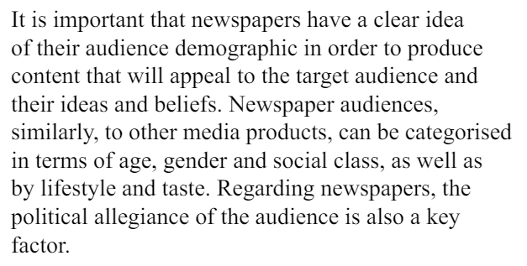
How is The Mirror’s audience categorised?
The Daily Mirror’s target audience, according to ABC data, is predominantly C2DE, over 35 and are working class Labour supporters.
See the next slides for examples of how this type of audience is targeted by The Mirror

Slide 7
How does The Mirror target its audience?
The front page is a great starting point as it will be the thing people see straight away. This is particularly true for a tabloid, which is a more visual product than a broadsheet. Look at the media language choices being made (font style, colour, layout, linguistic codes, image choice) and decide why those choices are appropriate for the target audience. Often the choices will be more ‘sensational’ and emotive than a broadsheet.
The audience can be targeted through its content, often ‘teased’ on the front page.
Creating digital formats can help target audiences in specific ways. In May 2021 the Daily Mirror’s website became the no. 1 most read online newspaper, attracting 32 million monthly viewers. As with all digital formats, the opportunities for interaction and community building are increased compared to print editions.
Editorial opinion pieces and cartoons can be a way of targeting audiences by signalling the paper’s political allegiances more forcibly. The editorial section of The Mirror, (The Voice of the Mirror) reinforces the ideology of the paper and will appeal to the politics of the audience.
Because of this targeting, the audience will have a preferred reading of the newspaper. https://www.mirror.co.uk/

Slide 8
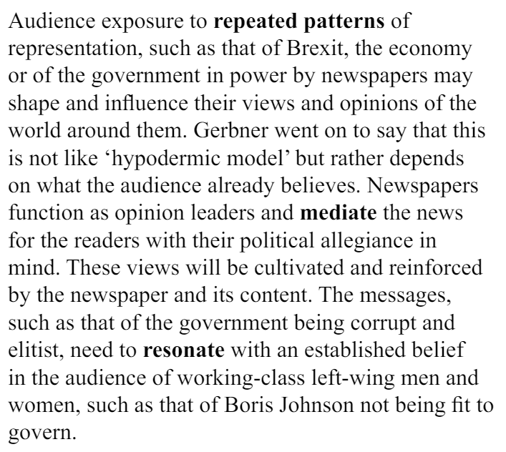
Theoretical approaches: Cultivation Theory
When we do our case studies, we will be looking for evidence of ‘cultivation’ in both papers

Slide 9
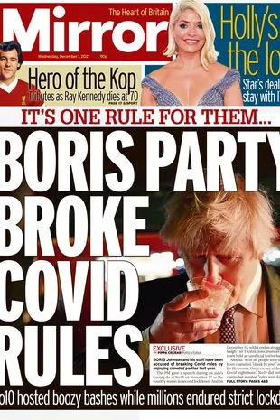
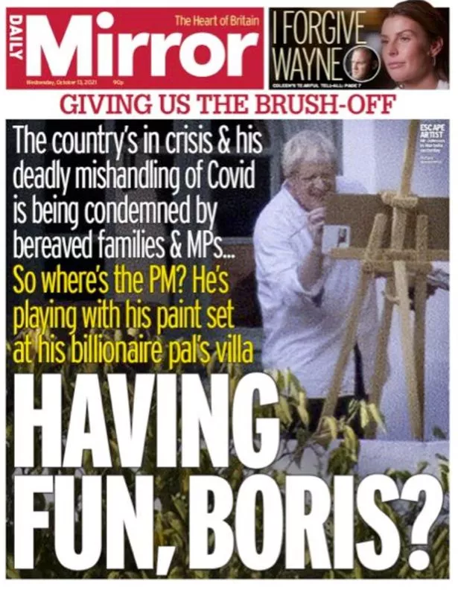
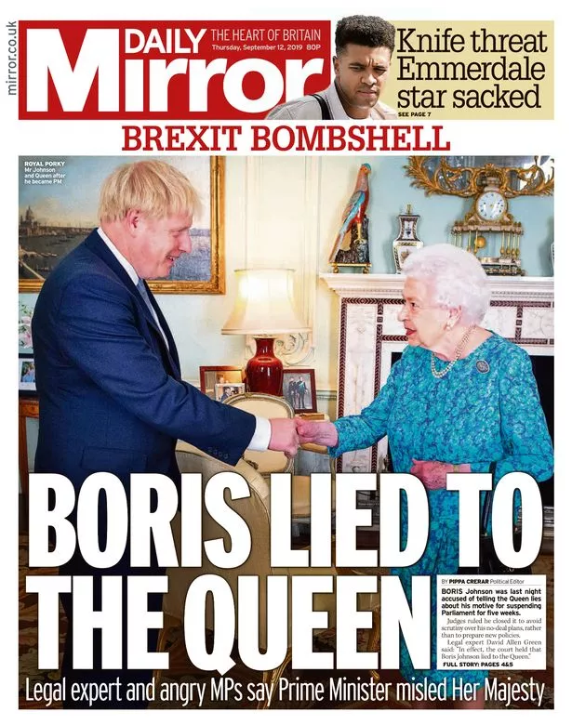
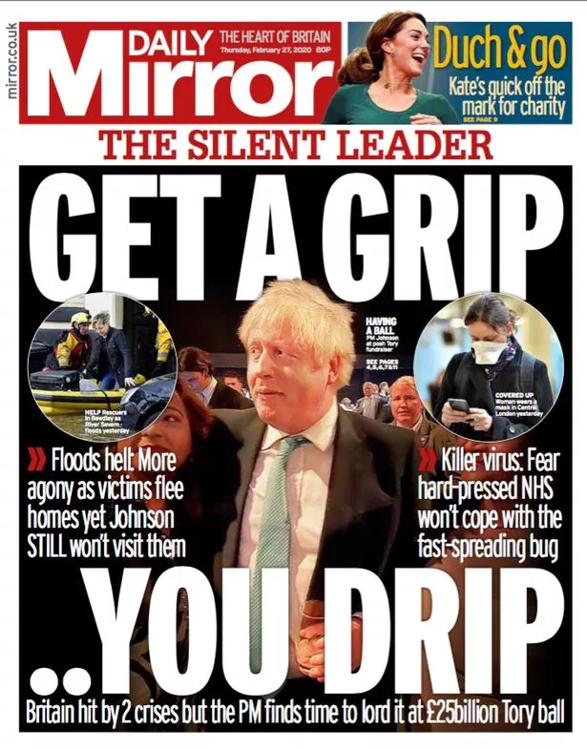
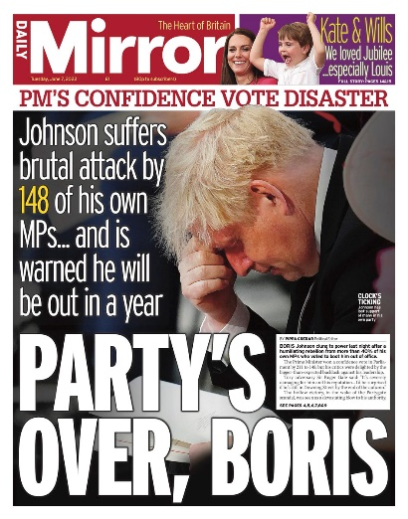
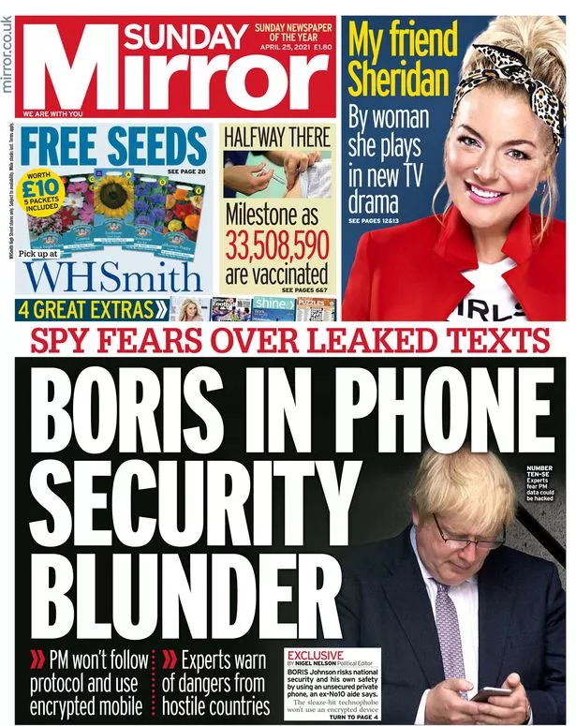
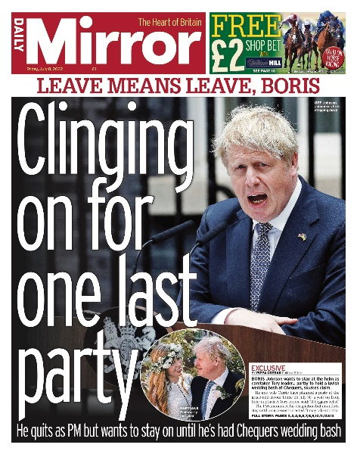
Cultivation in the Daily Mirror

Slide 10
Theoretical approaches: Reception Theory
When we do our case studies, we will be looking for examples of news stories that could be interpreted in various ways in both papers

Slide 11
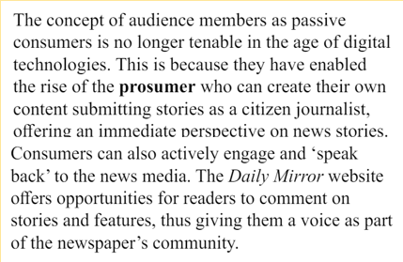
Theoretical approaches: End of Audience
When we do our case studies, we will be looking for examples of interactive opportunities on both websites

Slide 12
