Slide 1
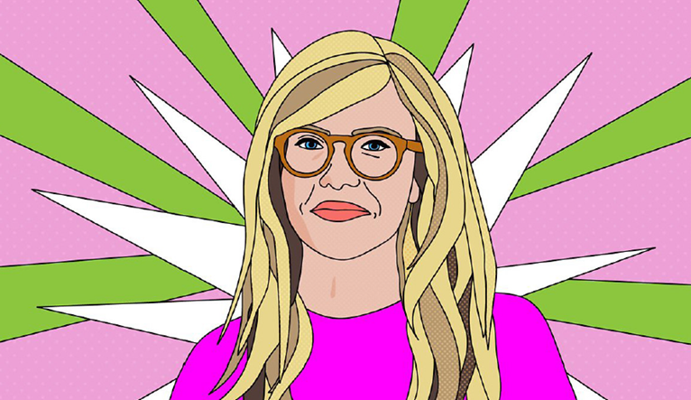
COM 1 SEC B
Woman’s Hour
L3: To explore the history and current remit of Woman’s Hour

Slide 2
Admin
Next week is assessment week
As I have already mentioned, your assessment will be on Assassin’s Creed.

Slide 3
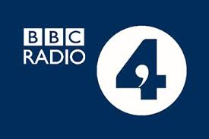
Radio 4
Woman’s Hour was originally broadcast in October of 1946 on the BBC’s ‘light programme’ (this would become Radio 2). Topics included would be very domestic, ‘how to hang your husband’s suit’.
It is now broadcast on Radio 4. There are new episodes every day at 10AM. The current topics have been considered to be very hard-hitting including period poverty, abortion, and social injustices. This is intermittent with more light-hearted topics such a friendship and popular television.
“The remit of Radio 4 is to be a mixed speech service, offering in-depth news and current affairs and a wide range of other speech output including drama, readings, comedy, factual and magazine programmes. The service should appeal to listeners seeking intelligent programmes in many genres which inform, educate and entertain.”
Challenge: Where does Woman’s Hour fit into this remit?

Slide 4
How does WH fulfil the remit of the BBC?
Specialised programme, targets a niche audience
The fact is it funded by a license fee allows greater freedom, creativity and experimentation.
The programme has low production values: no music, location reporting, or clever editing
The focus is the calibre of the guests and topics of discussion – too risky for commercial channels
How does it conform to codes and conventions of speech-led radio broad-casts?
The presenter: popular, and appealing to target audience
Discussion: periods, gender pay gap, contraception, make-up, education etc.
Contributors: high-brow, elevated language, have own social media following
Production and distribution: daily, 10am but available anytime on podcast

Slide 5
Woman’s hour - then
https://www.bbc.co.uk/sounds/play/p01ngy65
Aileen Graham-Jones recalls driving the British political activist and leader of the British suffragette movement Emmeline Pankhurst around the country in 1911. Broadcast in 1950s (date not given)

Slide 6
The Evolution of WH
Created by Norman Collins and originally presented by Alan Ivimey, Woman's Hour was first broadcast on 7 October 1946 on the BBC's Light Programme. Janet Quigley, who was also involved with the birth of the UK radio programme Today, has been credited with "virtually creating" the programme.
The programme was transferred to its current home on BBC Radio 4 in 1973.
In the early years the topics for the programme were arranged well in advance and printed in the Radio Times but by the 1980s there was a change to greater topicality. Clare Selerie-Gray became the producer in 1987 and steered the programme away from its tendency to include merely whimsical topics and ensured that the books read in the last section were more relevant to women's lives rather than ordinary novels.
For one week in April 2014, the programme was guest edited by J. K. Rowling, Kelly Holmes, and Lauren Laverne. It was the first time the programme had a guest editor since its initial decade of broadcast. In September 2015, the programme hosted "Woman's Hour Takeover" with a week of guest editors, including Kim Cattrall, Michelle Mone and Jacqueline Wilson.
Late Night Woman's Hour, a spinoff series, was launched in 2015, presented by Lauren Laverne. The series is broadcast in an 11 pm timeslot and each episode takes a single topic for discussion. The lateness of the broadcast allows for more freedom to handle topics considered unsuitable for the morning broadcast.

Slide 7
Key historical info WH
Read the extracts from The Guardian about Woman’s Hour.
What do they tell us about the institutional values of the BBC?
What does it tell us about how Woman’s Hour was originally received?
Notes:
Required for this lesson: https://www.theguardian.com/lifeandstyle/2016/oct/10/womans-hour-celebrates-70th-anniversary

Slide 8
Extracts from an article in The Guardian (2016)
Garvey, who has presented the show alongside Murray for nine years, told the Guardian that a glance at the script from the first ever show – which featured a section on how to “put your best face forward” – revealed the vast shift in women’s lives in the past 70 years. “It ends ‘a light dusting of powder can do wonders for your look and the family morale’, which I think shows that we have come a very long way,” she said. “Looking at the issues we talk about today you realise how much things have changed in the last 70 years, and the huge shift in our expectations compared with our grandmothers.”
But when Garvey joined the programme in 2007 she voiced some scepticism about its tone, saying: “One of my bugbears about it would be – and they know this – that there is too much about the negative side of being female and not enough about the many good factors.
“I would also like to have [fewer] middle-class ladies talking about cookery. Although there is nothing wrong with cookery, I think there is a massively middle-class bent to every programme on Radio 4.”

Slide 9
Extracts from an article in The Guardian (2016)
With 3.7 million listeners weekly, Woman’s Hour is now the second most popular daily podcast across BBC Radio – after The Archers – and a quarter of its listeners are under 35, while 40% are male.
“There simply isn’t anything else like it,” said Garvey. “The running order is such an incredible cocktail of things that everybody will find something they are interested in, something they want to know more about, or something they want to tell their mother, daughter or friend – that’s why it works.”
It survives, according to Murray, who has presented the programme for 29 years, “because it’s endlessly interesting, completely trustworthy and always up to date on the often neglected interests and concerns of 52% of the population”.

Slide 10
Extracts from an article in The Guardian (2016): The first programme…
Aired at 2pm to coincide with the moment that busy housewives could briefly put their feet up before the children came home from school, BBC bosses hired Alan Ivimey, an ex-RAF-officer-turned-journalist who “specialised in writing for and talking to women” to present the radio show. A woman, they decided, risked being “resented” by her listeners.
The subjects covered included “mother’s midday meal” and “how to hang your husband’s suit” – much to the first listeners’ ire, according to Amanda Vickery, professor of early modern history at Queen Mary, University of London. “Citizen housewives were not be hectored by professional men or bossy matrons,” Vickery wrote in the Radio Times.
A doctor’s talk on “how to be a happy woman”, encouraging listeners to let go of “frustration”, lead one housewife to retort: “I should like him to do a hard day’s housework – bending over a sink washing, then shopping and queuing – then see if his backache is only frustration and not due to hard work.”
While listener Bridget Long, writing to The Daily Worker in 1946, complained: “The programme is much too patronising. What women want is a programme to compensate us for being tied to our domestic chores, to help us keep in touch with the world outside, whether it’s books, films, politics or other countries.”

Slide 11
Extracts from an article in The Guardian
…but [a] recent poll also suggests the need for a programme that challenges deeply rooted sexism.
In the 25-34 age bracket, only 27% of respondents considered themselves happier than their mothers were at their age, compared to 43% of those aged 65 and over. And 70 years after those first make-up tips were broadcast on the first Woman’s Hour, 46% of younger listeners polled by the programme this year said they would consider having cosmetic surgery.

Slide 12
So, the big question is…
Do we still need Woman’s Hour? Why?
In this age of gender fluidity, isn’t the term ‘woman’ problematic anyway?
Is it patronising to have a programme only for women? Does it imply that all other radio programmes are male dominated and therefore not for women?
Notes:
This is a good opportunity to consider gender as a social construction
https://www.spectator.co.uk/2016/10/womens-hour-is-wayward-and-retrograde/

Slide 13
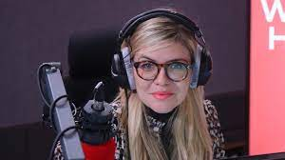
The gender price gap…
Task: Listen to the following broadcasts from Woman’s Hour.
What do they suggest about the relevance of Woman’s Hour?
BBC Radio 4 - Late Night Woman's Hour, Gender Price Gap (June 2019)
WH Mon 6th Nov 2023
Notes:
https://www.bbc.co.uk/programmes/p07f55rr

Slide 14
Review task
Use these sentence starters for each paragraph:
Woman’s Hour was first aired… (a paragraph about the history)
The first reason that Women’s Hour remains valid / is no longer valid is… (give examples from programmes)
The second reason…
The third reason…
In conclusion…
Write an argument for or against the validity of a programme such as Woman’s Hour in 2022.
Challenge: include examples from the programme you listened to today and others that you have researched
To help: https://www.bbc.co.uk/programmes/p01lhyz1?page=1

