Slide 1
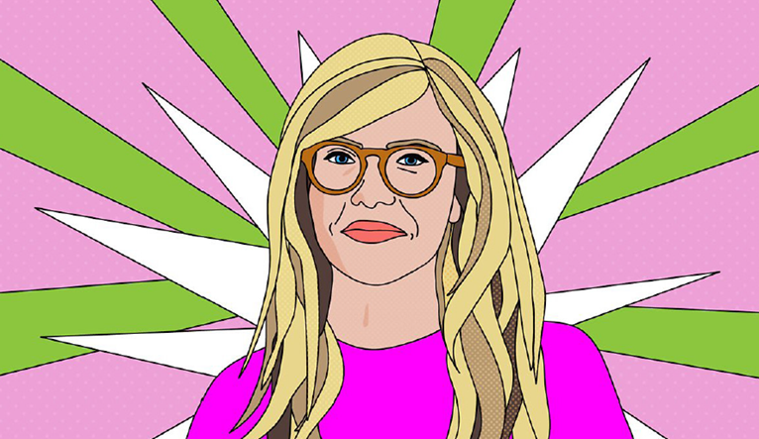
COM 1 SEC B
Woman’s Hour
L4: To explore the audience of Woman’s Hour

Slide 2
Review task from last lesson – how did you do?
Use these sentence starters for each paragraph:
Woman’s Hour was first aired… (a paragraph about the history)
The first reason that Women’s Hour remains valid / is no longer valid is… (give examples from programmes)
The second reason…
The third reason…
In conclusion…
Write an argument for or against the validity of a programme such as Woman’s Hour in 2022.
Challenge: include examples from the programme you listened to today and others that you have researched
To help: https://www.bbc.co.uk/programmes/p01lhyz1?page=1

Slide 3
Review
FLASH FORWARD!
What is appealing about radio to an audience?
Summarise the target audience of WH – think about mass, or specialised?
How does WH appeal to its audience?
Challenge: does WH exclude men?

Slide 4
One way to appeal to an audience is through THE MEDIUM

Slide 5
What is the appeal of radio?
Medium | Explanation
Blind medium | Hearing, with no visual images. Imagination?
Companion medium | Strong sense of personal communication. Interactive opportunities so call or text in/get a ‘mention/phone-ins
Intimate medium | Personal, encourages intimacy by mode of direct address
Undemanding medium | Ability to do other things whilst listening; a listener doesn’t need to devote all of their time to the platform

Slide 6
Another way to appeal to an audience is through THE CHOICE OF HOSTS

Slide 7
WH Hosts – Nuala McGovern
‘Nuala McGovern joins the Woman's Hour presenting team on 13 May. She is already a much-loved voice for Woman’s Hour listeners, having previously hosted the programme in 2023 to cover Emma Barnett’s maternity leave. She hosted the live reveal of the Woman's Hour 2023 Power List, which included interviewing captain of the England women’s football team, Leah Williamson, who topped the list. During her time on the programme, Nuala interviewed an incredible line-up of women including Malala Yousafzai, Laura Dern, Rosamund Pike, Arlo Parks, and the Deputy Commissioner of the Met Police Dame Lynne Owens, who spoke about women's safety.
Nuala brings a wealth of live broadcasting experience to Woman’s Hour: in her 20-year career, she has presented across the BBC network, and is currently one of the leading presenters on the BBC World Service. She has reported for the BBC on many of the most important events in recent history, including as part of BBC radio’s prestigious ceremonial team, commentating at both the funeral of Queen Elizabeth II and the coronation of King Charles III and as the lead presenter for Donald Trump’s inauguration in Washington, D.C. for the World Service. As well as journalistic rigor, Nuala is known for her warm and empathetic approach to interviews, making her the perfect fit for the diverse range of stories covered by Woman’s Hour.’ (from the BBC website)

Slide 8
WH Hosts – Anita Rani
‘An RTS Award-winning broadcaster with a career spanning nearly 20 years, Anita Rani is a hugely popular presenter with TV audiences. As one of the lead presenters on BBC One’s Countryfile, Anita has become a familiar face on British television whilst also presenting a range of explorative documentaries for the BBC including Bollywood: The World’s Biggest Film Industry; My Family, Partition and Me: India 1947, War On Plastic with Hugh and Anita alongside Hugh Fearnley-Whittingstall, social history series Saved by a Stranger as well as hosting the quiz show The Answer Trap on Channel 4.
Anita’s TV projects have included presenting Channel 4’s Britain’s Best Parent?, appearing on Celebrity Gogglebox alongside her father and presenting Beneath The Crown, a YouTube series for Netflix described as the ultimate viewing companion to the latest series of the hit show, The Crown.
Growing up in Bradford, Anita had her own radio show on Sunrise Radio at the age of 14, joining the BBC’s Asian Network in 2005 and covering numerous slots for BBC Radio 2.
Anita’s memoir, The Right Sort of Girl was published July 2021.’ (from the BBC website)

Slide 9
Another way to appeal to an audience is through choosing to target a MASS AUDIENCE or a SPECIALISED AUDIENCE. What is Woman’s Hour?

Slide 10
WH Audiences – mass or specialised?
There has been a raised awareness about inequality between males and females in the media, and the BBC has made efforts to address gender imbalance. With a roster of female presenters across its radio channels, some people have questioned the relevance of a show just dedicated to women. The impact of the #MeToo campaign and other social media campaigns highlighting sexism and the popularity of women’s podcasts, show there is a diverse and engaged audience for ‘women’s media’.
The topics discussed are not strictly based around female experiences. Although subjects like IVF, mastectomy and women’s safety are female-centric, other discussions about grief, adult literacy and disaster planning offer a female perspective on issues that would also interest male listeners.
Consider how men might respond to the content of WH - might the fact that it is composed of only female members (similar to Loose Women) alienate or unsettle male listeners?

Slide 11
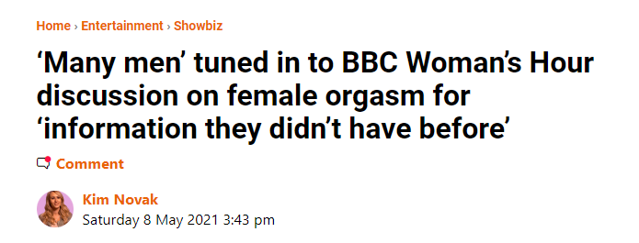
From ‘The Metro’
The male audience is currently estimated at 40% to 45%. This headline might give you a clue as to how men are ‘using’ the programme, but don’t forget, not all the content is like this.

Slide 12
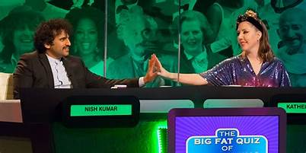
WH: Audience
What other programmes can you think of that are composed of only female members?
What is the effect on a male audience?
How about a female audience?
Notes:
Explore how a woman and man’s role has changed in society from the 50s and how representations have changed.
Raised awareness of inequality between males and females in the media and the BBC has made efforts to address gender imbalance.
Consider how the impact of MeToo and other campaigns highlighting sexism / popularity of women’s podcasts show there is an audience for ‘women’s media’

Slide 13
Mass vs specialised audiences
The BBC, as a public service broadcaster, has to cater for all audience demographics.
Remember that therefore includes both mass audiences and specialised.
As Radio 4 caters to a somewhat ageing population and has caused some controversy over the amount of money from the licence fee that they spend each year (as a result of being a speech based station which employs a large number of journalists, producers and contributors), it is important that they try to cater for a wider audience. Has this been addressed through the production of Woman’s Hour? Does the move to a podcast (in varying lengths and less controversial topics) also help to appeal to a wider audience?
In 2014, the BBC famously introduced a ban on all-male TV and radio panels to offset this dominance. So in terms of a preferred reading, consider why WH might be particularly welcome to some audiences.

Slide 14
Mass vs specialised audiences
As a PSB, the BBC has a remit to produce content for all audience demographics. Consider whether Woman’s Hour has been designed to explicitly appeal to a specialised female audience as part of the remit of the organisation itself. An extension of this discussion might consider whether there are any other media products that appeal to this specific target audience on the radio (BBC or otherwise).
Specialised audiences contribute to the diversity of the BBC and enhance the profile of Radio 4 as a station that caters for a broader demographic. In the case of Woman’s Hour, it is through the choice of presenters, guests and topics selected.
The programme airs a range of serious and more light-hearted stories to appeal to the demographic. In one week in March 2022, content included the release of Nazanin Zagahri-Radcliffe, body hair in history, growing up in poverty, domestic abuse and the first black Superwoman.
Advances in technology have enabled radio audiences to access content across a range of digital platforms to suit their needs. Some audiences will loyally listen to the daily programme whilst others will ‘catch-up’, selecting the episodes that match their interest and concerns. Audiences can subscribe to the podcast ‘Woman’s Hour Daily’ to catchup on episodes and be notified when new ones are released.

Slide 15
Another way to appeal to an audience is through INTERACTION

Slide 16
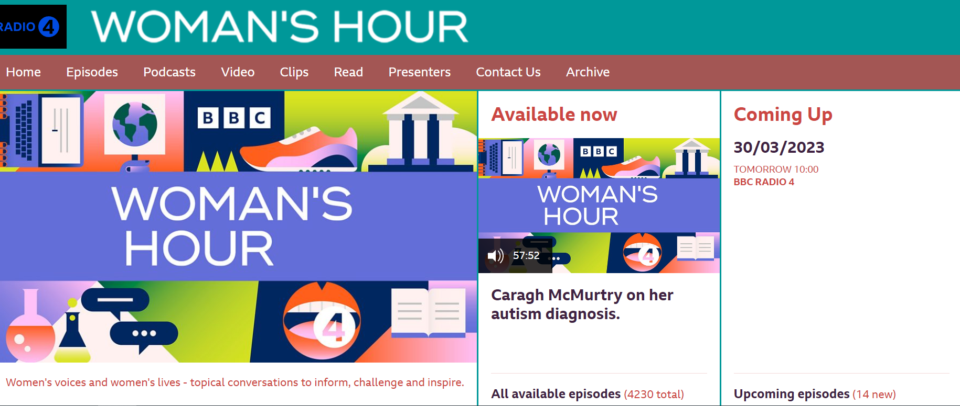
WH: the website
Woman’s Hour website

Slide 17
WH: Social media
Twitter
Instagram

Slide 18
Clay Shirky, ‘End of Audience Theory’
Shirky put forward that there is no such thing as a ‘passive’ audience now. People, generally, do not aimlessly consume media and never think about it again.
We are now ‘active’ audiences. We expect to be able to like/share/comment on the media product.
Technology largely allows us to do this.
We can now ‘speak back’ to producers of media content, shifting the hierarchy and giving more power to audiences.
In WH: each show begins with various ways you can get in touch: email, Whatsapp (voice note option), social media, and text. Audiences are actively encouraged to contact the show.

Slide 19
Evaluating Shirky
There is no doubt new digital medias have made it easier to audiences to interact, but the extent to which they actually participate is worth debating
Nico Carpentier: ‘the presupposition of a hyperactive and hyperproductive audience […] is not always substantiated by actual audience practices.’
How many people commented compared to how many people viewed?
An example from their Instagram page: several hundred ‘likes’ and tens of comments, compared to millions of listeners?

Slide 20
In summary: How does WH appeal to audiences?
The choice of presenter – similar life experiences to the target audience
The language and mode of address are aimed at a youngish (late 20s?) to middle-aged and older female target demographic – a specialised audience
Themes of the programme are constructed to be of interest to the audience
Audience is constructed through the style of programme and the choice of guests – educated and high-brow females
Available across a range of platforms

Slide 21
Review
FLASH FORWARD!
What is appealing about radio to an audience?
Summarise the target audience of WH – think about mass, or specialised?
How does WH appeal to its audience?
Challenge: does WH exclude men?

Slide 22
Task – listen to an episode and pick out more examples
BBC Radio 4 - Woman's Hour, Zeinab Badawi, Singing and periods, How is the debate over abortion shaping the US election?

Slide 23
2019: Example of stepped questions (a)
Notes:
Adapt for WH

Slide 24
How were the audience grouped?
Audience were targeted by content, reflecting gender, age, lifestyle, and taste – distinct sense of middle-class values highlighted through discussion of dinner parties, tea lights, and hygge
Expectation the female listener will have a historical understanding of have women’s roles have changed since the 1950s
Assumption the women listening are professional and independent
Topics clearly target a middle-class, intelligent, younger audience
1 hour – total discussion. Ability to concentrate? Sustaining interest?

