Slide 1
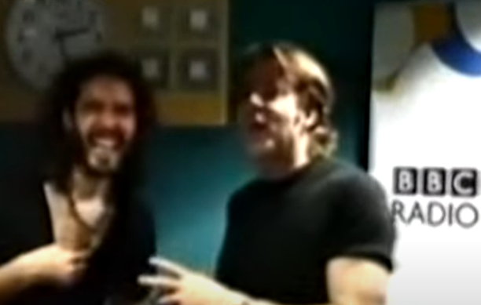
COM 1 SEC B
Woman’s Hour
L9: Case Study – SACHSGATE: a radio scandal (regulation)

Slide 2
Admin
Big apologies – I haven’t quite finished marking your assessments. I will have them by Tuesday.

Slide 3
CASE STUDY TASK Listen to the following news report: https://www.youtube.com/watch?v=xrRrtXih9Kc
How much do you already know about this?
After listening to the news item, can you explain why this scandal has become known as ‘Sachsgate’?

Slide 4
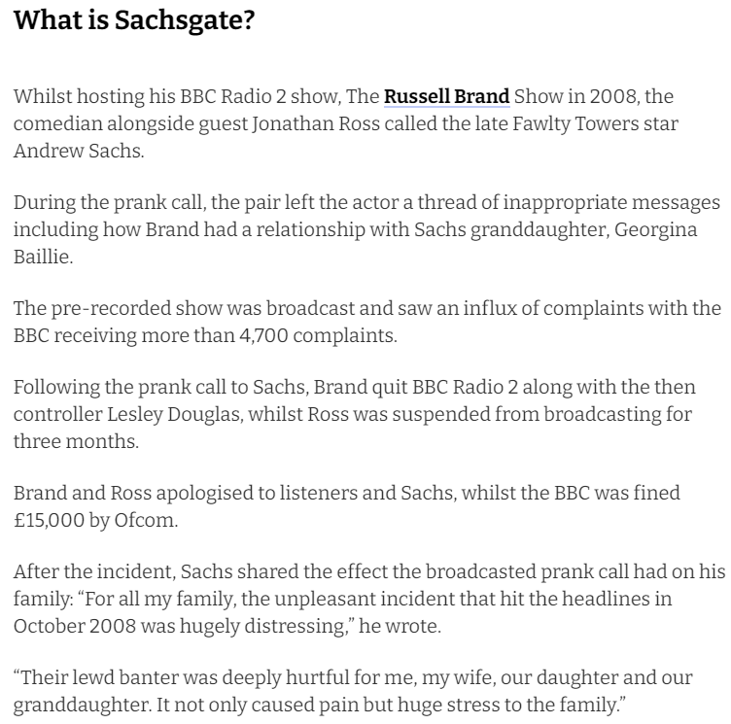

Slide 5
The ‘prank’ call in full
https://www.youtube.com/watch?v=U7IHJ66wj9g

Slide 6
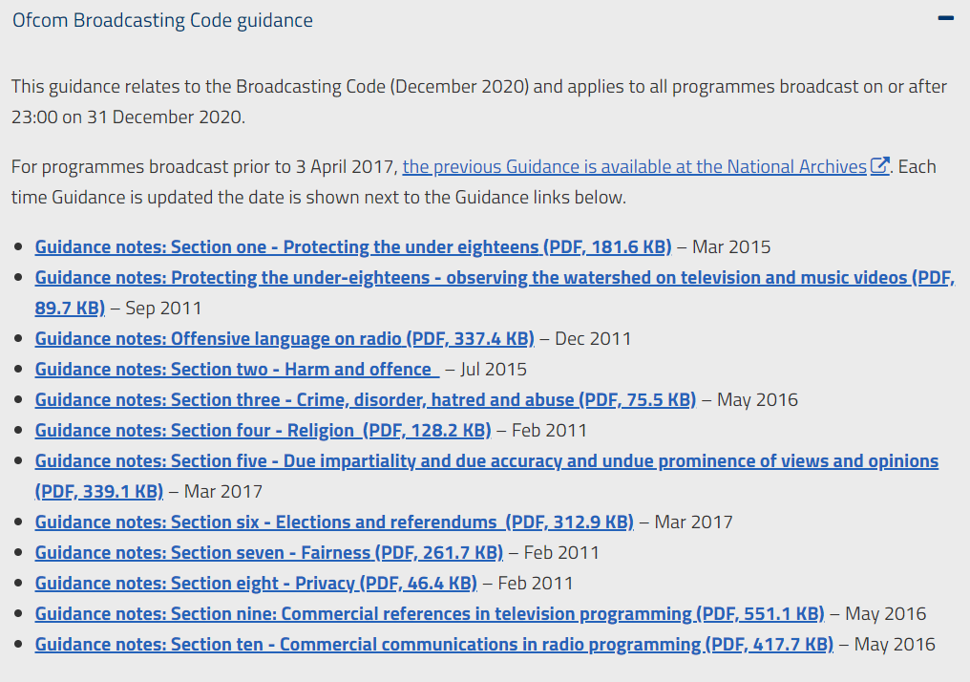
Ofcom has codes for the following:

Slide 7
Homework
Go onto the Ofcom Website https://www.ofcom.org.uk/tv-radio-and-on-demand/information-for-industry/guidance/programme-guidance
and read any codes that you think are relevant for the ‘Sachsgate’ scandal.
Homework task: complete the task on the next slide

Slide 8
‘Male Fertility and Holocaust Education’
HOMEWORK TASK
Answer the following questions either on Word or handwritten. Try to write at least ONE paragraph for each answer. Hand in a paper copy next Friday 9th May
How does this episode of Woman’s Hour reflect the ideology of the programme? Give examples from the programme.
Can this programme be considered niche or is it for a broader audience? Give examples from the programme and your own opinions.
Is this programme easy to access for the casual listener? If yes, how? If not, how?

