Slide 1
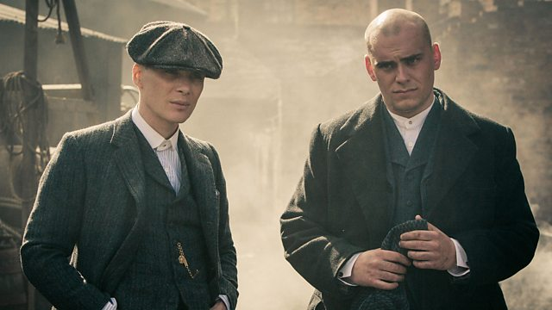
COM 2 SEC A
BBC iPlayer - Peaky Blinders - Series 1: Episode 1
Television in the Global Age
THE BRIDGE / PEAKY BLINDERS
L2: PEAKY BLINDERS – INTERTEXTUALITY AND GENRE HYBRIDITY

Slide 2
A note about the homework
Due in next Friday
Swap last week’s homework for the new one please!

Slide 3
Starter (using learning from last lesson)
What do we mean by ‘genre hybridity’?
How does this apply to Peaky Blinders?
What is the appeal of this?

Slide 4
In Peaky Blinders, a lot of the genre hybridity is established through intertextuality, which adds its own ‘appeal’.
Why do audiences like intertextuality?
https://www.youtube.com/watch?v=I6vPuIMAOlA
Went to see it last night with my wife. The moment this scene came on I was laughing like a maniac. Very few people caught the reference…or the one to Dr. Strangelove…or the one to Monty Python and the Holy Grail. I never realized those other two until reading about them somewhere else. Haven’t laughed to tears this much at a movie in ages.
A brilliant parody/homage to the iconic original. Based on this, I am inclined to go see the movie.

Slide 5
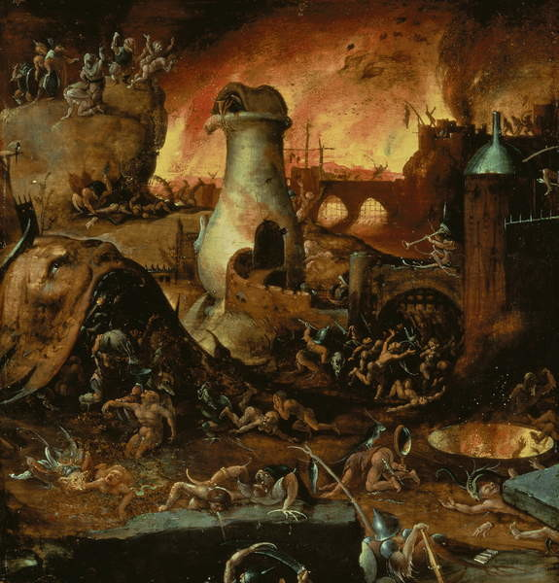
Hieronymous Bosch: Hell
How does this intertextual reference help to anchor meaning in Peaky Blinders?

Slide 6
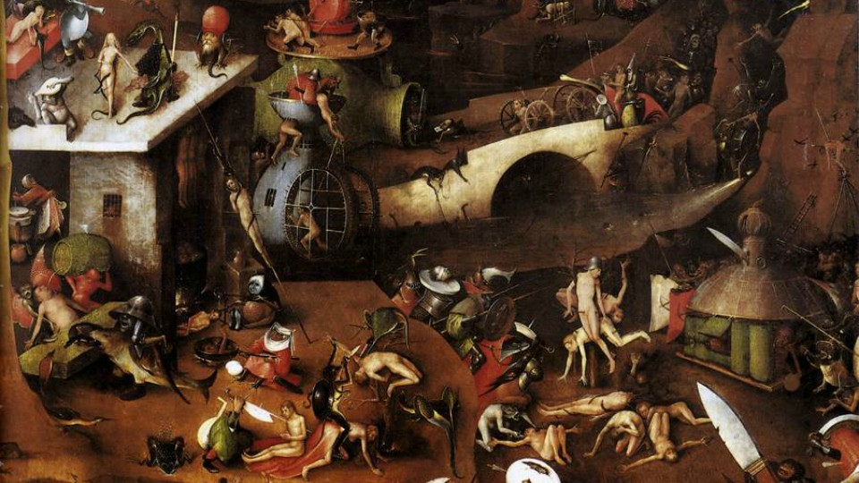
Bosch: The Last Judgement
How does this intertextual reference help to anchor meaning in Peaky Blinders?

Slide 7
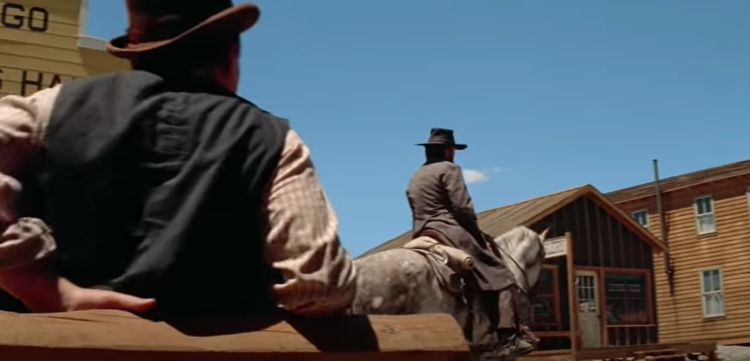
‘High Plains Drifter’ – remind you of anything?
https://www.youtube.com/watch?v=8IhindipjIM
How does this intertextual reference help to anchor meaning in Peaky Blinders?

Slide 8
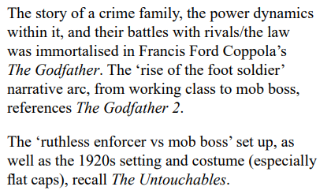
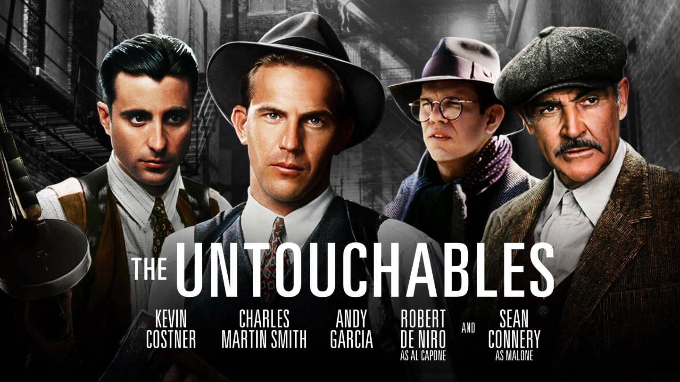
Gangster references

