Slide 1
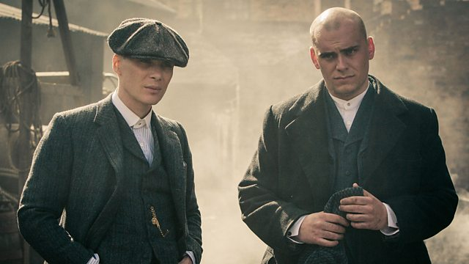
COM 2 SEC A
Television in the Global Age
THE BRIDGE / PEAKY BLINDERS
L3: PEAKY BLINDERS – HOW DO MEDIA LANGUAGE FEATURES COMBINE TO CREATE MEANING?

Slide 2
For this part of the exam, it’s really important to think of how things combine to create coherent meanings. In this text, the following elements are key to creating meaning:
Visual codes
Clothing
Iconography and setting
Gesture and expression
Visual technical codes such as tracking shots, editing and so on
Audio codes
Dialogue
Music

Slide 3
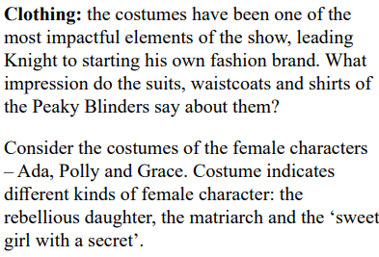
Codes of clothing
Task – answer the question at the end of the first paragraph
Then, write your thoughts about the costumes of the three women: Ada, Aunt Polly and Grace.

Slide 4
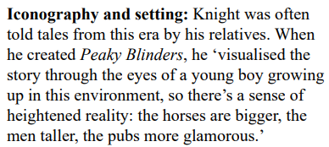
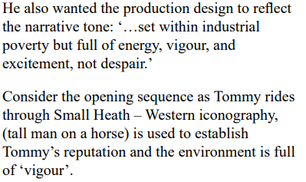
Setting and iconography

Slide 5
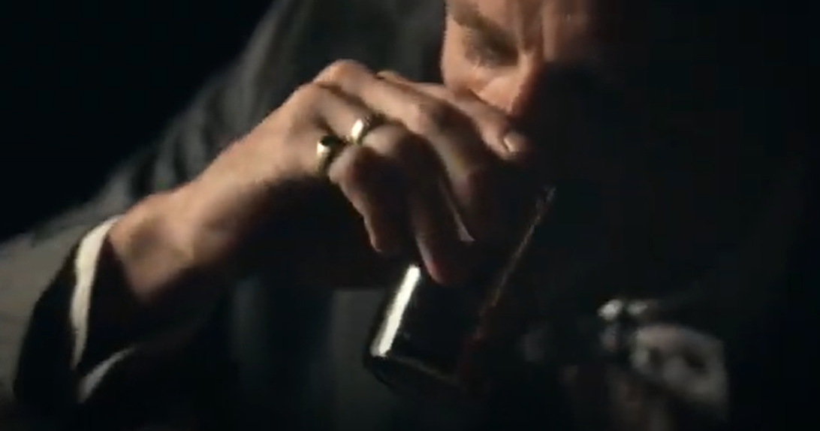
Codes of gesture and expression: look at this clip
Tommy and Arthur have a conversation

Slide 6
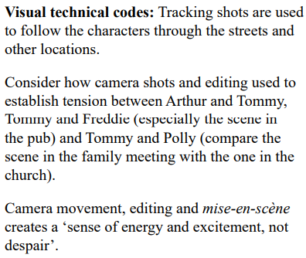
Visual technical codes
Task: re-watch the opening sequence with Tommy on a horse riding through Small Heath. Make notes on the camera methods (shot types, shot angles)
Make notes on the editing and link that to pace and this idea of ‘vigour’
Then, have a look at the scenes mentioned in the second paragraph – take notes.

Slide 7
Dialogue: look at this clip
Tommy and Arthur have a conversation

Slide 8
Music: Nick Cave - Red Right Hand
https://www.youtube.com/watch?v=RrxePKps87k
How does this intertextual reference help to anchor meaning in Peaky Blinders?

Slide 9
Take a little walk to the edge of town
And go across the tracks
Where the viaduct looms
Like a bird of doom
As it shifts and cracks
Where secrets lie in the border fires
In the humming wires
Hey man, you know
You're never coming back
Past the square, past the bridge
Past the mills, past the stacks
On a gathering storm comes
A tall handsome man
In a dusty black coat with
A red right hand
You don't have no money?
He'll get you some
You don't have no car?
He'll get you one
You don't have no self-respect
You feel like an insect
Well don't you worry buddy
'Cause here he comes
Through the ghettos and the barrio
And the bowery and the slum
A shadow is cast wherever he stands
Stacks of green paper in his
Red right hand
You'll see him in your nightmares
You'll see him in your dreams
He'll appear out of nowhere but
He ain't what he seems
You'll see him in your head
On the TV screen
And hey buddy, I'm warning
You to turn it off
He's a ghost, he's a god
He's a man, he's a guru
You're one microscopic cog
In his catastrophic plan
Designed and directed by
His red right hand
He'll wrap you in his arms
Tell you that you've been a good boy
He'll rekindle all the dreams
It took you a lifetime to destroy
He'll reach deep into the hole
Heal your shrinking soul
But there won't be a single thing
That you can do
He's a god, he's a man
He's a ghost, he's a guru
They're whispering his name
Through this disappearing land
But hidden in his coat
Is a red right hand

Slide 10
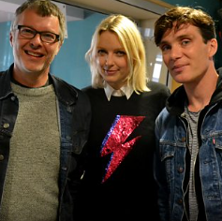
For more on the music, and some interesting background to the writing…
Lauren Laverne talks to Cillian Murphy and music producer Flood

Slide 11
To finish off, answer this:
HOW DO MEDIA LANGUAGE FEATURES COMBINE TO CREATE MEANING?
If you are short of time, do it as a series of bullet points first.
If you still have time, work it up into a media language style answer

