Slide 1
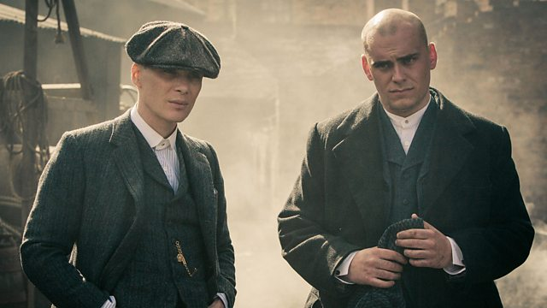
COM 2 SEC A
Television in the Global Age
THE BRIDGE / PEAKY BLINDERS
L4: PEAKY BLINDERS – HOW CAN MEDIA LANGUAGE THEORY BE APPLIED TO PEAKY BLINDERS?

Slide 2
Peaky Blinders Season 1 Episode 1
BBC iPlayer - Peaky Blinders - Series 1: Episode 1
BBC iPlayer - Peaky Blinders - Series 1: Episode 1

Slide 3
Starter
Please finish off the tasks from L3 ppt on media language (20 mins) – all on Satchel.

Slide 4
What theories does the board want you to study in relation to Peaky Blinders?
Media Language:
Narratology (Todorov) – use the 5 part version (google it!)
Genre Theory (Neale)
Structuralism (Levi-Strauss)
Postmodernism (Baudrillard)
Representation:
Representation Theories (Hall)
Feminist Theories (Van Zoonen, bell hooks)
Industry:
Regulation (Livingstone and Lunt)
Cultural Industries (Hesmondhalgh)
Audience:
Reception Theory (Hall)
Fandom (Jenkins)

Slide 5
Tasks
Media Language:
Narratology (Todorov) – use the 5 part version (google it!) – Belle, Grace, Letty
Genre Theory (Neale) - Layla, Jonty, Fred
Structuralism (Levi-Strauss) – Bea, Alissa, Flo, Sophie
Postmodernism (Baudrillard) – Smriti, Ben, Rosey
In your group, create a short guide to your theory, applied to Peaky Blinders. Think of three brilliant examples of the theory in action, and analyse them.
Please use the template on Satchel and adapt as appropriate. I will ask you to email me a digital copy of your response so that I can disseminate to the rest of the class.

Slide 6
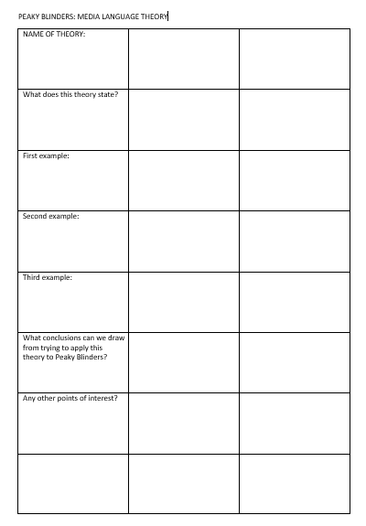
The template
Tips
Organise the group first – how are you going to work? Could you create something like a shared Google doc to help you collaborate, or do you want to organise one person to collate everything?
Revise the theory thoroughly first – use Mrs Fisher for a guide if you need to.
Skim watch (youtube does highlights) to find the right moments
It’s definitely worth googling your theory with Peaky Blinders (e.g. ‘Todorov and Peaky Blinders’) – lots of media students and teachers have created content on this exact subject. Make sure you ‘quality control’ before using it.

Slide 7
BBC iPlayer - Peaky Blinders - Series 1: Episode 1

Slide 8
BBC iPlayer - Peaky Blinders - Series 1: Episode 1

Slide 9
BBC iPlayer - Peaky Blinders - Series 1: Episode 1

Slide 10
BBC iPlayer - Peaky Blinders - Series 1: Episode 1

