Slide 1
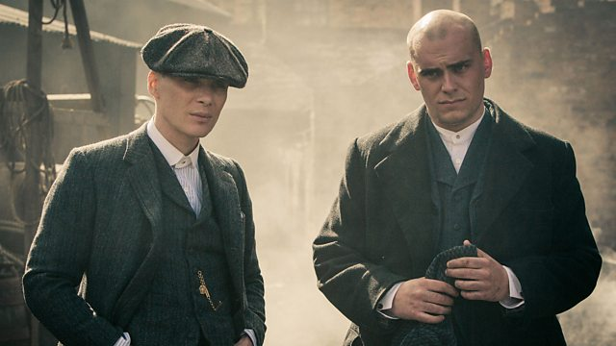
COM 2 SEC A
Television in the Global Age
THE BRIDGE / PEAKY BLINDERS
L5: PEAKY BLINDERS – REPRESENTATION

Slide 2
Peaky Blinders Season 1 Episode 1
BBC iPlayer - Peaky Blinders - Series 1: Episode 1
BBC iPlayer - Peaky Blinders - Series 1: Episode 1

Slide 3
Some reminders of what you already know…
BBC iPlayer - Peaky Blinders - Series 1: Episode 1

Slide 4
BBC iPlayer - Peaky Blinders - Series 1: Episode 1

Slide 5
Stuart Hall on constructing representations
BBC iPlayer - Peaky Blinders - Series 1: Episode 1

Slide 6
What is being represented in PB?
BBC iPlayer - Peaky Blinders - Series 1: Episode 1
Ideologies – political (strikes, first world war, Irish nationalism)
Places – Birmingham: Small Heath
Historical contexts – industrialization
Historical figures – Winston Churchill
Gangs
Crime
The Law
Men
Women
Family
Poverty
Mental illness
Any more?
Questions
How do the representations of various ideologies position audiences?
How does the historical context affect the representations?
How do the other representations position audiences?
Do the representations challenge or support stereotypes?
How could you apply representation theories to this text?

Slide 7
How do the representations of various ideologies position audiences?
BBC iPlayer - Peaky Blinders - Series 1: Episode 1
Are we positioned to be on the side of crime or the law? How?
Are we positioned to be sympathetic to communism or not? How?
Are we positioned to support the war or not? How?

Slide 8
How does the historical context affect the representations?
BBC iPlayer - Peaky Blinders - Series 1: Episode 1
There are two historical contexts: the 1920s and the present day. It is clear to see how modern-day interests are examined in Peaky Blinders. The focus on PTSD reflects our modern interest in and openness towards mental health.
The women are given agency – they are not just ‘bit parts’ or ‘decorative’. Their lives are examined in some depth, even though this feels like a ‘masculine’ story. (However, there are constraints because of the historical context – more on this later)
Can you think of others? Is the critique of war a modern interjection?

Slide 9
How do the other representations position audiences? Some thoughts…
BBC iPlayer - Peaky Blinders - Series 1: Episode 1
Are we positioned to read this as a feminist text? How?
Are we positioned to read this as a patriarchal text? How?
Are we positioned to read this as a critique of poverty? How?
Are we positioned to read this as a homage to the original Peaky Blinders?

Slide 10
How could you apply representation theories to this text?
BBC iPlayer - Peaky Blinders - Series 1: Episode 1
Representation theories for this text are:
Lisbet van Zoonen, bell hooks, Stuart Hall

Slide 11
Do the representations challenge or support stereotypes?
BBC iPlayer - Peaky Blinders - Series 1: Episode 1
Stuart Hall’s theory of representation is applicable when answering this question
So, what stereotypes might occur in this genre of TV drama?
Tough guy
Helpless woman
Depressing poverty
Brutalised workers
Communist troublemakers

Slide 12
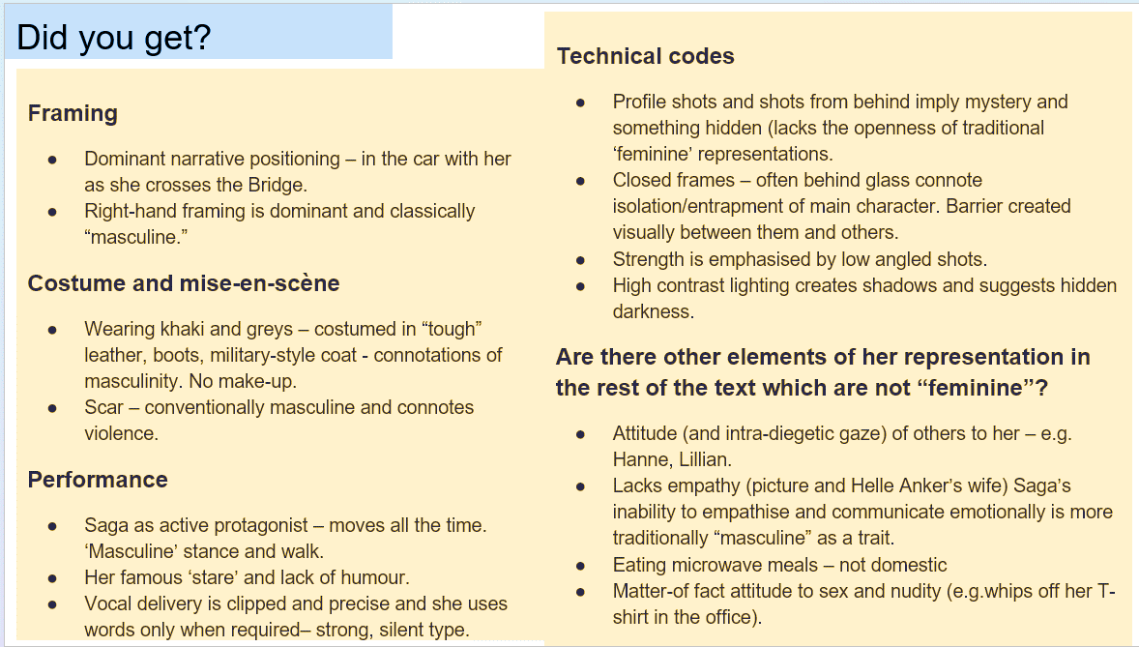
Here’s how you examined this very question for ‘The Bridge’
BBC iPlayer - Peaky Blinders - Series 1: Episode 1

Slide 13
Here’s what you already know about Van Zoonen:
BBC iPlayer - Peaky Blinders - Series 1: Episode 1
What follows are some slides from last year. We will go through these to revise The Bridge and to learn how to apply the theory to Peaky Blinders.
This will also help you with your homework.

Slide 14
Liesbet Van Zoonen
The Bridge challenges several ideas about representation.
Van Zoonen writes about female representation in the media and arts: she has written about different types of female representation
Van Zoonen argues that gender is constructed and that its meaning varies dependent on cultural and historical context.
She suggests that masculinity as well as femininity is constructed – and that the codes used to construct men ‘as a spectacle’ are different. But are they in The Bridge?

Slide 15
Van Zoonen
‘[There is] a depressing stability in the articulation of women’s politics and communication . . . The underlying frame of reference is that women belong to the family and domestic life and men to the social world of politics and work; that femininity is about care, nurturance and compassion, and that masculinity is about efficiency, rationality and individuality.’ – Van Zoonen
What examples from ‘The Bridge’ illustrate or challenge this concept?

Slide 17
Representation Theories: 1. Liberal Feminism
Fighting for power through the equal, legal rights of women in society
Media perpetuate sex role stereotypes because they reflect dominant social values
Male media producers are influenced by this
Men are not the enemy-can live alongside each other as equals
Women can be superwoman- home, family, body and work

Slide 18
Representation Theories: 2. Radical Feminism
Men control a patriarchal society through dominance and physical strength
Men have no place in feminist utopia
Believe in women dominating society
Reject typical gender roles
Media production is owned by men, operates to the benefit of the male and should be by women, for women

Slide 19
Representation Theories: 3. Socialist Feminism
Concerns with class and economics – ‘power is located in socio-economic structures’
Women’s ‘production of labour’ and the ‘economic value of domestic labour’ are not recognised
As this work is lower/unpaid, it is essential to maintain a capitalist society
Women as consumers in this society
Linked often to class, age and ethnicity
Advertising reinforces sexual objectification of women

Slide 21
But don’t forget…
BBC iPlayer - Peaky Blinders - Series 1: Episode 1
Peaky Blinders is a historical text and this can affect representations. It is a fact that gender roles in that era were much more rigid. Life was very difficult for everyone if you were poor but the ways that men and women struggled were very influenced by their gender.
Men were conscripted and suffered the appalling consequences
Women had no contraception and so were often pregnant and going through childbirth – deaths were common in those days, as were long-term, life-changing injuries
Men were expected to support their families financially. The expectation was that they would not really be involved in the care of their own children. Work for poorer men was often dangerous and very physically demanding
Women had little recourse to paid work – instead their substantial labour in the home went unpaid. Without money of their own, they were often utterly dependent on the men around them
For all of these reasons, in Peaky Blinders you would not expect to see a poor woman represented as the owner of a factory, or a man doing the cooking or washing up. But there are subtle ways of subverting stereotypes – after all, both men and women found ways to transgress. Humans always have!

Slide 22
ADMIN
Hand in homework please
NEA stuff – a quick follow up

Slide 23
bell hooks

