Slide 1
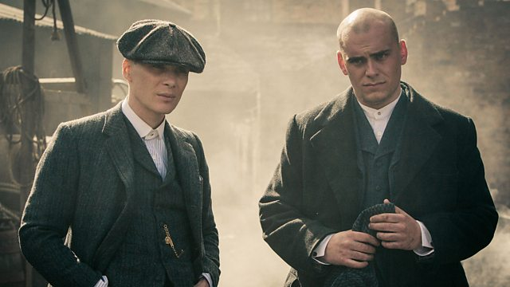
COM 2 SEC A
Television in the Global Age
THE BRIDGE / PEAKY BLINDERS
L9: PEAKY BLINDERS – MARKETING AND AUDIENCE

Slide 2
Peaky Blinders Season 1 Episode 1
BBC iPlayer - Peaky Blinders - Series 1: Episode 1
BBC iPlayer - Peaky Blinders - Series 1: Episode 1

Slide 3
The Impact of Media Technologies on Audiences
BBC iPlayer - Peaky Blinders - Series 1: Episode 1
Developing media technologies continue to have a profound effect on the way in which audiences use and engage with television products. With the advent of new technologies such as high definition (HD), Ultra HD and 4K, television screens have become much larger in recent years as picture quality and resolution has improved dramatically. Figures show that more than 70% of the country now have 50” or more screen TVs in their homes. This has been used to create a more immersive, cinematic experience for television viewers.
At the same time, the screens on which we watch programmes have also become smaller, with more people watching on smartphones, tablets and computers.
New technologies have also changed the way in which broadcasters and producers target, attract and reach their audiences. For example, social media has become an increasingly powerful tool for building audience engagement, while apps are increasingly used to target and interact with younger demographics in particular.

Slide 4
Task
BBC iPlayer - Peaky Blinders - Series 1: Episode 1
Write a paragraph explaining how you think new technologies have affected audiences, with a specific focus on Peaky Blinders (i.e. TV).
Consider the following:
Viewing situations (i.e. where/how we watch TV now)
Potential new ages of audiences (a wider age bracket due to iPlayer and Netflix taking away the idea of the watershed)
How social media is used
10 minutes

Slide 5
BBC iPlayer - Peaky Blinders - Series 1: Episode 1
The vicarious thrill of crime/ historical/ action
Traditionally ABC1 but this crosses over into C2DE because of its violence and intertextual links with Western and Gangster genres
Primary Target Audience – fans of crime texts = mainstream audience. 18+ (TV slot, violent content)
Peaky Blinders:
different lines of appeal to target specific audiences
Inherited fan bases – from e.g. Boardwalk Empire, fans of stars etc. (intertextuality with Cillian Murphy/Sam Neill).
Cross-gender appeal
Left-wing audiences may appreciate the alternative viewpoint being offered by the historical element of British history
Female viewers could admire the complex female characters that defy traditional stereotypes
Traditionally masculine viewers could identify with the tough male characters

Slide 6
When PB first aired…
BBC iPlayer - Peaky Blinders - Series 1: Episode 1
A negotiated audience enjoyed the text but thought it lacked originality and often seemed to mirror some of the key narrative themes of Board Walk Empire, an American text set in the same era. The text was accused of sacrificing its artistic merit and realism for mainstream convention. Others thought its failure to meet the heights of Boardwalk were down to budget.

Slide 7
Reviews picked up on this:
BBC iPlayer - Peaky Blinders - Series 1: Episode 1
The points of comparison between Peaky Blinders and HBO’s Boardwalk Empire are conspicuous. Both are set immediately after the first world was in a gangland in which the future is up for grabs; both feature a returning soldier shattered and embittered by his war experiences.
“Tommy is one of those men who came back from this war horrifically damaged, who were spat back into society without any counselling,,” said Murphy. “And, of course, a lot of them brought their weapons home with them. There were a lot of guns around at the time. Tommy has a huge disdain for authority – everything he was told is a lie."
‘In the end, Peaky Blinders flattered to deceive. Ultimately, it only served to prove that, when it comes to truly great shows, British TV still can’t match American television.’
The Daily Mail said they felt it was rushed; all style no substance – an oppositional response. This is coherent with the Daily Mail’s ideological position. It often opposes the BBC, seeing it as ‘woke’ and run by the ‘liberal elites’.

Slide 8
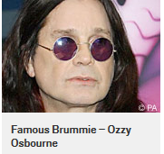
Attracting an audience
BBC iPlayer - Peaky Blinders - Series 1: Episode 1
One way Peaky Blinders attracted an audience, thus gaining a positive audience response, was via breaking the stereotypical representations of regional identity, in this case the ‘Brummie’.
A study was conducted in 2008 where people were asked to grade the intelligence of a person based on their accent. The ‘Brummie’ accent was ranked as the least intelligent accent.

Slide 9
Inheriting an audience…
BBC iPlayer - Peaky Blinders - Series 1: Episode 1

Slide 10
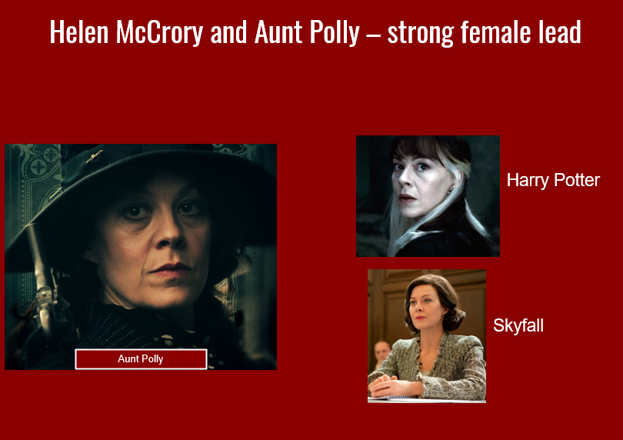
Appealing to female viewers
BBC iPlayer - Peaky Blinders - Series 1: Episode 1

Slide 11
Reviews improve – a preferred reading
BBC iPlayer - Peaky Blinders - Series 1: Episode 1

Slide 12
Trailers for each season
BBC iPlayer - Peaky Blinders - Series 1: Episode 1
Season 1
Season 2
Season 3
Observations? What changes? What stays the same? How are they appealing to different audiences?
https://www.youtube.com/watch?v=EM12mcTEI88
https://www.youtube.com/watch?v=W_62ZKR9rK0
https://www.youtube.com/watch?v=tTQhw37GTs8

Slide 13
Audience ‘pleasures’ task
BBC iPlayer - Peaky Blinders - Series 1: Episode 1
Choose 3 of the ‘pleasures’ below and give examples of how these are developed in the set episode of Peaky Blinders.
Audience expectations of genre
Pleasure in seeing expectations fulfilled or challenged (Neale).
Pleasure of intellectual puzzle
Enigma codes
Realism
Creates audience empathy and identification
Star/character identification
Escapism/
Diversion
Nostalgia
Safety
Moral messages
-Reinforces dominant ideologies
Catharsis
Emotional release, e.g. being made to cry
Scopophilia
Pleasure of looking

Slide 14
Two audience theories to finish
BBC iPlayer - Peaky Blinders - Series 1: Episode 1

Slide 15
Reception theory – Stuart Hall
BBC iPlayer - Peaky Blinders - Series 1: Episode 1
What the producers of a media text want an audience to think or feel as they watch.
Preferred reading
What do you think could be the preferred readings of Peaky Blinders?
What could be the negotiated/oppositional readings?
Oppositional readings –
When audience members completely reject the preferred reading of the text
Negotiated reading –
Midway between a preferred and oppositional reading - the audience engages with some aspects of the preferred reading, but not others.

Slide 16
Some thoughts about Reception Theory
BBC iPlayer - Peaky Blinders - Series 1: Episode 1
Negotiated meaning: the audience accept some of the intended meaning but reject others. Some viewers may enjoy the depictions of industrial areas as vibrant and exciting but may find the stylised violence upsetting.
Oppositional meaning: the audience reject the intended meaning and instead formulate their own interpretation. They may find style of the show off-putting and superficial and the historical accuracy dubious (factually, the Blinders mainly operated in the late 1800s, not the 1920s). They may also reject the use of anachronistic punk and rock music annoying.

Slide 17
Fandom – Henry Jenkins
BBC iPlayer - Peaky Blinders - Series 1: Episode 1
Henry Jenkins argues that fans form part of a ‘participatory culture’ in which audiences are active and creative participants in a text.
They also engage in textual poaching – selecting the elements of a text which are most appealing to them & using these elements as the basis of fan art, gifs, artefacts, cosplay, etc.
Jenkins also asserts that fandom is deeply personal and creative relationship with media products. He believes that particularly genre films and TV can unite marginalised people and even be appropriated for political purposes (e.g. the use of the three finger salute from The Hunger Games by Hong Kong democratic protestors).

Slide 18
Fandom research task
BBC iPlayer - Peaky Blinders - Series 1: Episode 1
Research the information available with regards to how fans have engaged with Peaky Blinders across the globe, and explain how fans “participate” actively and “creatively”.
Are there examples of “textual poaching”? (Look at fan art/fan fiction examples)
Put together a fact file to demonstrate your understanding of Jenkins’ theory and Peaky Blinders fans.

Slide 19
BBC iPlayer - Peaky Blinders - Series 1: Episode 1

Slide 20
BBC iPlayer - Peaky Blinders - Series 1: Episode 1

Slide 21
BBC iPlayer - Peaky Blinders - Series 1: Episode 1

Slide 22
BBC iPlayer - Peaky Blinders - Series 1: Episode 1

Slide 23
BBC iPlayer - Peaky Blinders - Series 1: Episode 1

Slide 24
BBC iPlayer - Peaky Blinders - Series 1: Episode 1

