Slide 1
Cross Media Production Coursework: Magazines
L1: COM 3 NEA
LQ: What is the brief and how do we plan our time?

Slide 2
Before we start…a note about assessment week
Your mock paper will be an entire paper 1 (COM 1) section A and section B. This means that your revision needs to cover everything we have studied this year.
Explanation of predictions
ALSO
Re: Opportunity for Media Students
‘I hope you’ve been having a super week. I am getting in touch as we are making preparations for Founder’s Day (27 June) and I wanted to check if any of the media students would like to be involved this year. There is a really nice opportunity for them to have some experience of a live event. We usually have 3-6 students to operate cameras for the event, but they have also previously had occasion to experience the sound and lighting and other elements of the show.
Would you mind having a conversation with the students and letting me know if they would like to be involved again this year.
Many thanks, b’

Slide 3
Teaching next term (June, July)
Tuesday: curriculum teaching (Com 2 Sec A)
Wed: NEA
Thurs: NEA
Fri: NEA
Unless specified, assume that your homework is to revise for mocks and/or work on NEA
The plan is to have the NEA finished around half term of the Christmas term.

Slide 4
NEA: Non-examined Assessment
This is component 3 of your qualification. It is worth 30% of the marks
You must produce:
Research and planning for your cross-media production
A ‘Statement of Aims’
Production Work
Paperwork – cover sheets
Production Work:
2 magazine front covers: one from the UK and one from an international version of the magazine.
One 400 word article based on a cover line from either of the front covers.
…And EITHER a podcast OR a YouTube channel about the magazine’s launch
Paperwork:
Online cover sheets (see back of booklet)

Slide 5
Representations of particular social groups
‘Your print production must construct representations of at least one social group and include a minimum of 6 original images’
‘The podcast / YouTube sequence must construct representations of at least one social group’
Make sure your specialist subject features real people!

Slide 6
Representations of particular social groups
GUIDANCE
Students must use media language to construct particular representations of people.
Therefore, it is imperative that students include images of people in their production, so that they can do this
Make sure students don’t choose a genre that makes it hard for them to have real people in the images
It is acceptable for students to construct representations of people of different ages using their peers; for example, a classmate might play the part of an older character, model or singer
The representation should be constructed by, for example, scripting any dialogue appropriately, using appropriate dress codes and gesture codes etc. It must be obvious to the examiner that this is what you have done. (For example, if I get a picture in a ‘fashion’ magazine of a load of students in grubby clothes lined up in front of wheelie bins in someone’s back garden, I won’t consider it a carefully constructed representation…)

Slide 7
Finally…
Start taking pictures as soon as possible: the more you have to choose from, the better
Read your NEA guide really carefully and keep it with you as you work
Expect me to interject some teaching, such as a lesson on how to write your statement of aims when you get a bit closer to that point. Otherwise, I will be ‘uninvolved’ in your work, as per the guidelines to teachers.
Come and see me straightaway if you are getting behind, overwhelmed, tearful etc. I promise I will be nice to you if you see me in good time.
Enjoy the independence and creativity!
I am sure I will forget something, but if I do I will get on to it immediately
Deadlines will appear as we start working

Slide 8
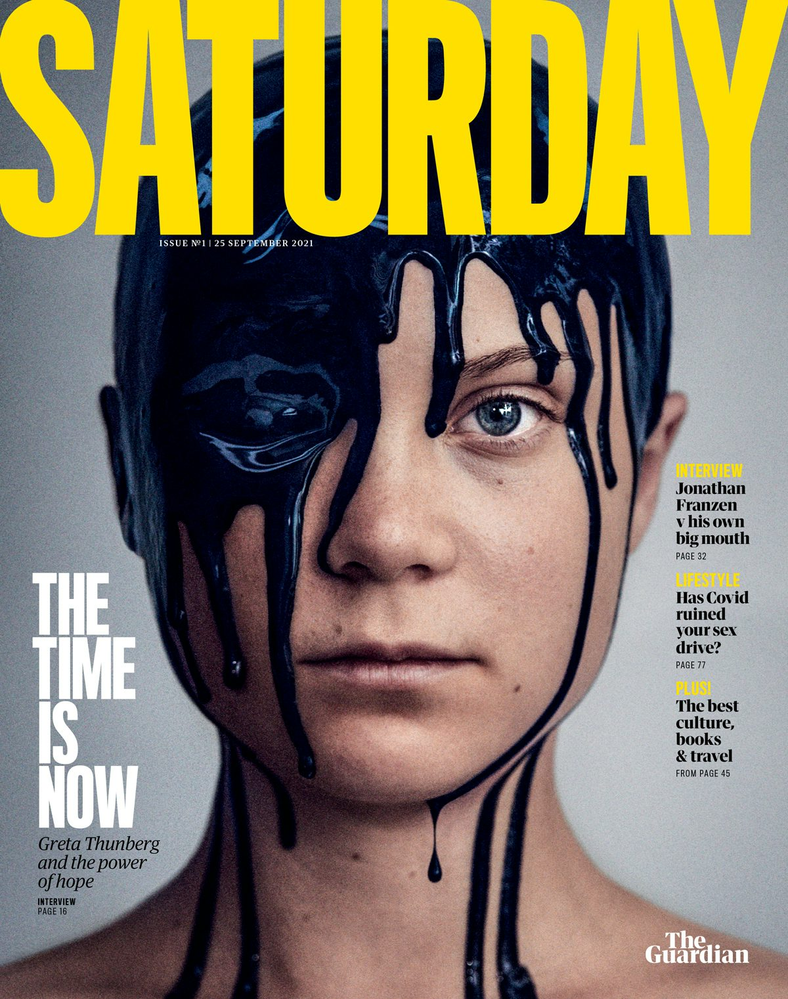
How does it construct a representation?
How does it help with layout?
Could you do this?
What music goes with this and why am I asking?

Slide 9
How does it construct a representation?
How does it help with layout?
Could you do this?
What music goes with this and why am I asking?

Slide 10
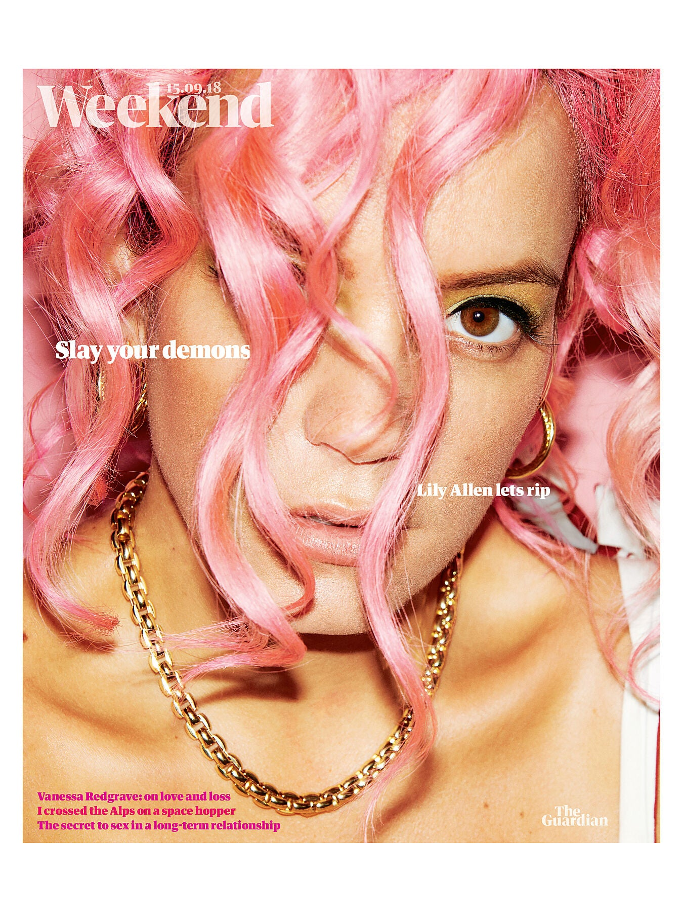
How does it construct a representation?
How does it help with layout?
Could you do this?
What music goes with this and why am I asking?

Slide 11
How does it construct a representation?
How does it help with layout?
Could you do this?
What music goes with this and why am I asking?

Slide 12
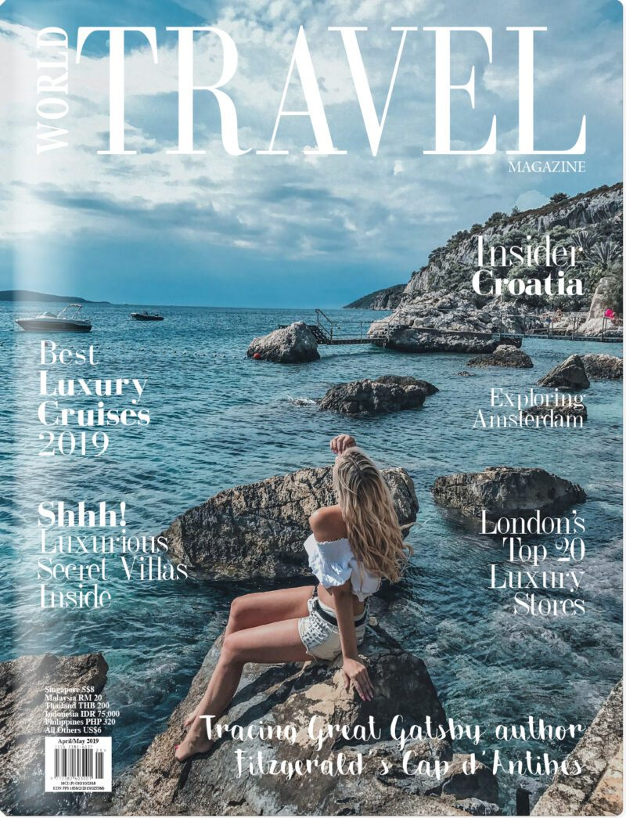
How does it construct a representation?
How does it help with layout?
Could you do this?
What music goes with this and why am I asking?

Slide 13
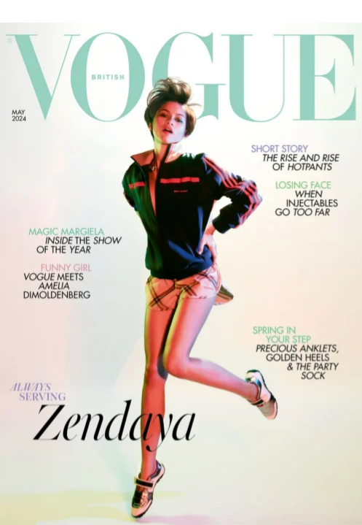
One is Vogue UK and one is Vogue USA. Can you tell which is which?
Vogue May 2024
Vogue May 2024

Slide 14
A note about copyright
You must use uncopyrighted music. There are websites that offer this and apps and programs often have their own music options. Do your research!

Slide 15
Software that year 13 used – KEEP A RECORD!
Soundlab (podcast)
Phone’s photo editor
Fotor (photo editing)
Publisher (magazine layout)
Pixlr (photo editing)
Audacity (sound editing)
InShot
Picsart
iMovie
Adobe Express
Capcut (video editing)
Clipchamp (video editing)
Canva (magazine layout – don’t use pre-supplied templates)
Cloudconverter for getting files into the correct format
How to save a file:
SMITHAlison2222COVER1
SMITHAlison2222COVER2
SMITHAlison2222DPS
SMITHAlison2222PODCAST
Or
SMITHAlison2222VIDEO
ACCEPTED FORMATS FOR PRODUCTION:

