Slide 1
Cross Media Production Coursework: Magazines
L3: COM 3 NEA
LQ: What shall I do over the holidays?

Slide 2
In September I expect…
All of the research and planning to be done
Plenty of photos taken (don’t forget you have to REPRESENT A CLEAR ‘TYPE’ OF PERSON in your photos) – please check this with me. I will be asking questions about this before you go on holiday to ensure you’ve understood this properly.
Article drafted
Statement of Aims drafted (see next few slides)
A FOLDER with all the research and planning in (digital or physical)

Slide 3
Key Reminders
Representations of particular groups
Rules around plagiarism
Information about how to draft your STATEMENT OF AIMS (500 – 550 words)

Slide 4
Representations of particular social groups
‘Your print production must construct representations of at least one social group and include a minimum of 6 original images’
‘The podcast / YouTube sequence must construct representations of at least one social group’

Slide 5
Representations of particular social groups
GUIDANCE
Students must use media language to construct particular representations of people.
Therefore, it is imperative that students include images of people in their production, so that they can do this
Make sure students don’t choose a genre that makes it hard for them to have people in the images
It is acceptable for students to construct representations of people of different ages using their peers; for example, a classmate might play the part of an older character, model or singer
The representation should be constructed by, for example, scripting any dialogue appropriately, using appropriate dress codes and gesture codes etc.

Slide 6
Plagiarism: what the board says
You are required to create original material for this component. The use of existing media brands or products is not permitted and the images, footage and text that you use in your media production must be original. You are permitted to use existing generic logos such as production company logos, logos for social media sites, age certificate logos and barcodes.
You are permitted to use an existing song by a band or artist for the music video production option, provided the track chosen for the music video does not have an existing video.
You may use existing music for an audio-visual soundtrack, but this must be royalty-free. Can I Use This Song In My Podcast? It Depends. - Lexology
All other aspects of the cross-media production must be your own, original work.
Any non-original music used as a soundtrack or in a music video must be acknowledged on the cover sheet.
You should create different material (such as images, footage, or written text) for each cross- media production task. Images/sections of written text must not be repeated in the cross- media production.

Slide 7
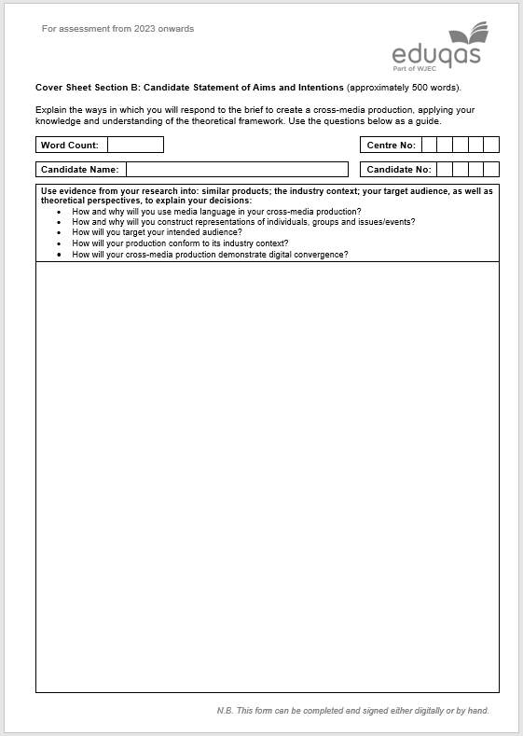
The Statement of Aims (10 marks)
Use evidence from your research into: similar products; the industry context; your target audience, as well as theoretical perspectives, to explain your decisions:
How and why will you use media language in your cross-media production?
How and why will you construct representations of individuals, groups and issues/events?
How will you target your intended audience?
How will your production conform to its industry context?
How will your cross-media production demonstrate digital convergence?
500 words – five bullet points

Slide 8
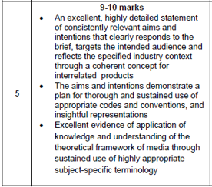
How do you do well?

Slide 9
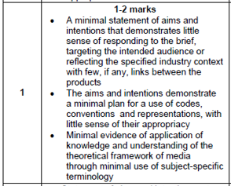
How do you do badly?

Slide 10
How and why will you use media language in your cross-media production? In this example, the first paragraph is an introduction. The second paragraph deals with Media Language. It is too long – how would you shorten it?
My cross-media production consists of a fashion magazine and linked podcast aimed at 16-25 year old reformers, explorers and aspirers of all genders. The emphasis will be on sustainability, ethical fashion and upcycling but with a focus on high-end styling.
The media language will reflect the aims and values of my production through careful use of colours. Greens and other natural tones will feature heavily on the front cover and be echoed throughout the production. The podcast will reflect this through its soundbed, which will include the sounds of nature, and also through location, which will be in a natural setting. My presenters will be young and represent all genders. My images will be inclusive and diverse and the models will wear recycled, upcycled or second-hand clothing. The codes of gesture, posture and expression will echo those used in upmarket magazines such as Vogue, using long-shots to allow clear displays of clothing and mid-shots to focus on hair and makeup, maybe with some lower angles to create an ‘edgy’ dynamic feel. There will be a carefully controlled colour palette and artistic arrangements of mise-en-scene. The linguistic codes of my article and the podcast will be both thought-provoking and thoughtful to reflect the serious-minded personality of my typical reader. (138 words)

Slide 11
How and why will you construct representations of individuals, groups and issues/events? An example of how to write well about your plans for representation. Again, it is too long. How would you shorten it?
I aim to consistently represent diverse young people who care about the future of our planet and who are fully engaged in political issues, perhaps even involved in activism. I will do this through my selection of models who will represent all genders and ethnicities, body shapes and abilities, partly inspired by Vogue’s recent diversity campaign. I want to represent this lifestyle as attractive, so the models will be photographed in excellent lighting, with opulent natural settings and artistic poses. They will wear dramatic and flattering makeup and the hair and clothing will reflect the shapes and silhouettes of high-end fashion.
Models will be photographed in groups to represent the idea of collective action and a move away from the cult of the individual. Natural settings will be used to help construct the representation of people who care about biodiversity and nature. Post-production editing will ensure that the final representation is polished and professional, with a focus on natural beauty, so there will only be minimal retouching. In the podcast, these representations will be reinforced through the choices of presenters (young, diverse) and their linguistic codes (serious, aspirational, intelligent), alongside the music, which might include artists such as Young Fathers, a band that encapsulates ideas of political awareness and diversity.

Slide 12
How will you target your intended audience? Write about the following:
Clearly state who audience are: paint a picture of a type of person, their interests and values.
Connect the media codes to these interests and values.
Consider pricing and availability (where will it be sold? How often will it come out?) of magazine.
Consider pricing/funding and availability of podcast/video. Will your audience accept advertising?

Slide 13
How will your production conform to its industry context? Write about the following:
Clearly state which pre-existing texts belong to the same category or ‘family’ as your texts. Imagine a supermarket shelf. What publications would sit next to yours?
Explain how your production is recognisably part of this family. For example, if you judge that your magazine should sit on the same part of the shelf as Vogue, you need to demonstrate why. It could be the insistence on high-end fashion, moody and innovative photography, glossy paper, price, font etc.
Do the same with the podcast/video

Slide 14
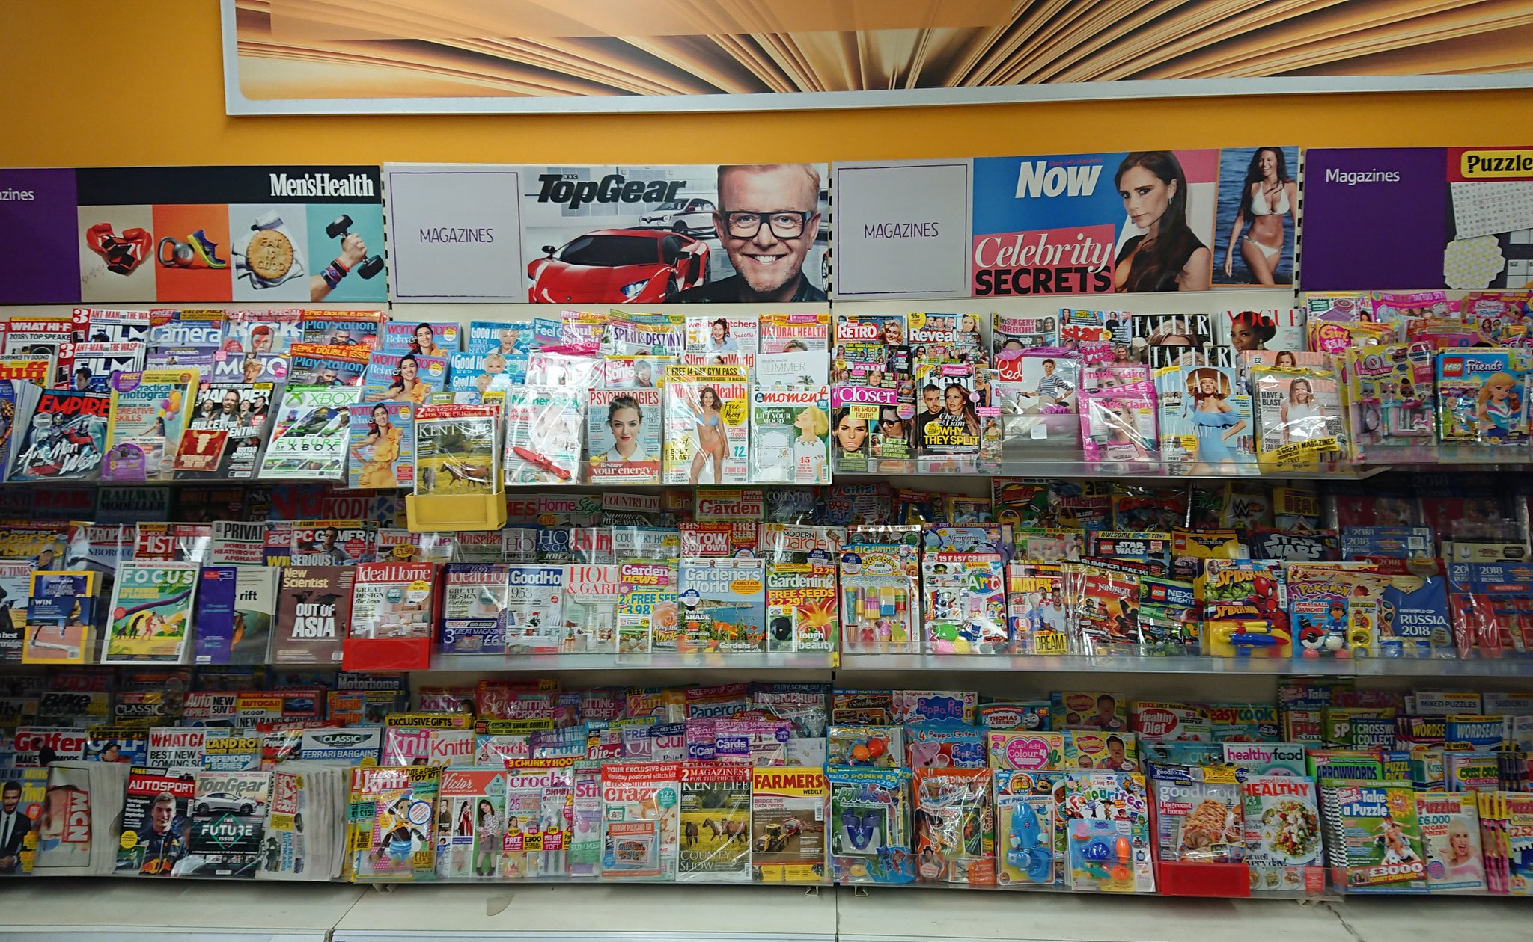

Slide 15
How will your cross-media production demonstrate digital convergence?
In this section, you need to show how it is clear that your magazine and your podcast/video are the same brand.
This requires a lot of creative thinking, particularly if you are doing the podcast as you can’t rely on visuals. Consider linguistic codes and soundscapes.

Slide 16
Final thoughts
To stay within the word limit, make sure you save the right things for the right sections. In my models, for example, I feel I have not always done this, saying things about representation that could go in the audience section. I’ve also not considered royalty issues.
Once you have written it, reflect! Where have you written inefficiently? Can you use one word instead of ten? Is everything in the right category?
Your categories don’t have to be equal. I feel like representation and media language could well be a bit longer than industry context.
Media terminology! Theories (where appropriate)!

Slide 17
Video for you
A Level Media NEA - Writing the Statement of Aims - YouTube

Slide 18
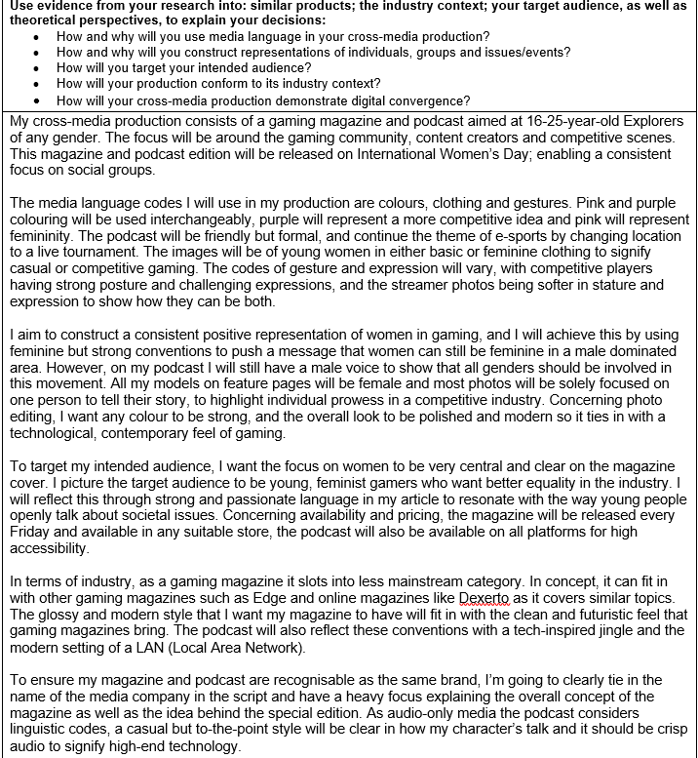
A good SOA example

