Slide 1
LO TBAT: setup and run the Jenness Jar Experiment
Zimbardo et al. (1973)

Slide 2
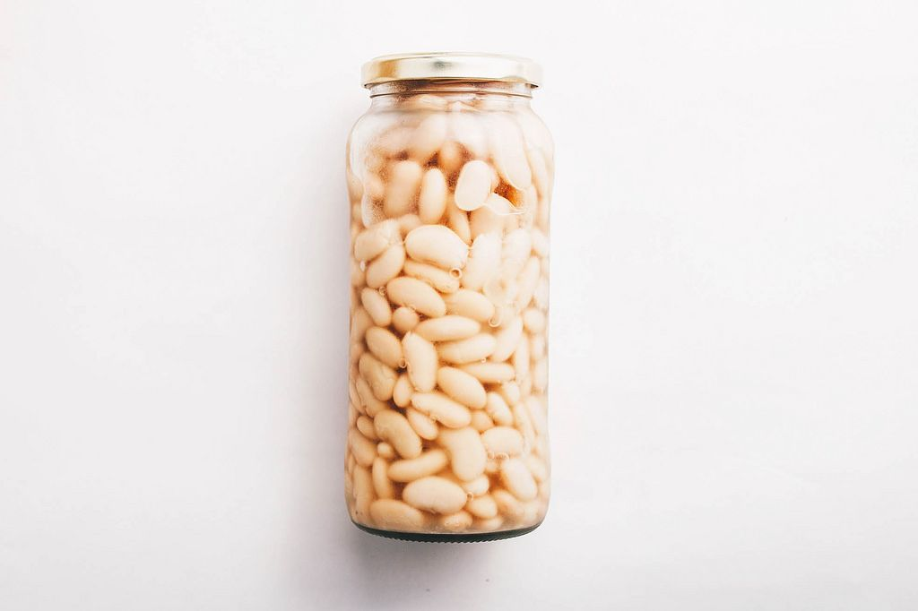
Jenness (1932)
Glass bottle with 811 white beans
101 psychology students → individual estimates of beans → mean = 875
Divided into groups of three – came up with group estimates
Individual estimates were given again
Nearly all pts changed their original answer by a huge margin (mean change = 319)
This demonstrated conformity to a group - the group is thought to be more likely to be right (informational social influence) when the situation is unclear (ambiguous)

Slide 3
What you will need
A large jar of sweets / lego bricks / marbles / anything small!
  You will be working in groups of 3-4, you will need a similar jar each!
  Consider how many items will be in your jars – e.g., 100
Two recording sheets
  Sheet 1 – 4-5 fake answers (in different handwriting!) with a mean of 50
  Sheet 2 – 4-5 fake answers (in different handwriting!) with a mean of 150
  The number of items in the jars is about 1/2 between the fake means

Slide 4
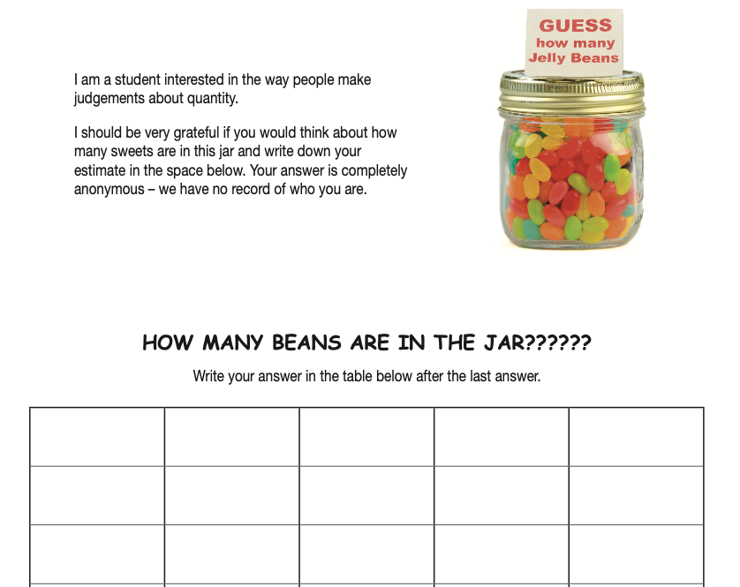
Recording sheet
Create a recording sheet
  Instructions to pts
  Ethics (privacy)
38
61
45
59

Slide 5
Each person in your group should
Collect data from about 2-3 pts for
  Sheet 1 and
  Sheet 2
The data must be collected individually (don’t get pts into groups)

Slide 6
What should happen
Participants should give estimates close to the fake estimates on each sheet
The task is ambiguous (no clear answer) so pts may conform through informational social influence

Slide 7
What to bring back
Collect about 2-3 people each
Combine your group data for each sheet
Return with the means and ranges for each sheet
A summary table and bar chart of your findings
A brief conclusion from your findings
Note – don’t worry if doesn’t work – think about why!

Slide 8
Example
Sheet | No participants | Mean estimate | Range
1 (fake mean = 50) | 10 | 58.5 | 12
2 (fake mean = 150) | 8 | 130.7 | 18

