Slide 1
LO TBAT: describe and evaluate the Asch (1955) studies into conformity

Slide 2


Slide 3
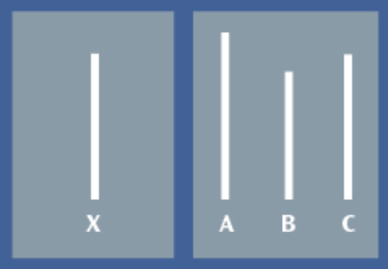
The ‘baseline’ study – who, what
Asch (1951)
123 American men*
X = standard line
ABC = comparison lines
Notes:
123 American men (spot a potential problem?)

Slide 4
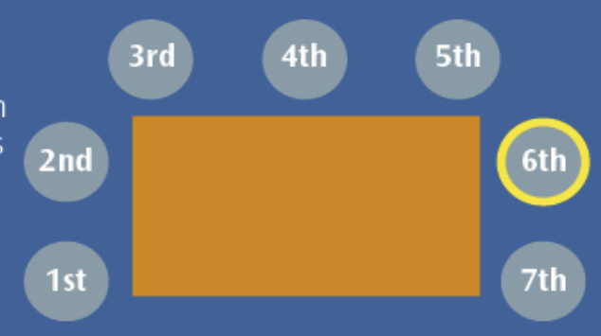
The ‘baseline’ study - how
6 = genuine participant
The others = confederates (fake participants)
The confederates all gave the same scripted answers (deliberately getting it wrong)

Slide 5
The ‘baseline’ study - findings
Results
Conclusions
Ps went along with the group about 1/3 of the time (36.8%)
25% of Ps never conformed
Ps will conform to a group when presented with the Asch line comparison test some of the time
However, there are ‘individual differences’ – some P never conform to the majority view

Slide 6
Whiteboards - quiz
Describe the task
Describe what the confederates did
Give the % of time participants conformed
What % never conformed?
What does the % who never conformed tell us?

Slide 7
Whiteboards - answers
Describe the task
Describe what the confederates did
Give the % of time participants conformed – 36.8%
What % never conformed? 25%
What does the % who never conformed tell us? There are individual differences in conformity

Slide 8
Assessment Objectives
A01: descriptions, definitions, explanations
A02: application (methods, maths, scenarios)
A03: evaluation (strengths, weaknesses, evidence for/against, alternative viewpoints)

Slide 9
Asch (1955) – ‘variables’ impacting conformity
Group Size
Unanimity
Task difficulty

Slide 10
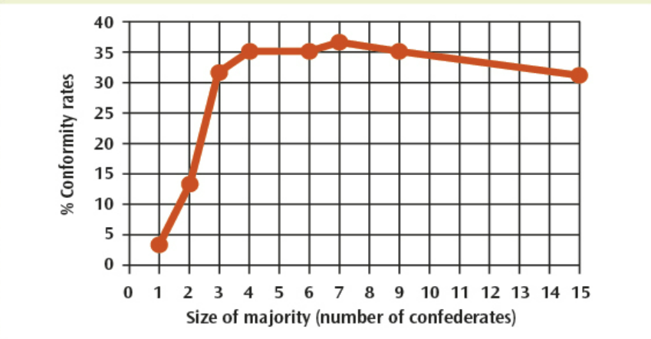
Asch (1955) – Group Size
Notes:
Asch found that group size affected level of conformity – up to 3 confederates levels increased, thereafter they tended to plateau.

Slide 11
Asch (1955) – Unanimity
One confederate who disagreed with the rest
Conformity decreased – the participant had an 'ally'
Conformity dropped by 75%!

Slide 12
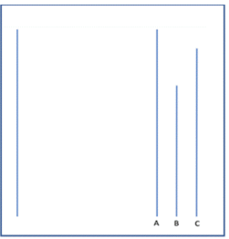
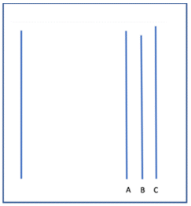
Asch (1955) – Task difficulty
Notes:
When the task got harder, conformity went up – informational social influence – we look to others because the majority might have the answer

Slide 13
Asch (1955) – for each variable you need:
What the variable was (1-2 sentence definition)
The procedure - what was done
The findings (results– data, conclusions – what the data meant)
LEFT HAND SIDE

Slide 14
Evaluation of Asch (1955): use book headings!
How valid* was the method (artificial situation and task)?
How generalisable is the research (other genders, cultures)?
What do other studies tell us?
  Do they support Asch?
  Do they suggest there is more going on?
How useful are the findings – can they be applied to help in the real world?
How ethical was the research – did the benefits outweigh the ethical costs?
Note: a study can be unethical, but still scientific!!
Hint: use the eXtra evaluation box
RIGHT HAND SIDE
Notes:
Validity = truth – was Asch really measuring real world conformity, or just whether people went along with a lab task that they thought didn’t really matter

Slide 15
What you need to find out / do
A01 (description) – Asch (1955)
A03 (evaluation)
Group Size
Unanimity
Task difficulty
2-3 strengths
2-3 limitations (weaknesses)
Use a table or create bullet points
Have a mixture of + and – points.
Counter-points are fab (however…)
You must give details – explain why something is a strength or a limitation

Slide 16
Describe and evaluate Asch’s research into conformity (16)
6 marks of A01 – what Asch did, found, concluded
10 marks of A03 –
  Strengths and limitations
  2-3 strengths
  2-3 limitations
  These should be detailed, linked together, and cover a range of issues that the study raises (scientifically, ethically)

