Slide 1
LO TBAT: describe and evaluate the Zimbardo study into conformity to social roles
Zimbardo et al. (1973)

Slide 2
On your whiteboards, write down what you see / think is happening in the images
Participant selection
Procedure
Realism
Ethics
Behaviour from participants
Anything else you see!

Slide 3
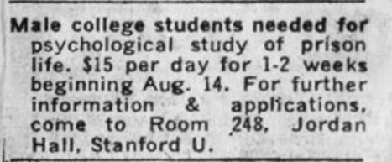
Discuss what you see: participants, procedure, ethics, realism, behaviour seen

Slide 4
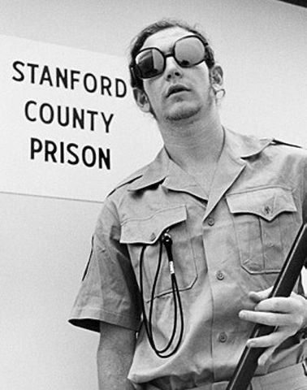
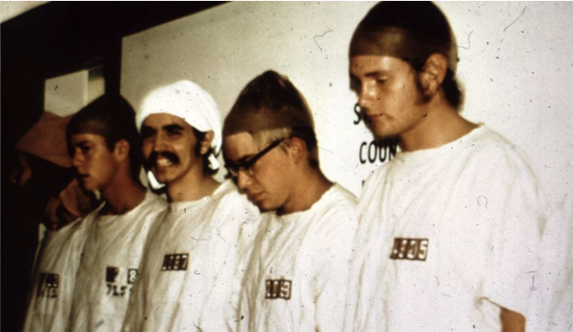

Discuss what you see: participants, procedure, ethics, realism, behaviour seen

Slide 5
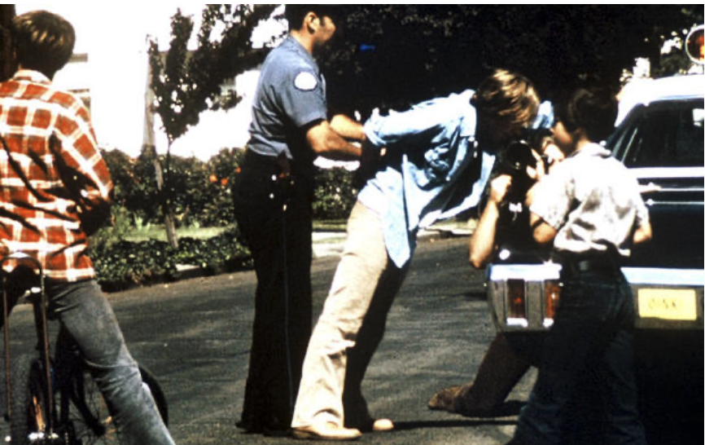
Discuss what you see: participants, procedure, ethics, realism, behaviour seen

Slide 6
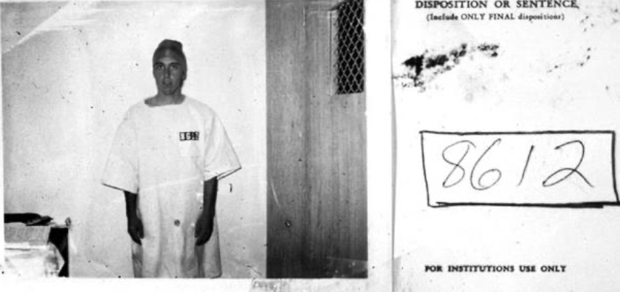
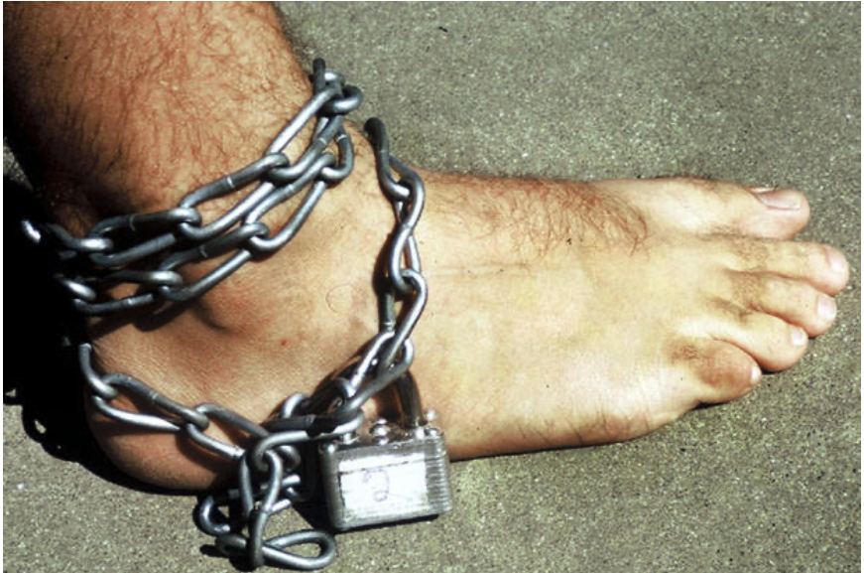
Discuss what you see: participants, procedure, ethics, realism, behaviour seen

Slide 7
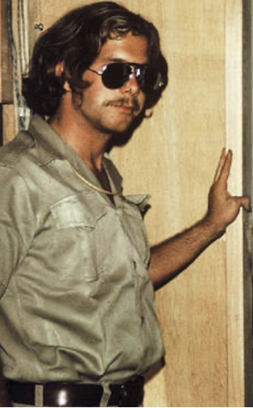
Discuss what you see: participants, procedure, ethics, realism, behaviour seen

Slide 8
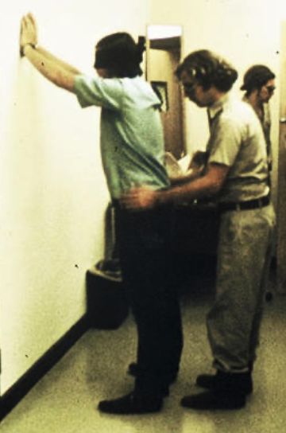
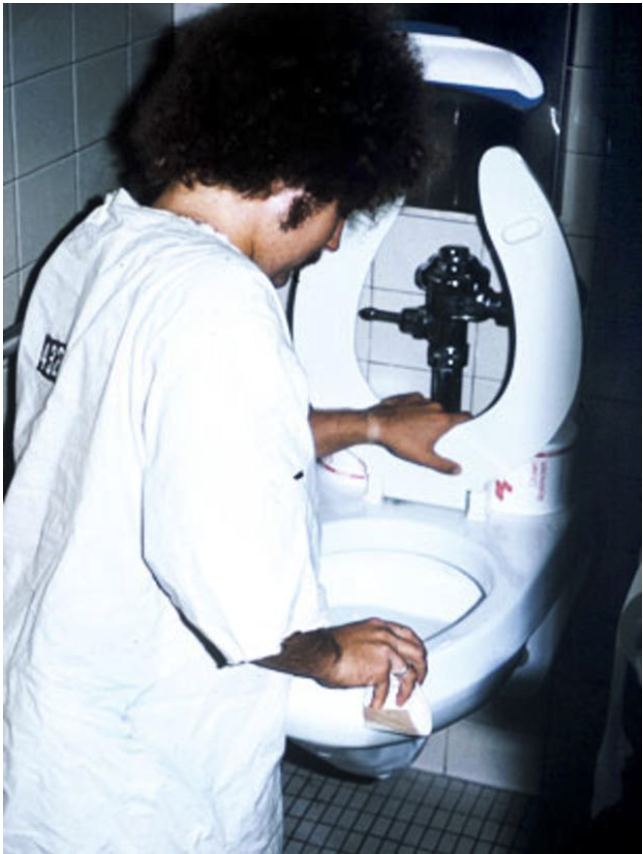
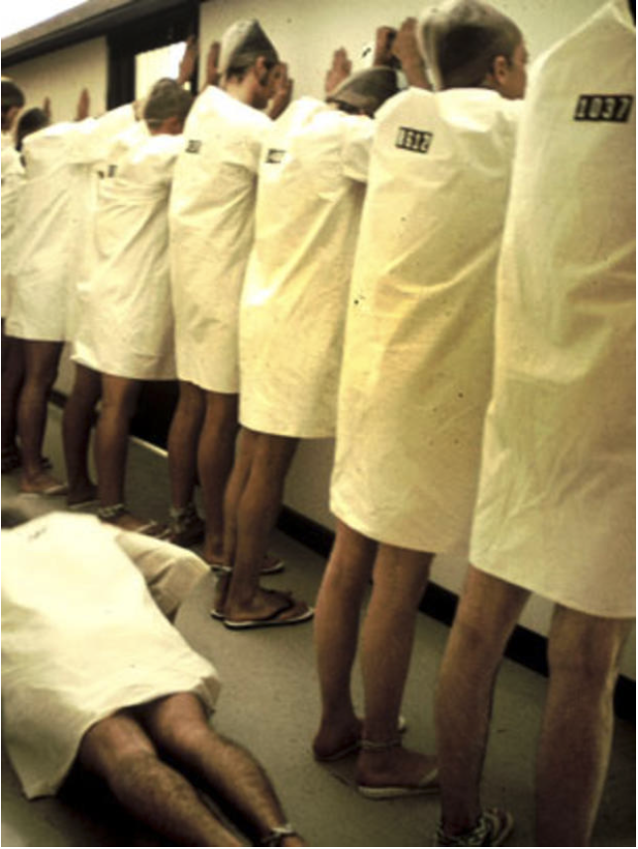
Discuss what you see: participants, procedure, ethics, realism, behaviour seen

Slide 9
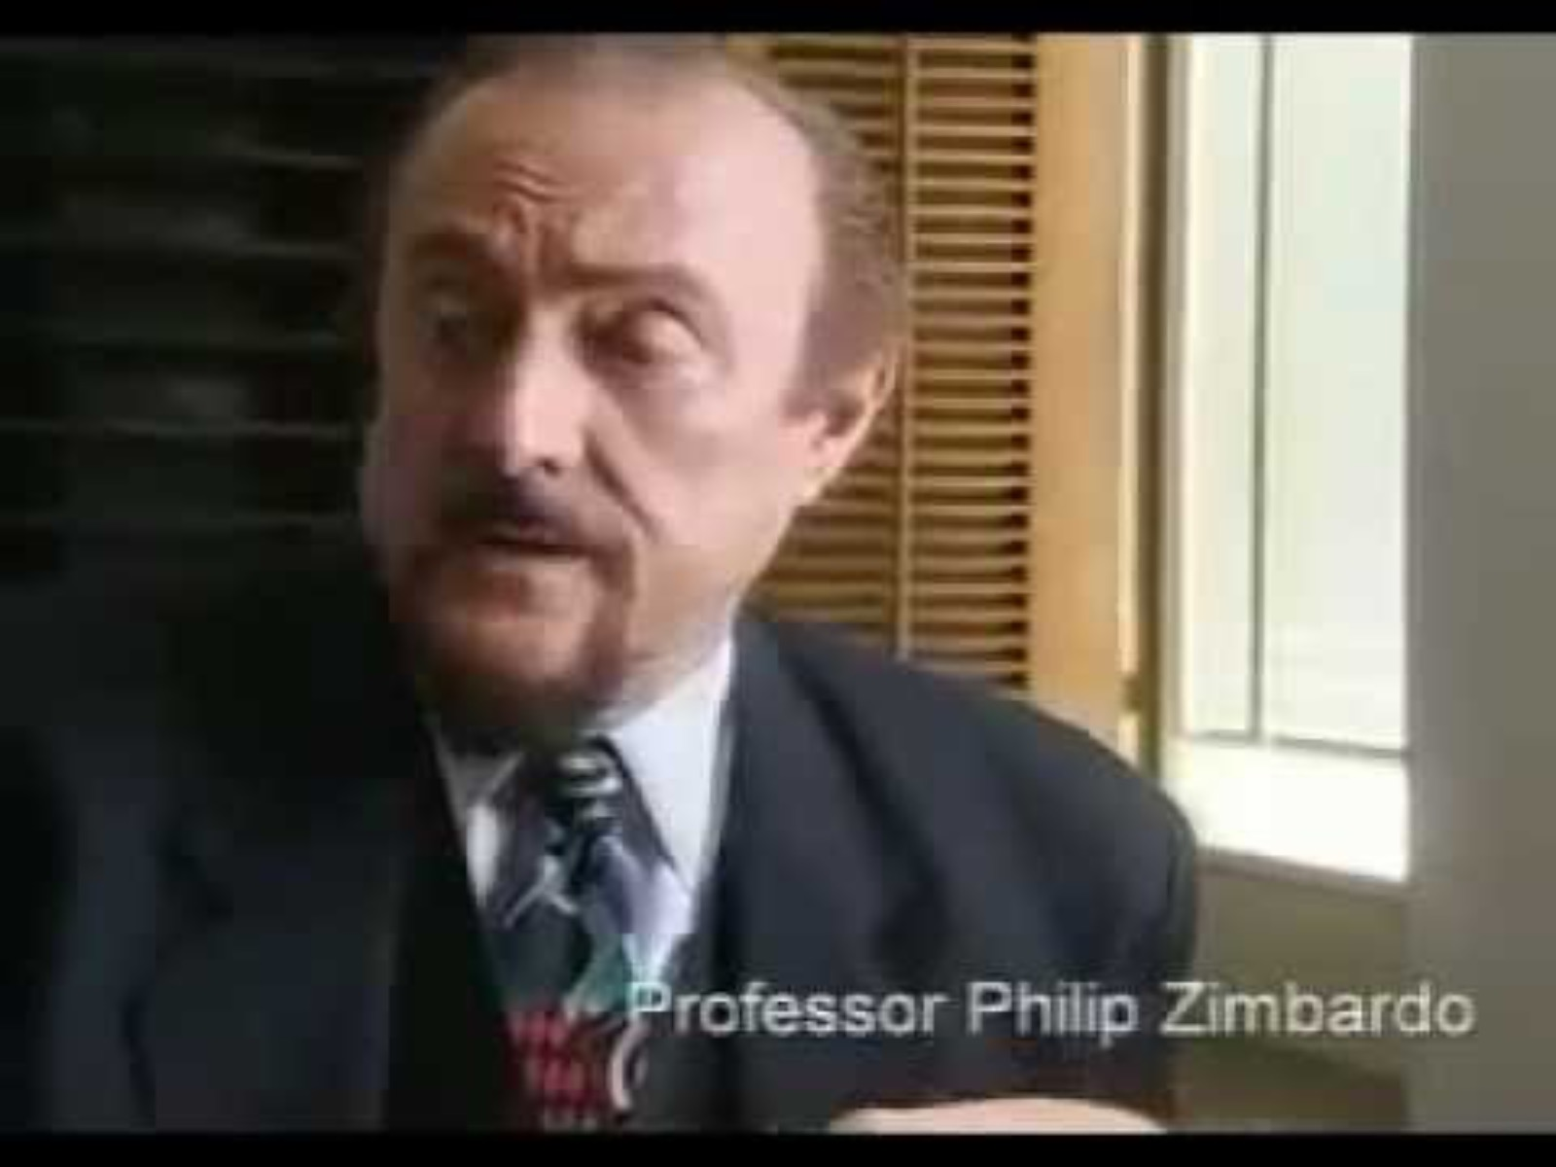
Documentary on Zimbardo et al. (1973)
Notes:
Show 5-10 minutes of documentary

Slide 10
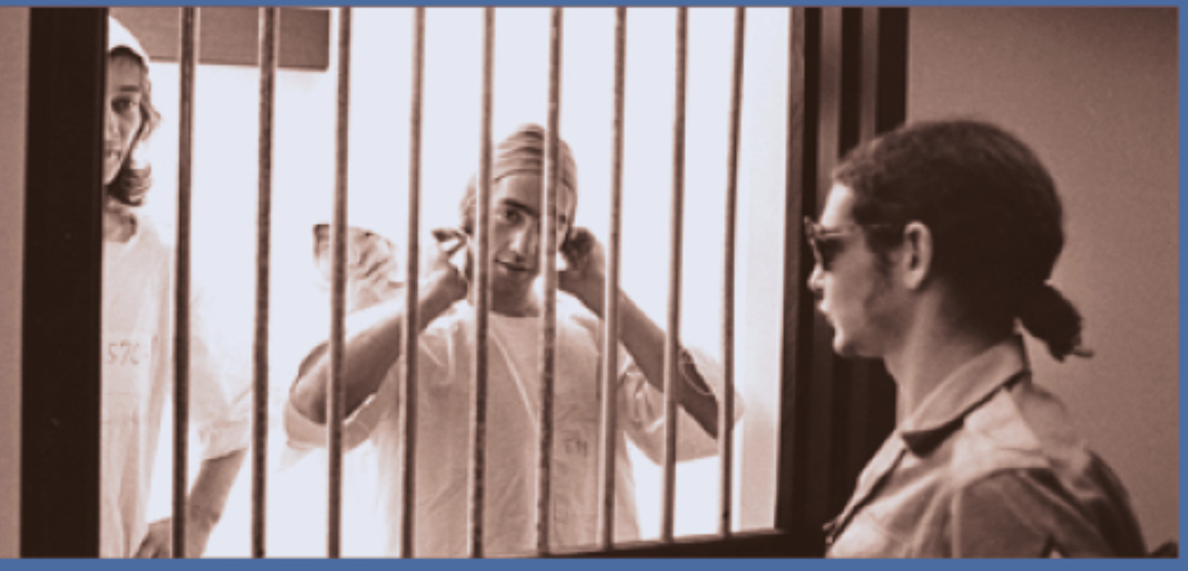
Zimbardo et al. (1973) – participants and setup
21 men – ‘emotionally stable’
Randomly assigned to ‘prisoner’ or ‘guard’
To make the situation more ‘real’ prisoners were arrested at their homes
The ‘prison’ was a set of rooms / corridor in Stanford University
Prisoners and guards were given uniforms and encouraged to ‘identify’ with their social roles
Notes:
123 American men (spot a potential problem?)

Slide 11
Zimbardo et al. (1973) – Day 1
9 men arrested by Palo Alto police – charged with burglary and armed robbery
Brought to a ‘prison’ in Stanford Uni psych building
Prisoners → stripped, wore a numbered shift, delousing spray
Guards → sunglasses, uniform
Some guards mocked naked prisoners

Slide 12
Zimbardo et al. (1973) – Day 2
Prisoners confined to cells
After a full day of prison and a 2.30 AM wake up call – prisoner rebellion
Guards sprayed fire extinguishers at prisoners and stripped cells of mattresses
Prisoners → stripped, wore a numbered shift, delousing spray
Rebels put in the ’Hole’

Slide 13
Zimbardo et al. (1973) – Day 3
Guards get prisoners to do pushups, stop bathroom access
#8612 → shows start of mental breakdown → released once Zimbardo realised how much 8612 was suffering

Slide 14
Zimbardo et al. (1973) – Day 4
Prisoners divide into rebels and ‘snitches’
#819 → starts crying
Guards make prisoners chant abuse about 819
#819 → released

Slide 15
Zimbardo et al. (1973) – Day 5
Friends and family brought in for ‘visit’
Some parents investigate use of lawyer for early release
Christina Maslach, a PhD student, visits and questions ethics of study
Zimbardo starts to consider ending the study

Slide 16
Zimbardo et al. (1973) – Day 6
Zimbardo ends study and meets with all guards and prisoners to discuss what happened
Prisoners who left early returned to discuss thoughts and feelings
Zimbardo originally planned the study to run for 14 days

Slide 17
Zimbardo et al. (1973) – months later
#416 writes to Zimbardo about the time spent in the Hole
I began to feel that I was losing my identity, that the person that I called Clay, the person who put me in this place, the person who volunteered to go into this prison - because it was a prison to me; it still is a prison to me. I don't regard it as an experiment or a simulation because it was a prison run by psychologists instead of run by the state. I began to feel that that identity, the person that I was that had decided to go to prison was distant from me - was remote until finally I wasn't that, I was 416. I was really my number.

Slide 18
Zimbardo et al. (1973) – conclusions
Social roles have strong influence on behaviour – brutal guards, submissive prisoners.
Social roles can be very easily adopted
Notes:
(including by volunteers who came in from outside to function as a ‘prison chaplain’).

Slide 19
Zimbardo et al. (1973) – Evaluation Summary
Strengths
Limitations
Control over key variables: emotionally stable pts only, random role assignment
Pts behaved as if roles were real to them
Can explain how ‘Abu Graib’ happened
Orlando (1973) → staff who became mock psychiatric patients → lost self identity → became patients
Ethics – harm, consent, right to withdraw
Validity – Zimbardo was prison governer and psychological observer
Sample bias, mundane realism (play acting prisoners/guards)
Lack of exact replication
Only 1/3 conformed to social roles

Slide 20
Zimbardo et al. (1973) – Evaluation Exercise

