Slide 1
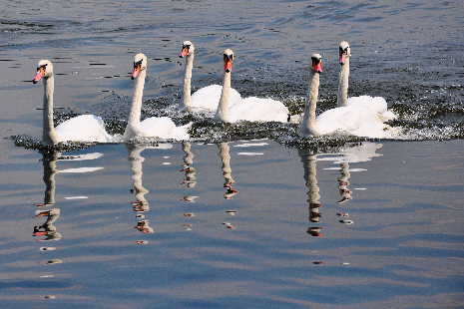
All swans are white

Slide 2
So go looking for all the white swans to prove it

Slide 3
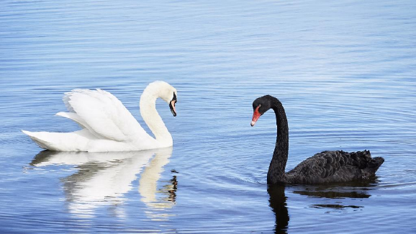
But what happens when you meet a black swan?

Slide 4
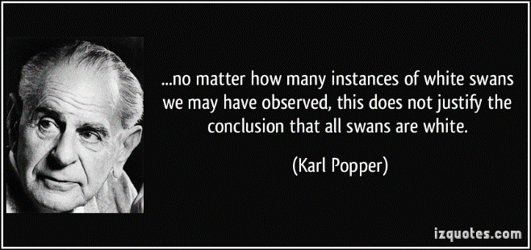
Karl Popper thought differently

Slide 5
Start with:
Not all swans are white

Slide 6
So science should be about disproving theories not proving them

