Slide 1
LO TBAT evaluate the reliability and validity of the DSM diagnostic system

Slide 2
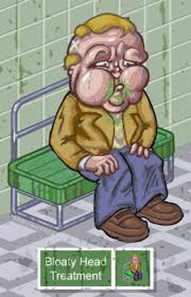
George
George goes to his GP. The GP diagnoses bloaty head.
George isn’t sure about this diagnosis so he goes to another GP at a different practice. This GP also diagnoses bloaty head.
George is now really worried. He travels to Paris to see a famous French doctor. She diagnoses George with Hairritis
What’s going on? Think about validity and reliability!

Slide 3
Reliability of diagnosis
A diagnosis is reliable if two or more clinicians agree that the patient has the same disorder (inter-rater)
A diagnosis is also reliable if the patient is diagnosed repeatedly with the same disorder (test-retest)

Slide 4
Validity of diagnosis
A diagnosis is valid if it is accurate and useful
Being reliable doesn’t mean being valid!
Etiological validity = different patients show the same symptoms for a disorder
Concurrent validity = two different tests for a disorder agree on the diagnosis
Predictive validity = the symptoms the patient shows accurately predict the disorder the patient has/will be diagnosed with

Slide 5
Classifying and diagnosing mental illness
There are two main ‘manuals’ that get used to diagnose mental illness:
The WHO International Classification of Diseases (ICD) – started in 1948
The APA Diagnostic and Statistical Manual of Mental Disorders (DSM) – started in 1952
Both are designed to allow a clinician to determine a diagnosis and therefore course of treatment from behavioural symptoms (e.g. hallucinations)
You need to be able to describe and evaluate the use of these manuals
Are they valid?
Are they reliable?

Slide 6
The DSM
Diagnostic and Statistical Manual of Mental Disorders (APA, US manual)
Focuses only on mental disorders
Origins in the US Army after WWII
The latest version is DSM V
It’s controversial - homosexuality wasn’t removed until 1973 (DSM III-TR) - and sexual orientation disorder (which replaced it) didn’t go until 2000!!!
It doesn’t just have V versions - each is updated - so DSM-IV-TR is a revision of the DSM IV
It’s gone from 106 disorders in 1952 to around 374 today

Slide 7
DSM-V (5)
Three sections -
Section I: guidance about using the system
Section II: classifications of main MH disorders
  What symptoms are seen
  How many
  Over what period
  Issues in diagnosis
Section III:
  New disorders (Internet Gaming Disorder)
  Impact of culture on symptoms and culture based syndromes (e.g. Ghost Sickness)
  Cultural formulation interview to help with disorder diagnosis
A MHD is classified based on symptoms and bio/social factors shown by patient

Slide 8
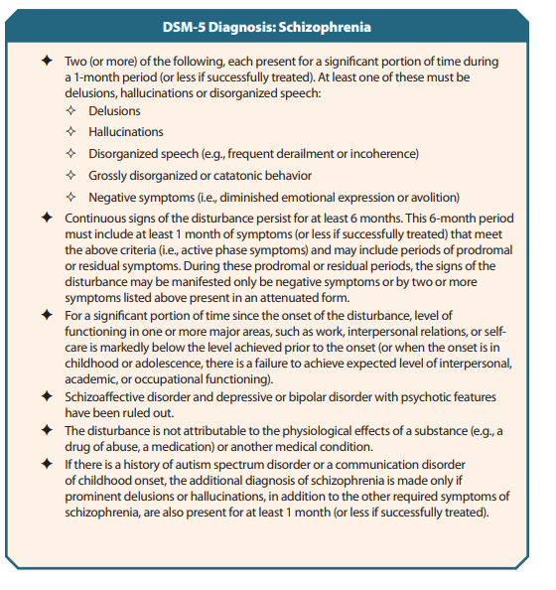
II. Main MH Disorder Classification

Slide 9
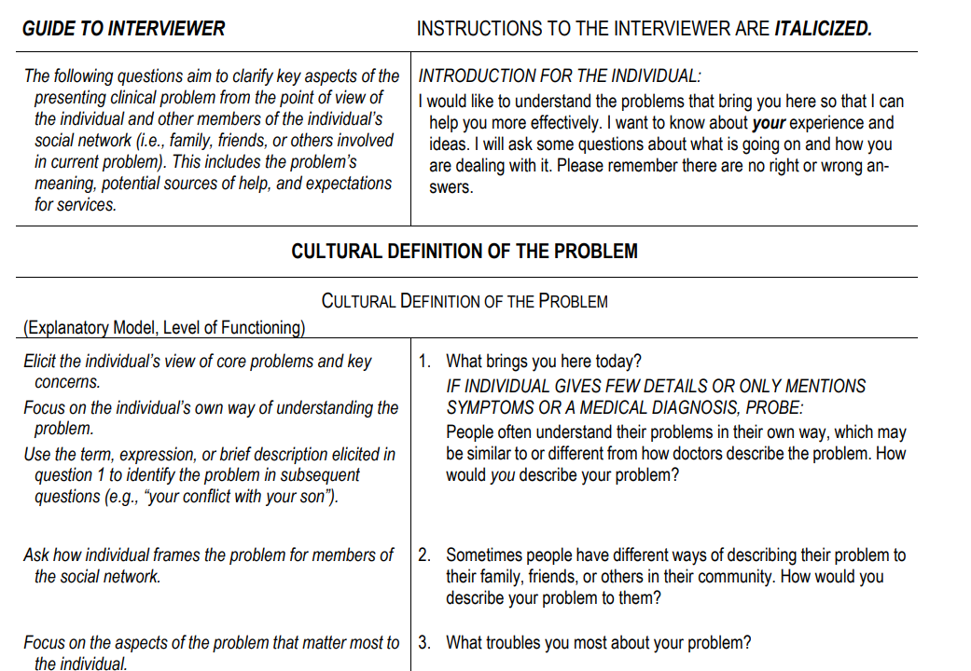
III. Cultural Formulation Interview

