Slide 1
LO TBAT describe and evaluate drug treatment for Schizophrenia

Slide 2
Treatment Questions
Is it effective? (does it work, for how long for, for whom?)
Is it appropriate (ethical, side effects?)

Slide 3
Keywords
Term | Definition
Antipsychotic | A drug used to treat psychotic disorders
Typical antipsychotic | Block D2 receptors to reduce dopamine activity and therefore reduce positive symptoms Developed in 1950s Example: Haloperidol Noted for side effects such as tardive dyskinesia
Atypical antipsychotic | Temporarily block D2 receptors – reducing dopamine activity/positive symptoms Newer versions work on glutamate rather than dopamine control (see Carlsson contemporary study) Developed in 1990s Example: clozapine Fewer side effects (less chance of TD) – still can have impact on e.g. weight gain
Tardive dyskinesia Extra-pyramidal effects | Involuntary neurological muscle movements Can be permanent Can be result of typical antipsychotics (less so for atypical)

Slide 4
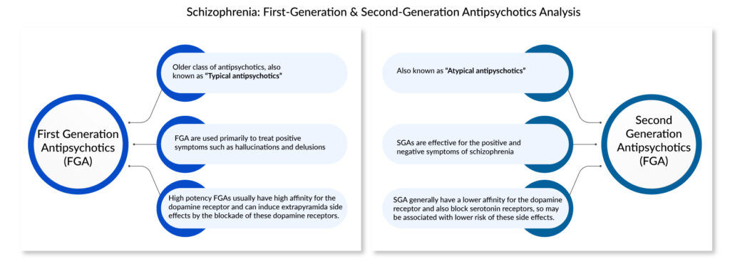

Slide 5
Examples of FGA and SGA drugs
FGA | SGA
Chlorpromazine (1950s) | Clozapine (1960s)
Dopamine antagonist | Serotonin antagonist
Reduces +ve symptoms | Reduces +ve & –ve symptoms
Tardive dyskinesia | Weight gain Lowered white blood cell count (Agranulocytosis)

Slide 6
Main classes of drugs
Typical (FGA) antipsychotics: chlorpromazine
Atypical (SGA) antipsychotics: clozapine
Extension: Third GA antipsychotics: target glutamate
Search for the two drugs above using:
  clozapine mind and/or clozapine NHS
  chlorpromazine side effects

Slide 7

Living with tardive dyskinesia

Slide 8

Antipsychotic drugs tutorial

Slide 9
Finding out about this(A01 + A03)
A01: | A03
What do FGAs do?
How effective are they? | Zhao et al. (2016) meta-analysis +ve Patel et al. -ve
What are the side effects | What impact might side effects have on the effectiveness of these drugs?
What do SGAs do? | Lots of evidence from animal studies: -ve Publication bias in studies: -ve
How effective are they? | Application: +ve
How should drugs be administered? (protocol) | What external factors can impact the effectiveness of these drugs?

Slide 10
What are the differences?
FGA – typical – Chlorpomazine – 1950s | SGA – atypical – Clozapine – 1960s
Dopamine antagonist (reduce the action) | Acts on serotonin (antagonist)
Reduces positive symptoms | Reduces positive + negative symptoms
Side effect issues: tardive dyskinesia | Side effects: e.g., weight gain, white blood cell issues

