Slide 1
L/O TBAT discuss situational explanations of obedience
Agency Theory
Legitimacy of Authority

Slide 2
The My Lai Massacre (Vietnam, 1968)
26 US soldiers entered My Lai village on March 16, 1968
They rampaged through the village – killing men, women and children
None of the victims were enemy soldiers
Around 500 innocent people were killed, many women were raped
Only Lt. William Calley (platoon leader) was convicted of the killings
His defence: he was obeying the orders of his superior officer

Slide 3
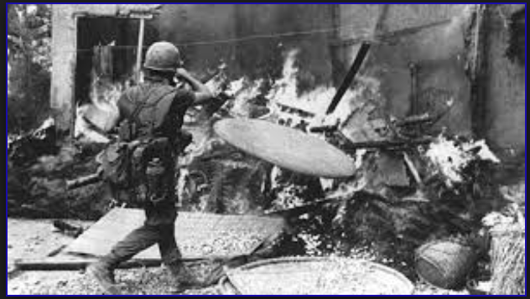
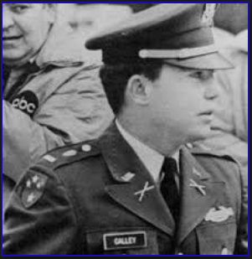
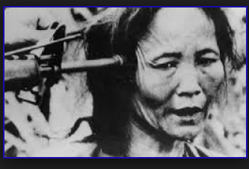
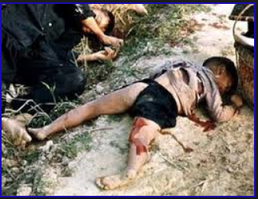

Slide 4
Calley was sentenced to prison in 1971, but was quietly pardoned in 1974 by President Nixon

Slide 5
Albert Eichmann
Eichmann organised the ”Final Solution” – the mass execution of Jews during WW II
“I was not a responsible leader, and as such do not feel myself guilty.” – spoken at his trial in 1961
Eichmann’s defence → Milgram’s ideas about how obedience to ‘destructive’ authority occurs

Slide 6
”I just obeyed orders.”
Who was responsible? (My Lai, Milgram, Holocaust)
Think
Pair
SHARE what you’ve found with the group

Slide 7
Milgram thought this happened to participants who obeyed…
Pts start in AUTONOMOUS state
Experimenter is seen as authority figure
Shift to AGENTIC state
Exp has more power and higher position in social hierarchy

Slide 8
Agency Theory – Behaviour has two opposing states
Agentic State – people:
Autonomous State – people:
Act on behalf of authority figure
Don’t use their free will
Put responsibility onto authority figure
Can experience moral strain
Reduce moral strain by using binding factors - e.g., shift responsibility to victim
Use free will and take responsibility for own actions
Notes:
Create sheet – heading – key terms → term/definition/example – put in definitions part of folder
(anxiety and stress) → result of going against own conscience
Behaviour has two opposing states:
Autonomous – we use our free will and take responsibility for our own actions
Agentic – we act on behalf of another – we don’t use our free will and we are ‘used’ as a means to an end (i.e. the responsibility isn’t ours)
Moral strain – the consequences of going against your own conscience and doing something you know to be wrong – this a consequence of acting in a agentic state
When we obey a ‘legitimate’ authority figure we tend to use the agentic state
We move between the autonomous and agentic state
Binding Factors – aspects of a situation that allow us to ignore/minimize the damage our own behaviour is doing and help us reduce moral strain
Milgram thought that humans developed the agentic/autonomous states as evolutionary responses – our ancestors survived through obeying authority and forming law-abiding societies – without obeying rules society would fall into chaos!

Slide 9
Using Agency Theory
Come up with an example of when you:
Acted autonomously – and explain why!
Acted agentically – and explain why!
When you experienced moral strain
If you struggle – come up with some imaginary examples (e.g. bullies and their cronies in a playground/office etc.)
Notes:
Then explain My Lai – agency theory
Agentic state: The soldiers on the ground at My Lai took their orders from their commanding officer, Lt Calley. He took his orders from higher-ranking officers in other locations. All could deny personal responsibility for their behaviour because they perceived themselves to be acting as agents of a higher authority. They were not following the dictates of their own consciences, so were not in an autonomous state where they could behave freely and independently. This agentic shift occurred when the soldiers joined the army.

Slide 10
My Lai and the Agentic State
Explain the behaviour of the soldiers in My Lai in terms of the agentic state (order, agency, autonomy, responsibility)
Took orders from Lt Calley
Became agents of Calley’s authority → deny personal responsibility
Not in autonomous states to act freely
Agentic shift happened when they joined the army
Notes:
Agentic state: The soldiers on the ground at My Lai took their orders from their commanding officer, Lt Calley. He took his orders from higher-ranking officers in other locations. All could deny personal responsibility for their behaviour because they perceived themselves to be acting as agents of a higher authority. They were not following the dictates of their own consciences, so were not in an autonomous state where they could behave freely and independently. This agentic shift occurred when the soldiers joined the army.

Slide 11
Legitimacy of Authority
Most societies → hierarchical
Draw out the hierarchy (from top to bottom) of the UK
Who is in charge?
Why do we accept this?
What do you think is meant by destructive authority?

Slide 12
My Lai and Legitimate Authority
Explain the behaviour of the soldiers in My Lai in terms of legitimate authority (order, agency, autonomy, responsibility)
Army = structured hierarchy, those above you have power to punish your disobedience
Authority = legitimate by law, government and army itself
Calley = legitimate authority with power to punish soldiers
Calley = same belief about his commanding officers/chain of command
Obedience to destructive authority
Notes:
My La- Legitimate Authority
Legitimacy of authority: The army is a perfect example of an extremely structured hierarchy, in which power increases with rank. The officer who ranks above you has the power to punish your failure to obey. His or her authority is made legitimate by the law, the government and the army itself. The soldiers at My Lai accepted that Lt Calley was entitled to expect their obedience because of his position in the army's hierarchy and his power to punish them. Lt Calley's attitude to his commanding officer would have been identical, and so on up the chain of command. The outcome was obedience to destructive authority at every level.

Slide 13
Situational Explanations
Flash cards and Notes
Flash cards
A01 + A03 notes for
Agentic, autonomous states
Moral strain
Agentic shift
Legitimate authority
Destructive authority
Agentic state
Legitimacy of authority
Skim read the A03 material first to get an idea of the main strengths / limitations of each explanation

Slide 14
Revision Poster
Create an A3 poster that covers A01 and A03 for Situational Explanations of Obedience
Use definitions, examples, real life scenarios, research evidence
There is LOTS of A03 (support and limitation) – use it!

