Slide 1
The Authoritarian Personality

Slide 2
Levels of explanation
Situational – environment, social roles, obedience to legitimate (if destructive) authority
Dispositional – the personality of an individual

Slide 3
The Authoritarian Personality - definition
Strict obedience to authority
Adherence to traditional values (e.g., family)
The concept came from Adorno et al. (1950) who wanted to understand prejudice and authoritarian behaviour (i.e., Germany in WWII)

Slide 4
The Authoritarian Personality - features
Rigid thinking
Obedience without questioning
Intolerance of minority groups or out-groups
Aggression towards ‘weak’ or ‘deviant’

Slide 5

The Authoritarian Personality – features - review
What makes him authoritarian?
Notes:
On whiteboards:
Rigid thinking
Obedience without questioning
Intolerance of minority groups or out-groups
Aggression towards ‘weak’ or ‘deviant’

Slide 6
The Authoritarian Personality - origins
Childhood parenting
  Strict discipline
  High expectations
  Severe criticism
  Conditional love based on behaviour
Emotional impact
  Resentment and hostility
  Expression of feelings is repressed to avoid punishment
Scapegoating behaviour
  Anger and hostility – displaced onto weaker individuals → prejudice

Slide 7
The Authoritarian Personality – origins review
Childhood parenting
Emotional impact
Scapegoating behaviour
Notes:
Put categories onto whiteboards – what can they remember?

Slide 8
Psychodynamic Explanation of Behaviour
Early childhood experience
Defence mechanisms (repression, displacement)
Influence of unconscious mind
Notes:
Emphasise link to where authoritarian personality comes from and how it develops. UC – not aware this is happening to us in childhood and why we behave the way we do in adulthood2

Slide 9
Adorno et al. (1950) - research
2000 middle-class, Americans
F-scale – measured authoritarianism
Pts with high F-scores:
  identified with ‘strong’ people
  Contempt for the ‘weak’
  Very status conscious
  Black and white thinking
Notes:
Emphasise link to where authoritarian personality comes from and how it develops. UC – not aware this is happening to us in childhood and why we behave the way we do in adulthood2

Slide 10
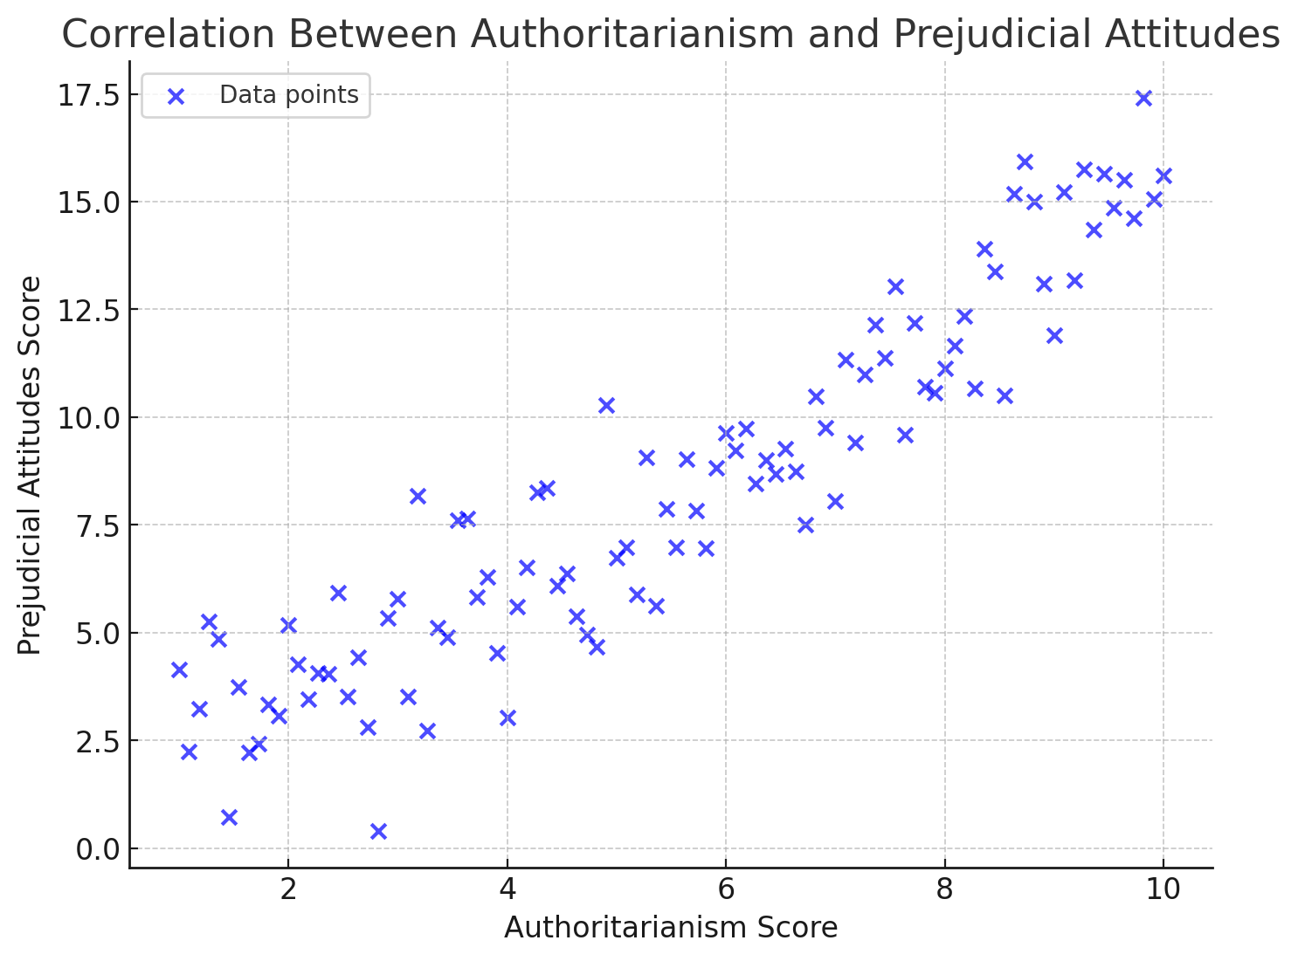
Adorno et al. (1950) - research
Notes:
What does this show? Positive correlation as AS goes up, so does PA

Slide 11
Evaluation of dispositional explanation
Complete the A3 evaluation sheet
Remember – A03 is worth more (10 A03, 6 A01)

