Slide 1
Explain how we can resist social influence

Slide 2

You want to persuade people that a 4-day work week is a good idea. How are you going to do it?

Slide 3
Three ways that minority influence can work
Consistency
Commitment
Flexibility

Slide 4
Consistency
Synchronic – the minority all says the same thing
Diachronic – the minority has been saying the same thing for a while
Examples: Greenpeace, LGTBQ+, Suffragettes

Slide 5
Moscovici et al. (1969)
The evidence for consistency in minority influence!

Slide 6


Slide 7
Commitment
Demonstrating real belief (in an issue)
Extreme activities
Majority pays more attention → augmentation principle
Examples: Just Stop Oil, Suffragette Hunger Strikes

Slide 8
Flexibility
Being prepared to adapt your viewpoint
Accept reasonable counter-arguments
Majority pays more attention → augmentation principle
Examples: LGBTQ gradual recognition/steps towards rights, Union negotiations with employers

Slide 9
How does change happen?
New message
Consistent, committed, flexible
Majority stops and starts deep thinking/processing
Conversion to minority view
Snowball effect

Slide 10
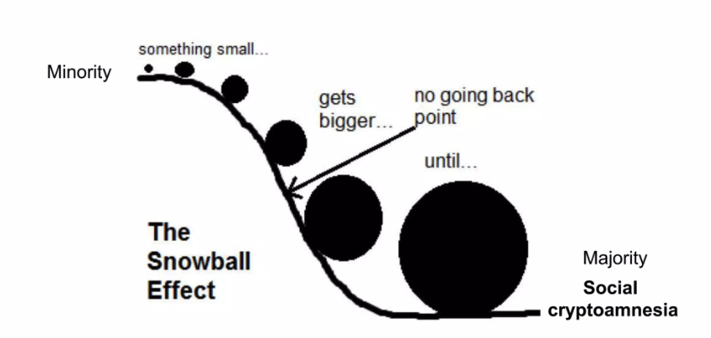
The snowball effect

Slide 11

The snowball effect

Slide 13
Using commitment, flexibility and consistency
Revisit your 4-day work week campaign – what are you going to do now and why?

Slide 14
A02 Example Question

Slide 15
Exemplar Answer Colour Coding
RED: Link to the scenario (A02)
Italic: description (A01)
Last bullet on each slide → explains how A01/A02 work

Slide 16
Exemplar answer - consistency
Jamil can bring about change in his university by using several factors related to minority influence.
First, he shows consistency by continuing to express his opposition to animal testing, despite the majority of his classmates supporting it.
This consistency makes his argument more persuasive over time, as people tend to take consistent viewpoints more seriously.

Slide 17
Exemplar answer - commitment
Second, Jamil shows commitment by persisting with his views in the face of opposition.
His willingness to stand up for his beliefs, even when it’s unpopular, may make his classmates admire his dedication and reconsider their own views.
This commitment can lead people to believe that he must truly believe in his cause, which makes his position more influential.

Slide 18
Exemplar answer - flexibility
Lastly, Jamil might demonstrate flexibility by acknowledging the importance of scientific research but suggesting alternative methods that don’t involve animal testing.
If Jamil is seen as willing to compromise or adapt his argument when needed, it may make him seem more reasonable and less extreme, which can help in persuading others.

Slide 19
A03 The Martins et al. (2003) study
Procedure (1)
Pts read arguments in favour of an issue
Pts were told the arguments came either from:
  A minority group, or
  A majority group

Slide 20
A03 The Martins et al. (2003) study
Procedure (2)
Pts were asked their own attitudes to the issue
Pts were given a conflicting argument (against the issue)
Pts were then asked their own attitudes again

Slide 21
A03 The Martins et al. (2003) study
Findings and Conclusion
Pts → minority condition → less likely to change opinion
Pts → majority condition → more likely to change option
So, minority message → more deeply processed → lasting change

Slide 22
Notes on Minority Influence
A01
A03
Definitions
3 methods
How minority influence works
Evidence based strengths and limitations
Counter-arguments

