Slide 1
Explain how the processes of social influence might create social change

Slide 2


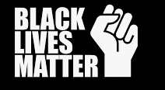

Social change examples – last 20 years
Notes:
• Extinction Rebellion (2018–present): This group used civil disobedience to raise awareness of climate change. Their activism contributed to the UK government declaring a climate emergency in 2019, showing how consistent activism by minority groups can drive policy discussions on urgent issues.
• Anti-Racism Protests (2020): The Black Lives Matter movement sparked widespread discussions on racial injustice in the UK. Demonstrations highlighted issues around systemic racism and police reform, contributing to public debates on decolonizing education and racial inequality in various sectors.
• #MeToo Movement (2017 onwards): This movement created greater awareness of sexual harassment in workplaces. It led to significant changes in safeguarding policies and challenged workplace cultures, demonstrating how a minority movement can shift attitudes on gender equality.
• Disability rights groups have continued to campaign for better accessibility, employment opportunities, and inclusivity in public spaces. Their activism has led to improvements in public transport access and broader discussions about disability rights in society.

Slide 3
Three main questions
What can we learn from minority influence change?​
What can conformity research tell us? (normative influence)​
What can obedience research tell us?

Slide 4
Key ways minorities influence social change
Drawing attention
Consistency
Deeper processing
Augmentation principle
Snowball effect
Social cryptomnesia

Slide 5
Drawing attention to the issue
Protesting – violently or peacefully
Makes majority aware of the problem.

Slide 6
Consistency
Consistent messaging over time shows dedication and commitment to a cause, reinforcing the minority's influence.
#MeToo was founded in 2006 by Tarana Burke
Went viral in 2017

Slide 7
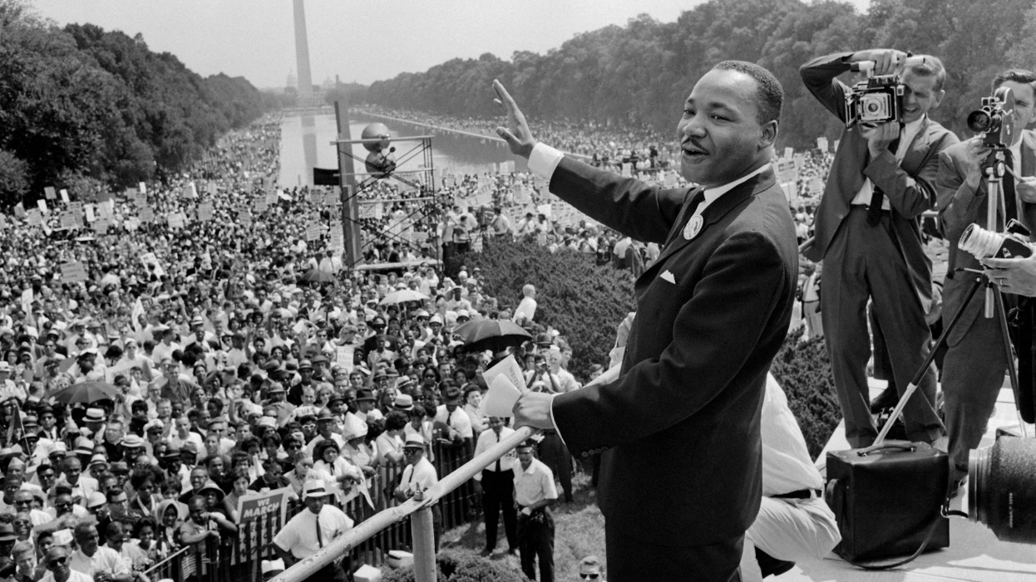
Deeper processing
When people engage in deeper processing, they start to think more critically about the issue, often challenging their existing views.
Notes:
The civil rights movement is an example of minority influence, which is when a small group of people changes the beliefs, attitudes, and behaviors of a majority. The civil rights movement involved deeper processing because it led many people to think about the injustice of the status quo.

Slide 8
Augmentation Principle
The strength of the minority's message is amplified by the risks they take.
Notes:
A UK example in the last 20 years where individuals have risked their lives to convey their message is the Gurkha Justice Campaign, led by Joanna Lumley and supported by Gurkha veterans.
Who Are the Gurkhas?
The Gurkhas are soldiers from Nepal who have served in the British Army for over 200 years. Despite their loyalty and service, Gurkha veterans were denied the right to settle in the UK after retiring, unlike their British counterparts. The Gurkha Justice Campaign sought to challenge this unfair treatment and secure the right for Gurkhas who served in the British Army before 1997 to live in the UK.
Many Gurkha veterans and their supporters, particularly elderly veterans, undertook hunger strikes and peaceful protests to highlight their cause. In 2008, several Gurkha veterans, some of them elderly and in poor health, protested outside the British Parliament for days on end. They were determined to risk their health and well-being to draw attention to the injustice they faced.

Slide 9
Snowball effect
A minority view can gradually gather momentum, gaining more support over time.
Notes:
Small beginnings: When XR first began, it was a relatively small group of activists raising awareness about climate change through acts of civil disobedience, including road blockades and public protests.
Media attention and public awareness: The group’s actions, such as disrupting traffic in central London and large-scale sit-ins, drew significant media attention. Their demands for immediate and radical action to reduce carbon emissions began to resonate with the wider public.
Growing influence and widespread support: Over time, XR gained more followers and supporters, including celebrities, academics, and prominent figures like Greta Thunberg, contributing to a surge in public awareness and concern about climate change. Their April 2019 protests in London, where tens of thousands of people participated, marked a key moment when the movement gained major traction. Public support for climate action increased as more people became aware of the severity of the environmental crisis.
Government response: In response to XR's mass protests, the UK Parliament declared a climate emergency in May 2019, the first country in the world to do so. This declaration reflected how what began as a small protest snowballed into a larger movement that influenced political discourse on climate change.

Slide 10
Social cryptomnesia
A situation where people forget the origins of social change, or the struggles that led to it.
Notes:
A recent example of social cryptomnesia in the UK is the mainstream acceptance of LGBTQ+ rights, particularly the legalisation of same-sex marriage in 2014.
What Happened?
In 2014, same-sex marriage was legalized in England and Wales (and later in Scotland and Northern Ireland). This was the culmination of decades of activism by LGBTQ+ groups, who fought for equal rights and recognition in society. Over the years, societal attitudes toward LGBTQ+ individuals have shifted dramatically, with same-sex marriage now widely accepted by the majority of the population.
Cryptomnesia in Action
Social cryptomnesia occurs when society experiences significant social change but forgets the struggles and efforts made by minority groups to bring about that change. In the case of LGBTQ+ rights in the UK, many people today enjoy the benefits of these progressive changes—such as the right to marry a same-sex partner—without fully remembering or acknowledging the long and difficult fight that preceded it.
Historical Struggles Forgotten: The early LGBTQ+ movement, including the fight against discrimination, police harassment, and the HIV/AIDS crisis, involved decades of activism, protests, and lobbying. However, many people today may not fully recall the intense resistance and marginalization faced by the LGBTQ+ community.
Mainstream Acceptance: With same-sex marriage now legal and LGBTQ+ rights broadly accepted, some people may not remember the pivotal role played by activists in securing these rights. The issue is often treated as though it was always a given, with little reflection on the challenges and opposition faced by earlier generations of LGBTQ+ activists.

Slide 11
Conformity Research
Asch
  1 dissenter could break the power of a majority
  Dissent → social change
Health campaigns
  Tell people that the majority of the UK doesn’t smoke/drink/etc
  Normative social influence → people stop smoking to fit in

Slide 12
Obedience Research
Milgram
  Support from a disobedient teacher → obedience dropped to 10%
Zimbardo (2007, so not the prison study!)
  Gradual commitment → higher levels of obedience → social change

Slide 13
Main A03 points
Strengths | Limitations
Normative influences do impact social change (Nolan et al., 2008) | People don’t always change their behaviour when shown social norms (Foxcroft et al., 2015)
Minority influences → social change (Nemeth, 2009) → changes the type of thinking | It’s majority influence, not minorities, that impacts deeper processing (Mackie, 1987)

Slide 14
Complete the A01 and A03 reading question tasks to create your notes on this topic

