Slide 1
Pilot Studies, 'Blind' studies, and Control Groups

Slide 2
What are pilot studies?
Pilot studies are small-scale prototypes of a study that are carried out in advance of the full research to find out if there are any problems with the methodology.
This helps to ensure that time, effort and money are not wasted on a flawed methodology.
When writing about pilot studies in the exam, make sure that your answers are specific to the context or study presented.

Slide 3
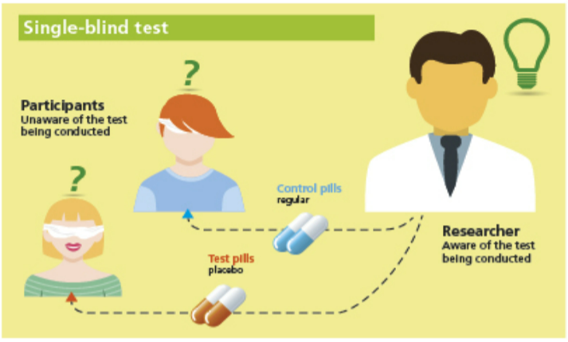
Single Blind Studies

Slide 4
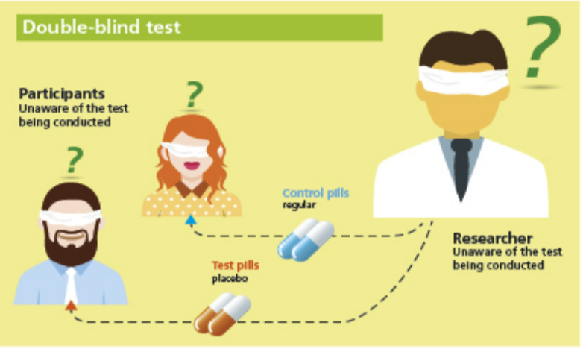
Double Blind Studies

Slide 5
Control Groups and Conditions
A control group is sometimes called a 'baseline' group
Control groups are compared with the Experimental condition/s to see if there is a difference

Slide 6
Control Group Example
We are testing a new therapy for aerophobia
We recruit 20 participants and randomly allocate each person to the control or experimental condition
We ask each participant to complete a questionnaire measuring their level of aerophobia (fear of flying)

Slide 7
Control Group Example
We are testing a new therapy for aerophobia
Control group: gets no therapy – left alone for 2 weeks
Experimental group: gets 2 weeks of the new therapy
Both groups: complete the questionnaires again
We compare the two groups to see if the experimental group have significantly lower scores than the control group

Slide 8
Notes – write clear definitions
Pilot studies
Single and Double Blind studies
Control groups and conditions (comparisons)

Slide 9
Exercises and questions
Book questions (Fake Estimates and Gender Differences)
Exam questions

Slide 10


