Slide 1
Descriptive Statistics

Slide 2
Central tendency Any measure of the ‘average’ value in a data set

Slide 3
+ve – uses all the data, so it’s the most representative of central tendency
-ve – can be distorted by extreme values. If we change the 8 opposite into a 50, the mean becomes 10.57 which seems too high for most of the data

Slide 4
+ve – isn’t affected by extreme scores
-ve – less sensitive than the mean as it ignores higher and lower numbers

Slide 5
+ve – very easy to calculate and sometimes is the only method you can use (e.g., what’s the most typical hair colour in this class?)
-ve – can have multiple modes (not helpful!) and often is quite different from the mean or median

Slide 6
Exercises
Complete worksheet 6.26 (The central line)

Slide 7
Dispersion Any measure of the ’spread’ of a data set

Slide 8
+ve – very easy to calculate – you only need two values
-ve – very unrepresentative of the data set as it only uses the two extreme values (highest and lowest). If we changed the 8 opposite into 100, the range would be: 98!

Slide 9
Standard Deviation
This uses all the scores in a data set
It works out the ‘average’ distance the scores are from the mean
+ve – most sensitive and accurate measure of dispersion as it uses all scores
-ve – tricky to calculate and it can still be affected by extreme values (but less so than the range)

Slide 10
Calculating and interpreting standard deviation
Complete the Standard Deviation Worksheet to learn how to calculate and interpret standard deviation
Practice your interpretation skills on the Standard Deviation Exercises Worksheet

Slide 11
Distribution What the frequency of the data looks like

Slide 12
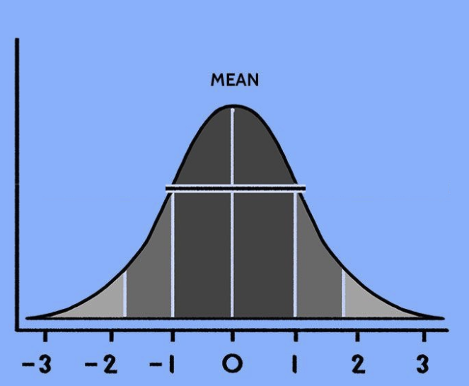
This is the Normal distribution
The centre represents the mean/median/mode
The area under the curve is the % of the population
The x axis is the number of standard deviations above or below the mean the data is

Slide 13
Normal DIstribution
Mean, median and mode
The area under the curve represents the % of the population
The numbers in italics are the number of standard deviations + or – from the mean
-3 -2. -1. 0. +1 +2 +3

Slide 14
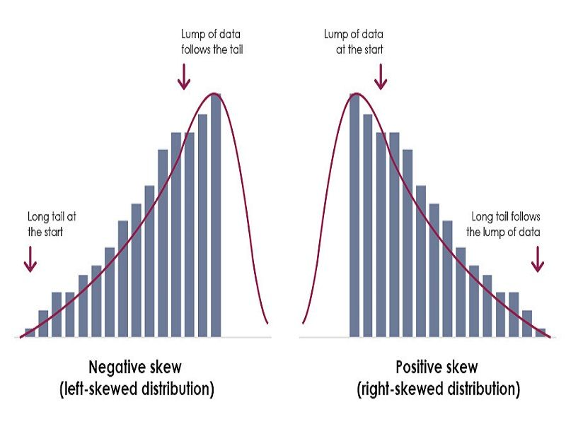

Slide 15
Exercises
Complete worksheet ‘Spread the Word’ – 6.27

