Slide 1
LO TBAT identify the normal distribution, positive and negative skews

Slide 2
The Normal Distribution
The Normal distribution is where the data is evenly distributed around the mean. The median, median and mode are all in the middle of the data set.

Slide 3
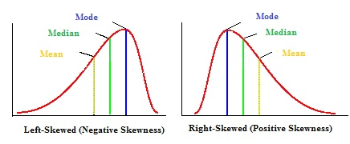
Positive and Negative Skews
The Negative skew is where the mode/median are higher than the mean – in other words most of the data is at the top end of the value range.
The Positive skew is the opposite – and the mode/median are lower than the mean.

