Slide 1
The Multi-Store Model of Memory (Atkinson and Shiffrin, 1968)

Slide 2
Lesson Plan (double click to edit)

Slide 4
Multi-Store Model Example
BANG!!
BIFF!
WALLOP!!
Notes:
Batman is on the prowl in Gotham City
He stands on top of a skyscraper surrounded by the sounds, smells and sights
This information comes into his sensory store but he doesn’t really remember it for any length of time until he pays attention
(sound of sirens)
A crime is in progress – he’s paid attention now it’s in his Short Term Memory
He jumps and glides towards the sirens – he’s got to keep rehearsing there’s a crime on – otherwise he’ll forget! He uses maintenance rehearsal to keep tell himself there’s a crime on!
He reaches the crime scene
BIFF
BANG
WALLOP
He’s rehearsed this crime so many times now that it’s gone into his long term memory – he won’t forget this one!

Slide 5
The MSM Quiz – what do you know already…
Notes:
Quizziz
leighv@wallingfordschool.com
Wallingford

Slide 6
Keywords 1
Sensory Memory → store for memories from vision, hearing, etc.
Short-term Memory → store for memories limited in duration and capacity (duration of 18-20 seconds, capacity of 5 to 9 items)
Long-term Memory → store for memories which last a lifetime

Slide 7
Keywords 2
Capacity → how much a memory store can hold
Duration → how long memory lasts (be recalled / remembered)
Coding → transforming information into a form it can be stored

Slide 8
Keywords 3
Trace decay → when the chemical trace of a memory fades
Interference → when a new memory interferes or gets confused with an old memory
Cue retrieval → using a cue such as smell or emotion to recall a memory

Slide 9
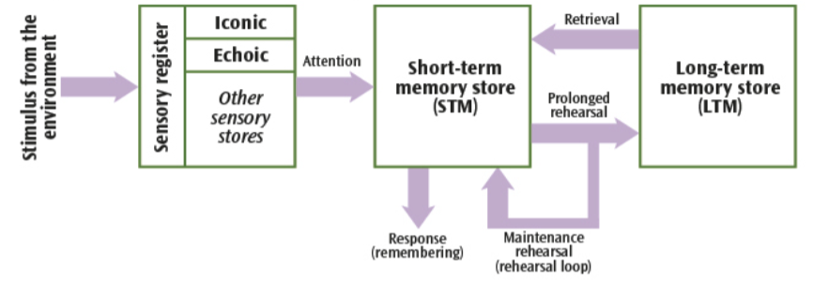
Drawing the MSM
Drawing the MSM
Notes:
Copy this diagram into workbooks - make sure they develop (by end of A01 lessons):​ ​
All the processes by labelling the arrows (explain these fully)
Duration, capacity and coding for each store​

Slide 10
MSM – A01 - Overview
There are three separate (unitary) memory stores
Each store has its own capacity, duration and encoding
Each store is passive – it only stores information
Processes such as attention or rehearsal allow information to move from one to store to another
Notes:
Add A01 overview to notes

Slide 11
MSM – The Xmas Song…

Slide 12
LTM Shepard Experiment
Simply look at these faces
You won’t meet any of them so don’t worry!
Notes:
Show this and then don’t worry about it!

Slide 20
Sperling (1960)
Notes:
Experiment for Sensory memory
Do experiment first – then discuss what it shows / do notes

Slide 21
Instructions
Stay focused on the centre of the screen
I will press ‘Start’ – and a blue + will appear
A grid of 12 letters will flash on the screen for 1/10th second
Write down the letter grid with the letters in the right place
There will be an example trial go first

Slide 22
Start

Slide 24
A | 2 | K | X
S | R | P | 9
7 | F | P | N

Slide 25
Answer (for trial)

Slide 26
A | 2 | K | X
S | R | P | 9
7 | F | P | N

Slide 27
Experiment One

Slide 28
Start

Slide 30
B | X | 2 | F
Q | 0 | H | E
N | 3 | K | B

Slide 31
Experiment Two
I will say either ’top’, ’middle’ or ‘bottom’
Stay focused on the centre of the screen
I will press ‘Start’ – and a blue + will appear
A grid of 12 letters will flash on the screen for 1/10th second
Write the row (top, middle, or bottom) with the letters in the right place

Slide 32
Start

Slide 34
F | Y | W | 6
4 | P | S | M
T | G | 5 | L
Notes:
bottom

Slide 35
Start

Slide 37
3 | P | J | F
S | M | 0 | Q
D | 7 | T | R
Notes:
top

Slide 38
Start

Slide 40
P | G | 1 | J
9 | J | R | X
G | K | B | 4
Notes:
middle

Slide 41
Start

Slide 43
3 | H | I | S
E | X | 4 | J
1 | L | E | W
Notes:
bottom

Slide 44
Debriefing
Thank you for your participation.
If you feel that any psychological harm has been done, please feel free to see the teacher or arrange counselling with the school counsellor

Slide 45
Class findings
How many letters were you able to correctly recall on the different versions of this study?
What does this show about sensory memory?
What other experiences have you had of sensory memory?

Slide 46
Sensory Memory
Environmental information → Stored briefly in sensory memory
Lasts for less than 0.5 seconds
Very high capacity (you have 1 million cells in each eye)
Encodes information the way it came in (if visual, encodes visually)
Fades rapidly; once gone information can’t be recalled later
If you pay attention → information sent to STM
SPERLING EXPERIMENT

Slide 47
A03: Support for SM (existence, duration, capacity) Sperling (1960)
Aimed to prove the existence of sensory memory through showing Ps a grid of numbers for 50ms
Found that:
sensory memory had very small duration (less than 1 second)
Focusing attention increased duration

Slide 48
MSM Diagram – add these details to SM
Duration
Capacity
Encoding
Process – paying attention transfers info to STM
Supporting Evidence – Sperling study shows that:
SM has very small duration (< 1s)
Focusing attention increases duration

Slide 49
Digit Span (Jacobs) Write these digits in a line 5 1 2 6 3 9 8 6 8 9 2 1 7
MOVE ME TO DEMONSTRATE HIDE/SHOW!
Notes:
Cover up with paper
Reveal first digit (7)
Hide
Say digit out loud
Reveal 2 digits (1 7)
Repeat until you get an error
The last correct response is the digit span

Slide 50
Chunking (Miller, 1956)

Slide 51
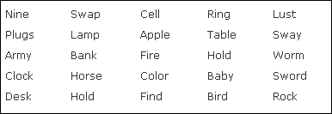
Read these to yourself quietly

Slide 52
Write down as many as you remember

Slide 53
Read these to yourself quietly

Slide 54
Write down as many as you remember

Slide 55
Read these phrases
Empire of the Sun
The Year of Living Dangerously
Kind Hearts and Coronets
Steel Magnolias
The Shawshank Redemption
How to Train Your Dragon
The Time Traveller’s Wife

Slide 56
Write down as many as you remember

Slide 57
STM – Key A01
Information comes from SM
Duration of about 18-30 seconds
Capacity of about 7 +/- 2 items (Miller, 1956)
Encodes information in an auditory way (what it sounds like)
Can be temporarily increased through chunking
e.g., C B N Y I N S V K T B C → BBC ITV CNN SKY.
You can store 7 +/- 2 chunks

Slide 58
MSM diagram: add these details to STM
Encoding, duration, capacity
Maintenance (keep in STM and send to LTM)
A03 evidence:
Capacity: Jacobs, Miller
Duration: Peterson and Peterson, Glanzer and Cunitz

Slide 59
STM – Extra A01
Forgetting comes through
Displacement
Interference
Trace decay
To keep information in STM you use maintenance rehearsal
If you rehearse STM information enough times → LTM
Notes:
Forgetting is not in the syllabus but worth mentioning

Slide 60
LTM – Key information
Information comes from short term memory
Duration and capacity are potentially limitless
Encodes information in a semantic way (by what it means)
Information must be organised semantically to be easily retrieved

Slide 61
LTM – Forgetting happens through
Cue retrieval failure
Interference
Trace decay
BAHRICK ET AL. STUDY
Notes:
Do Bahrick then return here

Slide 62
LTM – Add to your diagram
Encoding, duration, capacity
Evidence:
Glanzer + Cunitz: existence of separate stores + rehearsal process
Bahrick et al. (1975) – duration
Notes:
Bahrick in next section – do before this bit!

Slide 63
Bahrick et al. – Recall!!
On a whiteboard write the numbers 1 to 8 down the side
On each photo you see write Y if that person was in the original set of photos, N if that person wasn’t in the original set
Notes:
* Photos were in original set

Slide 65
Notes:
*

Slide 67
Notes:
*

Slide 68
Notes:
*

Slide 71
Notes:
*

Slide 72
Bahrick et al. (1975)
Participants could remember the names and faces of their classmates 50 years later
Evidence for LTM
MSM Diagram Notes

Slide 73
Explain to a partner how Batman uses his SM, STM and LTM to solve crimes in Gotham

Slide 74
MSM Post It Parade
Use an orange post it for Sensory Memory
Use a yellow post it for Short Term Memory
Use a pink post it for Long Term Memory
Add at least 1 thing you remember about each store to each post it
Leave your post its stuck to your desks
Move around the room – add new information to each post it
Notes:
Post it parade review – use as starter for evaluation lesson

Slide 75
MSM Post It Parade – Poss Answers
Sensory memory
A buffer for information from the environment
It’s broken into separate stores for different types of information
If we pay attention to that information it gets transferred to …
Short term memory
Limited store
Holds about 7 +/-2 bits of information (so limited capacity)
Lasts about 18-30 seconds
To keep information in STM it needs to be rehearsed
If you rehearse the information enough then it transfers to…
Long term memory
Potentially infinite capacity
Holds memories for a few minutes to many years (lifetime)
Notes:
Reviews post it- parade

Slide 76
MSM Experiments Each part of the model is supported by evidence
Sensory: Sperling study
STM: Peterson and Peterson Trigrams
LTM: Shepard Experiment
STM and LTM: Serial Position Effect

