Slide 1
Biological Explanations of Criminality

Slide 2
Three main explanations
Brain Injury – especially in childhood
Amygdala (i.e. the Raine study)
XYY syndrome (extra Y chromosome)

Slide 3
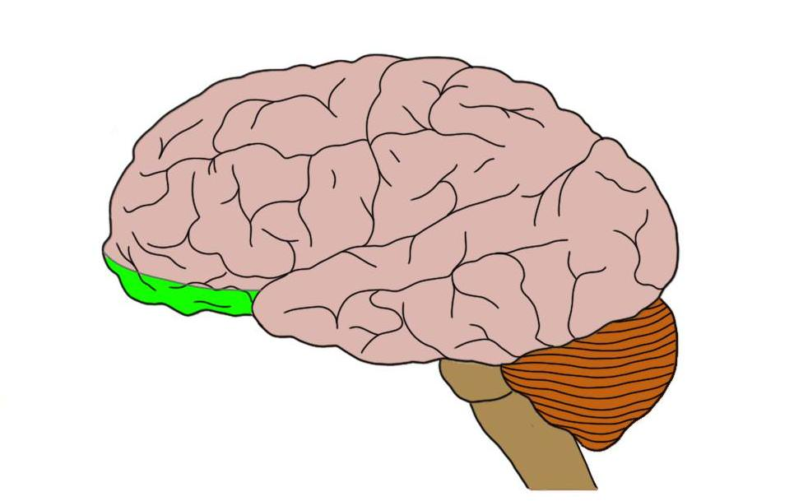
The Orbitofrontal Cortex (OFC)
Damage → increased aggression and loss of control

Slide 4
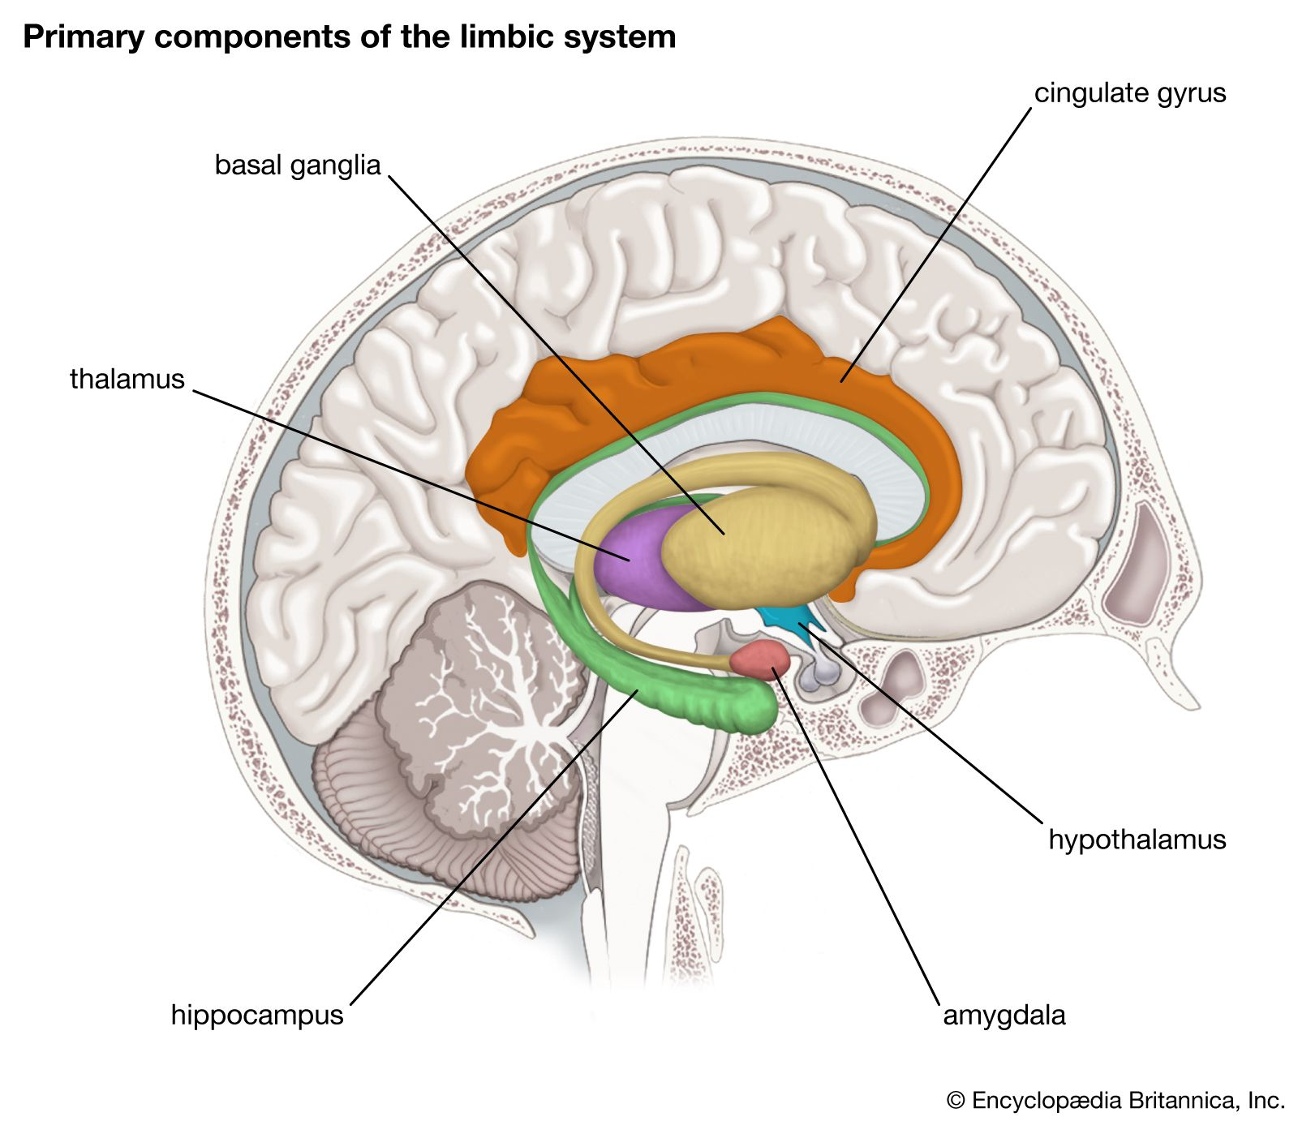
The Amygdala
Emotional regulation centre
Raine found NGRI murderers had reduced activity (reduced fear processing and emotion regulation)

Slide 5
Brain injury example – Williams et al. (2010)
196 inmates from a UK prison
60% had a history of one or more head injuries in their youth
The 60% also tended to be younger at their first offence, had higher rates of reoffending – and had spent more time in prison over the last 5 years than the rest of the sample
+ve – evidence supported - Fazel et al, 2011, 8% of Swedes who had suffered an ABI had committed a violent crime compared to 3% of a matched control group
–ve – not necessarily a causal relationship. ABI has been linked to increased mental illness, alcohol, and drug addiction.

Slide 6
Amygdala and aggression
Amygdala → processes fear and threat stimuli.
Abnormalities in size, structure, or activity are linked to increased aggression and criminal behaviour.
Raine et al. (1997): Found reduced amygdala activity in certain brain areas of violent individuals, suggesting a link between underactive amygdala and aggression.
Gao et al. (2010): Studied fear responses in children and found that those with poor fear responses at age 3 (due to abnormal amygdala function) were more likely to commit crimes later in life.
Pardini et al. (2014): Conducted brain scans of 26-year-old men, revealing that those with smaller or less active amygdalae were three times more likely to show aggression, violence, and psychopathic traits.

Slide 7
XYY Syndrome
Male genetic condition (1 in 1000)- with an extra Y chromosome (supermale)
Some studies suggest XYY males are more likely to have criminal records - but this may be down to lower intelligence levels in these individuals
Weak evidence – Re and Birkhoff (2015) found no link in a meta-analysis of studies into XYY and criminality over the last 50 years
There is more XYY in prison populations, but this might be because XYY is linked to lower intelligence levels, learning difficulties and impulsive/behavioural control issues

