Slide 1
Crime and Personality

Slide 2
Eysenck’s Personality Theory
Responses to socialisation (reinforcement & punishment)
Social
Possible criminal behaviour
Psychological
Stable psychological traits
Biological
Functioning of the nervous system

Slide 3
Three dimensions to personality
Extraversion – how much stimulation you need
Neuroticism – how emotionally unstable you are
Psychoticism – how cold, uncaring, solitary, aggressive you are

Slide 4
The biological link
E measures your central and autonomic arousal level. The lower your arousal level is, the more stimulation you need from your environment – i.e. High Es need lots of external stimulation.
N measures how strongly your nervous system reacts to aversive stimuli. The stronger your responses the more extreme your emotional changes. High N-scorers find it difficult to learn socially acceptable behaviour.

Slide 5
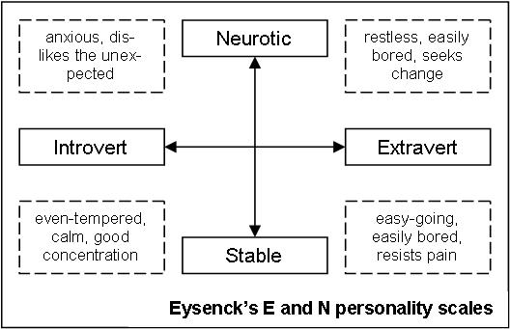

Slide 6
Predictions
High E, N and P → higher risk of offending → difficult for them to learn to control their immature impulses.
EN - anti-social behaviour, stealing
P – violence, aggression

Slide 7
Evaluation of situational variables
Complete the A4 evaluation sheet on situational variables

