Slide 1
LO: TBAT explain how labelling and SFP impact criminality

Slide 2
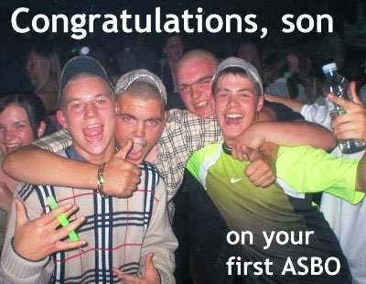
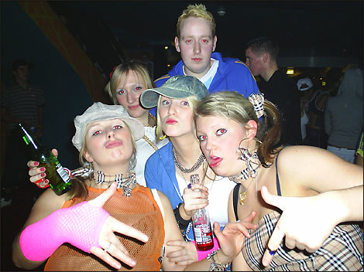
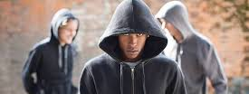
Labelling individuals and behaviour

Slide 3
Labelling
People classify themselves and others using words or phrases (labels)
These labels → come to define a person
If people don't meet the standards of society → 'deviant'
Society treats those we have labelled (e.g. hoodies) as criminal
Labelling turns crime into a 'social construct’ → behaviour isn’t criminal until we label that way.

Slide 4
Labelling can lead to…
Labels can affect an individual's self concept (how they see ourselves)
Labels can affect the way individuals are treated by others
Self-fulfilling prophecy

Slide 5
Self-Fulfilling Prophecy
Prophecy
Is set
Expectation
Prophecy is fulfilled

Slide 6
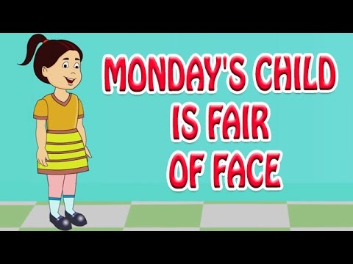
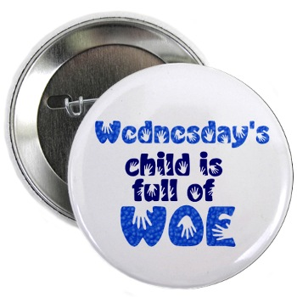
Jahoda (1954)
Males born on Wednesday had a significantly higher arrest rate (22%) than males born on Monday (6%)

Slide 7
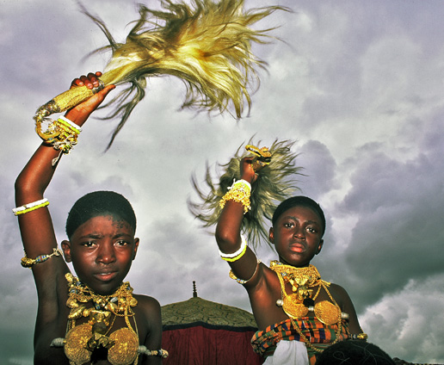
Jahoda (1954)
Ashanti Tribe of West Africa boys and girls are named after the day of week they are born
Boy born on Monday was named KWADWO (Considered to be mild mannered)
Boy born on Wednesday named KWADKU (considered to be aggressive and short tempered)
What names do you know that suggest certain characteristics in a person?

Slide 8
Lamb and Crano (2014)
Group of teens that didn’t take marijuana
BUT if parents thought they did take it, then 4.4 x more likely to actually do so 1 year later
I.e. → prophecy set + expectation → prophecy fulfilled!

Slide 9
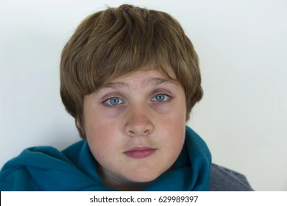
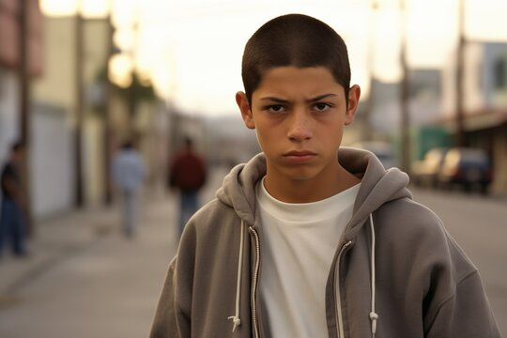
Zebrowitz (1998) – Baby Face or Mature?

Slide 10
Zebrowitz (1998)
Baby face teens more likely to be delinquent than mature-faced teens
Perhaps trying to overcompensate for being seen as ‘innocent’ or ‘child-like’?
In other words – SFP and labelling hasn’t worked here!

Slide 11
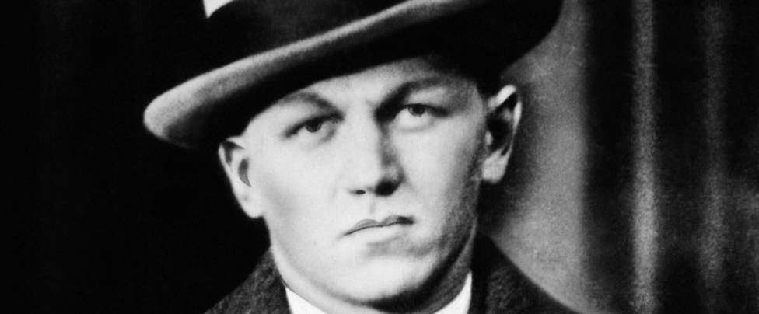
George Nelson - ”Baby face Nelson” Too violent for Al Capone

Slide 12
Self-fulfilling prophecy
We / society labels individuals or groups as criminal based on where they live, how they dress, their family, social class, finances etc.
An expectation is created that those individuals/groups will act in a criminal way and so they are treated as such
The individuals/groups may internalise the label and see themselves as criminal / demonstrate criminal behaviour
Low self-esteem are more likely to fit their behaviour to the expectation and become criminal

Slide 13
Basic evaluation
Strengths | Weaknesses
Real world study evidence – e.g. Jahoda | Zebrowitz (1998) – the Baby Face criminal
Reintegrative versus disintegrative shaming The way you label might help someone away from crime. Focus on the behaviour being wrong, not the person. | Not complete explanation – doesn’t look at biological factors such as brain structure/damage/XYY gene
 | Can’t explain those individuals who don’t respond to labelling – e.g. those with high self esteem

