Slide 1
Ethical interviewing and the Cognitive Interview

Slide 2
Ethical interviewing purpose
To ensure suspects feel comfortable and are humanely treated by police interviewers (less aggression, open minded)
To establish a good working relationship (rapport) between the interviewer and suspect

Slide 3
Example of ethical interviews: PEACE model
Preparation and planning – aims of the interview
Engage and explain – active listening/rapport
Account – open ended questions
Closure – suspect gets chance to ask any questions
Evaluate – how did the interviewer do?

Slide 4
Evaluation
Strengths | Weaknesses
70% of police officers trained in ethical interviewing – seen as useful in real world | Empathy (understanding of others) not always seen in interviews
Walsh and Milne (2008) – ethical interview led to more information from suspects | Milne (2010) – training only made interviews longer not better – so training may not be effective in PEACE
Fewer false confessions → more just outcomes and less waste of money | Take a very long time to plan and run

Slide 5
Evaluation
Strengths | Weaknesses
70% of police officers trained in ethical interviewing – seen as useful in real world | Empathy (understanding of others) not always seen in interviews
Walsh and Milne (2008) – ethical interview led to more information from suspects | Milne (2010) – training only made interviews longer not better – so training may not be effective in PEACE
Fewer false confessions → more just outcomes and less waste of money | Take a very long time to plan and run

Slide 6
LO TBAT outline and evaluate the Cognitive Interview (Fisher and Geiselman)

Slide 7
Problems with EWT
EW might make up details
EW might not tell the truth
EW might forget details
Memory isn’t encoded exactly (previous experiences, schema)
Leading questions (interviewer)
False convictions

Slide 8
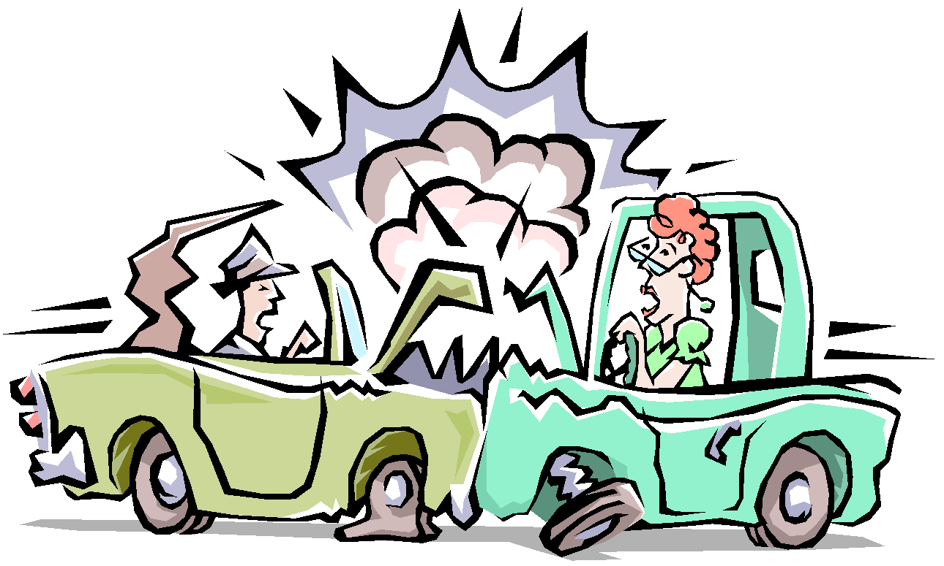
A few of the problems of eyewitness testimony
The incident
Encoding challenges
Setting(lighting, distance...)
Distractions
Stress, guilt
?
Encoded information
Stored information
Interviewer challenges
Types of questions
Body language
Schemas
Emotions
Retrieval challenges
Schemas
Emotional factors
?
?
Retrieved information

Slide 9
The standard witness interview
Closed questions
Questions asked in quick succession
Witness can be interrupted
Witness can be asked to guess/speculate
No attempt to reduce witness anxiety

Slide 10
Questions from video - answers
It uses the principle of Encoding Specificity by linking memories to the context in which they were formed, enhancing retrieval.
Geiselman et al. found that witnesses could recall 35% more information using the CI compared to those in a SI
The challenges stem from variations in how police forces implement the CI leading to inconsistencies in practice
The CI may be more effective for older populations because it accommodates the way their memories function, which can differ from those of younger witnesses.

Slide 11
Aim of the Cognitive Interview
Improve the effectiveness of interviewers when questioning witnesses
Apply the results of psychological research which showed that memory is not like a video camera but an active process.

Slide 12
Fisher and Geiselman (1984)
Reviewed psychological studies on memory and police interviewing techniques
Developed a 4-component interview technique
Report everything
Mental reinstatement of original context (using retrieval cues)
Reverse the order
Changing the perspective (recall from multiple perspectives)

Slide 13
The 4 components / stages of the CI Fisher and Geiselman (1984)
CI Component/Stage
What witnesses are asked to do
1. Report everything
Report every detail you can even if they seem irrelevant or trivial
2. Context reinstatement
Recall the scene, the weather, what you were thinking and feeling
3. Recall in reverse order
Describe the event in reverse order
4. Recall from different perspective
Describe what you thought the other witness (person in front of you) saw
Notes:
Write out landscape for clarity

Slide 14
Psychological reasoning for each component
CI Component/Stage
Psychological reasoning
1. Report everything
Ws might not realise importance of some details. These might help recall of significant information
2. Context reinstatement
Recalling how you felt and the context enhance recall (these details act as cues to recall)
3. Recall in reverse order
When events are recalled in forward order, witnesses reconstruct based on their schemas.
If the order is changed they are more accurate
4. Recall from different perspective
Encourages many retrieval paths

Slide 15
Summary of Psychological Basis of the CI
Report everything and context re-instatement:
If there is ‘consistency’ between the mental recreation and the actual real incident → more chance that the witness recalls more details, more accurately
Changing the order and the perspective
Information can be retrieved using multiple routes
Varying the routes in will lead to better recall

Slide 16
The Enhanced CI added
More social aspects to the interview setting and procedure
A focus on reducing witness anxiety

Slide 17
Which stage do these prompts relate to?
Think about how you were feeling at the time and think about your reactions to the incident.
Please do not edit anything out of your report, even things you think may not be important.
RE
CR
Think about what the surrounding environment looked like at the scene, such as rooms, the weather, any nearby people or objects.
Try starting with the thing that impressed you the most in the incident and then go from there, going both forward in time and backward.
CR
RTO
Try to place yourself in the role of a prominent character in the incident and think about what he or she must have seen.
CP

Slide 18
SI or CI (identify component)
Which model of car did the burglars use to get away?
Starting from the end of the incident, tell me what happened - but go backwards in time.
What kind of weapon did the attacker have?
Imagine yourself back just before the incident took place. What did you see/feel/hear?
Did you see the suspect running away from the scene?
What do you think the waiter saw/experienced during the incident?
Tell me everything that happened, no matter how silly or small it seems to you.
What time did the incident take place?

Slide 19
SI or CI (identify component) - answers
Which model of car did the burglars use to get away? SI
Starting from the end of the incident, tell me what happened - but go backwards in time. CI – changing the order
What kind of weapon did the attacker have? SI
Imagine yourself back just before the incident took place. What did you see/feel/hear? CI – context reinstatement
Did you see the suspect running away from the scene? SI
What do you think the waiter saw/experienced during the incident? CI – changing perspective
Tell me everything that happened, no matter how silly or small it seems to you. CI - recall everything
What time did the incident take place? SI

Slide 20
Evaluation - Does it work?
Kohnken et al (1999) – meta-analysis of 53 studies showed 34% increase in the amount of correct information recalled vs standard interview techniques
Milne and Bull (2002)
Looked at each component separately
When participants used 1 technique – same recall as control group
When participants used report everything and mental reinstatement – significantly higher recall than all other conditions

Slide 21
Evaluation – Is it practical?
Take a lot more time to do than standard interview
Needs specialist training
Studies use different versions of the CI –can’t easily compare them
CI might create more inaccurate material: Kohnken et al. (1990) – both amount of accurate (81%) and inaccurate information (61%) increased

Slide 22
Cognitive Interview Notes (p 63-64)
Description
Evaluation
Clear explanation for each CI stage, what it involves and why (psychologically)
Brief description of enhanced CI
Strengths | Weaknesses
 | Time consuming
Milne + Bull (2002) | eXtra: Variations
Köhnken et al. (1999) Meta-analysis | Köhnken CI → more incorrect information

Slide 23
CI Quiz
Who developed the CI?
What are the 4 stages?
Which stage depends on cue-dependent memory?
State two practical problems with the CI
What support is there for the CI from Geiselman et al. (1985)?
What is the purpose of the CI?
What are the two cognitive ideas the CI is based on?

Slide 24
CI Quiz – Answers 1
Who developed the CI? Fisher and Geiselman
What are the 4 stages? Context reinstatement, recall everything, recall in different order, recall from different perspective
Which stage depends on cue-dependent memory? Context reinstatement
State two practical problems with the CI requires time to do (more than standard interview) and needs training to administer

Slide 25
CI Quiz – Answers 2
What support is there for the CI from Geiselman et al. (1985)? CI got significant more correct items than SI – and needed fewer questions to be asked (no difference in errors though)
What is the purpose of the CI? To develop an interview technique that is more valid, reliable (accurate) and ethical than the standard interview used by the police
What are the two cognitive ideas the CI is based on? 1) Memories of events are linked to associations – and cue-dependent 2) Retrieving a memory works better if we can reinstate the original context of that memory

Slide 26
and a few other points...
Fisher et al. (1987) added a few extra features:

