Slide 1
Attachment Introduction Infant-caregiver interactions
Notes:
Define attachment
Define what behaviours humans show in attachment
Discuss reciprocity - alert phases and active involvement
Discuss interactional synchrony
Meltzoff and Moore study on beginnings of synchrony (2 years old)
Why it matters for attachment
Evaluation
Strengths
Lab control observations establishing IR, babies aren’t aware of obs so behaviour natural —> validity
Practical applications to parenting skills training
Counter - socially sensitive research could be used to argue against mother returning to work to avoid risk to baby’s development
Weaknesses
Difficulties in interpreting infant behaviour
Can’t easily link synchrony/reciprocity to later child development
Counterpoint - Isabella et al. (!989) - interactional synchrony predicted good quality attachment later in life

Slide 2
What will you do and why?
It’s 1941 and the war is waging.
You are married with three small children: a girl aged 6, a boy aged 5 and a baby girl of 8 months. Your partner is away fighting a lot of the time.
You live in London and the bombing is bad. You cannot move away. You are being encouraged by the government to have your children evacuated.
Notes:
You’d be surprised how heated this discussion can get! Give the students 15 minutes or so to reach their decision then each group in turn should say what they will do and why. You quite often find that the students decide to send the older two children but not the baby and that gives you the opportunity to ask why they did this (they have some appreciation of attachment – they are worried that the baby will not ‘know’ the parents when she returns). You can develop the discussion onto other topics, for example, if they send the older two children but not the baby, what effect do you think this will have on sibling relationships (something that is little investigated)? Whoever is sent, what effect might it have on later relationships? Is it selfish not to send any of the children?

Slide 3
What will you do and why?
The government’s conditions are that you can send any number of your children to live with families in the countryside and, if more than one child is evacuated, they will stay together with one family.
The government will ensure that they are not ill-treated. You can visit them once a month for the weekend but, because of travelling distances, your visit is likely to last for just 24 hours or so.
You don’t know how long the war will last.
Notes:
You’d be surprised how heated this discussion can get! Give the students 15 minutes or so to reach their decision then each group in turn should say what they will do and why. You quite often find that the students decide to send the older two children but not the baby and that gives you the opportunity to ask why they did this (they have some appreciation of attachment – they are worried that the baby will not ‘know’ the parents when she returns). You can develop the discussion onto other topics, for example, if they send the older two children but not the baby, what effect do you think this will have on sibling relationships (something that is little investigated)? Whoever is sent, what effect might it have on later relationships? Is it selfish not to send any of the children?

Slide 4
Think / Discuss
Why might you send the older children but keep the baby?
What impact might that have on sibling relationships?
What impact might that have on the relationships between the older children and the parents?
What impact on later (adult) relationships might sending the children away have?
Is it selfish to keep all the children with you?

Slide 5
Attachment and the Observation method
Most of the studies you will come across in Attachment use observation
As a reminder, observations can be:
Overt or covert
Participant or non-participant
Natural or controlled
Event sampled or time sampled

Slide 6
Introduction to attachment
What is meant by the term ‘attachment’
According to Dr Atkinson, why do babies form attachments?

Slide 8
What are Attachments?
Task: In pairs, write a definition of the word ‘attachment’ on a mini- whiteboard.
Do attachments only form between parents and their children? Can you think of another example of attachment.
Attachment is …

Slide 9
Attachment definition
An emotional tie or bond between two people, usually a mother and a child (infant and caregiver)
The relationship is said to be reciprocal (two-way / shared)

Slide 10
Attachment behaviours
Task: write down what behaviours we can see when two people are attached to one another
Possible factors include:
Seeing proximity (closeness)
Distress on separation
Joy on reunion
Person used as safe base to explore world
Attachment
Behaviours

Slide 11
Features of attachment
Proximity. Children remain physically close to those they are attached to.
2. Separation distress. People are distressed when an attachment figure leaves their presence.
3. Secure-base behaviour. Infants display secure-base behaviour when they return to their attachment figure while playing.

Slide 12
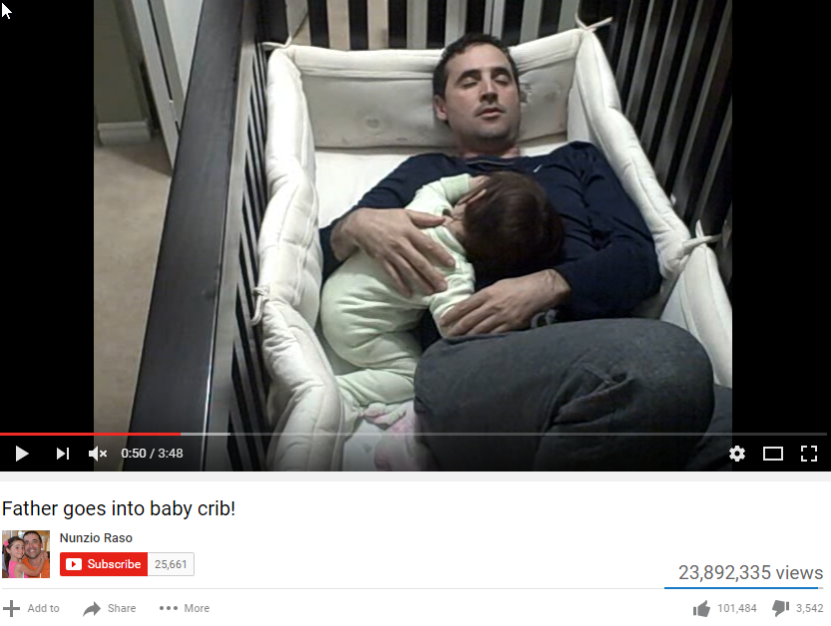
Attachment Example
This is an example of attachment which has reached 39 million views on YouTube.
Task: While watching the video consider the following question:
What attachment behaviours is this infant demonstrating?

Slide 14
Researching infant-caregiver relationships
What are the practical and ethical challenges with doing research in this area?
What research methods could we use and why?
What research methods could we not use and why?
What impact might participant variables have on this type of research?

Slide 15
Caregiver-Infant Interactions
Reciprocate VERB “Respond to (a gesture or action) by making a corresponding one”. (Oxford University Press, 2016).
Question: What do you think the terms ‘reciprocity’ and ‘interactional synchrony’ mean in relation to attachment. Hint: Think about the way in which infants interact with their parents/ carers. | Synchrony NOUN “Simultaneous action, development, or occurrence.” “Example sentence - The state of operating or developing according to the same time”. (Oxford University Press, 2016).

Slide 16
Caregiver-Infant Interactions
Reciprocity
Where an infant responds to the action of another person, or where the actions of one partner (e.g., the infant) elicits a response from the other (e.g. the mother).
Interactional Synchrony
Where an infant mirrors the actions of another person; for example, an infant imitating behaviours and/or the emotions of their parents/carer.

Slide 17
Reciprocity Behaviours

Slide 18
Caregiver-Infant Interactions - questions
4 Minutes

Slide 19
Whiteboard Review
Define attachment
Give 3 attachment behaviours
Define reciprocity (in terms of attachment)
Define interactional synchrony (in terms of attachment)

Slide 20
Whiteboard Review - Answers
Define attachment emotional bond between two people that is reciprocal
Give 3 attachment behaviours: proximity, joy on reunion, secure base behaviour
Define reciprocity (in terms of attachment) Where an infant responds to the action of another person
Define interactional synchrony (in terms of attachment) Where an infant mirrors the actions of another person

Slide 21
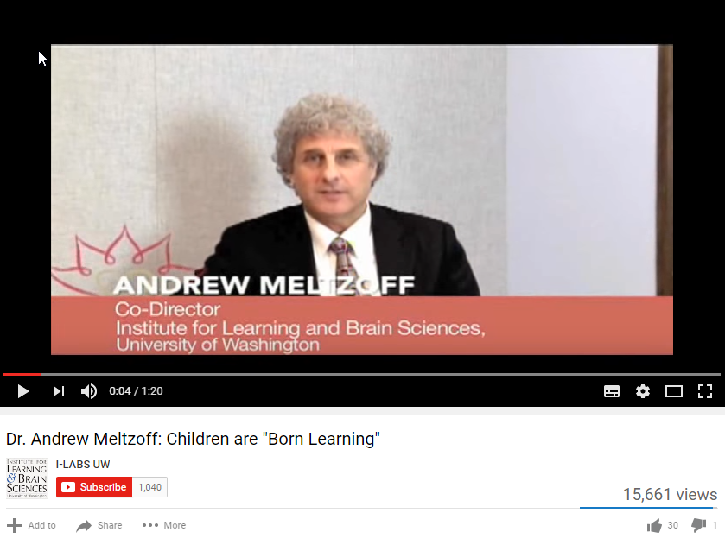
Melzoff and Moore (1977) The beginnings of synchrony
Conducted research into caregiver-infant interactions.
Task: While watching the video consider the following question:
Why is social interaction so important for infants?

Slide 23
Meltzoff and Moore (1977) - Method
Participants: 6 infants, aged between 12 and 21 days old.
Infants were shown a series of gestures by an adult model:
Facial gestures (e.g., sticking out the tongue, opening the mouth).
Manual gestures (e.g., moving fingers).
An independent observer recorded the infants’ responses. The responses were filmed.
Behaviours were scored for similarity to the adult’s actions.

Slide 24
Meltzoff and Moore (1977) - Findings
Infants imitated the gestures performed by the adult
This was observed even in very young infants (innate not learned)
This supports the interactional synchrony concept in infant-caregiver attachment.
Extension - the study also supports the idea of ‘mirror neurons’ – find out what these are!

Slide 25
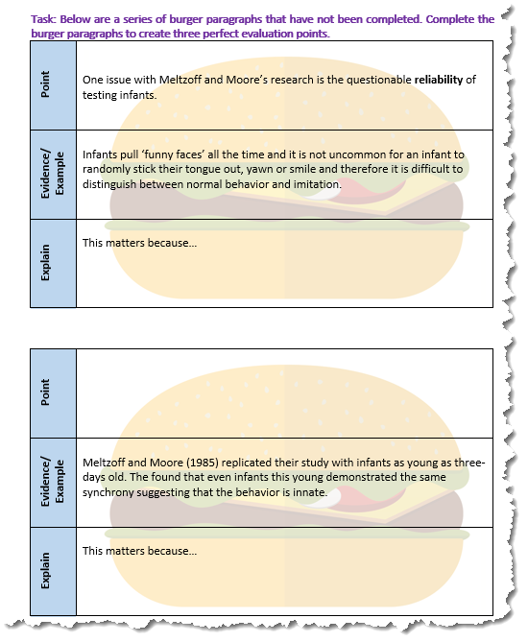
Evaluating Meltzoff and Moore (1977)
Task: On your handout are a series of burger paragraphs that have not been completed. Complete the burger paragraphs to create three perfect evaluation points.

Slide 26
Evaluating Meltzoff and Moore (1977)
Point
Evidence or Example
Explain
One issue with Meltzoff and Moore’s research is the questionable reliability of testing infants.
Infants pull ‘funny faces’ all the time and it is not uncommon for an infant to randomly stick their tongue out, yawn or smile and therefore it is difficult to distinguish between normal behavior and imitation.
This matters because we are unable to conclude whether the results of Meltzoff and Moore’s research demonstrate caregiver-infant interactions or everyday infant behaviour, and therefore further research is required to test the reliability of these findings.

Slide 27
Evaluating Meltzoff and Moore (1977)
Point
Evidence or Example
Explain
One strength of Meltzoff and Moore comes from a replication of the study conducted by the authors six years later.
Meltzoff and Moore (1983) replicated their study with infants as young as three-days old. The found that even infants this young demonstrated the same synchrony, suggesting that the behavior is innate.
This suggests that the original findings were reliable and that caregiver-infant interactions are an innate mechanism used to help develop an attachment bond.

Slide 28
Evaluating Meltzoff and Moore (1977)
Point
Evidence or Example
Explain
However, one issue with Meltzoff and Moore’s research is that other researchers have been unable to replicate their findings.
Koepke et al. (1983) attempted to replicate Meltzoff and Moore’s findings, but failed to produce the same results.
This matters because it questions the reliability of Meltzoff and Moore’s findings and their replication conducted 6 years later, and further illustrates the need for additional research in this area.

Slide 29
Evaluation
Strengths | Weaknesses
Filmed observations: High IR High validity (babies aren’t aware) | Not all studies support findings
Practical applications – parenting skills training | Socially sensitive research – could this be used to argue against a mother returning to work?
 | Difficult to interpret infant behaviour
Isabella et al. (1989) – interactional synchrony predict good quality attachment later in life | Linking synchrony/reciprocity to later child development is difficult

