Slide 1
LO: TBAT discuss the role of the father in attachment

Slide 2
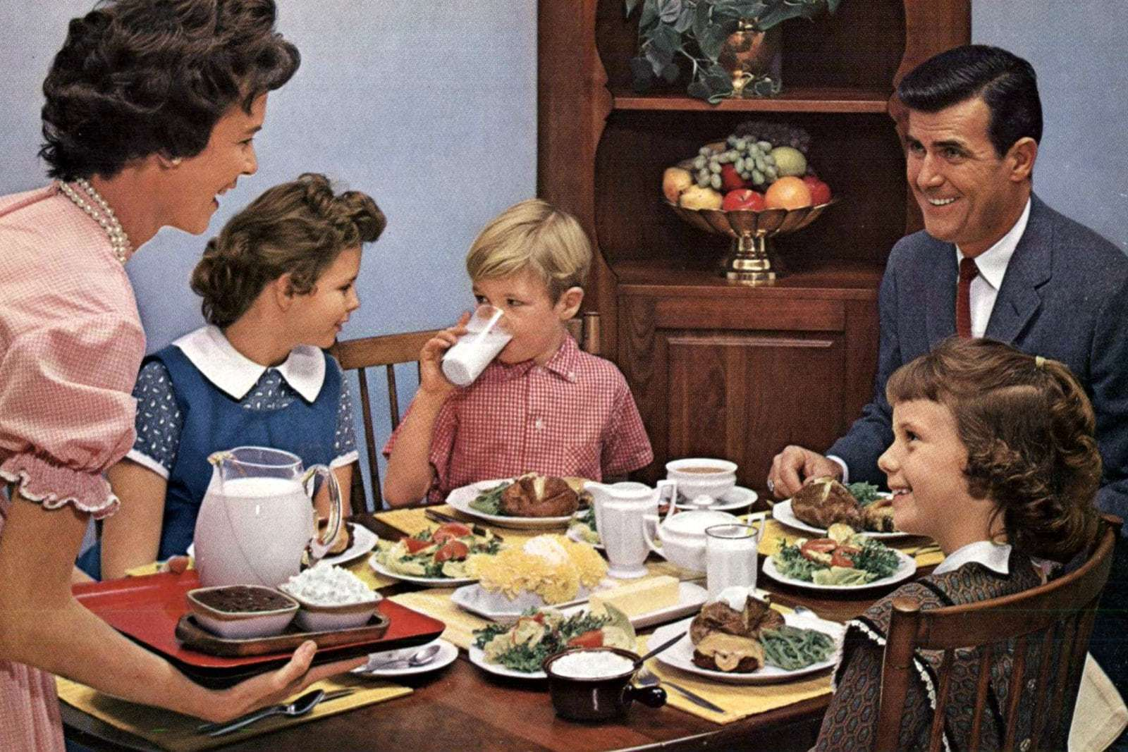
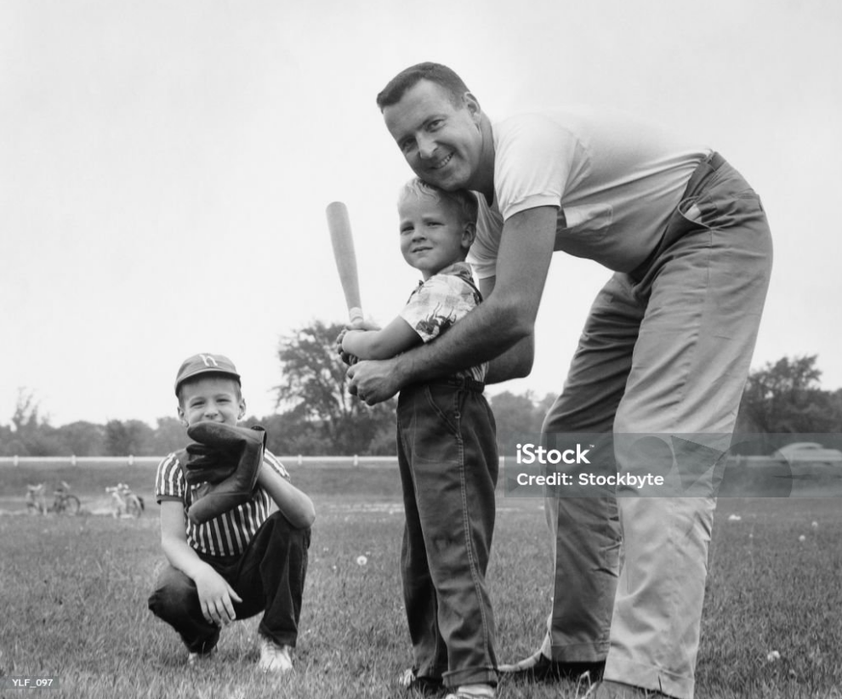
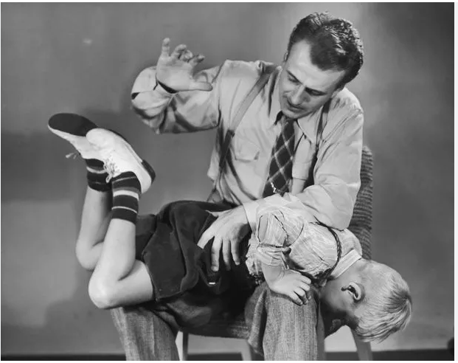
Whiteboards – discuss and put down your ideas about the role of the father:
The traditional role (see images below for help!) | The modern role (last 20-30 years)

Slide 3
Whiteboards – discuss and put down your ideas about the role of the father:
The traditional role | The modern role (last 20-30 years)
Bread winner (money earner) | Can be breadwinner, but there are many who have the stay-at-home role
‘Playmate’ rather than a ‘caregiver’ | Shift to more of a caregiver role
Discipline | Co-parenting – shared responsibilities

Slide 4
Whiteboards – discuss and put down your ideas about the role of the father:
The traditional role | The modern role (last 20-30 years)
Bread winner (money earner) | Can be breadwinner, but there are many who have the stay-at-home role
‘Playmate’ rather than a ‘caregiver’ | Shift to more of a caregiver role
Discipline | Co-parenting – shared responsibilities

Slide 5
Whiteboards: Think/pair/share Why has the role of the father changed in the last 30-40 years?
Economic changes: increased number of dual income households
Cultural and social changes: the expectations of masculinity have changed → men are expected to be involved!
Legal and workplace law: paternity leave, family-friendly work policies
Psychological understanding and research: fathers play a potentially beneficial role in attachment/emotional development of children

Slide 6
UK Statistics – what do you think the %s are?
What % of British single parents are male?
What % of fathers care for their children while the mother returns to work?
10% - 186, 000
10%

Slide 7
The problem with the research in this area Are we asking:
What the role of the father is in attachment specifically?
What the role of the father is in early childhood?
What the role of the father is in family life generally?

Slide 8
Research on the role of the father
Find out about research on the different sides of the argument
The father plays an important role in attachment
The father has a different (but as important) role
The father doesn’t play a significant role in attachment
Summarise what the researchers found / suggest about fathers
The areas to focus on are highlighted on the A3 sheet

Slide 9
Conclusion: the role of the father Starting points – summarise what you’ve got!
Fathers play an important role in…
However research into single-parent or same-sex families shows …
Overall…

Slide 10
Conclusion: the role of the father My version
Fathers play an important role in a child’s social and emotional development, often contributing through play / stimulation rather than primary attachment figures
However research into single-parent or same-sex families shows that attachment can develop just as well, suggesting that fathers are not essential but can enhance a child’s upbringing
Overall…while fathers offer unique benefits, other caregivers can fulfil similar roles in supporting healthy development.

Slide 11
Short answer check: what you’ve learned so far – and maybe a bit more!

