Slide 1
LO TBAT discuss the factors that impact jury decision making

Slide 2
Factors you need to find out about
Attractiveness of the defendant
Race of the defendant
Accent of the defendant
Pre-trial publicity – knowing something about the accused

Slide 3
Defendant characteristics

Slide 4
Attractiveness

Slide 5
Attractiveness of defendant Abwender and Hough (2001)
Are attractive defendants treated more leniently than less attractive ones?
Pts were asked to judge the guilt and recommend a sentence for a drunk driver.
The descriptions of the driver were varied
Attractive / Unattractive
Gender
Race

Slide 6
Attractiveness of defendant Abwender and Hough (2001)
Factor
Key Finding
Attractive defendants
Tended to get more lenient sentences and judgements
Unattractive defendants
Tended to get harsher sentences and judgements
Female jurors
More lenient towards attractive female defendants
Harsher towards unattractive female defendants
Male jurors
More lenient towards unattractive female defendants
Harsher towards attractive female defendants
Jury making IS impacted by attractiveness
BUT
Gender of the juror has an impact on the judgement as well

Slide 7
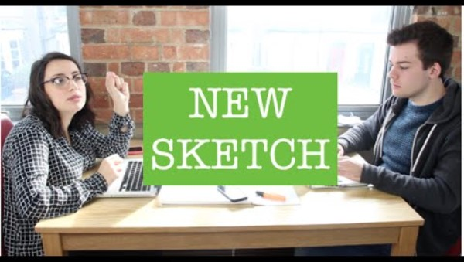
Which woman would you convict of a robbery?

Slide 8
Accent – Dixon et al. (2002)
Method
Pts heard recorded conversation between male suspect and a policeman
Suspect spoke with either a Birmingham or Standard British accent
Results
Defendants with a Birmingham accent were rated as significantly more
guilty than those with a Standard British accent.
Conclusions
Regional accents influence jury decision-making
Certain accents (e.g., Birmingham) carry negative stereotypes that may lead
to bias.

Slide 9
Race
There is a higher proportion of ethnic minorities in prison (15%) compared to 8% of the UK general population.
Studies have found that that white jurors are more likely to find a black defendant guilty compared to a white one.

Slide 10
Race of defendant
Study
Method
Key Findings
Bradbury & Williams (2013)
Analysis of real cases / trials
White
-
majority juries and Hispanic
-
majority juries were more likely to convict
black defendants.
Effect was stronger for specific crimes like
drug offenses.
Pfeifer and
Ogloff
(1991)
Experiment with pts rating guilt of
Participants rated black defendants as
defendant from trial transcripts
guiltier than white defendants, particularly
when the victim was white.
Findings suggest that racial biases influence jury verdicts
Minority defendants, particularly black individuals, are judged more harshly than white defendants --> especially in cases involving white victims.

Slide 11
Pre-trial Publicity

Slide 12
Pre-trial publicity – Steblay et al. (1999)
Can -ve PTP influence whether a jury returns a guilty verdict?
Meta-analysis of 44 studies with over 5700 pts (mock juries)
 | Exposed to –ve PTP | Control group
Likely to return guilty verdict | 59% | 45%
-PTP leads to a higher likelihood of guilty verdict, perhaps because the PTP creates schemas in the minds of jurors which become difficult to change during the trial

