Slide 1
Darwin’s Theory of Evolution
What do you remember about Darwin’s Theory of Evolution?
Write down 3-4 key bullet points
Pair
Share
Complete the gapped sheet
Evolutionary Theory is …
Notes:
Why do some animals survive better in certain environments than others? (Leads to natural selection)
How do individuals within the same species differ from each other? Where do these differences come from? (Leads to variation)
What happens to individuals who have traits that help them survive better? What happens to those who don’t? (Leads to survival of the fittest)
Why do some animals have bright colors, large antlers, or elaborate dances? How does this help them reproduce? (Leads to sexual selection)
Over time, what happens if only the individuals with the best traits survive and reproduce? How might this lead to new species? (Leads to gradual change and evolution)
If you go back far enough in time, what do all living things have in common? (Leads to common ancestry)

Slide 2
Darwin’s Theory of Evolution – Summary
Element
Description
Natural Selection
Organisms with traits better suited to their environment survive
and reproduce, passing on these traits.
Variation
Individuals within a species show differences due to genetic
mutations.
Survival of the Fittest
Those with advantageous traits are more likely to survive and
reproduce.
Sexual
Selection
Traits that increase an organism's chances of attracting a mate (e.g.,
bright feathers, large antlers) are passed on.
Gradual Change & Common Ancestry
Over generations, beneficial traits become more common, leading
to species evolution from a shared ancestor.

Slide 3
Bowlby’s Monotropic Theory of Attachment

Slide 4
Bowlby (1958) - Adaptive
Attachments are Adaptive.
According to Bowlby, forming an attachment helps to ensure the survival of a child.
Attachment give our species an ‘adaptive advantage’, making us more likely to survive.
This is because if an infant has an attachment to a caregiver, they are kept safe, given food, and kept warm.

Slide 5
Adaptive Survival Behaviours
On whiteboards write down any behaviours you can think of that are adaptive in humans – we do these unconsciously and innately to survive
Adaptive Behaviours …
Notes:
Fight-or-Flight Response – Automatic reaction to danger, increasing heart rate and alertness.
Reflex Actions – Includes the startle reflex, withdrawal from pain, and Moro reflex in infants.
Blinking and Pupillary Reflex – Protects the eyes and adjusts vision to light changes.
Gag and Vomit Reflex – Prevents choking and expels harmful substances.
Shivering and Sweating – Regulates body temperature to prevent hypothermia or overheating.
Automatic Breathing Adjustments – Unconscious control of breathing based on oxygen levels.
Fear of Heights (Visual Cliff Effect) – Instinctive aversion to high places to prevent falls.
Pain Perception and Endorphin Release – Alerts the body to danger while reducing pain in emergencies.

Slide 6
Adaptive Survival Behaviours List
Fight-or-Flight Response – Automatic reaction to danger, increasing heart rate and alertness.
Reflex Actions – startle, blinking, pain withdrawal, gag and vomit, Moro reflex in infants.
Shivering and Sweating – Regulates body temperature to prevent hypothermia or overheating.
Automatic Breathing Adjustments – Unconscious control of breathing based on oxygen levels.
Pain Perception and Endorphin Release – Alerts body to danger while reducing pain in emergencies.
Body Temperature Adjustments
Notes:
Fight-or-Flight Response – Automatic reaction to danger, increasing heart rate and alertness.
Reflex Actions – Includes the startle reflex, withdrawal from pain, and Moro reflex in infants.
Blinking and Pupillary Reflex – Protects the eyes and adjusts vision to light changes.
Gag and Vomit Reflex – Prevents choking and expels harmful substances.
Shivering and Sweating – Regulates body temperature to prevent hypothermia or overheating.
Automatic Breathing Adjustments – Unconscious control of breathing based on oxygen levels.
Fear of Heights (Visual Cliff Effect) – Instinctive aversion to high places to prevent falls.
Pain Perception and Endorphin Release – Alerts the body to danger while reducing pain in emergencies.

Slide 9
Adaptive Behaviours human babies show
Rooting – an infant’s head turns toward their cheek when stroked and sucking/swallowing reflexes follow, which allow the infant to take in nourishment.
Feeding: the rooting (head turns toward cheek that is stroked), sucking and swallowing reflexes allow infants to take in nourishment.
Breathing: the breathing reflex, hiccups, sneezes, and moving arms and legs when something is covering the face all protect an infant’s ability to get oxygen.
Body temperature: infants can maintain their body temperatures by shivering, crying, and tucking their legs into their bodies to stay warm. To cool off, they will automatically push off blankets and decrease their movement.

Slide 10
Bowlby (1958) Theory of Attachment
Social releasers
Unlock parental response
Physical (baby face)
Critical period
Birth to 2.5 years old
Must form attachment here otherwise later development is damaged
Monotropy
Form one important main bond
Special, intense relationship
Internal working model
Baby learns about relationships from the monotropic bond
Impacts how future relationships are conducted
Behavioural (crying, smiling)
Becomes an internal model of how relationships work
Notes:
Put into notes at start as main ideas
Then do reading notes

Slide 11
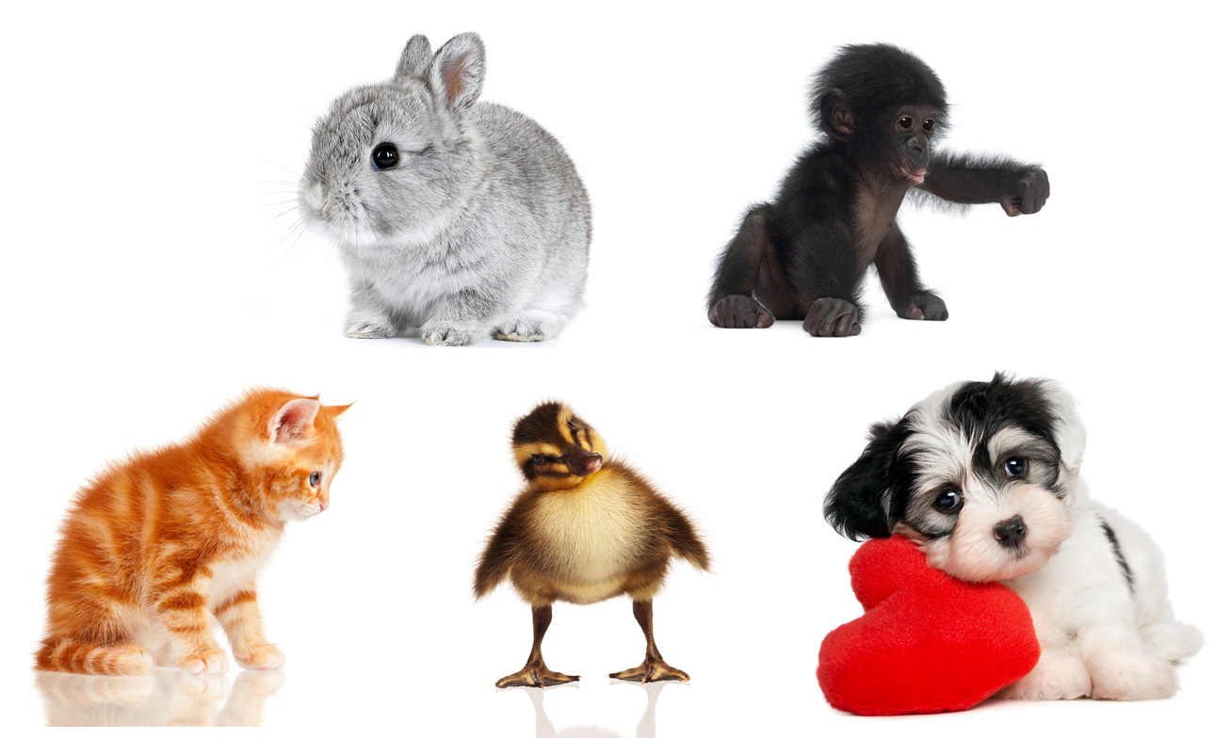
Bowlby (1958) – Social Releasers
How do these pictures make you feel?
What features do they have in common?

Slide 12
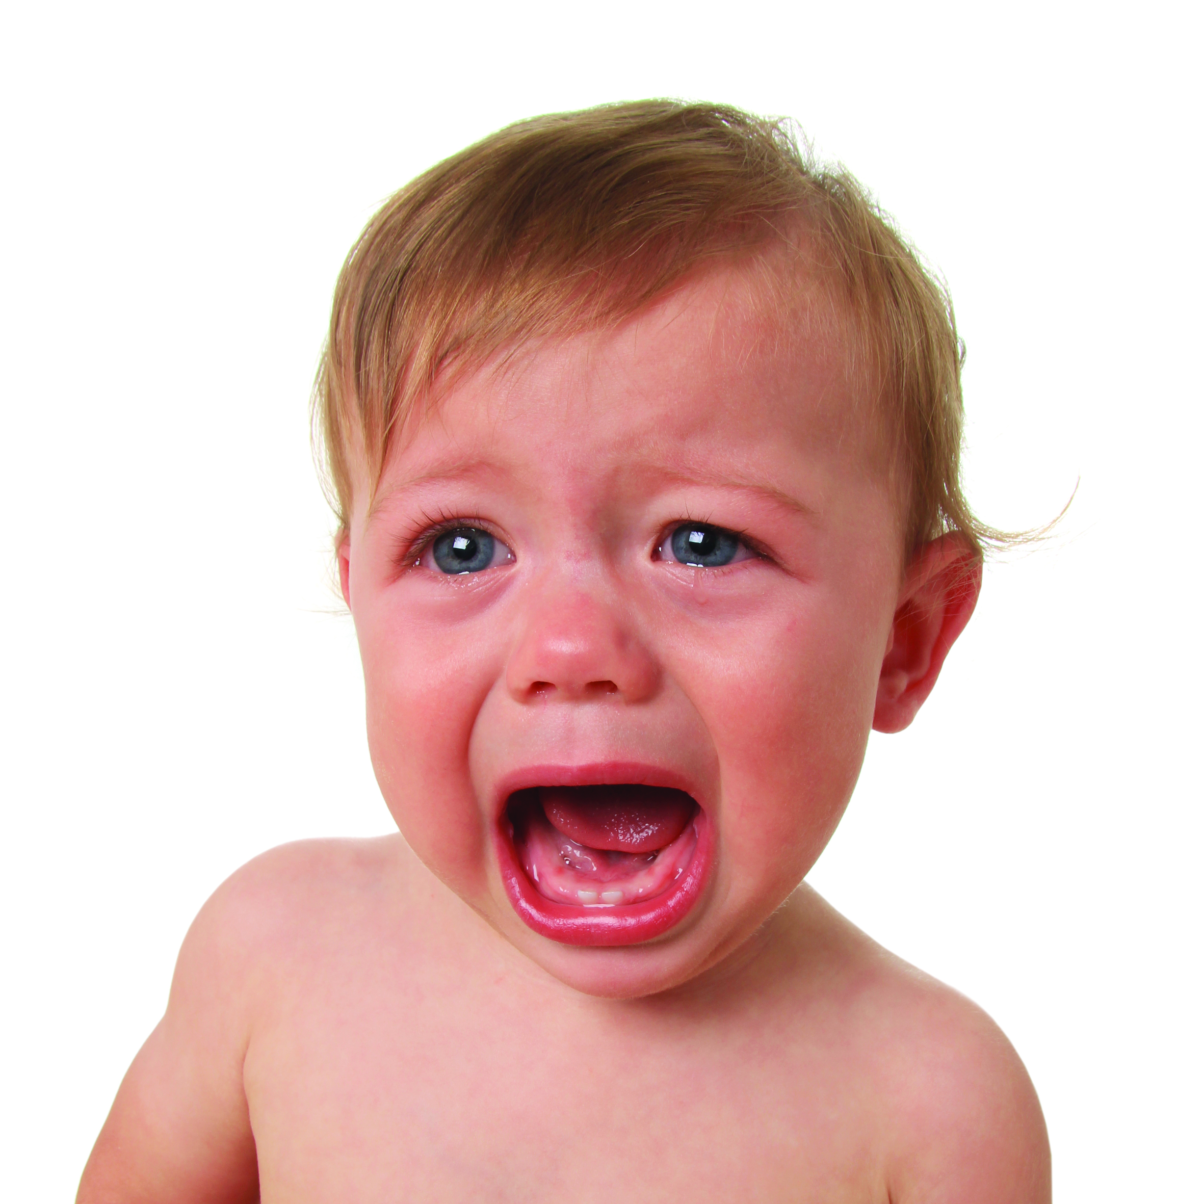
Bowlby (1958) – Social Releasers
Babies have social releasers which ‘unlock’ an innate tendency in adults (in particular, mothers) to care for them.
These social releasers are both:
Physical – ‘baby face’ features and body proportions
Behavioural – crying, cooing, smiling

Slide 13
Bowlby (1958) – Critical Period
Babies must form an attachment with their caregiver during a critical period.
This is between birth and 2½ years old.
If a child doesn’t form an attachment during this time then it would be damaged socially, emotionally, intellectually and physically.

Slide 14
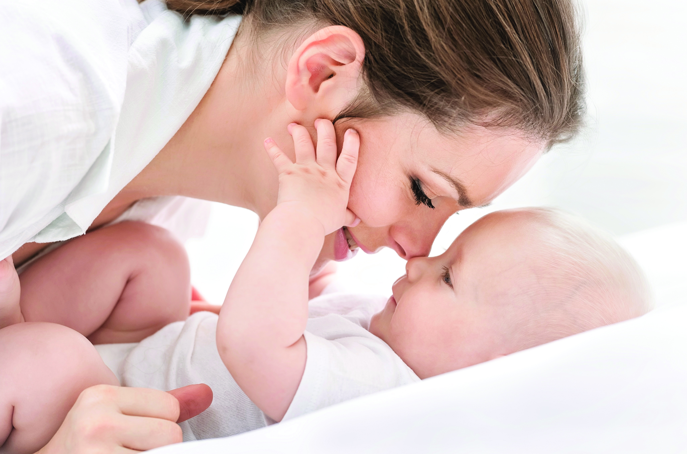
Bowlby (1958) - Monotropy
Bowlby believed that infants form one very special attachment with their mother.
This special, intense attachment is known as monotropy.
If the mother isn’t available, the infant could bond with another ever-present adult mother-substitute.

Slide 15
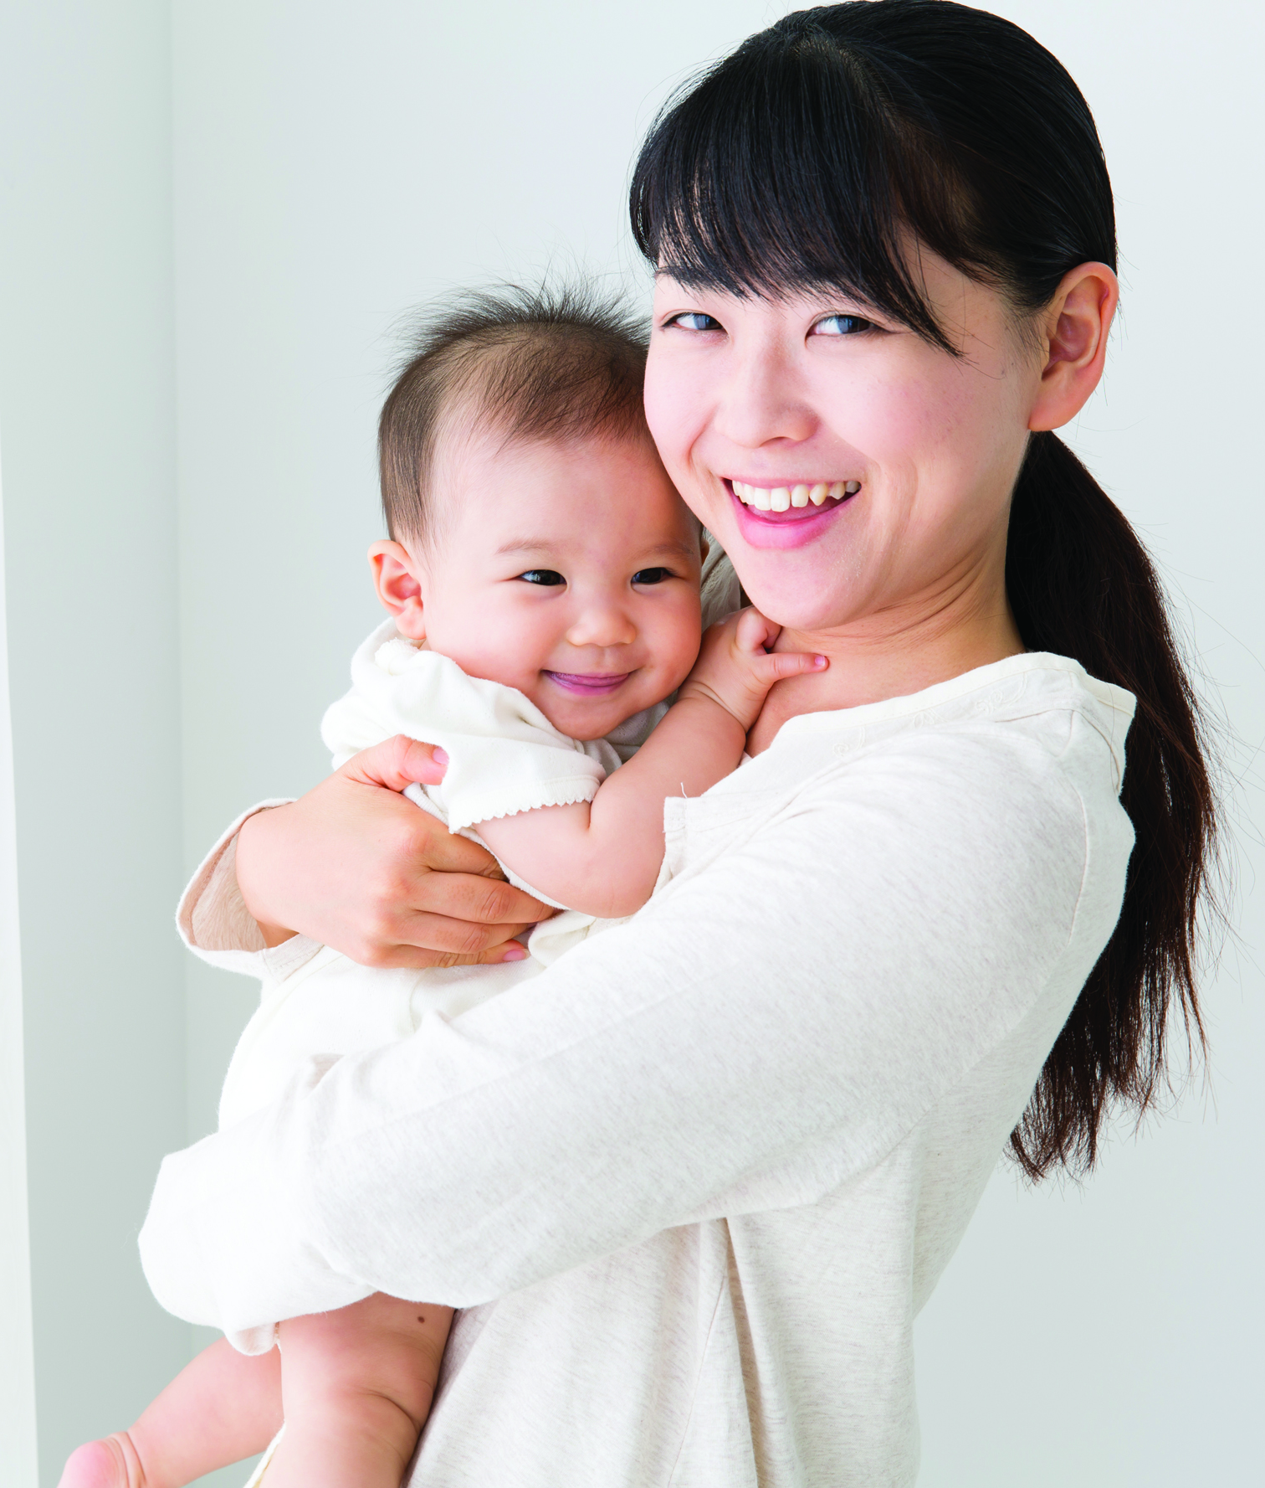
Bowlby (1958) – Internal Working Model
Through the monotropic attachment, the infant would form an Internal working model.
This is a special model for relationships. All the child’s future adult relationships will be based on their early attachment relationship.

Slide 16
Validity of Monotropy Challenged
Schaffer & Emerson (1964) found many babies form multiple attachments.
Some attachments may be stronger but not necessarily different in quality.
Other attachments (e.g., fathers, siblings) provide emotional support.

Slide 17
Support for Social Releasers
Brazelton et al. (1975) studied social releasers (e.g., cooing, smiling).
When ignored by caregivers, babies became distressed and motionless.
Supports Bowlby’s idea that social releasers encourage attachment.

Slide 18
Support for Internal Working Model
Bailey et al. (2007) found attachment styles pass down generations.
Mothers with poor attachments had babies with poor attachment.
Supports Bowlby’s idea that early attachment affects later relationships.

Slide 19
Counterpoint to Internal Working Model
Genetic factors (e.g., anxiety, sociability) may influence attachment.
Kornienko (2016) suggests genetics also impact parenting ability.
Bowlby may have overstated early attachment’s role in social behaviour.

Slide 20
Feminist Concerns
Bowlby’s theory suggests working mothers may harm child development.
Feminists (e.g., Burman 1994) argue it unfairly blames mothers.
However, the theory has real-world applications in childcare settings.

Slide 21
Discussion Question
On balance, has Bowlby’s theory done more harm or more good?
Consider real-world applications vs. negative implications for mothers.
How important is attachment compared to genetics and environment?

Slide 22
Conclusion
Strengths: Research support for social releasers & internal working model.
Weaknesses: Challenges to monotropy, overemphasis on early attachment.
Bowlby’s theory is influential but should be considered alongside other factors.

